Slide 1
COS3302 Applied Data Science
Midterm Examination
Wheat Seeds Dataset
Jutharat Pooamorn
6405003317

Slide 2
Objectives
Use the Wheat Seeds Dataset as a case study to enhance data analytics and data visualization
Tools such as Histogram, Box Plots, Pair Plots
and Correlation Matrix
Experience Statistical Information and Relationships of Dataset

Slide 3
Storytelling with Data
Source : The Institute of Agrophysics of the Polish Academy of Sciences in Lublin
Number of Data : 210 samples
Technique : Soft X-ray
Data contain 8 features
Target field : classes(label)
Kama(70) , Rosa (70) , and Canadian (70)
Other attributes : 7
Describe each wheat seeds

Slide 4
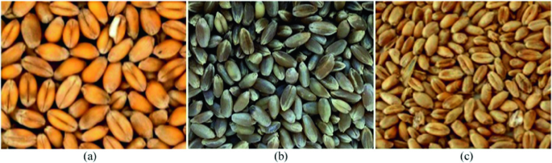
Pictures of the Three Wheat Seeds
Kama
Rosa
Canadian
https://link.springer.com/chapter/10.1007/978-3-031-22405-8_7

Slide 5
Data Features with Details of Wheat Seeds
Categorical
Nominal | Consist Of
class | Kama, Rosa, Canadian
Numerical
Ratio | Definition | Range
Area | ขนาดพื้นที่ของเมล็ด | 10.59 - 21.18 mm²
Perimeter | ความยาวเส้นรอบวงเมล็ด | 12.41 - 17.25 mm
Compactness | ความหนาแน่นของเมล็ด | 0.81 - 0.92
Kernel Length | ความยาวของเมล็ด | 4.90 - 6.68 mm
Kernel Width | ความกว้างของเมล็ด | 2.63 - 4.03 mm
Asymmetry Coefficient | ความสมส่วนของเมล็ด | 0.77 - 8.46
Kernel Groove Length | ความยาวร่องของเมล็ด | 4.52 - 6.55 mm

Slide 6
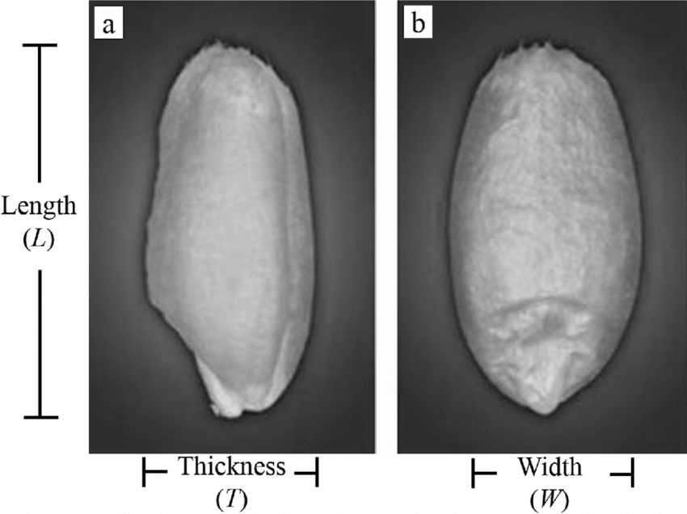
Anatomy of Wheat
Numerical Features :
Area (mm²)
Perimeter (mm)
Compactness
Kernel Length (mm)
Kernel Width (mm)
Asymmetry Coefficient
Kernel Groove Length (mm)
https://www.researchgate.net/figure/Axial-dimensions-in-a-wheat-kernel-a-Length-L-and-thickness-T-b-width-W_fig1_317101638

Slide 7
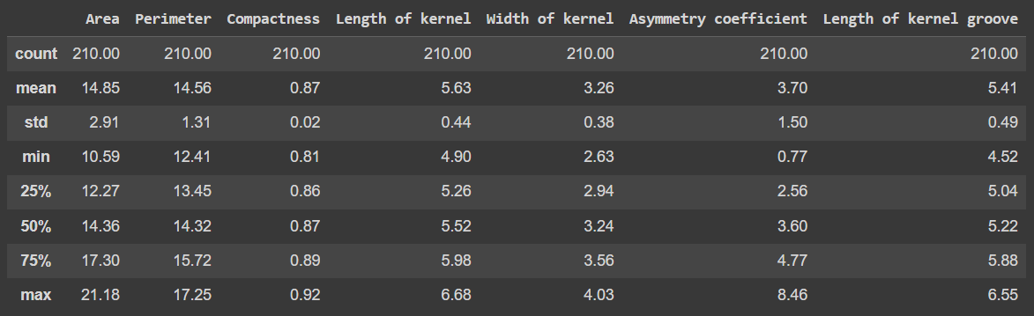
Statistics of Ratio Data

Slide 8
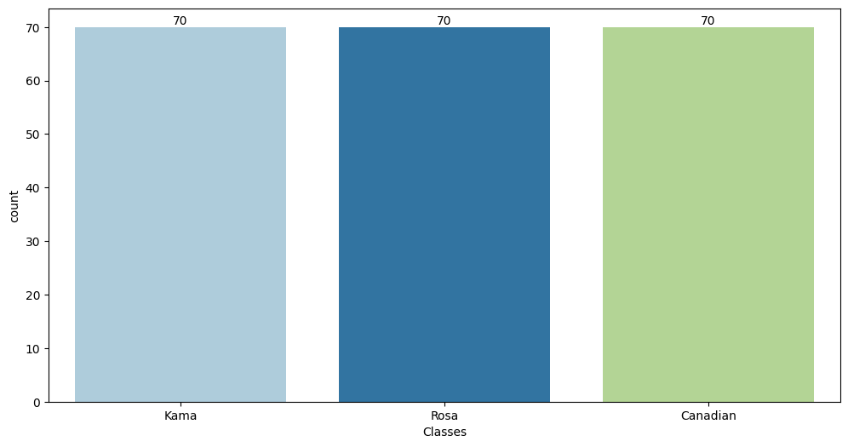
Wheat Seeds Classes

Slide 9
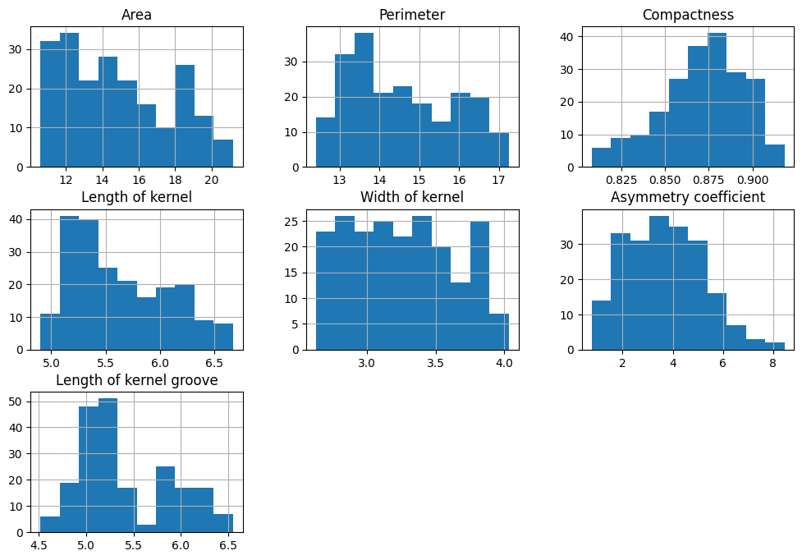
Histograms

Slide 10
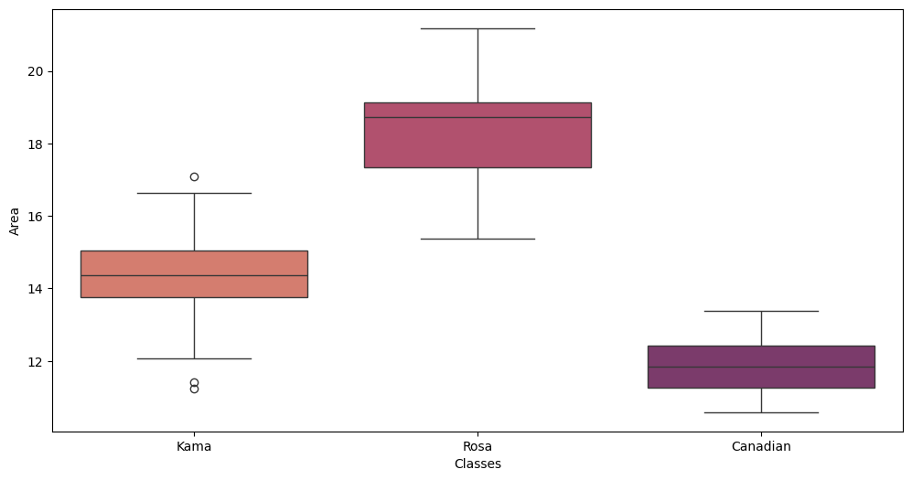
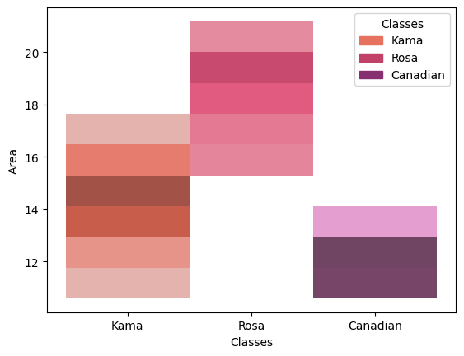
Distribution of Area

Slide 11
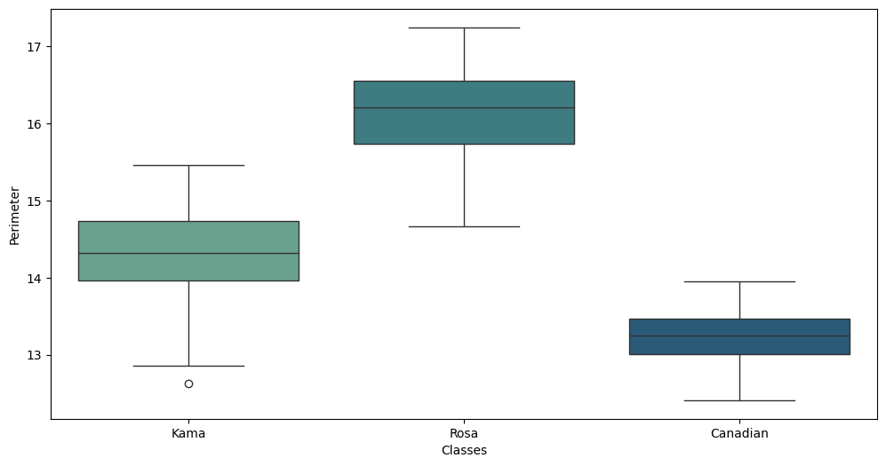
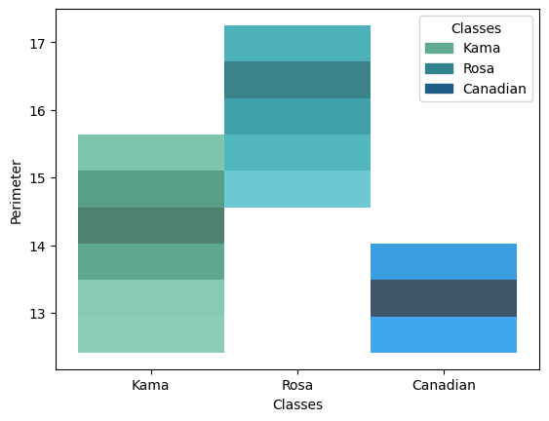
Distribution of Perimeter

Slide 12
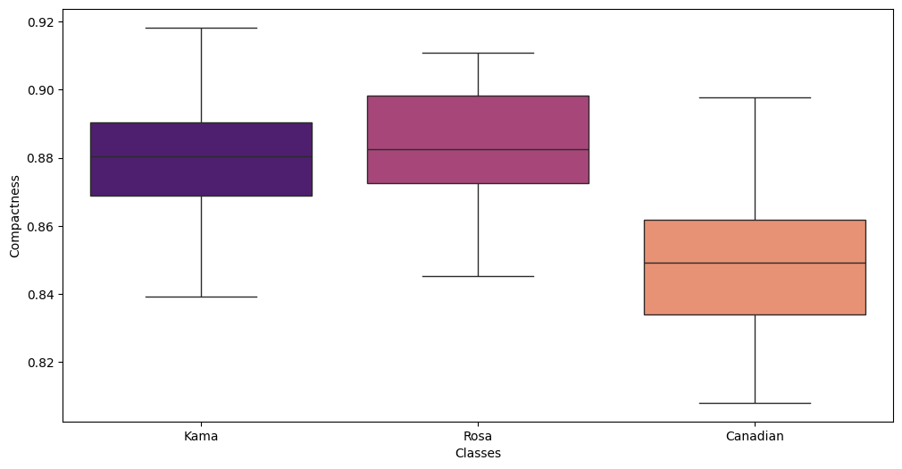
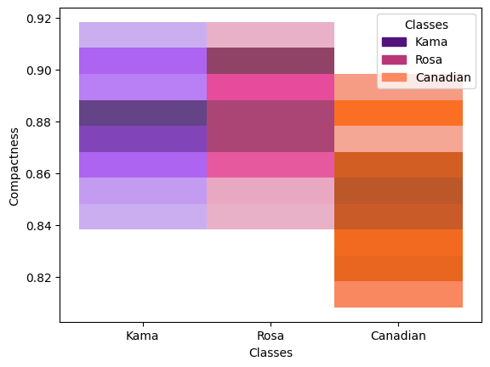
Distribution of Compactness

Slide 13
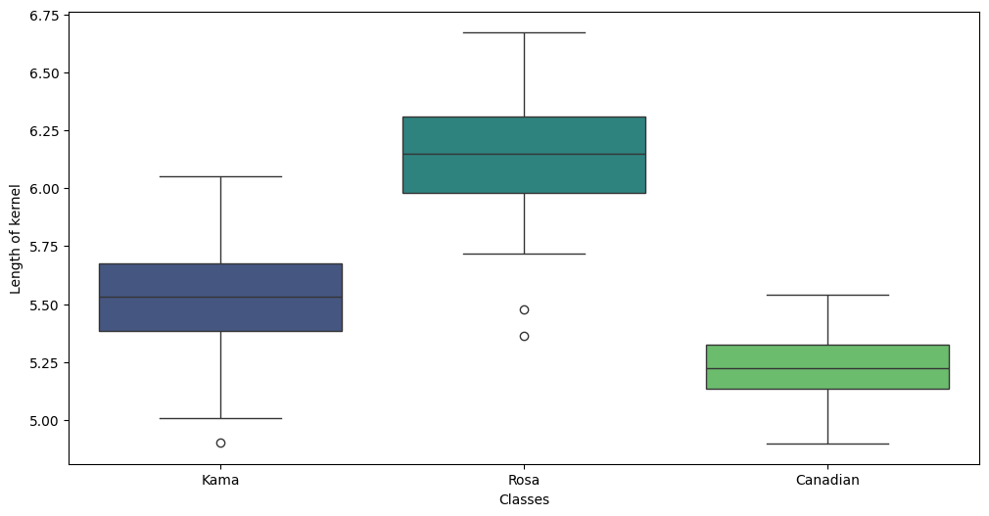
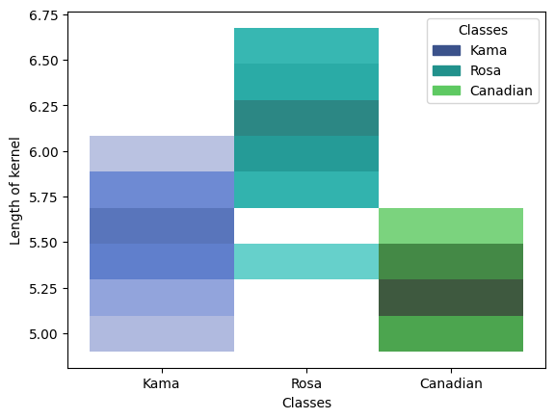
Distribution of Length of kernel

Slide 14
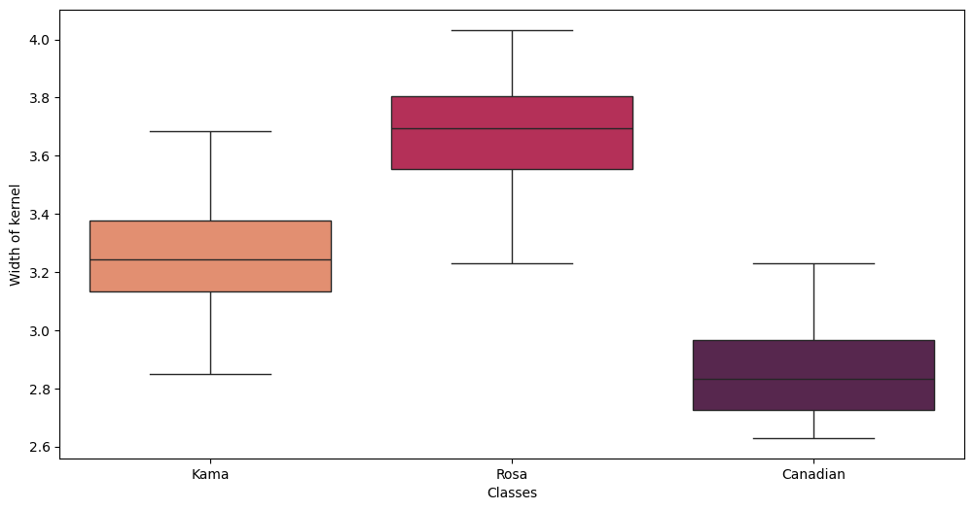
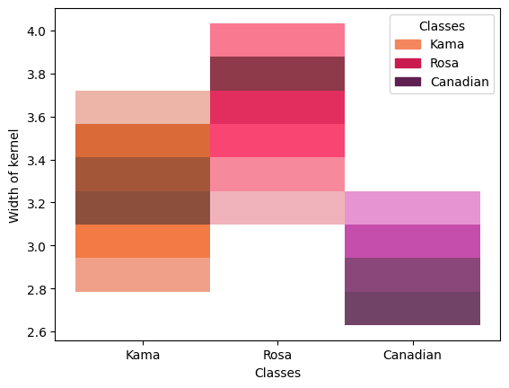
Distribution of Width of kernel

Slide 15
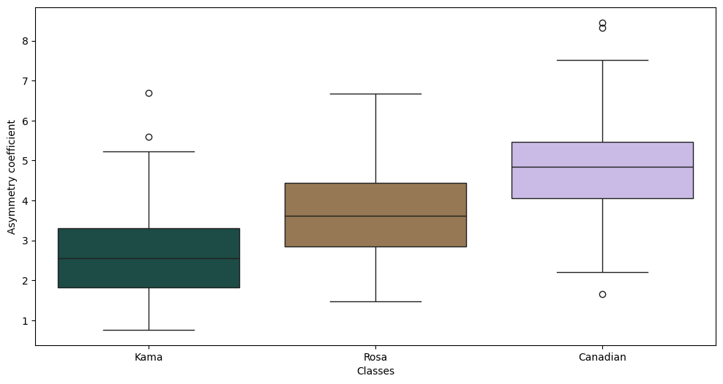
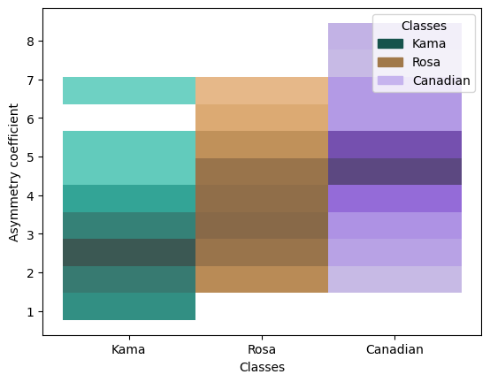
Distribution of Asymmetry coefficient

Slide 16
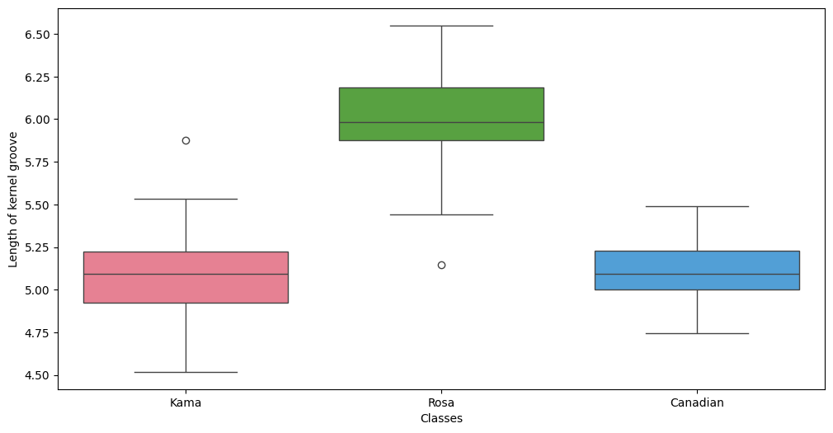
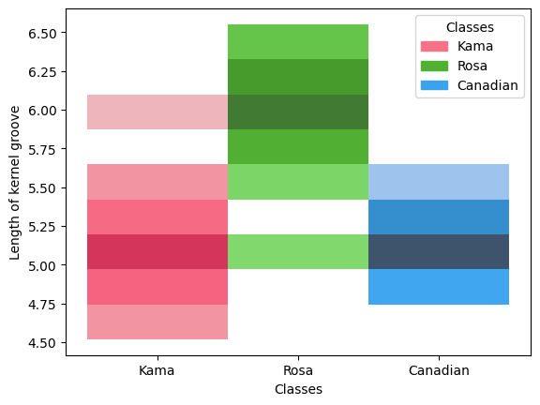
Distribution of Length of kernel groove

Slide 17
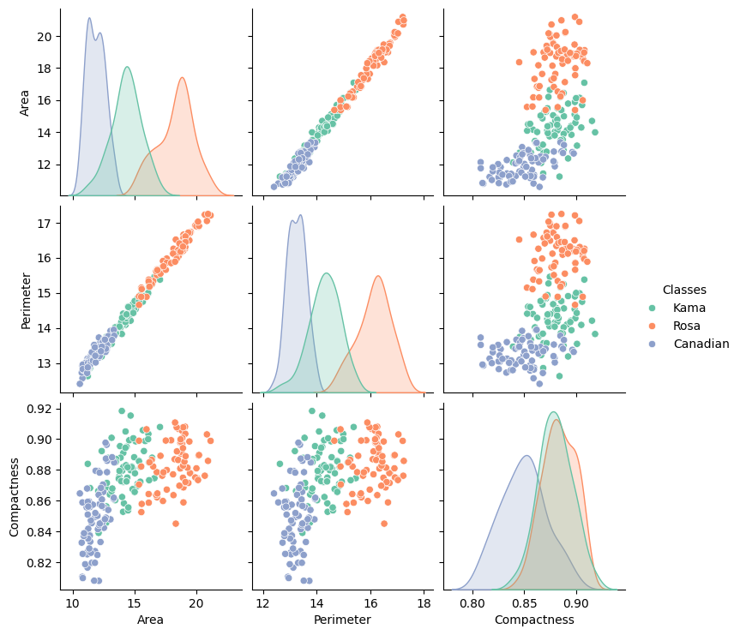

Slide 18
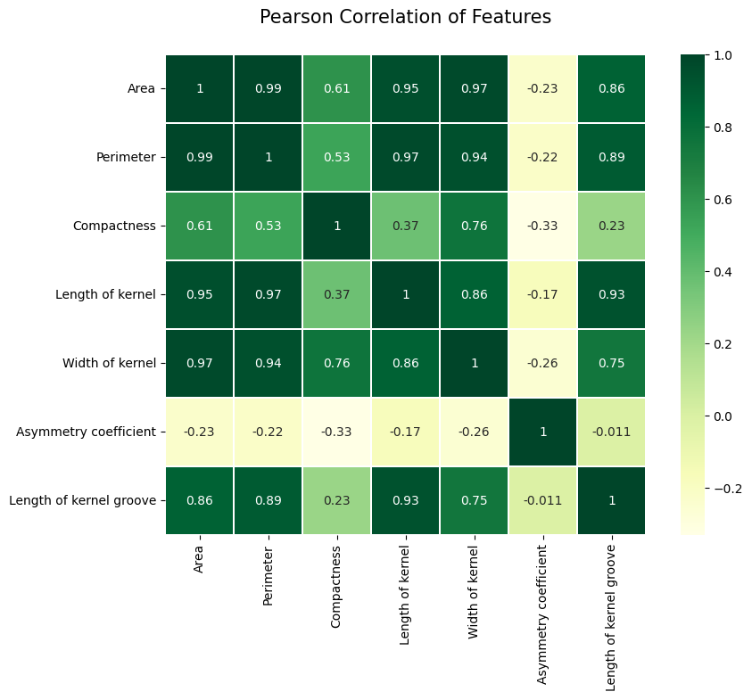

Slide 19
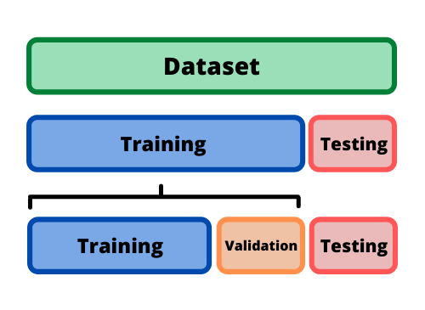
Split Ratio
Dataset : 210
Training : 147
Validation : 42
Testing : 21
70%
20%
10%
https://datascience.stackexchange.com/questions/15135/train-test-validation-set-splitting-in-sklearn
https://dhavalpatel2101992.wordpress.com/2021/05/21/kaggle-titanic-dataset-cleaning-split-data-into-train-validation-and-test-set/
https://medium.com/@utkarsh.kant/how-to-split-your-dataset-into-train-test-and-validation-sets-17f40e98dfd0

Slide 20
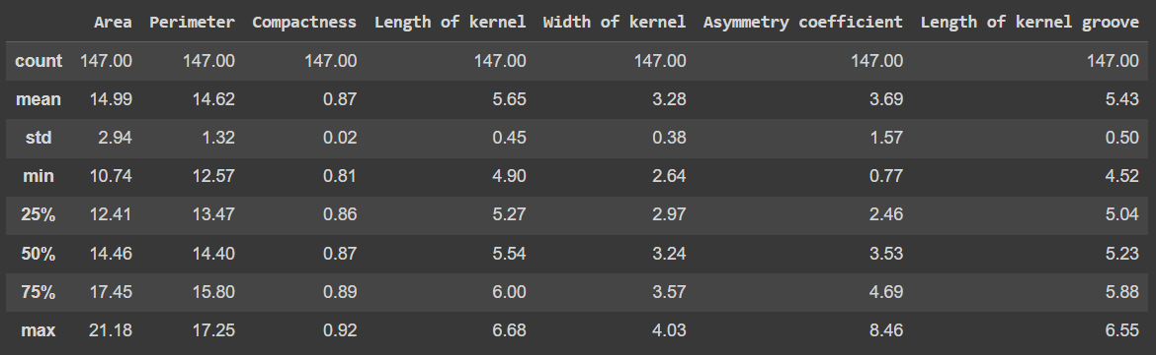
DataFrame : Training

Slide 21
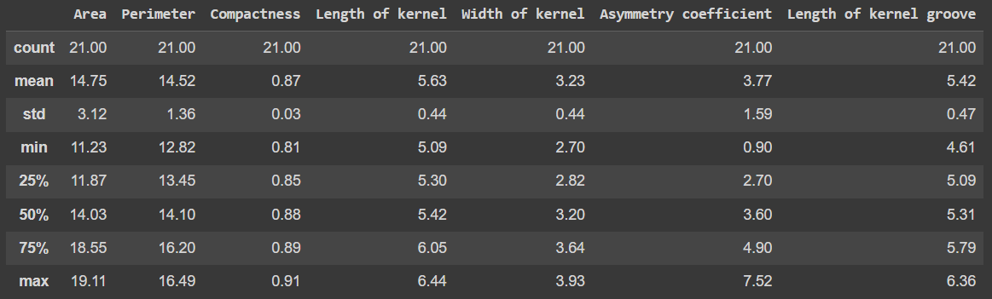
DataFrame : Validation

Slide 22
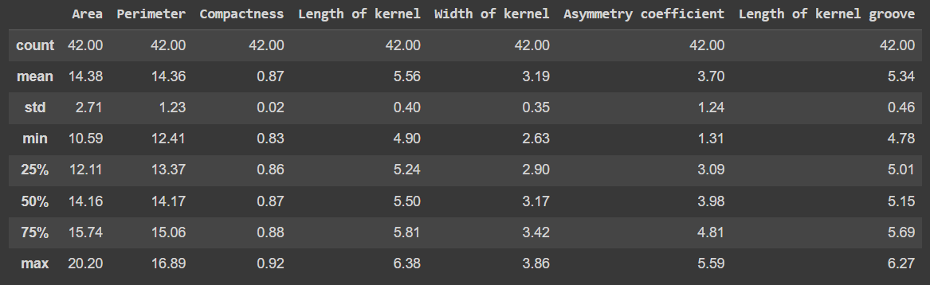
DataFrame : Test

Slide 23
Thank You

