Slide 1
Elementary Differential Equations and Boundary Value Problems
Twelfth Edition
Boyce
Chapter 2
First-Order Differential Equations
Copyright ©2021 John Wiley & Sons, Inc.

Slide 2
Section 2.9 First-Order Difference Equations

Slide 3
Introduction to Difference Equations
Although a continuous model leading to a differential equation is reasonable and attractive for many problems, there are some cases in which a discrete model may be more appropriate. Examples of this include accounts where interest is paid or charged monthly rather than continuously, applications involving drug dosages, and certain population growth problems where the population one year depends on the population in the previous year. For example,
Notice here that the independent variable n is discrete. Such equations are classified according to order, as linear or nonlinear, as homogeneous or nonhomogeneous. There is frequently an initial condition describing the first term y₀.

Slide 4
Difference Equation and Equilibrium Solution
Assume for now that the state at year n +1 depends only on the state at year n, and not on the value of n itself
Then
This procedure is referred to as iterating the difference and it is often of interest to determine the behavior of y_{n} as n → ∞.
An equilibrium solution exists when
and this is often of special interest, just as it is in differential equations.

Slide 5
Linear Homogeneous Difference Equations
Suppose that the population of a certain species in a region in year n +1 is a positive multiple of the population in year n:
Notice that the reproduction rate may differ from year to year.
If the reproduction rate has the same value ρ for all n:
If the initial value y₀ is zero, then the equilibrium solution = 0
Otherwise

Slide 6
Adding and Subtracting a Term to the Equation
Suppose we have a net increase in population each year due to migration:
Then iterating this:
If the migration is constant (b) each year:
And as long as ρ ≠ 1, we can use the geometric series formula to get:

Slide 7
Conditions for an Equilibrium
Letting n →∞ in the equation for y_{n} we get:
Recall that ρ ≠ 1. If it were, the sequence would become:
If
, an equilibrium solution.
If
does not exist, so the
fails to exist unless

Slide 8
Example 2.9.1: Extending the Model
If we have a $10,000 car loan at an annual interest rate of 12%, and we wish to pay it off in four years by making monthly payments (–b), we can adapt the previous result as follows:
To pay the loan off in four years, we set y₄₈ = 0 and solve for b:
The total amount paid on the loan is 48(263.34)=$12,640.32, so the amount of interest paid is $2640.32.

Slide 9
Nonlinear Difference Equations
As is the case with differential equations, nonlinear difference equations are much more complicated and have much more varied solutions than linear equations.
We will analyze only the logistic equation, which is similar to the logistic differential equation discussed in 2.5.
Seeking the equilibrium solution yields:
Are either of these equilibrium solutions asymptotically stable?

Slide 10
Examining Points Near Equilibrium Solutions
For the first equilibrium solution of zero, the quadratic term ≈ 0:
We have already examined this equation and concluded that for |ρ| < 1, the solution is asymptotically stable.
We will now consider solutions near the second equilibrium:
Let
From our previous discussion, we can conclude that v_{n} → 0 provided |2 – ρ| < 1 or 1 < ρ < 3. So, for these values of ρ, we can conclude that the solution is asymptotically stable.

Slide 11
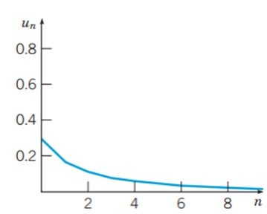
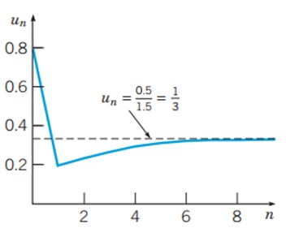
Solutions for Varying Initial States and Varying Parameter Values Between 0 and 3 (part one)
y₀ = 0.3, ρ = 0.8
y₀ = 0.8, ρ = 1.5

Slide 12
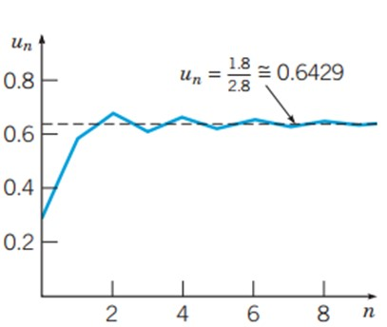
Solutions for Varying Initial States and Parameter Values Between 0 and 3 (part two)
y₀ = 0.3, ρ = 2.8

Slide 13
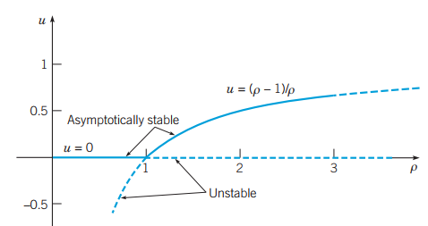
Summary of Asymptotic Stability Intervals
has two equilibrium solutions:
We found that the difference equation
Considering nonnegative values of the parameter ρ, the first equilibrium solution required that 0 ≤ ρ <1, while the second equilibrium solution required that 1 < ρ < 3. there is an exchange of stability from one equilibrium solution to the other at ρ = 1. This is demonstrated in the chart below:

Slide 14
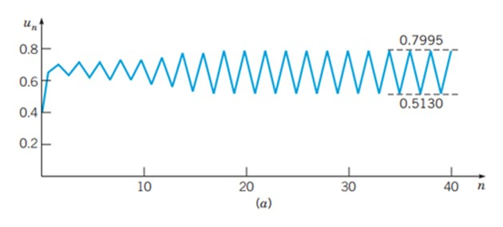
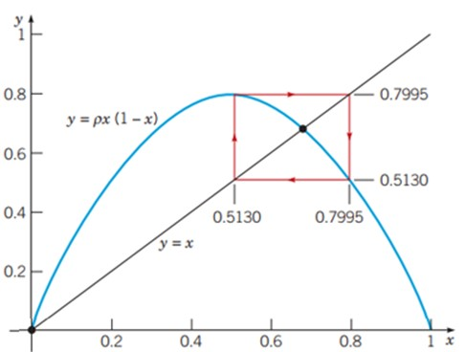
Solutions of the Difference Equation That Do Not Approach an Equilibrium - 2 Cycle

Slide 15
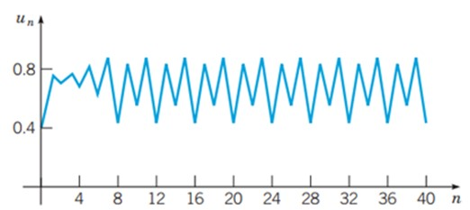
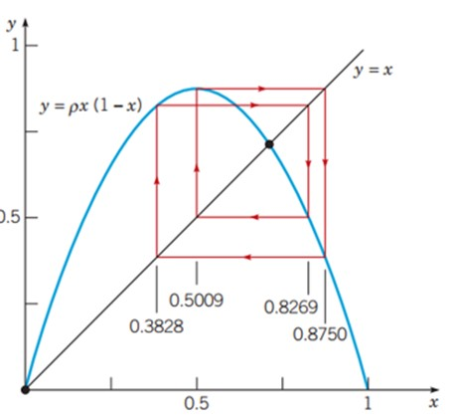
Solutions of the Difference Equation That Do Not Approach an Equilibrium - 4 Cycles

Slide 16
Solutions of the Difference Equation That Do Not Approach an Equilibrium: General Cyclic and Chaotic Behavior
Notice from the preceding graphs how the behavior of the solution to the difference equation
behaves rather unpredictably when ρ > 3. First, at ρ = 3.2, we saw the sequence oscillate between two values, creating a period of two. Then, at ρ = 3.5, the terms in the sequence were oscillating among four values, creating a period of 4. It is actually around ρ = 3.449 that this doubling of the period occurs and this is called a point of bifurcation. As ρ increases slightly further, periodic solutions of period 8, 16, … occur.
By the time we reach ρ > 3.57, the solutions possess some regularity, but no discernible detailed pattern is present for most values of ρ. The term chaotic is used to describe this situation. One of the features of chaotic solutions is extreme sensitivity to the initial conditions. This is demonstrated on the following slide.

Slide 17
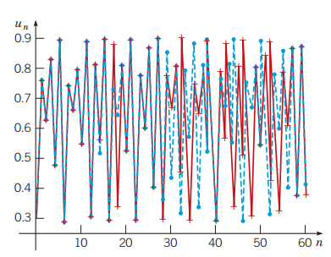
Chaotic Solutions Graphical Example
Below are two solutions to
The blue solution corresponds to the initial state 𝑢₀ = 0.300
The red solution corresponds to the initial state 𝑢₀ = 0.305

Slide 18
What Chaotic Solutions May Suggest
On the basis of Robert May’s analysis of the nonlinear equation we have considered
as a model for the population of certain insect species, we might conclude that if the growth rate ρ is too large, it will be impossible to make effective long-range predictions about these insect populations.
It is increasingly clear that chaotic solutions are much more common than was suspected at first, and that they may be part of the investigation of a wide range of phenomena.

Slide 19
Copyright
Copyright © 2021 John Wiley & Sons, Inc.
All rights reserved. Reproduction or translation of this work beyond that permitted in Section 117 of the 1976 United States Act without the express written permission of the copyright owner is unlawful. Request for further information should be addressed to the Permissions Department, John Wiley & Sons, Inc. The purchaser may make back-up copies for his/her/their own use only and not for distribution or resale. The Publisher assumes no responsibility for errors, omissions, or damages, caused by the use of these programs or from the use of the information contained herein.

