Slide 1
Elementary Differential Equations and Boundary Value Problems
Twelfth Edition
Boyce
Chapter 2
First-Order Differential Equations
Copyright ©2021 John Wiley & Sons, Inc.

Slide 2
Section 2.2 Separable Differential Equations

Slide 3
Definition of Separable Differential Equations
In this section we examine a subclass of linear and nonlinear first order equations. Consider the first order equation
We can rewrite this in the form
For example, we can let M(x,y) = – f (x,y) and N (x,y) = 1 to do this, but there may be other ways as well. In differential form,
If M is a function of x only and N is a function of y only, then
In this case, the equation is called separable.

Slide 4
Example 2.2.1: Finding a General Solution for a Separable Equation
Solve the following first order nonlinear equation:
Separating variables, and using calculus, we obtain

Slide 5
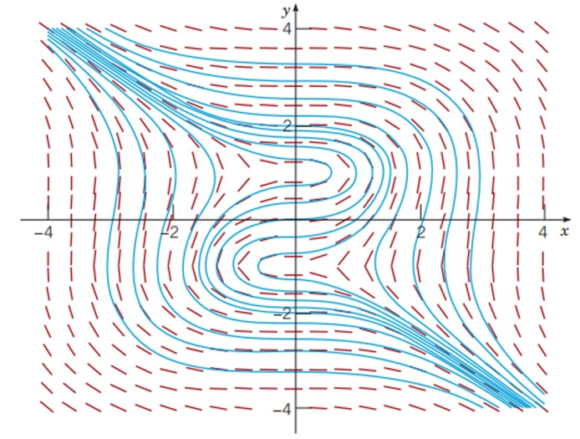
Example 2.2.1: Graphing Solutions for a Separable Equation
defines the solution y implicitly. A graph showing the direction field and implicit plots of several solution curves for the differential equation is shown below:
The general solution

Slide 6
Example 2.2.2: Finding an Implicit General Solution
Solve the following first order nonlinear equation:
Separating variables and using calculus, we obtain
The equation above defines the solution y implicitly. An explicit expression for the solution can be found (next slide)

Slide 7
Example 2.2.2: Rearrange to create an explicit general solution in terms of “y”
The general equation above defines the solution y implicitly. An explicit expression for the solution can be found in this case:

Slide 8
Example 2.2.2: Initial Value Condition (0, −1)
Suppose we seek a solution satisfying 𝑦(0) = −1. Using the implicit expression of y, we obtain
The implicit particular solution is y² − 2y = x³ + 2x² + 2x + 3
An explicit expression of y is:
satisfies the 𝑦(0) = −1 initial condition.
Of which only

Slide 9
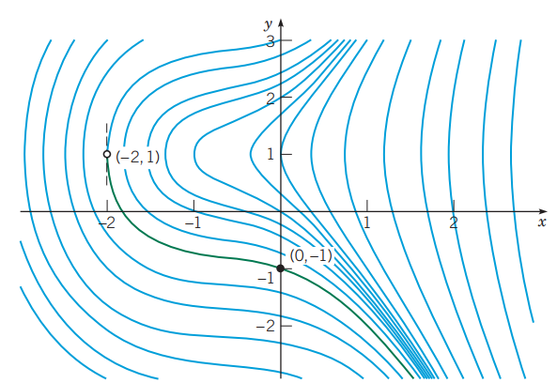
Example 2.2.2: Solution Domain
If initial condition is 𝑦(0) = −1, then we choose the positive sign, instead of negative sign, on the square root term:
The solution is valid over x-values for which the quantity under the radical is positive: 𝑥 > −2
domain shown in green in the graph
vertical tangent at domain boundary point (−2,1)

Slide 10
Example 2.2.3: Implicit Solution of an Initial Value Problem
Consider the following initial value problem:
Separating variables and using calculus, we obtain
Using the initial condition, 𝑦(0) = 1 , it follows that C = 17.

Slide 11
Example 2.2.3: General Solution vs. Particular Solution Through Point (0,1)
Thus the general solution is
and the solution through (0,1) is
Vertical asymptotes for this particular solution will be found where:

Slide 12
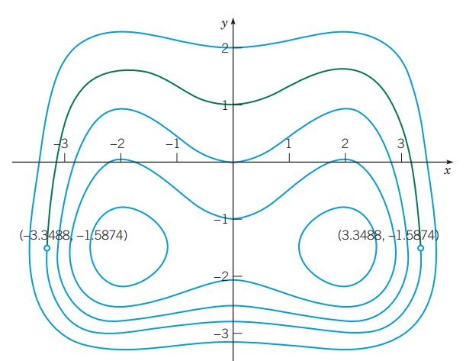
Example 2.2.3: Graph of Solutions
The graph of the solution through (0, 1) is shown in green
The points identified with open dots correspond to the solution domain boundaries where the tangent lines are vertical.

Slide 13
Parametric Equations
The differential equation:
is sometimes easier to solve if x and y are thought of as dependent variables of the independent variable t and rewriting the single differential equation as the system of differential equations:
Chapter 9 is devoted to the solution of systems such as these.

Slide 14
Copyright
Copyright © 2021 John Wiley & Sons, Inc.
All rights reserved. Reproduction or translation of this work beyond that permitted in Section 117 of the 1976 United States Act without the express written permission of the copyright owner is unlawful. Request for further information should be addressed to the Permissions Department, John Wiley & Sons, Inc. The purchaser may make back-up copies for his/her own use only and not for distribution or resale. The Publisher assumes no responsibility for errors, omissions, or damages, caused by the use of these programs or from the use of the information contained herein.

