Slide 1
Elementary Differential Equations and Boundary Value Problems
Twelfth Edition
Boyce
Chapter 10
Partial Differential Equations and Fourier Series
Copyright ©2021 John Wiley & Sons, Inc.

Slide 2
Section 10.2 Fourier Series

Slide 3
Fourier Series
We will see that many important problems involving partial differential equations can be solved, provided a given function can be expressed as an infinite sum of sines and/or cosines.
In this and the following two sections, we explain in detail how this can be done.
These trigonometric series are called Fourier series, and are somewhat analogous to Taylor series in that both types of series provide a means of expressing complicated functions in terms of certain familiar elementary functions.

Slide 4
Fourier Series Representation of Functions
We begin with a series of the form
On the set of points where this series converges, it defines a function f whose value at each point x is the sum of the series for that value of x.
In this case the series is said to be the Fourier series of f.
Our immediate goals are to determine what functions can be represented as a sum of Fourier series, and to find some means of computing the coefficients in the series corresponding to a given function.

Slide 5
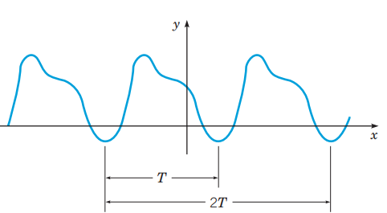
Periodic Functions
We first develop properties of sin(mπx/L) and cos(mπx/L), where m is a positive integer.
The first property is their periodic character.
A function is periodic with period T > 0 if the domain of f contains x + T whenever it contains x, and if f (x + T) = f(x) for all x.
See graph below.

Slide 6
Periodicity of the Sine and Cosine Functions
For a periodic function of period T, 𝑓(𝑥 + 𝑇)=𝑓(𝑥) for all x.
Note that 2T is also a period, and so is any integer multiple of T.
The smallest value of T for which f is periodic is called the fundamental period of f.
If f and g are two periodic functions with common period T, then any linear combination c₁f + c₂g is also periodic with period T.
In particular, sin(mπx/L) and cos(mπx/L), m = 1,2,3,…, are periodic with period T = 2L/m.

Slide 7
Orthogonality
The standard inner product (u, v) of two real-valued functions u and v on the interval α ≤ x ≤ β is defined by
The functions u and v are orthogonal on α ≤ x ≤ β if their inner product (u, v) is zero:
A set of functions is mutually orthogonal if each distinct pair of functions in the set is orthogonal.

Slide 8
Orthogonality of Sine and Cosine
The functions sin(mπx/L) and cos(mπx/L), m = 1, 2, …, form a mutually orthogonal set of functions on –L ≤ x ≤ L, with
These results can be obtained by direct integration; see text.

Slide 9
Finding Coefficients in Fourier Expansion
Suppose the series converges, and call its sum f(x):
The coefficients a_{m} and b_{m}, m = 1, 2, …, can be found as follows.
By orthogonality,

Slide 10
Coefficient Formulas
From the previous slide we have
To find the coefficient a₀, we have
Thus the coefficients a_{n} are given by
Similarly, the coefficients b_{n} are given by
The above equations for a_{n} and b_{n} are known as the Euler-Fourier formulas

Slide 11
The Euler-Fourier Formulas
Note that the Euler-Fourier formulas depend only on the values of 𝑓(𝑥) in the interval −𝐿 ≤ 𝑥 ≤ 𝐿.
Since each term of the Fourier series is periodic with period 2L, the series converges for all x whenever it converges in −𝐿 ≤ 𝑥 ≤ 𝐿, and its sum is also a periodic function with period 2L.
Hence 𝑓(𝑥) is determined for all x by its values in the interval −𝐿 ≤ 𝑥 ≤ 𝐿.

Slide 12
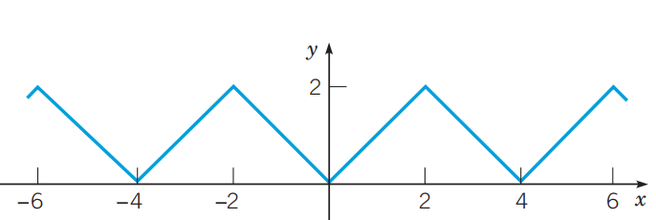
Example 10.2.1: A Triangular Wave
Assume that there is a Fourier series converging to the function f defined below. Determine the coefficients in this Fourier series.
This function represents a triangular wave and is periodic with period T = 4. See graph of f below. In this case, L = 2.
Assuming that f has a Fourier series representation, find the coefficients a_{m} and b_{m}.

Slide 13
Example 10.2.1: Coefficients
First, we find a₀:
Then for a_{m}, m = 1, 2, …, we have
where we have used integration by parts. See text for details.
Similarly, it can be shown that b_{m}= 0, m = 1, 2, …

Slide 14
Example 10.2.1: The Fourier Expansion
Using the expressions for a₀, a_{m}, and b_{m}, we obtain the Fourier series for f:

Slide 15
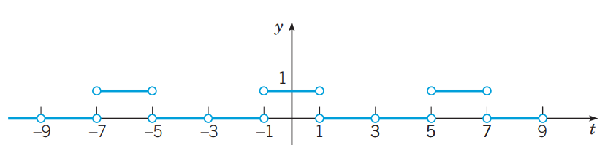
Example 10.2.2: A Function
Consider the function below and suppose that 𝑓(𝑥+6) = 𝑓(𝑥). Graph three periods of 𝑦 = 𝑓(𝑥). Find the coefficients in the Fourier series for f.
This function is periodic with period T = 6. In this case, L = 3. See graph below.
Assuming that f has a Fourier series representation, find the coefficients a_{n} and b_{n}.

Slide 16
Example 10.2.2: Points of Discontinuity
Note that f(x) is not assigned values at the points of discontinuity, such as x = −1 and x = 1.
This has no effect on the values of the Fourier coefficients, because they result from the evaluation of integrals, and the value of an integral is not affected by the value of the integrand at a single point, or at a finite number of points.
Thus, the coefficients are the same regardless of what value, if any, f(x) is assigned at a point of discontinuity.

Slide 17
Example 10.2.2: Coefficients
First, we find a₀:
Using the Euler-Fourier formulas, we obtain

Slide 18
Example 10.2.2: Fourier Expansion
Thus the Fourier series for f is

Slide 19
Example 10.2.3: A Triangular Wave
Consider again the function from Example 10.2.1 (below) and its Fourier series. Investigate the speed with which the series converges. In particular, determine how many terms are needed so that the error is no greater than 0.01 for all x.
The m^{th} partial sum in this series can be used to approximate the function f.

Slide 20
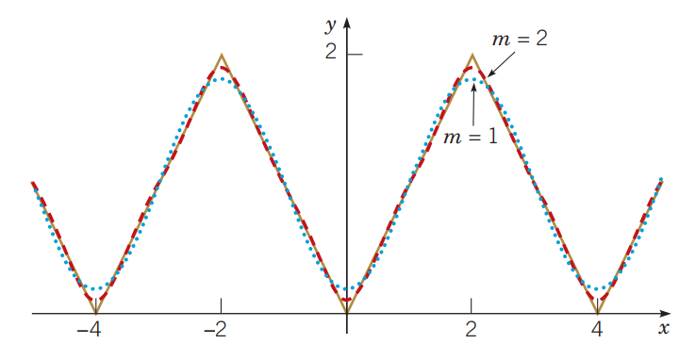
Example 10.2.3: Partial Sums
The coefficients diminish as (2n −1)², so the series converges fairly rapidly. This is seen below in the graph below where the partial sums for m = 1 (dotted blue) and m = 2 (dashed red) are plotted.

Slide 21
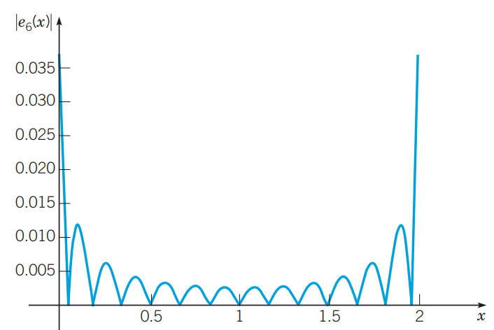
Example 10.2.3: Errors
To investigate the convergence in more detail, we consider the error function e_{m}(x) = f (x) – s_{m}(x).
Given below is a graph of |e₆(x)| on 0 ≤ x ≤ 2.
Note that the error is greatest at x = 0 and x = 2, where the graph of f(x) has corners.
Similar graphs are obtained for other values of m.

Slide 22
Example 10.2.3: A Uniform Error Bound
Since the maximum error occurs at x = 0 or x = 2, we obtain a uniform error bound for each m by evaluating |e_{m}(x)| at one of these points.
For example, e₆(2) = 0.03370, and hence |e₆(x)| < 0.034 on 0 ≤ x ≤ 2, and consequently for all x.

Slide 23
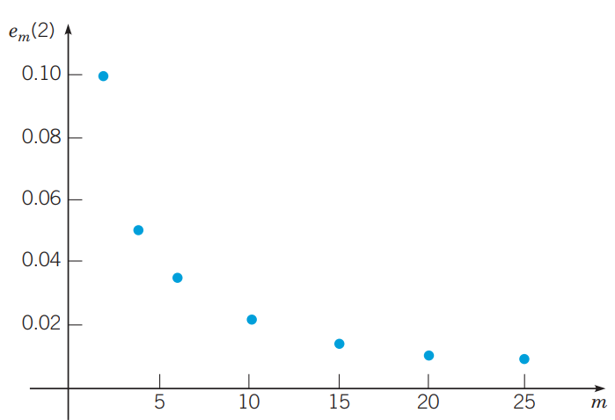
Example 10.2.3: The Speed of Convergence
The table below shows values of |e_{m}(2)| for other values of m, and these data points are plotted below also.
From this information, we can begin to estimate the number of terms that are needed to achieve a given level of accuracy.
To guarantee that |e_{m}(2)| ≤ 0.01, we need to choose m = 21.
m | e_{m}(2)
2 | 0.09937
4 | 0.05040
6 | 0.03370
10 | 0.02025
15 | 0.01350
20 | 0.01013
25 | 0.00810

Slide 24
Broad Use of Fourier Series
We will be using Fourier series as a means of solving certain problems in partial differential equations.
However, Fourier series have much wider application in science and engineering and, in general, are valuable tools in the investigations of periodic phenomena.
For example, a basic problem in spectral analysis is to resolve an incoming signal into its harmonic components, which amounts to constructing its Fourier series representation.
In some frequency ranges the separate terms correspond to different colors or to different audible tones.
The magnitude of the applicable coefficient determines the amplitude of each component.

Slide 25
Copyright
Copyright © 2021 John Wiley & Sons, Inc.
All rights reserved. Reproduction or translation of this work beyond that permitted in Section 117 of the 1976 United States Act without the express written permission of the copyright owner is unlawful. Request for further information should be addressed to the Permissions Department, John Wiley & Sons, Inc. The purchaser may make back-up copies for his/her own use only and not for distribution or resale. The Publisher assumes no responsibility for errors, omissions, or damages, caused by the use of these programs or from the use of the information contained herein.

