Slide 1
Elementary Differential Equations and Boundary Value Problems
Twelfth Edition
Boyce
Chapter 2
First-Order Differential Equations
Copyright ©2021 John Wiley & Sons, Inc.

Slide 2
Section 2.6 Exact Differential Equations and Integrating Factors

Slide 3
Exact Differential Equations Definition
Consider a first order ODE of the form
M (x, y) + N(x, y)yʹ = 0
Suppose there is a function Ψ(x, y) such that
Ψ_{x}(x, y) = M (x, y), Ψ_{y}(x, y) = N(x, y)
and such that Ψ(x, y) = c defines y = ϕ(x) implicitly. Then
and hence the original ODE becomes
Thus Ψ(x, y) = c defines a solution implicitly.
In this case, the ODE is said to be an exact differential equation.

Slide 4
Example 2.6.1: Exact Equation
Consider the equation:
2x + y² + 2xyyʹ = 0
It is neither linear nor separable, but there is a function φ such that
The function that works is Ψ(x, y) = x² + xy²
Thinking of y as a function of x and calling upon the chain rule, the differential equation and its solution become

Slide 5
Theorem 2.6.1
Suppose an ODE can be written in the form
where the functions M, N, M_{y} and N_{x} are all continuous in the rectangular region R: α < x < β, γ < y < δ Then Eq. (1) is an exact differential equation in R if and only if
That is, there exists a function ψ satisfying the conditions
if and only if M and N satisfy Equation (2).

Slide 6
Example 2.6.2: Exact Equation
Consider the following differential equation.
Then
and hence
From Theorem 2.6.1,
Thus

Slide 7
Example 2.6.2: Exact Equation Solution
We have
and
It follows that
Thus
By Theorem 2.6.1, the solution is given implicitly by

Slide 8
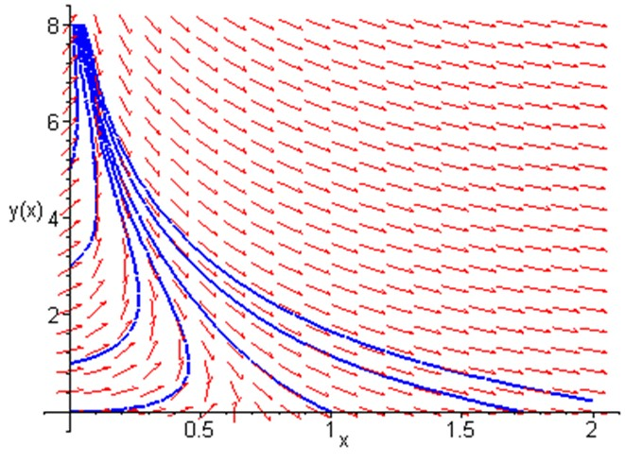
Example 2.6.2: Direction Field and Solution Curves
Our differential equation and solutions are given by
A graph of the direction field for this differential equation, along with several solution curves, is given at right:

Slide 9
Example 2.6.3: Non-Exact Equation Presentation
Consider the following differential equation.
Then
and hence
To show that our differential equation cannot be solved by this method, let us seek a function ψ such that
Thus

Slide 10
Example 2.6.3: Non-Exact Equation Confirmation
We seek ψ such that
and
Then
Because h′(y) depends on x as well as y, there is no function ψ(x, y) such that

Slide 11
Integrating Factors
It is sometimes possible to convert a differential equation that is not exact into an exact equation by multiplying the equation by a suitable integrating factor μ(x, y):
For this equation to be exact, we need
This partial differential equation may be difficult to solve. If μ is a function of x alone, then μ_{y}= 0 and hence we solve
provided right side is a function of x only. Similarly if μ is a function of y alone. See text for more details.

Slide 12
Example 2.6.4: Non-Exact Equation
Consider the following non-exact differential equation.
Seeking an integrating factor, we solve the linear equation
Multiplying our differential equation by μ, we obtain the exact equation
which has its solutions given implicitly by

Slide 13
Copyright
Copyright © 2021 John Wiley & Sons, Inc.
All rights reserved. Reproduction or translation of this work beyond that permitted in Section 117 of the 1976 United States Act without the express written permission of the copyright owner is unlawful. Request for further information should be addressed to the Permissions Department, John Wiley & Sons, Inc. The purchaser may make back-up copies for his/her/their own use only and not for distribution or resale. The Publisher assumes no responsibility for errors, omissions, or damages, caused by the use of these programs or from the use of the information contained herein.

