Slide 1
Elementary Differential Equations and Boundary Value Problems
Twelfth Edition
Boyce
Chapter 5
Series Solutions of Second Order Linear Equations
Copyright ©2021 John Wiley & Sons, Inc.

Slide 2
Section 5.2 Series Solutions Near an Ordinary Point, Part I

Slide 3
Second Order Linear Equations with Variable Coefficients
In Chapter 3, we examined methods of solving second order linear differential equations with constant coefficients.
We now consider the case where the coefficients are functions of the independent variable, which we will denote by x.
It is sufficient to consider the homogeneous equation
since the method for the nonhomogeneous case is similar.
We primarily consider the case when P, Q, R are polynomials, and hence also continuous.
We will see that the method of solution is also applicable when P, Q and R are general analytic functions.

Slide 4
Ordinary Points
Assume P, Q, R are polynomials with no common factors, and that we want to solve the equation below in a neighborhood of a point of interest x₀:
The point x₀ is called an ordinary point if P(x₀) ≠ 0. Since P is continuous, P(x) ≠ 0 for all x in some interval about x₀. For x in this interval, divide the differential equation by P to get
Since p and q are continuous, Theorem 3.2.1 says there is a unique solution, given initial conditions y(x₀) = y₀, y'(x₀) = y₀'

Slide 5
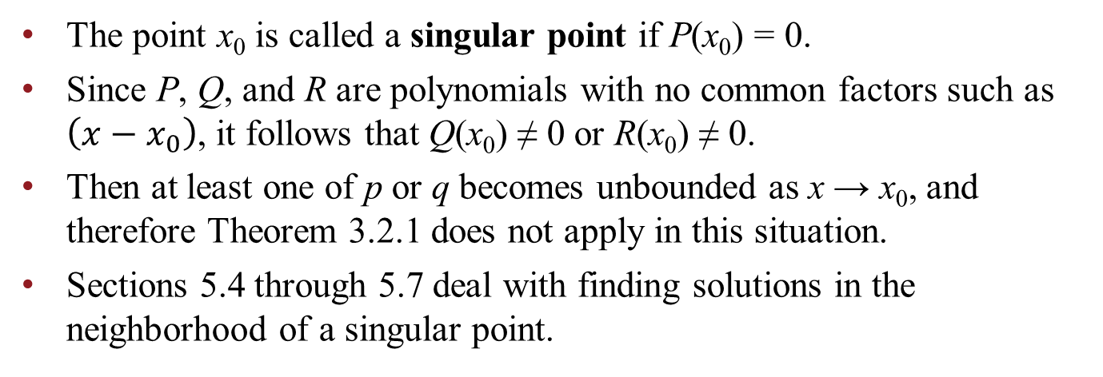
Singular Points
Suppose we want to solve the equation below in some neighborhood of a point of interest x₀:
The point x₀ is called a singular point if P(x₀) = 0.
Since P, Q, and R are polynomials with no common factors such as $\left(x−x_{0}\right)$, it follows that Q(x₀) ≠ 0 or R(x₀) ≠ 0.
Then at least one of p or q becomes unbounded as x → x₀, and therefore Theorem 3.2.1 does not apply in this situation.
Sections 5.4 through 5.7 deal with finding solutions in the neighborhood of a singular point.

Slide 6
Series Solutions Near Ordinary Points
In order to solve our equation near an ordinary point x₀,
we will assume a series representation of the unknown solution function y:
As long as we are within the interval of convergence, this representation of y is continuous and has derivatives of all orders.

Slide 7
Example 5.2.1: Series Solution to a Homogeneous Equation
Find a series solution of the equation
Here, P(x) = 1, Q(x) = 0, R(x) = 1. Thus every point x is an ordinary point. We will take x₀ = 0.
Assume a series solution of the form
Differentiate term by term to obtain
Substituting these expressions into the equation, we obtain

Slide 8
Example 5.2.1: Combining the Series
Our equation is
Shifting indices by replacing n with n + 2, we obtain

Slide 9
Example 5.2.1: Recurrence Relation
Our equation is
For this equation to be valid for all x, the coefficient of each power of x must be zero, and hence
This type of equation is called a recurrence relation.
Next, we find the individual coefficients a₀, a₁, a₂, …

Slide 10
Example 5.2.1: Even Coefficients
Starting with the recurrence relationship:
To find a₂, a₄, a₆, …., we proceed as follows:

Slide 11
Example 5.2.1: Odd Coefficients
Starting with the recurrence relationship:
To find a₃, a₅, a₇, …., we proceed as follows:

Slide 12
Example 5.2.1: Solution
We now have the following information:
Thus
the first and second terms represent two series solutions y₁ and y₂
Note: a₀ and a₁ are determined by the initial conditions. (Expand series a few terms to see this.)
Also, by the ratio test it can be shown that these two series converge absolutely on (−∞, ∞) and hence the manipulations we performed on the series at each step are valid.

Slide 13
Example 5.2.1: Functions Defined by IVP
Our solution is
From Calculus, we know this solution is equivalent to
In hindsight, we see that cos x and sin x are indeed fundamental solutions to our original differential equation
Many important functions are defined by the initial value problems solved by cos x and sin x.

Slide 14
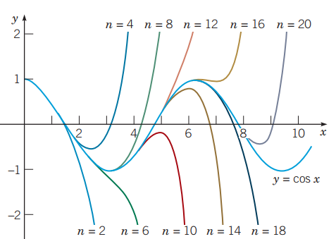
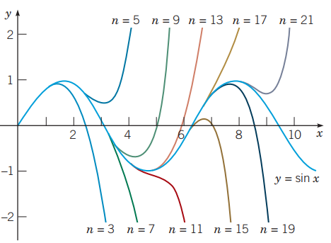
Example 5.2.1: Graphs
The graphs below show the partial sum approximations of cos x and sin x.
As the number of terms increases, the interval over which the approximation is satisfactory becomes longer, and for each x in this interval the accuracy improves.
The truncated power series provides only a local approximation in the neighborhood of x = 0.

Slide 15
Example 5.2.2: Airy’s Equation
Find a series solution of Airy’s equation:
Here, P(x) = 1, Q(x) = 0, R(x) = −x. Thus every point x is an ordinary point. We will take x₀ = 0.
Assuming a series solution and differentiating, we obtain
Substituting these expressions into the equation, we obtain

Slide 16
Example 5.2.2: Combine the Series
Starting with equation:
Shift the index in the first term by replacing n with n + 2:
Shift the index of the second term by replacing n with n – 1 and starting the summation at 1 rather than zero:

Slide 17
Example 5.2.2: Recurrence Relation
Start with equation:
For this equation to be valid for all x, the coefficient of each power of x must be zero; hence a₂ = 0 and

Slide 18
Example 5.2.2: Determine the Coefficients
We have a₂ = 0 and
For this recurrence relation, note that a₂ = a₅ = a₈ = … = 0.
Next, we find the coefficients a₀, a₃, a₆, ….
We do this by finding a formula for a_{3n}, n = 1, 2, 3, …
After that, we find a₁, a₄, a₇, …, by finding a formula for a_{3n+1}, n = 1, 2, 3, …

Slide 19
Example 5.2.2: Find a_{3n}
Given
Find a₃, a₆, a₉, ….
The general formula for this sequence is

Slide 20
Example 5.2.2: Find a_{3n+1}
Given
Find a₄, a₇, a₁₀, ….
The general formula for this sequence is

Slide 21
Example 5.2.2: Solution
Thus our solution is
where a₀, a₁ are arbitrary (determined by initial conditions).
Consider the two cases
(1) a₀ = 1, a₁ = 0 and satisfying y(0) = 1, y'(0) = 0
(2) a₀ = 0, a₁ = 1 and satisfying y(0) = 0, y'(0) = 1
The corresponding solutions y₁(x), y₂(x) are linearly independent, since W[y₁, y₂] (0) = 1 ≠ 0, where

Slide 22
Example 5.2.2: Fundamental Solutions
Our solution:
For the cases
(1) a₀ = 1, a₁ = 0 and where y(0) = 1, y'(0) = 0
(2) a₀ = 0, a₁ = 1 and where y(0) = 0, y'(0) = 1,
the corresponding solutions y₁(x), y₂(x) are linearly independent, and thus are fundamental solutions for Airy’s equation, with the general solution
y (x) = a₀ y₁(x) + a₁ y₂(x)

Slide 23
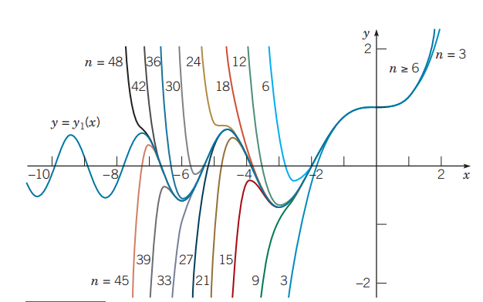
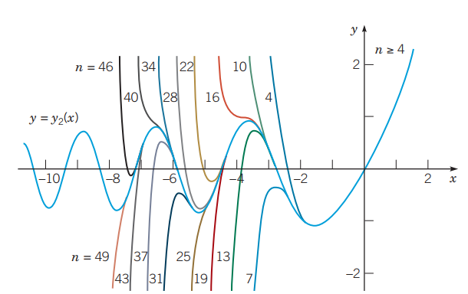
Example 5.2.2: Solution Graphs
The graphs of the solutions y₁ and y₂ are given below. The accuracy interval for each approximation increases as n increases.
Polynomial approximations to y = y₁(x) where the value of n is the degree of the approximating polynomial.
Polynomial approximations to y = y₂(x) where the value of n is the degree of the approximating polynomial.

Slide 24
Example 5.2.3: Airy’s Equation where x = 1 is an ordinary point
Find a series solution of Airy’s equation in powers of x – 1:
Here, P(x) = 1, Q(x) = 0, R(x) = − x. Thus every point x is an ordinary point. We will take x₀ = 1.
Assuming a series solution and differentiating, we obtain
Substituting these into ODE & shifting indices, we obtain

Slide 25
Example 5.2.3: Rewriting the Series Equation
Our equation is
The x on right side can be written as 1 + (x – 1); and thus

Slide 26
Example 5.2.3: Solving the Recurrence Relation
Thus our equation becomes
The corresponding recurrence relation is
Equating like powers of x – 1, we obtain

Slide 27
Example 5.2.3: The Solution
We now have the following information:
and

Slide 28
Example 5.2.3: Recursion with More Than Two Terms
Our solution:
The recursion has three terms,
and determining a general formula for the coefficients a_{n} can be difficult or impossible.
However, we can generate as many coefficients as we like, preferably with the help of a computer algebra system.

Slide 29
Example 5.2.3: Solution and Convergence
Since we don’t have a general formula for the a_{n}, we cannot use a convergence test (i.e., the ratio test) on our power series
This means our manipulations of the power series to arrive at our solution are suspect. However, the results of Section 5.3 will confirm the convergence of our solution.
It can be shown that the solutions y₃(x), y₄(x) are linearly independent, and thus are fundamental solutions for Airy’s equation, with general solution

Slide 30
Copyright
Copyright © 2021 John Wiley & Sons, Inc.
All rights reserved. Reproduction or translation of this work beyond that permitted in Section 117 of the 1976 United States Act without the express written permission of the copyright owner is unlawful. Request for further information should be addressed to the Permissions Department, John Wiley & Sons, Inc. The purchaser may make back-up copies for his/her own use only and not for distribution or resale. The Publisher assumes no responsibility for errors, omissions, or damages, caused by the use of these programs or from the use of the information contained herein.

