Slide 1
Elementary Differential Equations and Boundary Value Problems
Twelfth Edition
Boyce
Chapter 2
First-Order Differential Equations
Copyright ©2021 John Wiley & Sons, Inc.

Slide 2
Section 2.7 Numerical Approximations: Euler’s Method

Slide 3
Analytical Solutions to First Order ODE’s not Always Available
Recall that a first order initial value problem has the form
If f and ∂f/∂y are continuous, then this IVP has a unique solution y = ϕ(t) in some interval about t₀.
When the differential equation is linear, separable or exact, we can find the solution by symbolic manipulations.
However, the solutions for most differential equations of this form cannot be found by analytical means.
Therefore it is important to be able to approach the problem in other ways.

Slide 4
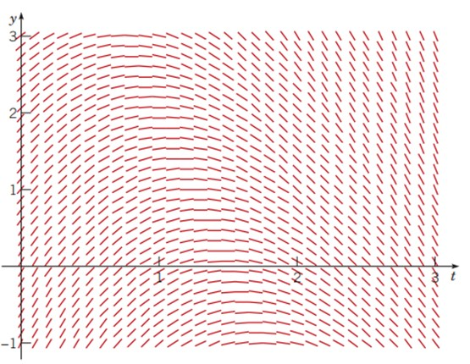
Direction Fields
For the first order initial value problem
we can sketch a direction field and visualize the behavior of solutions. This has the advantage of being a relatively simple process, even for complicated equations. However, direction fields do not lend themselves to quantitative computations or comparisons.
direction field solution to dy/dt = 3−2t−0.5y

Slide 5
Numerical Methods
For our first order initial value problem
an alternative is to compute approximate values of the solution y = ϕ(t) at a selected set of t-values.
Ideally, the approximate solution values will be accompanied by error bounds that ensure the level of accuracy.
There are many numerical methods that produce numerical approximations to solutions of differential equations, some of which are discussed in Chapter 8.
In this section, we examine the tangent line method, which is also called Euler’s Method.

Slide 6
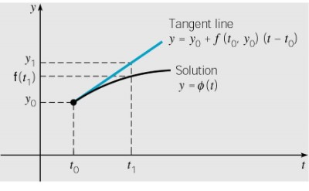
Euler’s Method: Tangent Line Approximation
For the initial value problem
we begin by approximating solution y = ϕ(t) at initial point t₀.
The solution passes through initial point (t₀, y₀) with slope f (t₀, y₀). The line tangent to the solution at this initial point is
The tangent line is a good approximation to solution curve on an interval short enough.
Thus if t₁ is close enough to t₀, we can approximate y = ϕ(t₁) by

Slide 7
Euler’s Formula
For a point t₂ close to t₁, we approximate y = ϕ(t₂) using the line passing through (t₁, y₁) with slope f (t₁, y₁):
Thus we create a sequence y_{n} of approximations y = ϕ(t_{n})
where f_{n} = f (t_{n}, y_{n}).
For a uniform step size t_{n+1}= –t_{n}+ h, Euler’s formula becomes

Slide 8
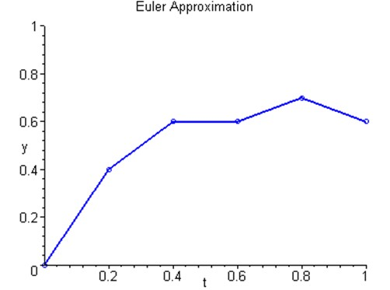
Euler Approximation
To graph an Euler approximation, we plot the points (t₀, y₀), (t₁, y₁),…, (t_{n}, y_{n}), and then connect these points with line segments.

Slide 9
Example 2.7.1: Euler’s Method: Approximate Solutions
For the initial value problem
we can use Euler’s method with h = 0.2 to approximate the solution at t = 0.2, 0.4, 0.6, 0.8, and 1.0 as shown below.
n | t_{n} | y_{n} | f_{n} = f(t_{n} ,y_{n}) | Tangent Line | Exact y(t_{n})
0 | 0.0 | l.00000 | 2.5 | y =1 + 2.5(t − 0) | l.00000
1 | 0.2 | 1.50000 | 1.85 | y = 1.5 + 1.85(t− 0.2) | 1.43711
2 | 0.4 | 1.87000 | 1.265 | y = 1.87 + 1.265(t− 0.4) | 1.75650
3 | 0.6 | 2.12300 | 0.7385 | y = 2.123 + 0.7385(t− 0.6) | 1.96936
4 | 0.8 | 2.27070 | 0.26465 | y = 2.2707 + 0.26465(t− 0.8) | 2.08584
5 | 1.0 | 2.32363 |  |  | 2.11510

Slide 10
Example 2.7.1: Exact Solution
We can find the exact solution to our IVP, as in Chapter 2.1:

Slide 11
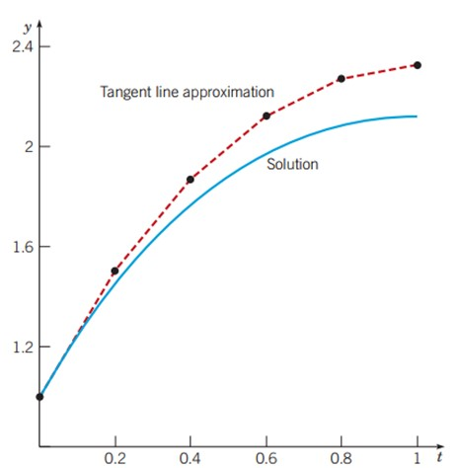
Example 2.7.1: Error Analysis
From the figure below, we see that the errors start small, but get larger as shown by the divergence of the tangent line approximation curve (dotted red) from the exact solution (blue).
This divergence is due to the fact that the exact solution is not linear on [0, 1].

Slide 12
Example 2.7.2: Euler’s Method - Defining Domain of Interest
For the initial value problem
we can use Euler’s method with various step sizes to approximate the solution at t = 1.0, 2.0, 3.0, 4.0, and 5.0 and compare our results to the exact solution
at those values of t.

Slide 13
Example 2.7.2: Euler’s Method - Choosing Step Size
Comparison of exact solution with Euler’s Method for h = 0.1, 0.05, 0.025, 0.01
t | h = 0.1 | h = 0.05 | h = 0.025 | h = 0.01 | Exact
0.0 | 1.0000 | 1.0000 | 1.0000 | 1.0000 | 1.0000
1.0 | 2.2164 | 2.1651 | 2.1399 | 2.1250 | 2.1151
2.0 | 1.3397 | 1.2780 | 1.2476 | 1.2295 | 1.2176
3.0 | −0.7903 | −0.8459 | −0.8734 | −0.8898 | −0.9007
4.0 | −3.6707 | −3.7152 | −3.7373 | −3.7506 | −3.7594
5.0 | −7.0003 | −7.0337 | −7.0504 | −7.0604 | −7.0671

Slide 14
Example 2.7.3: Euler’s Method - Approximate Solution over Domain of Interest
For the initial value problem
we can use Euler’s method with h = 0.1 to approximate the solution at t = 1, 2, 3, and 4, as shown below.
Exact solution (see Chapter 2.1):

Slide 15
Example 2.7.3: Error Analysis
The first five Euler approximations are given in table below for h = 0.1, 0.05, 0.025, 0.01.
With increasing number of approximations, the difference between the Euler approximated solutions and exact solution increase.
The errors are small initially, but quickly reach an unacceptable level. This suggests a nonlinear solution.
t | h = 0.1 | h = 0.05 | h = 0.025 | h = 0.01 | Exact
0.0 | 1.000000 | 1.000000 | 1.000000 | 1.000000 | 1.000000
1.0 | 15.77728 | 17.25062 | 18.10997 | 18.67278 | 19.06990
2.0 | 104.6784 | 123.7130 | 135.5440 | 143.5835 | 149.3949
3.0 | 652.5349 | 837.0745 | 959.2580 | 1045.395 | 1109.179
4.0 | 4042.122 | 5633.351 | 6755.175 | 7575.577 | 8197.884
5.0 | 25026.95 | 37897.43 | 47555.35 | 54881.32 | 60573.53

Slide 16
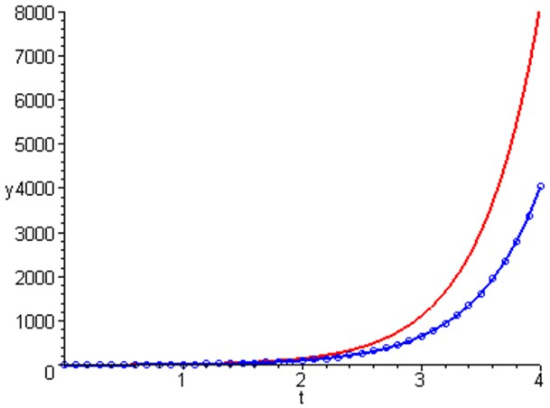
Example 2.7.3: Error Analysis & Graphs
The graphs below show the exact solution (red) plotted together with the Euler approximation (blue) for h = 0.1
t | Exact y | Approx y | Error | % Rel Error
0.00 | 1.00 | 1.00 | 0.00 | 0.00
1.00 | 19.07 | 15.78 | 3.29 | 17.27
2.00 | 149.39 | 104.68 | 44.72 | 29.93
3.00 | 1109.18 | 652.53 | 456.64 | 41.17
4.00 | 8197.88 | 4042.12 | 4155.76 | 50.69

Slide 17
Euler Method Summary: Approximate Applies to a Particular Initial Condition
are continuous, then our first order initial value problem
Recall that if f and
has a solution y = ϕ(t) in some interval about t₀.
In fact, the equation has infinitely many solutions, each one indexed by a constant c determined by the initial condition.
Thus ϕ(t) is the member of an infinite family of solutions that satisfies ϕ(t₀) = y₀
The Euler approximation will use only one of these solutions as input for the first approximation step.

Slide 18
Euler Method Summary: Iterative Steps
The first step of Euler’s method uses the tangent line to ϕ at the point (t₀, y₀) in order to estimate y₁.
The point (t₁, y₁) is typically not on the graph of ϕ, because y₁ is an approximation of ϕ(t₁).
Thus the next iteration of Euler’s method does not use a tangent line approximation to ϕ, but rather to a nearby solution ϕ₁ that passes through the point (t₁, y₁).
Thus Euler’s method uses a succession of tangent lines to a sequence of different solutions ϕ(t), ϕ₁(t), ϕ₂(t),… of the differential equation.

Slide 19
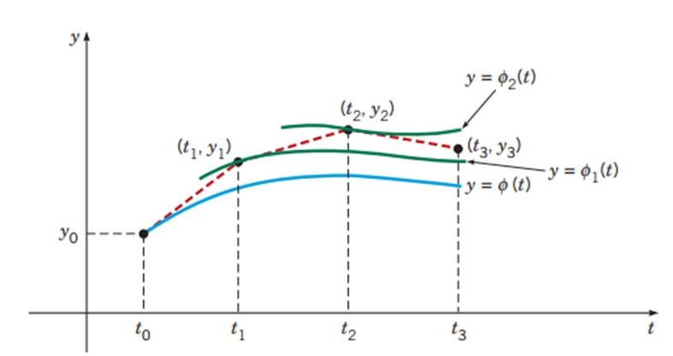
Euler Method Summary: Successive Tangents
The Euler Method uses tangents and function values from prior steps as inputs to subsequent steps.

Slide 20
Error Bounds and Numerical Methods
In using a numerical procedure, keep in mind the question of whether the results are accurate enough to be useful.
In our examples, we compared approximations with exact solutions. However, numerical procedures are usually used when an exact solution is not available. What is needed are bounds for (or estimates of) errors, which do not require knowledge of exact solution. More discussion on these issues and other numerical methods is given in Chapter 8.
Since numerical approximations ideally reflect behavior of solution, a member of a diverging family of solutions is harder to approximate than a member of a converging family.
Also, direction fields are often a relatively easy first step in understanding the behavior of solutions.

Slide 21
Copyright
Copyright © 2021 John Wiley & Sons, Inc.
All rights reserved. Reproduction or translation of this work beyond that permitted in Section 117 of the 1976 United States Act without the express written permission of the copyright owner is unlawful. Request for further information should be addressed to the Permissions Department, John Wiley & Sons, Inc. The purchaser may make back-up copies for his/her/their own use only and not for distribution or resale. The Publisher assumes no responsibility for errors, omissions, or damages, caused by the use of these programs or from the use of the information contained herein.

