Slide 1
Elementary Differential Equations and Boundary Value Problems
Twelfth Edition
Boyce
Chapter 3
Second-Order Linear Differential Equations
Copyright ©2021 John Wiley & Sons, Inc.

Slide 2
Section 3.1 Homogeneous Differential Equations with Constant Coefficients

Slide 3
2nd Order Linear Homogeneous Equations-Constant Coefficients
A second order ordinary differential equation has the general form
where f is some given function.
This equation is said to be linear if f is linear in y and y':
Otherwise the equation is said to be nonlinear.
A second order linear equation often appears as
If g(t) or G(t) = 0 for all t, then the equation is called homogeneous. Otherwise the equation is nonhomogeneous.

Slide 4
Homogeneous Equations, Initial Values
In Sections 3.5 and 3.6, we will see that once a solution to a homogeneous equation is found, then it is possible to solve the corresponding nonhomogeneous equation, or at least express the solution in terms of an integral.
The focus of this chapter is thus on homogeneous equations; and in particular, those with constant coefficients:
We will examine the variable coefficient case in Chapter 5.
Initial conditions typically take the form
Thus solution passes through (t₀, y₀), and the slope of solution at (t₀, y₀) is equal to y₀'.

Slide 5
Example 3.1.1: General Solution
Find the general solution for the second order linear differential equation:
Two solutions of this equation are
Other solutions include
Based on these observations, we see that there are infinitely many solutions of the form
It will be shown in Section 3.2 that all solutions of the differential equation above can be expressed in this form.

Slide 6
Example 3.1.1: Initial Conditions
Now consider the following initial value problem for our equation:
We have found a general solution of the form
Using the initial equations,
Thus

Slide 7
The Characteristic Equation
To solve the 2nd order equation with constant coefficients,
𝑎𝑦ʺ + 𝑏𝑦′ + 𝑐𝑦 = 0
we begin by assuming a solution of the form y = e^{rt}.
Substituting this into the differential equation, we obtain
Simplifying,
and hence
This last equation is called the characteristic equation of the differential equation.
We then solve for r by factoring or using quadratic formula.

Slide 8
The General Solution
Using the quadratic formula on the characteristic equation
we obtain two solutions, r₁ and r₂.
There are three possible results:
The roots r₁, r₂ are real and r₁ ≠ r₂.
The roots r₁, r₂ are real and r₁ = r₂.
The roots r₁, r₂ are complex.
In this section, we will assume r₁, r₂ are real and r₁ ≠ r₂.
In this case, the general solution has the form

Slide 9
Initial Conditions
For the initial value problem
𝑎𝑦ʺ + 𝑏𝑦′ + 𝑐𝑦 = 0 where y(t₀) = y₀ and
we use the general solution
together with the initial conditions to find c₁ and c₂. That is,
Since we are assuming r₁ ≠ r₂, it follows that a solution of the form y = e^{rt} to the above initial value problem will always exist, for any set of initial conditions.

Slide 10
Example 3.1.2 General Solution
Consider the linear differential equation
Assuming an exponential solution leads to the characteristic equation:
Factoring the characteristic equation yields two solutions: r₁ = –2 and r₂ = –3
Therefore, the general solution to this differential equation has the form

Slide 11
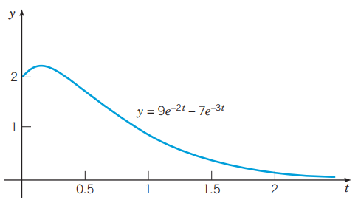
Example 3.1.3 Particular Solution
Consider the initial value problem
From the preceding example, we know the general solution has the form:
With derivative:
Using the initial conditions:
Thus

Slide 12
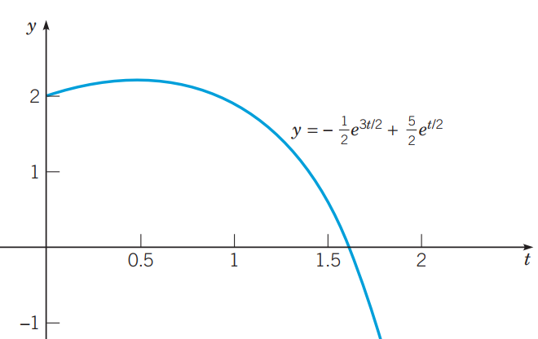
Example 3.1.4: Initial Value Problem
Consider the initial value problem
Then
Factoring yields two solutions,
The general solution has the form
Using initial conditions:

Slide 13
Example 3.1.5: Find Maximum Value
For the initial value problem in Example 3.3, to find the maximum value attained by the solution, we set y′(t) = 0 and solve for t:
Set 𝑦′ = 0 and multiply by e^{3t} to find t_{max} which satisfies
hence:
The corresponding maximum value y_{max} is given by:

Slide 14
Copyright
Copyright © 2021 John Wiley & Sons, Inc.
All rights reserved. Reproduction or translation of this work beyond that permitted in Section 117 of the 1976 United States Act without the express written permission of the copyright owner is unlawful. Request for further information should be addressed to the Permissions Department, John Wiley & Sons, Inc. The purchaser may make back-up copies for his/her/their own use only and not for distribution or resale. The Publisher assumes no responsibility for errors, omissions, or damages, caused by the use of these programs or from the use of the information contained herein.

