Slide 1
Elementary Differential Equations and Boundary Value Problems
Twelfth Edition
Boyce
Chapter 3
Second-Order Linear Differential Equations
Copyright ©2021 John Wiley & Sons, Inc.

Slide 2
Section 3.4 Repeated Roots; Reduction of Order

Slide 3
Repeated Roots; Reduction of Order
Recall our 2nd order linear homogeneous ODE
where a, b and c are constants
Assuming an exponential solution leads to characteristic equation:
Quadratic formula (or factoring) yields two solutions, r₁ and r₂:
with both roots yielding the same solution:
When b² – 4ac = 0, then

Slide 4
Finding the Second Solution Using Multiplying Factor v(t)
We know that if y₁(t) is a solution, then y₂(t) = cy₁(t) is a solution.
Since y₁ and y₂ are linearly dependent, we can generalize this approach and multiply by a function v(t), and determine conditions for which y₂ is a solution:

Slide 5
Finding the Multiplying Factor v(t)
Substituting derivatives into the original ODE, we can find and expression for v:

Slide 6
General Solution
To find our general solution, we have:
Thus the general solution for repeated roots is

Slide 7
Wronskian
The general solution is
Thus every solution is a linear combination of
The Wronskian of the two solutions is
Thus y₁ and y₂ form a fundamental solution set for equation.

Slide 8
Example 3.4.1 (part one)
Solve the differential equation:
Assuming an exponential solution leads to characteristic equation:
So one solution is
and a second solution is found:
Substituting these into the differential equation and simplifying yields
where k₁ and k₂ are arbitrary constants.

Slide 9
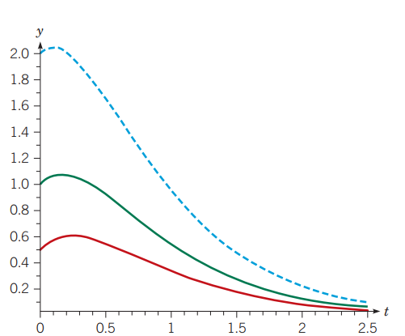
Example 3.4.1 (part two)
Letting
So the general solution is
Note that both y₁ and y₂ tend to 0 as t → ∞ regardless of the values of c₁ and c₂
The figure shows three solutions of this equation with different sets of initial conditions.
y(0) = 2, y’(0) = 1 (top)
y(0) = 1, y’(0) = 1 (middle)
y(0) = ½, y’(0) = 1 (bottom)

Slide 10
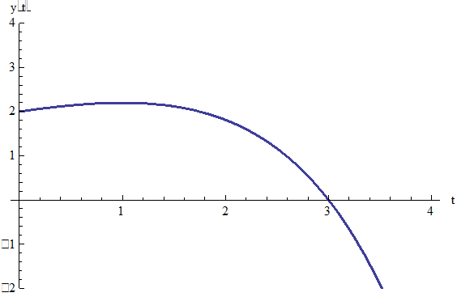
Example 3.4.2 (part one)
Find the solution of the initial value problem
Assuming exponential solution leads to characteristic equation:
Thus the general solution is
Using the initial conditions:
Thus

Slide 11
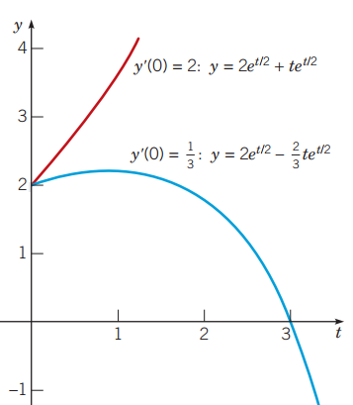
Example 3.4.2 (part two)
Suppose that the initial slope in the previous problem was increased
The solution of this modified problem is
Notice that the coefficient of the second term is now positive. This makes a difference in the graph, since the exponential function is raised to a positive power.

Slide 12
Reduction of Order
The method used so far in this section also works for equations with nonconstant coefficients:
That is, given that y₁ is solution, try y₂ = v(t)y₁:
Substituting these into the original ODE and collecting terms,
Since y₁ is a solution to the differential equation, this last equation reduces to a first order equation in v:

Slide 13
Example 3.4.3: Reduction of Order
Given the variable coefficient equation and solution y₁,
use reduction of order method to find a second solution:
Substituting these into the original ODE and collecting terms,

Slide 14
Example 3.4.3: Finding v(t)
To solve
for u, we can use the separation of variables method:
Thus
and hence

Slide 15
Example 3.4.3: General Solution
Since
Recall
So we can neglect the second term of y₂ to obtain
The Wronskian of
can be computed
Hence the general solution to the differential equation is

Slide 16
Copyright
Copyright © 2021 John Wiley & Sons, Inc.
All rights reserved. Reproduction or translation of this work beyond that permitted in Section 117 of the 1976 United States Act without the express written permission of the copyright owner is unlawful. Request for further information should be addressed to the Permissions Department, John Wiley & Sons, Inc. The purchaser may make back-up copies for his/her/their own use only and not for distribution or resale. The Publisher assumes no responsibility for errors, omissions, or damages, caused by the use of these programs or from the use of the information contained herein.

