Slide 1
Elementary Differential Equations and Boundary Value Problems
Twelfth Edition
Boyce
Chapter 3
Second-Order Linear Differential Equations
Copyright ©2021 John Wiley & Sons, Inc.

Slide 2
Section 3.3 Complex Roots of the Characteristic Equation

Slide 3
Complex Roots of Characteristic Equation
Recall our discussion of the equation
where a, b and c are constants
Assuming an exponential solution leads to characteristic equation:
Application of the quadratic formula (or factoring) yields two solutions, r₁ and r₂:
If b² – 4ac < 0, then the roots are conjugate complex numbers:
Thus

Slide 4
Euler’s Formula; Complex Valued Solutions
Substituting it into the Taylor series for e^{t}, we obtain Euler’s formula:
Generalizing Euler’s formula, we obtain
Then
Therefore

Slide 5
Real-Valued Solutions
Our two solutions thus far are complex-valued functions:
We would prefer to have real-valued solutions, since our differential equation has real coefficients.
To achieve this, recall that linear combinations of solutions are themselves solutions:
Ignoring constants, we obtain the two solutions

Slide 6
Real-Valued Solutions: The Wronskian
Thus we have the following real-valued functions:
Computation of the Wronskian gives:
Thus y₃ and y₄ form a fundamental solution set for our ODE, and the general solution can be expressed as

Slide 7
Example 3.3.1 (part one)
Find the general solution of the differential equation:
The characteristic equation is 𝑟² + 𝑟 + 9.25 = 0 with roots given by:
Therefore, separating the real and imaginary components,
and thus the general solution is

Slide 8
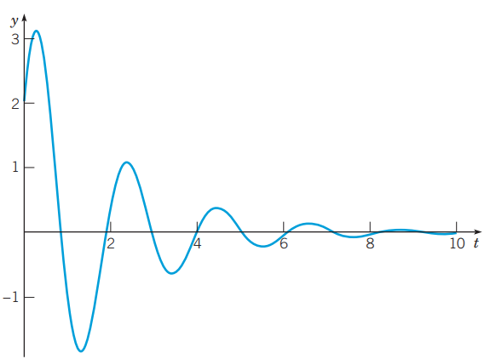
Example 3.3.1 (part two)
Using the general solution just determined
We can determine the particular solution that satisfies the initial conditions
So
Thus the solution of this IVP is
The solution is a decaying oscillation

Slide 9
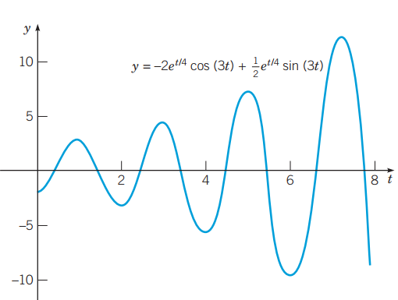
Example 3.3.2
Find the solution to the initial value problem
Then
Thus the general solution is
And
The solution of the IVP is
The solution is a growing oscillation

Slide 10
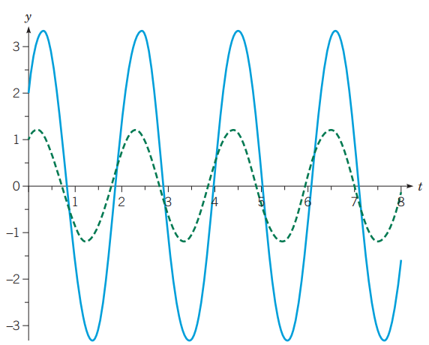
Example 3.3.3
Find the general solution of
Then
Therefore
and thus the general solution is
Because λ = 0, there is no exponential factor in the solution, so the amplitude of each oscillation is constant. The figure shows the graph with two sets of initial conditions.

Slide 11
Copyright
Copyright © 2021 John Wiley & Sons, Inc.
All rights reserved. Reproduction or translation of this work beyond that permitted in Section 117 of the 1976 United States Act without the express written permission of the copyright owner is unlawful. Request for further information should be addressed to the Permissions Department, John Wiley & Sons, Inc. The purchaser may make back-up copies for his/her/their own use only and not for distribution or resale. The Publisher assumes no responsibility for errors, omissions, or damages, caused by the use of these programs or from the use of the information contained herein.

