Slide 1
Elementary Differential Equations and Boundary Value Problems
Twelfth Edition
Boyce
Chapter 3
Second Order Linear Differential Equations
Copyright ©2021 John Wiley & Sons, Inc.

Slide 2
Section 3.7 Mechanical and Electrical Vibrations

Slide 3
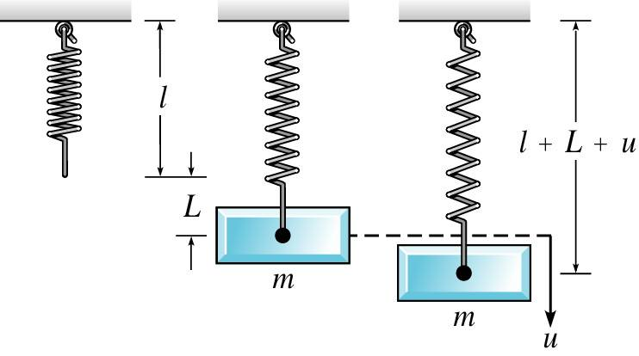
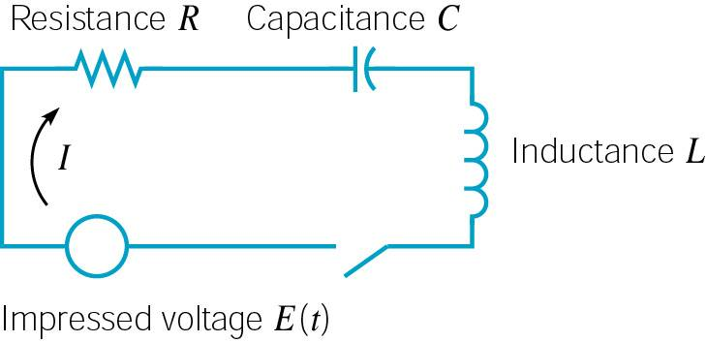
Mechanical & Electrical Vibrations
Two important areas of application for second order linear equations with constant coefficients are in modeling mechanical and electrical oscillations.
We will study the motion of a mass on a spring in detail.
An understanding of the behavior of this simple system is the first step in investigation of more complex vibrating systems.

Slide 4
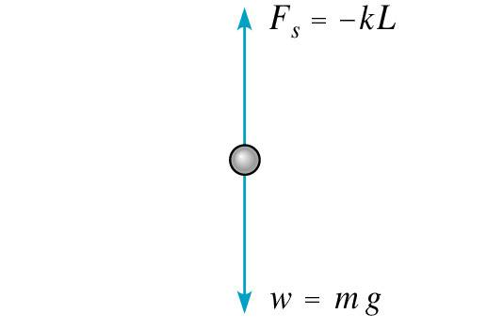
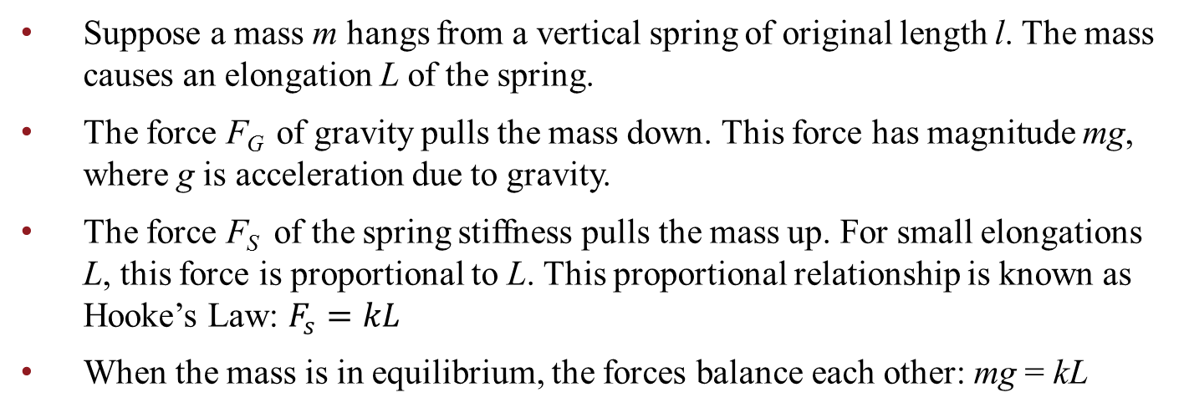
Spring – Mass System
Suppose a mass m hangs from a vertical spring of original length l. The mass causes an elongation L of the spring.
The force F_{G} of gravity pulls the mass down. This force has magnitude mg, where g is acceleration due to gravity.
The force F_{S} of the spring stiffness pulls the mass up. For small elongations L, this force is proportional to L. This proportional relationship is known as Hooke’s Law: $F_{s}=kL$
When the mass is in equilibrium, the forces balance each other: mg = kL

Slide 5
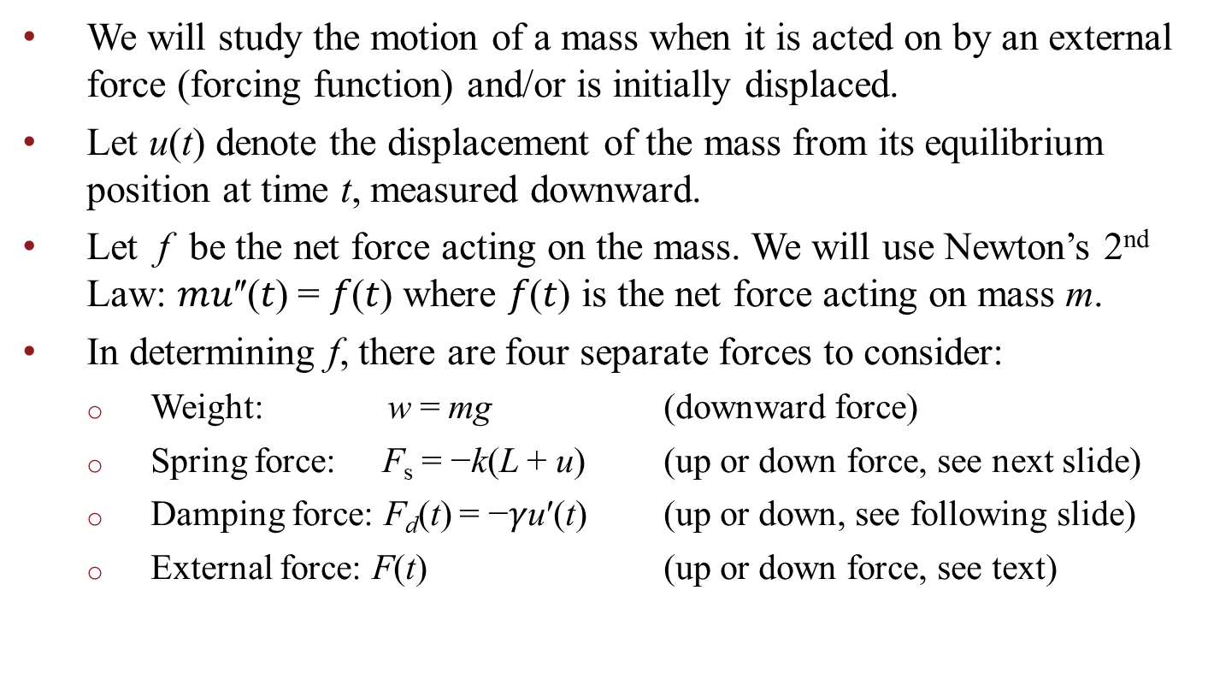
Spring Model
We will study the motion of a mass when it is acted on by an external force (forcing function) and/or is initially displaced.
Let u(t) denote the displacement of the mass from its equilibrium position at time t, measured downward.
Let f be the net force acting on the mass. We will use Newton’s 2nd Law: 𝑚𝑢ʺ(𝑡) = 𝑓(𝑡) where 𝑓(𝑡) is the net force acting on mass m.
In determining f, there are four separate forces to consider:
Weight: w = mg (downward force)
Spring force: F_{s} = −k(L + u) (up or down force, see next slide)
Damping force: F_{d}(t) = −𝛾uʹ(t) (up or down, see following slide)
External force: F(t) (up or down force, see text)

Slide 6
Spring Model: Spring Force Details
The spring force F_{s} acts to restore a spring to the natural position, and is proportional to L + u. If L + u > 0, then the spring is extended and the spring force acts upward. In this case
If L + u < 0, then spring is compressed a distance of |L + u|, and the spring force acts downward. In this case
In either case,

Slide 7
Spring Model: Damping Force Details
The damping or resistive force F_{d} acts in the opposite direction as the motion of the mass. This can be complicated to model. F_{d} may be due to air resistance, internal energy dissipation due to action of spring, friction between the mass and guides, or a mechanical device (dashpot) imparting a resistive force to the mass.
We simplify this and assume F_{d} is proportional to the velocity.
In particular, we find that
If u’ > 0, then u is increasing, so the mass is moving downward. Thus F_{d} acts upward and hence
If u’ < 0, then u is decreasing, so the mass is moving upward. Thus F_{d} acts downward and hence
In either case,

Slide 8
Spring Model: Differential Equation
Taking into account these forces, Newton’s Law becomes:
Recalling that mg = kL, this equation reduces to
where the constants m, γ, and k are positive.
We can prescribe initial conditions 𝑢(0) = 𝑢₀, 𝑢′ (0) = 𝑣₀
It follows from Theorem 3.2.1 that there is a unique solution to this initial value problem. Physically, if the mass is set in motion with a given initial displacement and velocity, then its position is uniquely determined at all future times.

Slide 9
Example 3.7.1: Identify Coefficients
A 4 lb mass stretches a spring 2 in. The mass is displaced an additional 6 in and then released, and is in a medium that exerts a viscous resistance of 6 lb when the mass has a velocity of 3 ft/s. Formulate the IVP that governs the motion of this mass:
Find m:
Find γ:
Find k:

Slide 10
Example 3.7.1: Express the IVP
Thus our differential equation becomes
and hence the initial value problem can be written as
This problem can be solved using the methods of Chapter 3.3 and yields the solution

Slide 11
Spring Model: Undamped Free Vibrations (part one)
Recall our differential equation for spring motion:
Suppose there is no external driving force and no damping. Then F(t) = 0 and γ = 0, and our equation becomes
The general solution to this equation is
where:

Slide 12
Spring Model: Undamped Free Vibrations (part two)
Using trigonometric identities, the solution can be rewritten as:
where
Note that in finding δ, we must be careful to choose the correct quadrant. This is done using the signs of cos δ and sin δ.

Slide 13
Spring Model: Undamped Free Vibrations (part three)
Thus our solution is
where
The solution is a shifted cosine (or sine) curve, that describes simple harmonic motion, with period
The circular frequency ω₀ (radians/time) is the natural frequency of the vibration, R is the amplitude of the maximum displacement of mass from equilibrium, and δ is the phase or phase angle (dimensionless).

Slide 14
Spring Model: Undamped Free Vibrations (part four)
Note that our solution
is a shifted cosine (or sine) curve with period
Initial conditions determine A & B, hence also the amplitude R.
The system always vibrates with the same frequency ω₀, regardless of the initial conditions.
The period T increases as m increases, so larger masses vibrate more slowly. The period T decreases as k increases, so stiffer springs cause a system to vibrate more rapidly.

Slide 15
Example 3.7.2: Define the IVP
A 10 lb mass stretches a spring 2 in. The mass is displaced an additional 2 in and then set in motion with an initial upward velocity of 1 ft/s.
Determine the position of the mass at any later time, and find the period, amplitude, and phase of the motion.
Find m:
Find k:
Thus our IVP is

Slide 16
Example 3.7.2: Find the Solution
Simplifying, we obtain
To solve, use methods of Ch 3.3 to obtain

Slide 17
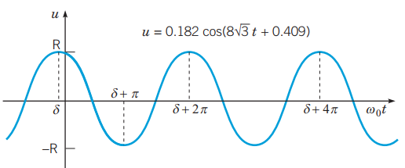
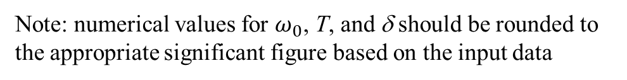
Example 3.7.2: Find Period, Amplitude, and Phase
The natural frequency is
The period is
The amplitude is
Next, determine the phase δ:
Note: numerical values for $ω_{0}$, T, and δ should be rounded to the appropriate significant figure based on the input data

Slide 18
Spring Model: Damped Free Vibrations
Suppose there is damping but no external driving force F(t):
What is effect of the damping coefficient γ on the system?
The characteristic equation is
with roots:
Three cases for the solution:
In all cases, the solution u tends to zero as t → ∞

Slide 19
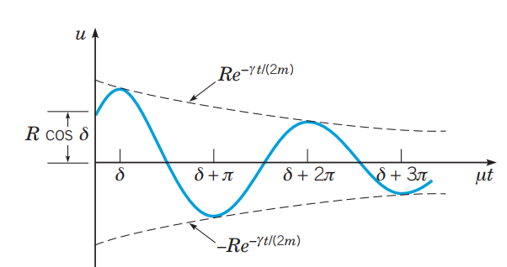
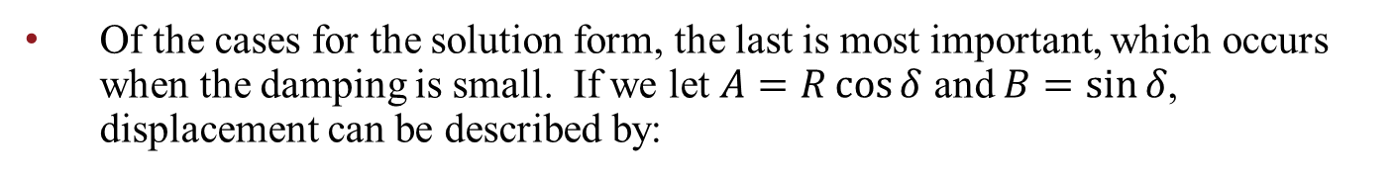
Damped Free Vibrations: Small Damping
Of the cases for the solution form, the last is most important, which occurs when the damping is small. If we let $A=R\cos{δ}$ and $B=\sin{δ}$, displacement can be described by:
The displacement u lies between the curves 𝑢 = ±𝑅𝑒^{−𝛾𝑡∕(2𝑚)}, so the displacement vs. time curve resembles a cosine wave whose amplitude decreases as t increases. This motion is called a dampened oscillation or dampened vibration.

Slide 20
Damped Free Vibrations: Quasi-frequency
Thus we have damped oscillations:
The amplitude R depends on the initial conditions, since
Although the motion is not periodic, the parameter μ determines the mass oscillation frequency.
Thus μ is called the quasi-frequency.
Recall

Slide 21
Damped Free Vibrations: Quasi Period
Comparing μ with the frequency ω₀ of undamped motion, we find:
approximation valid when 𝛾²∕4𝑘𝑚 is small ⇒ “small damping”
Similarly, the quasi-period is defined as 𝑇_{𝑑} = 2𝜋∕𝜇, where the relationship to period T is given by:
small damping increases quasi-period and decreases oscillation frequency

Slide 22
Damped Free Vibrations: Neglecting Damping for Small 𝛾²∕4𝑘𝑚
Consider again the comparisons between damped and undamped frequency and period:
The magnitude of γ alone is not as significant as the dimensionless ratio 𝛾²∕4𝑘𝑚. If 𝛾²∕4𝑘𝑚 is small, then damping has minimal effect on quasi-frequency and quasi-period.
The mass oscillates about its equilibrium position.

Slide 23
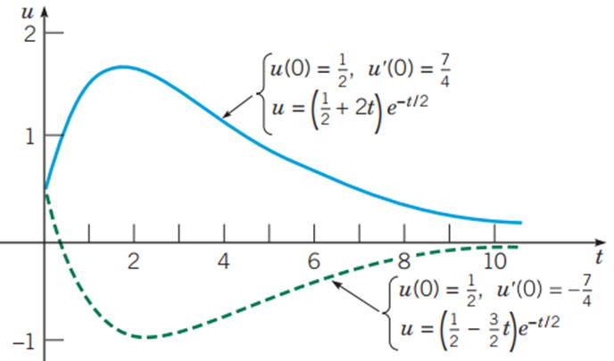
Damped Free Vibrations: Critical and Overdamping
Thus the nature of the solution changes as γ changes relative to
motion is critically damped.
If
If
motion is overdamped.
For both critically and overdamped conditions, the mass passes through its equilibrium position once, then creeps back to it.
Critically dampened motion for two different initial conditions.

Slide 24
Example 3.7.3: Initial Value Problem
Suppose that the motion of a spring-mass system is governed by the initial value problem
Find the following:
quasi-frequency and quasi-period;
time at which mass passes through equilibrium position;
time τ such that |u(t)| < 0.1 for all t > τ.
For Part (a), using methods of this chapter we obtain:
where

Slide 25
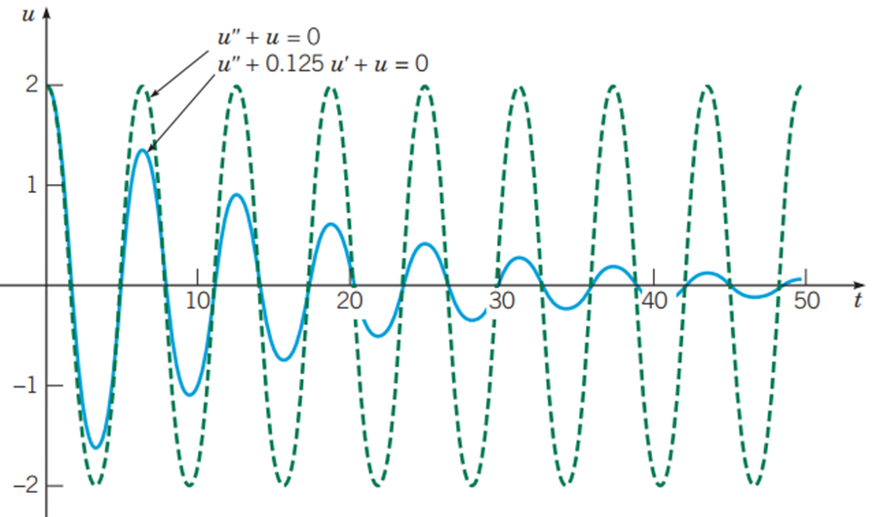
Example 3.7.3: Quasi Frequency & Period
The quasi-frequency is
and the quasi-period is 𝑇_{𝑑} = 2𝜋∕𝜇.
For the undamped case: 𝜔₀ = 1, 𝑇 = 2𝜋
The graph of this solution, along with solution to the corresponding undamped problem, is given below.
Blue curve = small damping
Dotted green curve = no damping

Slide 26
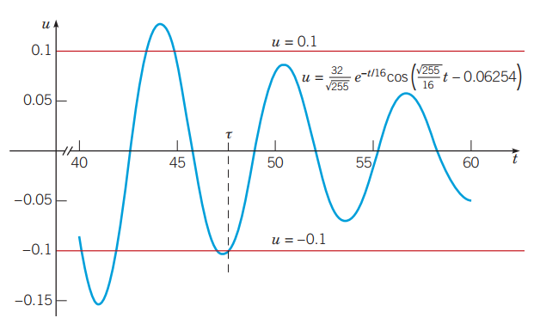
Example 3.7.3: Damping Coefficient
The damping coefficient is γ = 0.125 = 1/8, and this is 1/16 of the critical value
Thus damping is small relative to mass and spring stiffness, nevertheless the oscillation amplitude diminishes quickly.
Using a solver, we find that |u(t)| < 0.1 for t >
Solution for 40 ≤ 𝑡 ≤ 60, showing time τ after which the absolute value of the mass position is < 0.1

Slide 27
Example 3.7.3: Time for Mass to Pass Through Equilibrium Position
To find the time at which the mass first passes through the equilibrium position, we must solve
Or more simply, solve

Slide 28
Electric Circuits
The flow of current in certain basic electrical circuits is modeled by second order linear ODEs with constant coefficients:
The flow of current in this circuit is mathematically equivalent to motion of spring-mass system.
For more details, see text.

Slide 29
Copyright
Copyright © 2021 John Wiley & Sons, Inc.
All rights reserved. Reproduction or translation of this work beyond that permitted in Section 117 of the 1976 United States Act without the express written permission of the copyright owner is unlawful. Request for further information should be addressed to the Permissions Department, John Wiley & Sons, Inc. The purchaser may make back-up copies for his/her/their own use only and not for distribution or resale. The Publisher assumes no responsibility for errors, omissions, or damages, caused by the use of these programs or from the use of the information contained herein.

