Slide 1
Elementary Differential Equations and Boundary Value Problems
Twelfth Edition
Boyce
Chapter 3
Second Order Linear Differential Equations
Copyright ©2021 John Wiley & Sons, Inc.

Slide 2
Section 3.8 Forced Periodic Vibrations

Slide 3
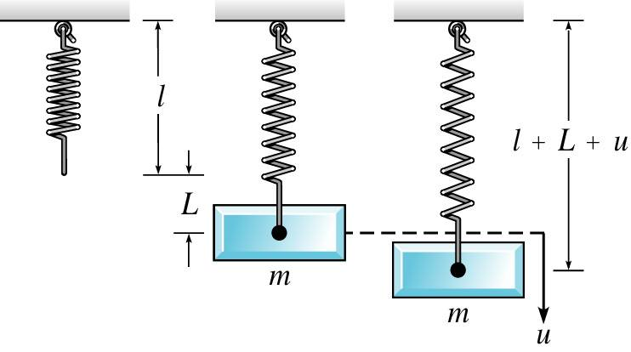
Forced Periodic Vibrations
We continue the discussion of section 3.7, adding the presence of a periodic external force:

Slide 4
Forced Vibrations with Damping
Consider the equation below for damped motion and external forcing function
The general solution of this equation has the form
where the general solution of the homogeneous equation is
and the particular solution of the nonhomogeneous equation is

Slide 5
Homogeneous Solution
The homogeneous solutions u₁ and u₂ depend on the roots r₁ and r₂ of the characteristic equation:
Since m, γ, and k are all positive constants, it follows that r₁ and r₂ are either real and negative, or complex conjugates with negative real part. In the first case,
while in the second case
Thus in either case,

Slide 6
Transient and Steady-State Solutions
Thus for the following equation and its general solution,
we have
Thus u_{C}(t) is called the transient solution. Note however that
is a steady oscillation with same frequency as forcing function.
For this reason, U(t) is called the steady-state solution, or forced response.

Slide 7
Transient Solution and Initial Conditions
For the following equation and its general solution,
the transient solution u_{C}(t) enables us to satisfy whatever initial conditions might be imposed.
With increasing time, the energy put into system by initial displacement and velocity is dissipated through damping force. The motion then becomes the response U(t) of the system to the external force F₀ cos(ωt).
Without damping, the effect of the initial conditions would persist for all time.

Slide 8
Example 3.8.1 (part one)
Consider a spring-mass system satisfying the differential equation and initial condition
Find the solution of this initial value problem and describe the behavior of the solution for large t.
The homogeneous equation is given by:
A particular solution to the nonhomogeneous equation will have the form U(t) = A cos t + B sin t and substitution gives A = 12/17 and B = 48/17.

Slide 9
Example 3.8.1 (part two)
The general solution for the nonhomogeneous equation is
Applying the initial conditions yields
Therefore, the solution to the IVP is

Slide 10
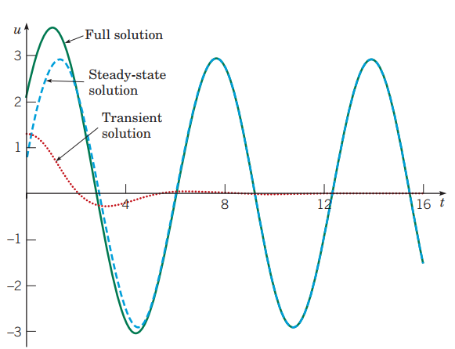
Example 3.8.1 (part three)
The graph breaks the solution into its steady state (U(t)) and transient (u_{c}(t))) components:

Slide 11
Rewriting the Forced Response
Using trigonometric identities, it can be shown that the steady state response:
can be rewritten as
It can also be shown that amplitude and phase can be written as:
where

Slide 12
Forced Response Amplitude vs. Frequency
The amplitude R of the steady state solution
depends on the driving frequency ω. For low-frequency excitation we have
where we recall (ω₀)² = k /m. Note that F₀ /k is the static displacement of the spring produced by force F₀.
For high frequency excitation,

Slide 13
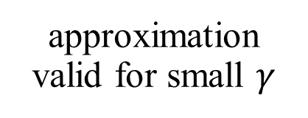
Maximum Amplitude of Forced Response
Summary of frequency effects on amplitude:
At an intermediate value of ω, the amplitude R may have a maximum value. To find this frequency ω, differentiate R and set the result equal to zero. Solving for ω_{max}, we obtain
where (ω₀)² = k /m. Note ω_{max} < ω₀, and ω_{max} is close to ω₀ for small γ. The maximum value of R is
approximation valid for small $γ$

Slide 14
Maximum Amplitude for Imaginary ω_{max}
We have
and
where the last expression is an approximation for small γ.
If γ ² /(mk) > 2, then ω_{max} is imaginary.
In this case the maximum value of R occurs for ω = 0, and R is a monotone decreasing function of ω.
Recall that critical damping occurs when

Slide 15
Resonance
From the expression
we see that R_{max}
for small γ.
Thus for lightly damped systems, the amplitude R of the forced response is large for ω near ω₀.
This is true even for relatively small external forces, and the smaller the γ the greater the effect.
This phenomenon is known as resonance. Resonance can be either good or bad, depending on circumstances. It must be taken into account when designing building structures.

Slide 16
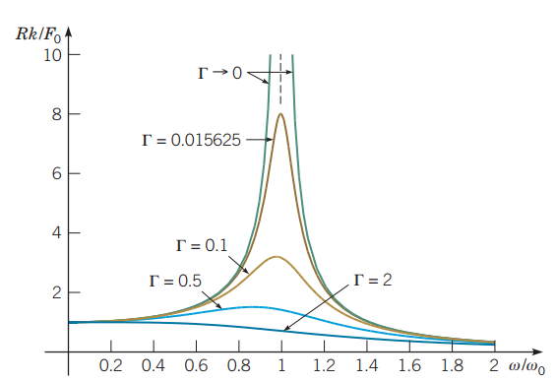
Graphical Analysis of Quantities
To get a better understanding of the quantities we have been examining, we graph the ratios
for several values of.
Note that the peaks tend to get higher as damping decreases.
As damping decreases to zero, the values of Rk/F₀ become asymptotic to ω= ω₀.
The graph corresponding to Г= 0.015625 is included because it appears in the next example.

Slide 17
Analysis of Phase Angle
Recall that the phase angle δ given in the forced response
is characterized by the equations
and they rise and fall together.
For ω = ω₀,
For ω near zero,
and response lags behind the excitation.
For very large ω,
so
and the response is out of phase. That is the response is a minimum when excitation is a maximum.

Slide 18
Example 3.8.2: Forced Vibrations with Damping (part one)
Consider the initial value problem
Show plots of the solution for different values of the forcing frequency ω, and compare them with corresponding plots of the forcing function.
For this systems ω₀ = 1, F₀/k = 3, and
The unforced motion of this system was discussed in Ch 3.7, with the graph of the solution on the next slide, along with the graph of the ratios Rk/F vs. ω/ω₀ for different values of ω.

Slide 19
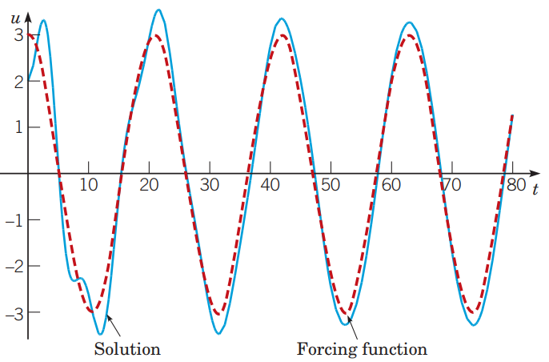
Example 3.8.2: Forced Vibrations with Damping (part two)
Graphs of the solution (solid blue), along with the external forcing function F(t) = 3 cos(0.3𝑡) (dashed red).
𝜔 = 0.3

Slide 20
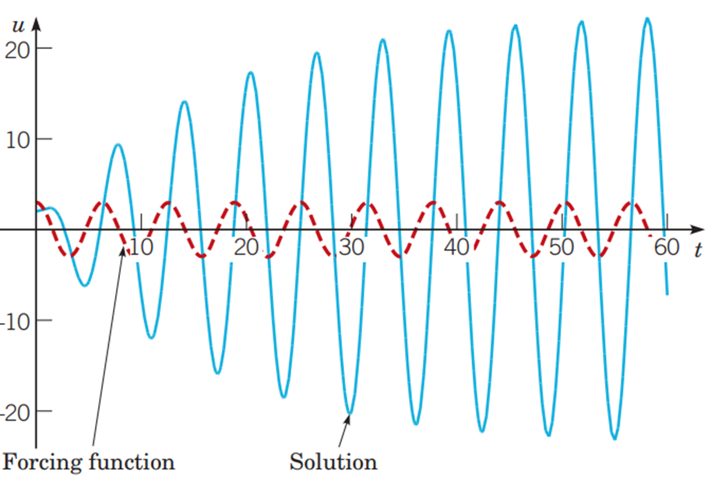
Example 3.8.2: Forced Vibrations with Damping (part three)
Graphs of the solution (solid blue), along with the external forcing function 𝐹(𝑡) = 3 cos(𝑡) (dashed red).
𝜔 = 1.0

Slide 21
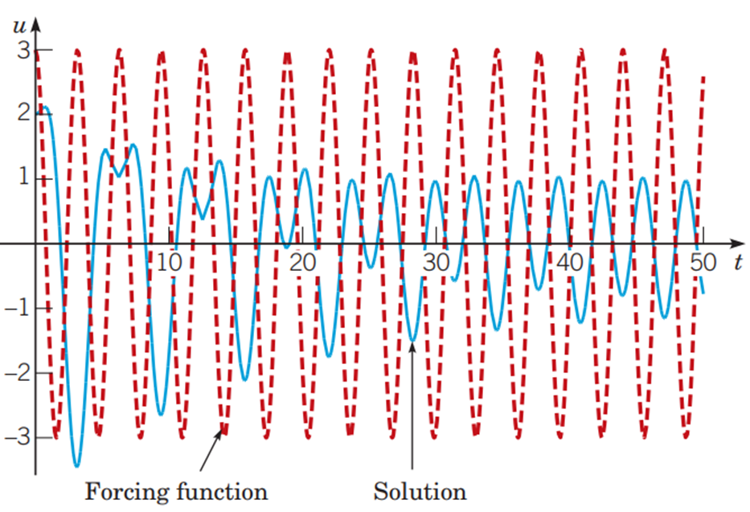
Example 3.8.2: Forced Vibrations with Damping (part four)
Graphs of the solution (solid blue), along with the external forcing function 𝐹(𝑡) = 3 cos(2𝑡) (dashed red).
𝜔 = 2.0

Slide 22
Undamped Equation: General Solution for the Case γ = 0
Suppose there is no damping term. Then our equation is
Assuming ω ≠ ω₀, the method of undetermined coefficients can be used to show that the general solution is

Slide 23
Undamped Equation: Mass Initially at Rest
If the mass is initially at rest, then the corresponding initial value problem is
Recall that the general solution to the differential equation is
Using the initial conditions to solve for c₁ and c₂, we obtain
Hence

Slide 24
Undamped Equation: Solution to Initial Value Problem
To simplify the solution even further, let
and
Then
Using the trigonometric identity
it follows that
and hence

Slide 25
Undamped Equation: Beats
Using the results of the previous slide, the amplitude of motion can be expressed as:
When
then 𝜔₀ + 𝜔 is much greater than |𝜔₀ −𝜔|, and
is oscillating more rapidly than
Thus motion is a rapid oscillation with frequency
but with slowly varying sinusoidal amplitude given by
This phenomenon is called a beat.

Slide 26
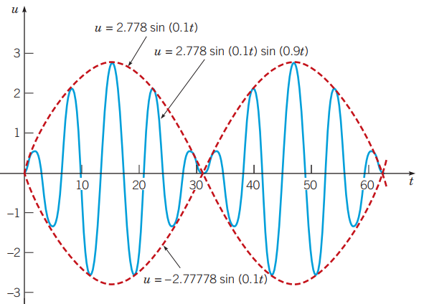
Example 3.8.3: Undamped, Mass Initially at Rest
Solve the initial value problem
In this case,
, and hence the solution is
The spring–mass system displacement oscillates with a frequency of 0.9, slightly less than the natural frequency ω₀= 1.
The amplitude variation has a slow frequency of 0.1 and period of 20 π.
A half-period of 10 π corresponds to a single cycle of increasing and then decreasing amplitude.

Slide 27
Undamped Equation: General Solution for the Case ω₀ = ω
Recall our equation for the undamped case:
If the forcing frequency equals the natural frequency of the system, then the nonhomogeneous term F₀ cos ωt is the solution of homogeneous equation. In this case, the solution is:

Slide 28
Example 3.8.4 (part one)
Solve the initial value problem
And plot the graph of the solution.
The general solution of the differential equation is
And the initial conditions require that c₁ = c₂ = 0. Thus the solution of the given initial value problem is

Slide 29
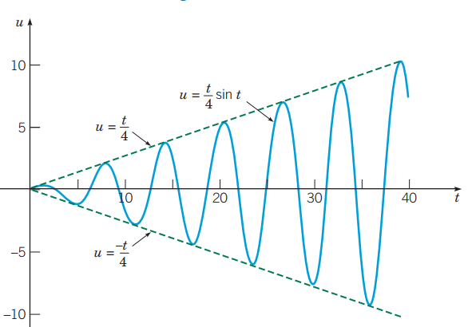
Example 3.8.4 (part two)
A graph of the solution is shown below:
In general, motion u remains bounded if damping is present. However, the response of u to input function F₀ cos ωt may be large if damping is small and
in which case we have resonance.

Slide 30
Copyright
Copyright © 2021 John Wiley & Sons, Inc.
All rights reserved. Reproduction or translation of this work beyond that permitted in Section 117 of the 1976 United States Act without the express written permission of the copyright owner is unlawful. Request for further information should be addressed to the Permissions Department, John Wiley & Sons, Inc. The purchaser may make back-up copies for his/her/their own use only and not for distribution or resale. The Publisher assumes no responsibility for errors, omissions, or damages, caused by the use of these programs or from the use of the information contained herein.

