Slide 1
Elementary Differential Equations and Boundary Value Problems
Twelfth Edition
Boyce
Chapter 2
First-Order Differential Equations
Copyright ©2021 John Wiley & Sons, Inc.

Slide 2
Section 2.3 Modeling with First-Order Differential Equations

Slide 3
Differential Equations Model Physical Systems
Mathematical models characterize physical systems, often using differential equations.
Model Construction: Translate the physical situation into mathematical terms, clearly stating physical principles believed to govern process. Many physical processes will be approximated by differential equations.
Analysis of Model: Solve the equations or obtain a qualitative understanding of the solution. Simplify the model, while preserving physical essentials.
Comparison with Experiment or Observation: Verify the solution and suggest model refinement.

Slide 4
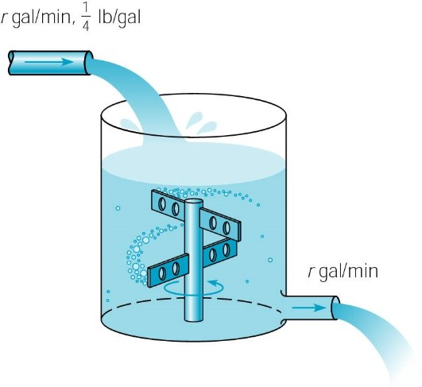
Example 2.3.1: Salt Solution Problem Statement
At time t = 0, a tank contains Q₀ lb of salt dissolved in 100 gal of water. Assume that water containing 0.25 lb of salt/gal is entering tank at rate of r gal/min, and is leaving at same rate.
Set up an IVP that describes this salt solution flow process.
Find the amount of salt Q(t) in tank at any given time t.
Find the limiting amount Q_{L} of salt Q(t) in tank after a very long time.
If r = 3 and Q₀ = 2Q_{L} , find the time t after which salt is within 2% of Q_{L} .
Find flow rate r required if t is not to exceed 45 min.

Slide 5
Example 2.3.1: Define mathematical expressions
At time t = 0, a tank contains Q₀ lb of salt dissolved in 100 gal of water. Assume water containing 0.25 lb of salt/gal enters tank at rate of r gal/min, and leaves at same rate.
Assume salt is neither created nor destroyed in the tank, and that the distribution of salt in tank is uniform (stirred).
Rate in: (0.25 lb salt/gal)(r gal/min) = (r/4) lb/min
Rate out: If there is Q(t) lbs salt in tank at time t, then concentration of salt is Q(t) lb/100 gal, and it flows out at rate of 𝑟𝑄(𝑡)/100 lb/min.
Thus our IVP is

Slide 6
Example 2.3.1: Find Solution Q(t)
To find amount of salt Q(t) in tank at any given time t, we need to solve the initial value problem
To solve, use integrating factor
to give general solution:
Using initial condition Q(0) = Q₀:

Slide 7
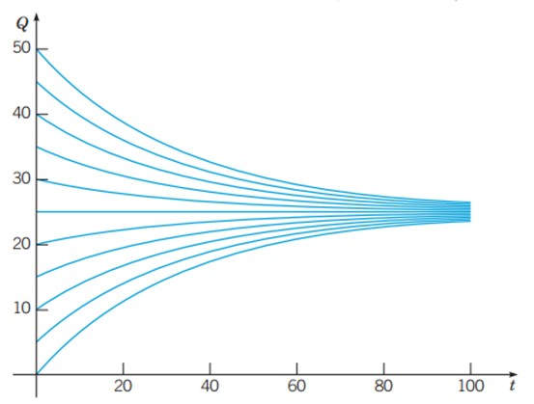
Example 2.3.1: Find the Limiting Amount Q_{L}
Next, we find the limiting amount Q_{L} of salt Q(t) in tank after a very long time:
This result makes sense, since over time the incoming salt solution will replace original salt solution in tank. Since incoming solution contains 0.25 lb salt / gal, and tank is 100 gal, eventually tank will contain 25 lb salt.
The graph shows integral curves for r = 3 and different values of Q₀.

Slide 8
Example 2.3.1: Find Time T of interest
Suppose r = 3 and Q₀ = 2Q_{L} . To find time T after which Q(t) is within 2% of Q_{L} , first note Q₀ = 2Q_{L} = 50 lb, hence
Since 2% of 25 lb is 0.5 lb, we solve:
(round to 1.3 × 10² min for consistency with input data significant figures)

Slide 9
Example 2.3.1: Find the Flow Rate of Interest
To find the flow rate r required if t is not to exceed 45 minutes, recall from part (d) that Q₀ = 2Q_{L} = 50 lb, with
and solution curves decrease from 50 lb to 25.5 lb.
Thus we solve:
(round to 8.7 gal/min for consistency with input data significant figures)

Slide 10
Example 2.3.1: Discussion
Since this situation is hypothetical, the model is valid.
As long as the flow rates are accurate, and the concentration of salt in tank is uniform, then the differential equation is an accurate description of the flow process.
Models of this kind are often used for pollution in lakes, drug concentrations in organs, and similar scenarios.
Flow rates may be harder to determine, or may be variable, and concentration may not be uniform.
Rates of inflow and outflow may not be the same, so variation in the amount of liquid must be taken into account.

Slide 11
Example 2.3.2: Compound Interest
If a sum of money is deposited in a bank that pays interest at an annual rate, r, compounded continuously, the amount of money (S) at any time in the fund will satisfy the differential equation:
The solution to this differential equation, found by separating the variables and solving for S, becomes:
Thus, with continuous compounding, the amount in the account grows exponentially over time.

Slide 12
Example 2.3.2: Effect of the Compounding Period m times per year
In general, if interest in an account is to be compounded m times a year, rather than continuously, the equation describing the amount in the account for any time t, measured in years, becomes:
The relationship between these two results is clarified if we recall from calculus that
Years | S(t)/S(t₀) From Equation (17): m = 4 | S(t)/S(t₀) From Equation (17): m = 365 | S(t)/S(t₀) From Equation (13)
1 | 1.0824 | 1.0833 | 1.0833
2 | 1.1717 | 1.1735 | 1,1735
5 | 1.4859 | 1.4918 | 1.4918
10 | 2.2080 | 2.2253 | 2.2255
20 | 4.8754 | 4.9522 | 4.9530
30 | 10.7652 | 11.0203 | 11.0232
40 | 23.7699 | 24.5239 | 24.5325
The table at right compares the effect of continuous compounding vs. two different compounding periods.

Slide 13
Example 2.3.2: Deposits and Withdrawals
Returning to the case of continuous compounding, suppose that there are deposits or withdrawals in addition to the accrual of interest, dividends, or capital gains. If we assume that the deposits or withdrawals take place at a constant rate k, this is described by the differential equation:
where k is positive for deposits and negative for withdrawals.
We can solve this as a general linear equation to arrive at the solution:
If one opens a retirement account at age 25 and makes annual investments of $2000 thereafter with r = 8%.
At age 65,

Slide 14
Example 2.3.3: Pond Pollution Problem Statement
Consider a pond that initially contains 10 million gallons of fresh water. Water containing toxic waste flows into the pond at the rate of 5 million gal/year, and exits at the same rate. The concentration c(t) of toxic waste in the incoming water varies periodically with time:
c(t) = 2 + sin(2t) g/gal
Construct a mathematical model of this flow process and determine amount Q(t) of toxic waste in pond at time t.
Plot the solution and describe in words the effect of the variation in the incoming concentration.

Slide 15
Example 2.3.3: Define Mathematical Expressions
Assume toxic waste is neither created or destroyed in pond, and distribution of toxic waste in pond is uniform (stirred).
Then
Rate in:
If there is Q(t) g of toxic waste in pond at time t, then concentration of salt is Q(t) lb/10⁷ gal
Rate out:

Slide 16
Example 2.3.3: Include Initial Conditions
Recall from previous slide that
Rate in:
Rate out:
Then initial value problem is
Change of variable (scaling): Let q(t) = Q(t)/10⁶. Then

Slide 17
Example 2.3.3: Solve the Initial Value Problem
To solve the initial value problem
use the integrating factor e^{t/2} to solve the initial value problem and get general solution:
Incorporating initial condition 𝑞(0) =𝑞₀ requires

Slide 18
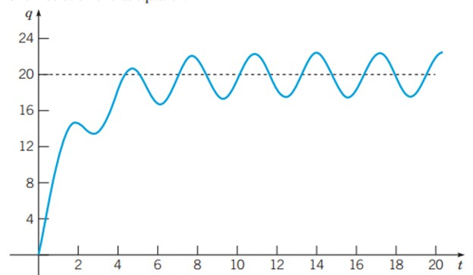
Example 2.3.3: Plot of the Solution
A graph of solution shows that the exponential term is important for small t, but decays for large t.
The expression q = 20 would be equilibrium solution if not for sin(2t) term.

Slide 19
Example 2.3.3: Review of Assumptions Used in the Problem Solution
The amount of water in the pond is controlled entirely by rates of flow, and none is lost by evaporation or seepage into ground, or gained by rainfall, etc.
The amount of pollution in the pond is controlled entirely by rates of flow, and none is lost by evaporation, seepage into ground, diluted by rainfall, absorbed by fish, plants or other organisms, etc.
The distribution of pollution throughout the pond is uniform.

Slide 20
Example 2.3.4: Escape Velocity Problem
A body of mass m is projected away from the earth in a direction perpendicular to the earth’s surface with initial velocity v₀ and no air resistance. Taking into account the variation of the earth’s gravitational field with distance, the gravitational force acting on the mass is given by:
where x is the distance above the earth’s surface, R is the radius of the earth, and g is the acceleration due to gravity at the earth’s surface.
Using Newton’s law F = ma,
Since
cancelling the m’s gives the expression:

Slide 21
Example 2.3.4: Escape Velocity Solution
We can solve the differential equation by separating the variables and integrating to arrive at:
The maximum height (altitude) will be reached when the velocity is zero. Calling that maximum height A_{max}, we have
We can now find the initial velocity required to lift a body to a height A_{max}
and, taking the limit as A_{max}→∞, we get
the escape velocity.
Notice that this does not depend on the mass of the body.

Slide 22
Copyright
Copyright © 2021 John Wiley & Sons, Inc.
All rights reserved. Reproduction or translation of this work beyond that permitted in Section 117 of the 1976 United States Act without the express written permission of the copyright owner is unlawful. Request for further information should be addressed to the Permissions Department, John Wiley & Sons, Inc. The purchaser may make back-up copies for his/her own use only and not for distribution or resale. The Publisher assumes no responsibility for errors, omissions, or damages, caused by the use of these programs or from the use of the information contained herein.

