Slide 1
Elementary Differential Equations and Boundary Value Problems
Twelfth Edition
Boyce
Chapter 2
First-Order Differential Equations
Copyright ©2021 John Wiley & Sons, Inc.

Slide 2
Section 2.1 Linear Differential Equations; Method of Integrating Factors

Slide 3
Definition of First-Order Linear ODE
A linear first-order ODE has the general form
where f is linear in y. Examples include equations with constant coefficients:
or equations with variable coefficients:

Slide 4
Example 2.1.1: Solution by Direct Integration
Solve the linear differential equation:
Notice that the left-hand side of the equation is the derivative of a product:
Using this relationship allows us to re-write the original ODE as:
Which can then be integrated and re-arranged to give the general solution:

Slide 5
Example 2.1.2: Method of Integrating Factors (part one)
If a linear ODE cannot be solved by direct integration, the use of a integrating factor can allow a general solution to be found.
Find the general solution of:
Step One: Multiply the original ODE by a function 𝜇(𝑡) which is yet undetermined:
The function 𝜇(t) is the integrating factor, which is specific to the original ODE and will be determined in Step Two (next slide)

Slide 6
Example 2.1.2: Method of Integrating Factors (part two)
Step Two: Find a 𝜇(𝑡) which permits us to express
as the derivative of a product.
Step Three: Apply the integration factor to the original ODE
General Solution:

Slide 7
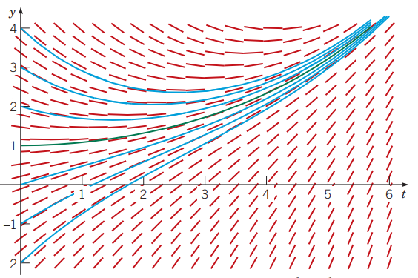
Example 2.1.2: Method of Integrating Factors (part three)
Step Four: Use initial conditions to find the particular solution.
Initial Condition: Solution should pass through (0,1) so 𝑡 = 0 when 𝑦 = 0.
Step Five: Examine families of particular solutions graphically
Figure 2.1.1 Direction field and integral curves for
the green curve passes through initial condition point (0,1).
Figure 2.1.1

Slide 8
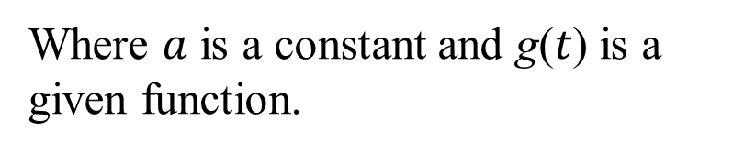
More General Form For Integrating Factors
We can extended the concept of integrating factors to linear ODE’s of the form:
Where $a$ is a constant and g(𝑡) is a given function.
Start with integration factor
and apply it to the ODE above:
General Form Solution:

Slide 9
Example 2.1.3: Application of General Integrating Factor (part one)
plot graphs for several particular solutions, and discuss solution behavior as 𝑡 → ∞.
Step One: Recognize that 𝑎 = −2, so the integrating factor is
Find the general solution to
Step Two: Apply the integration factor and obtain a general solution.
General Solution

Slide 10
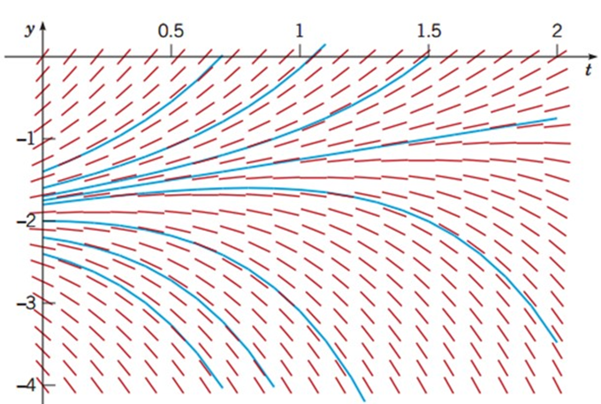
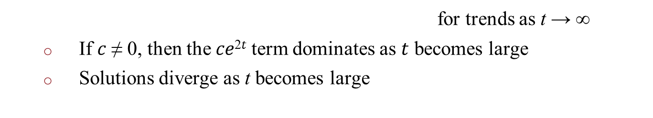
Example 2.1.3: Application of General Integrating Factor (part two)
Step Three: Examine general solution
for trends as t → ∞
If 𝑐 ≠ 0, then the 𝑐𝑒^{2𝑡} term dominates as $t$ becomes large
Solutions diverge as t becomes large
Step Four: Examine initial value condition t = 0, c = 0
Particular (initial value) solution:
Only solution which grows linearly vs. exponentially
Value
separates solutions which grow positively vs. negatively

Slide 11
General From For Integrating Factor Solutions to Linear ODE’s (part one)
We can further extend the concept of integrating factors to linear ODE’s of the form:
Where both 𝑝(𝑡) and 𝑔(𝑡) are given functions.
Apply the integration factor 𝜇(𝑡) to the ODE, then solve for 𝜇(𝑡) in terms of 𝑝(𝑡):

Slide 12
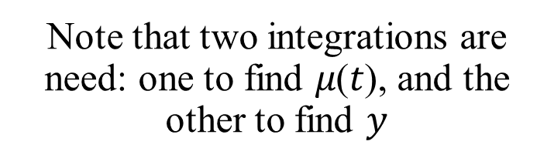
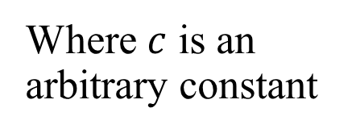
General From For Integrating Factor Solutions to Linear ODE’s (part two)
Now that we have expression 𝜇(𝑡) = 𝑒𝑥𝑝 ∫ 𝑝(𝑡)𝑑𝑡 as an integration factor, we apply it to the original ODE, permitting us to say:
Where $c$ is an arbitrary constant
The general solution can be expressed as:
Note that two integrations are need: one to find 𝜇(𝑡), and the other to find $y$
Where 𝑡₀ is a convenient lower limit of integration.

Slide 13
Example 2.1.4: Application of General Integrating Factor Method (part one)
Solve the initial value problem
Step One: Rewrite the given ODE into the standard form to apply an integrating factor:
Step Two: Compute integration factor 𝜇(𝑡):

Slide 14
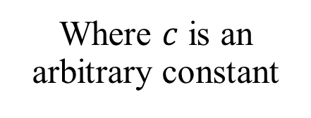
Example 2.1.4: Application of General Integrating Factor Method (part two)
Step Three: Apply the computed integration factor 𝜇(𝑡) = 𝑡²:
Where $c$ is an arbitrary constant
For 𝑡 > 0, we have the general solution:
The value of c will depend on initial conditions.

Slide 15
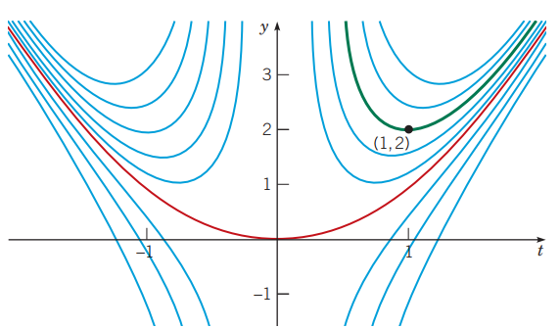
Example 2.1.4: Application of General Integrating Factor Method (part three)
Step Four: Apply initial conditions 𝑡 = 1, 𝑦 = 2 to find a particular solution and examine solution behavior for other particular solutions.
If 𝑦 = 2 when 𝑡 = 0, then 2 = 1 + 𝑐, so 𝑐 = 1 ⇛
Integral curves of t𝑦′ + 2𝑦 = 4𝑡²; where the green curve is the particular solution with 𝑦(1) = 2; the red curve is the particular solution with 𝑦(1) = 1.
Figure 2.1.3

Slide 16
Example 2.1.5: A Solution in Integral Form (part one)
Solve the initial value problem
where 𝑦(0) = 1.
Step One: Rewrite the given ODE into the standard form to and compute the integrating factor:
Step Two: Apply the integration factor and find a general solution:
Use initial condition 𝑡 = 0 for lower integration limit
⇓
General Solution

Slide 17
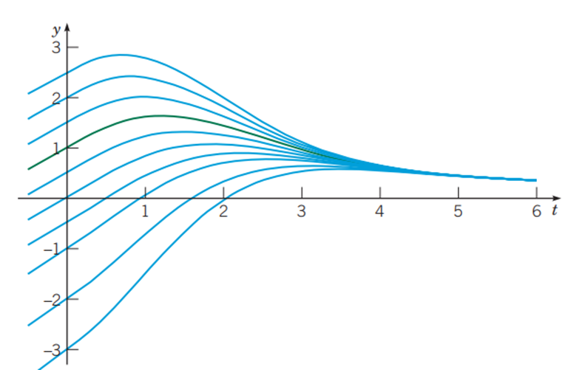
Example 2.1.5: A Solution in Integral Form (part two)
Step Three: Use initial conditions to find a particular solution
Integral must be solved via numerical methods
Integral curves for 2𝑦′ + 𝑡𝑦 = 2; the green curve is the particular solution satisfying the initial condition 𝑦(0) = 1.
Figure 2.1.4

Slide 18
Copyright
Copyright © 2021 John Wiley & Sons, Inc.
All rights reserved. Reproduction or translation of this work beyond that permitted in Section 117 of the 1976 United States Act without the express written permission of the copyright owner is unlawful. Request for further information should be addressed to the Permissions Department, John Wiley & Sons, Inc. The purchaser may make back-up copies for his/her own use only and not for distribution or resale. The Publisher assumes no responsibility for errors, omissions, or damages, caused by the use of these programs or from the use of the information contained herein.

