Slide 1
Insights
File created on: 12/16/2020 5:34:37 PM

Slide 2
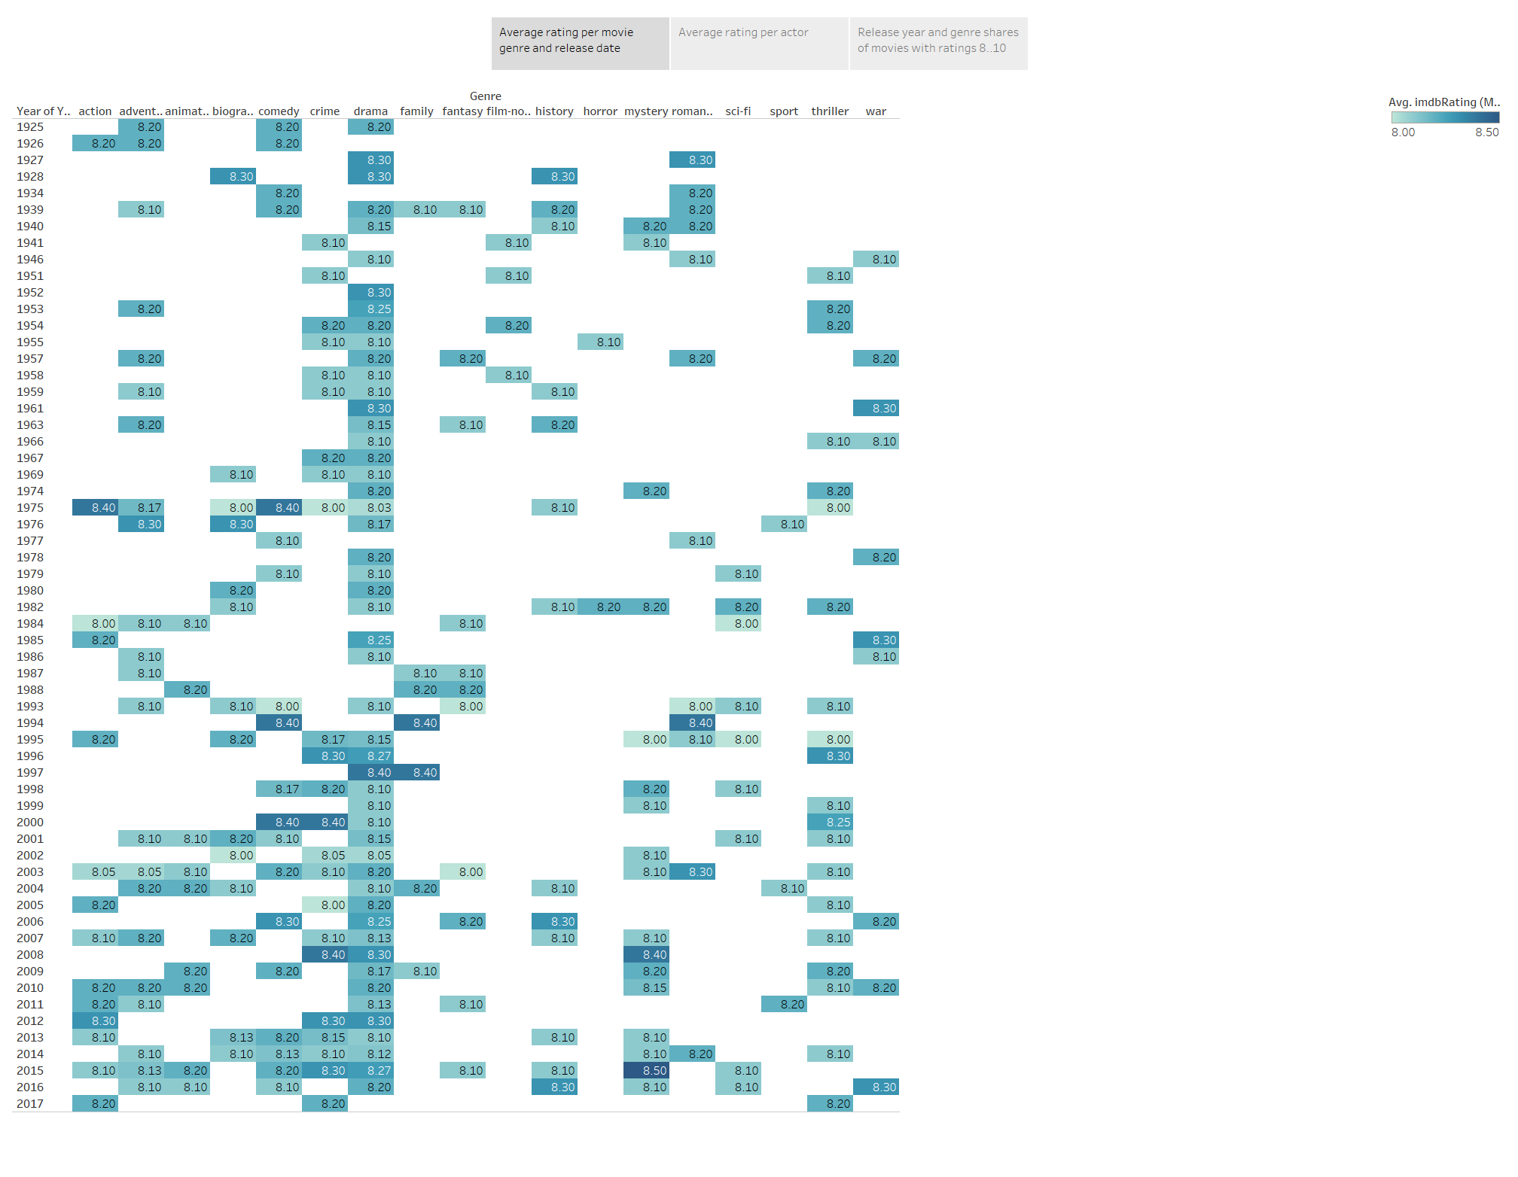

Slide 3
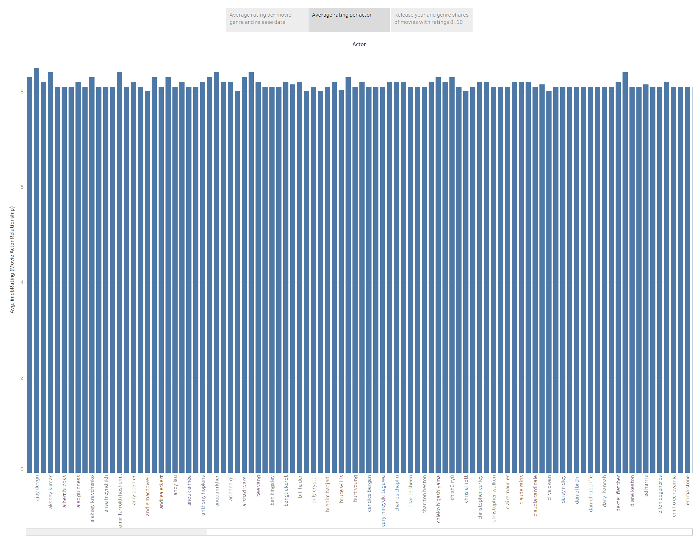

Slide 4
