Slide 1
Prediction of Accident Severity & Pattern Extraction
DAYANANDA CHALLA

Slide 2
Problem Statement
Build a model (i.e. a classifier) to predict the severity of the accident, given the characteristics of the accident, such as driver behavior and attributes of vehicle, highway and environment characteristics.
Recognize the key factors that influence accident severity with the help of patterns obtained from the aforementioned data

Slide 3
Solution
Multi-class classifier
Rules extraction

Slide 4
End users
Various Government Departments/Authorities like Police, R&B and Transport
The results of analysis and modelling can be used by these Departments to take appropriate measures to reduce accident impact and thereby improve traffic safety.
Insurance firms
It is also useful to the Insurers In assessing the claims made and better underwriting as well as rate making

Slide 5
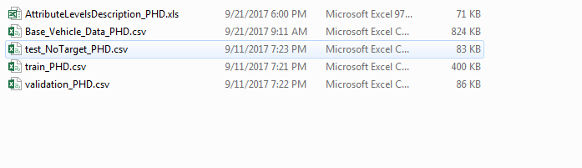
Overview of the dataset

Slide 6

Training data
Policing Area
Collision Severity
Weekday of Collision
Day of Collision
Month of Collision
Speed Limit
Junction Detail
Junction Control
Light Conditions
Weather Conditions
Road Surface Conditions..etc.,
Rows
8562
Columns
17

Slide 7
Test data
Rows
1835
Columns
17

Slide 8
Validation/unseen data
Rows
1834
Columns
16

Slide 9
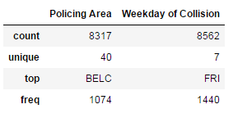
Exploring categorical variables

Slide 10
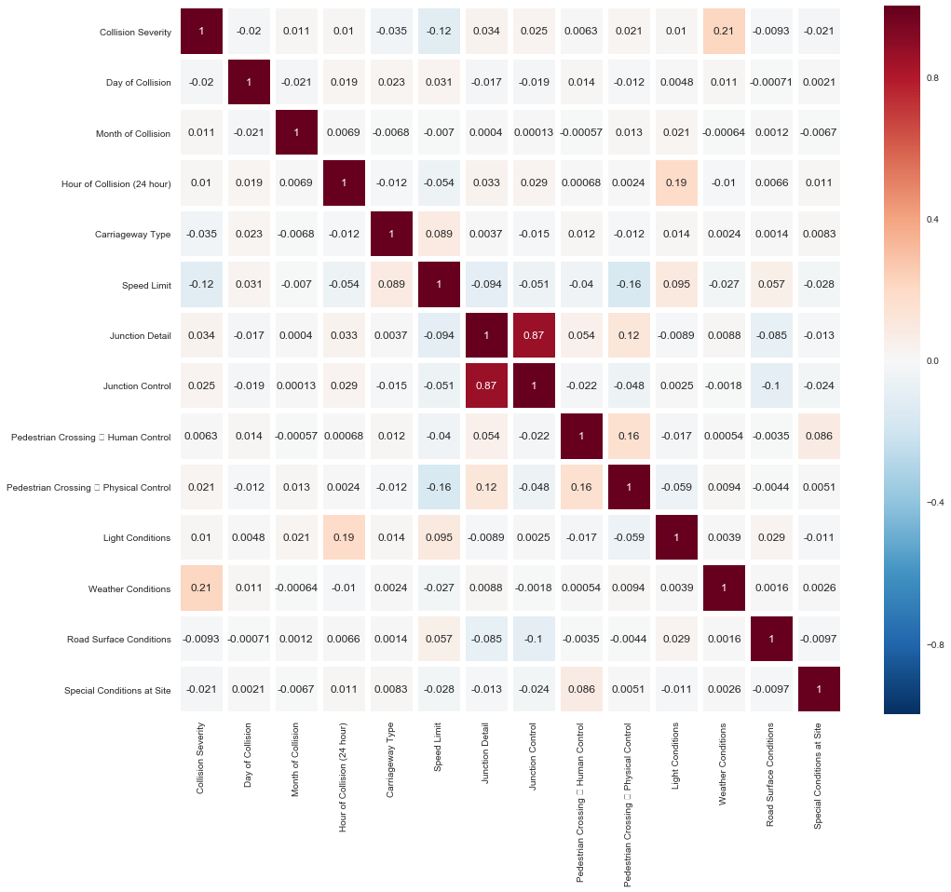
Correlation Analysis (numerical)

Slide 11
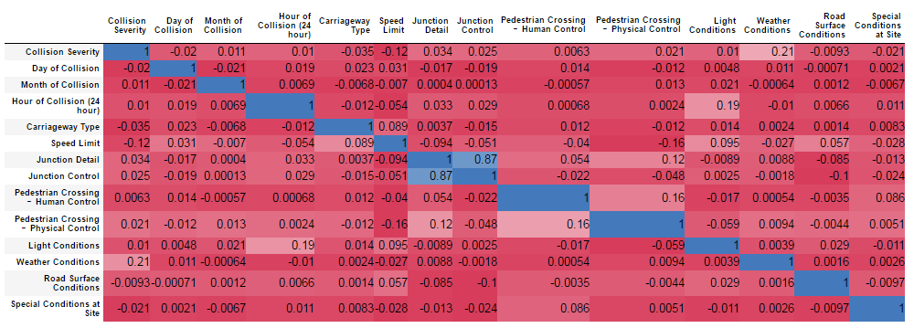
Contd..

Slide 12
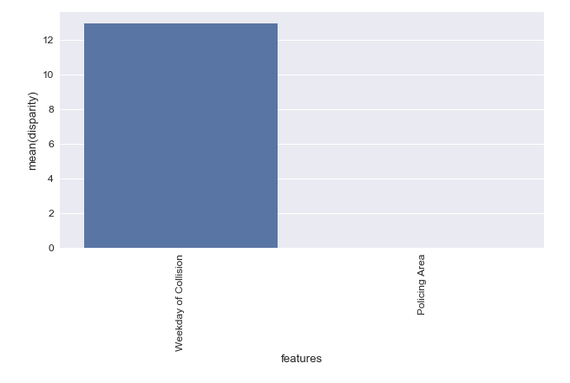
Correlation Analysis(Categorical)

Slide 13
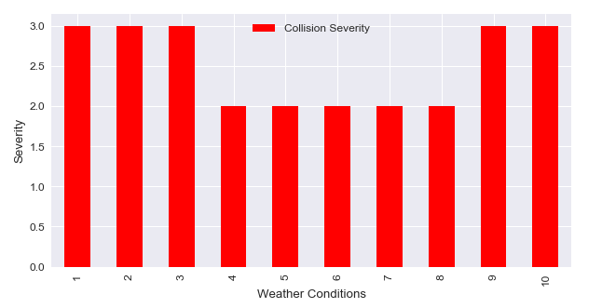
Weather Conditions

Slide 14
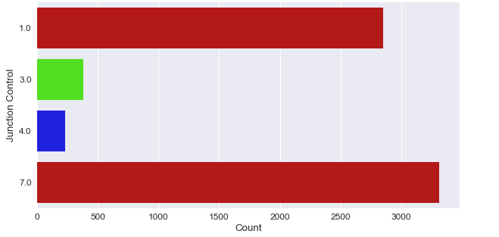
Junction Control

Slide 15
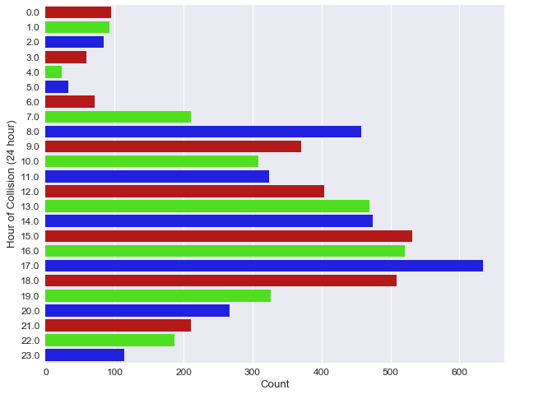
Hour of collision

Slide 16
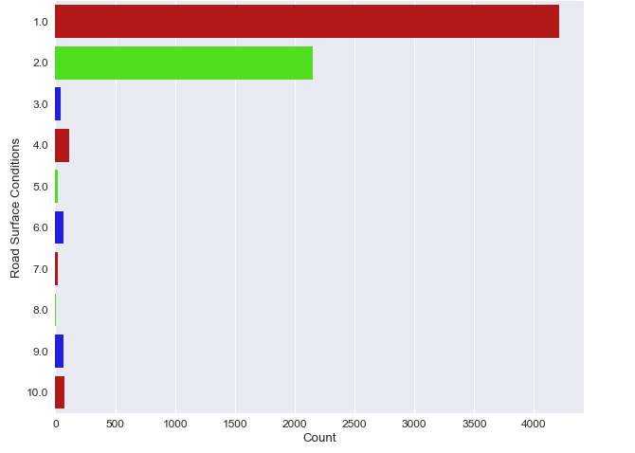
Road surface

Slide 17
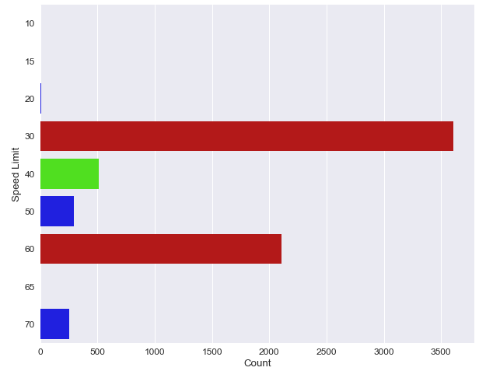
Speed Limit

Slide 18
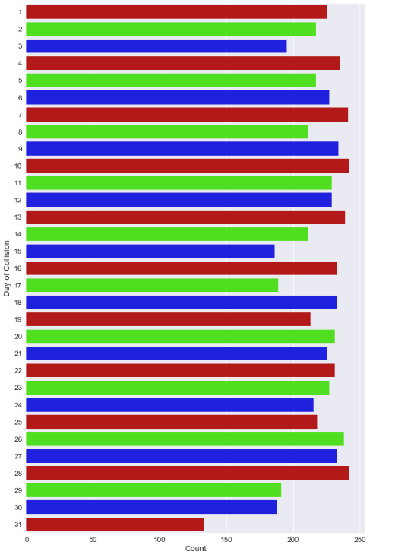
Day of collision

Slide 19
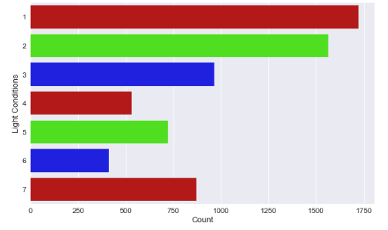
Light conditions

Slide 20
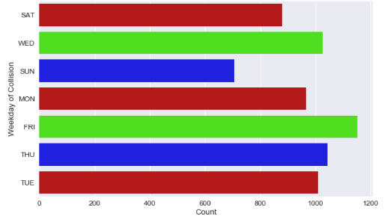
Weekday of collision

Slide 21
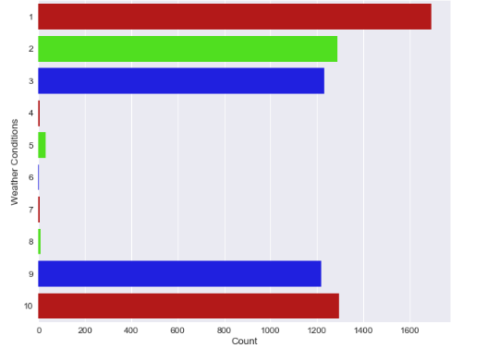
Weather conditions

Slide 22
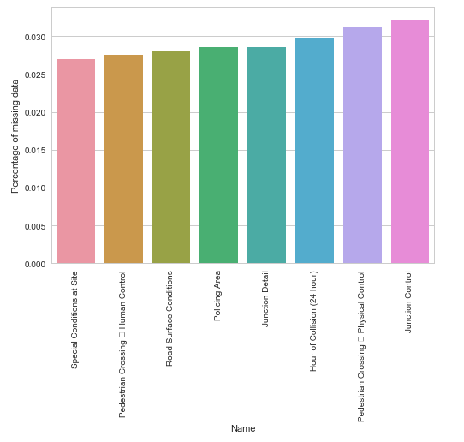
Missing value analysis

Slide 23
Impute or not?

Slide 24
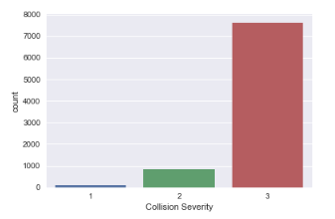
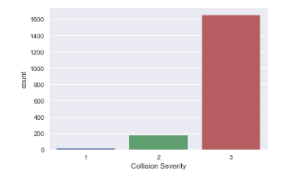
Distribution of class labels

Slide 25
Handling imbalance
SMOTE
SMOTE with over sampling
Random sampling
SMOTE with svm

Slide 26
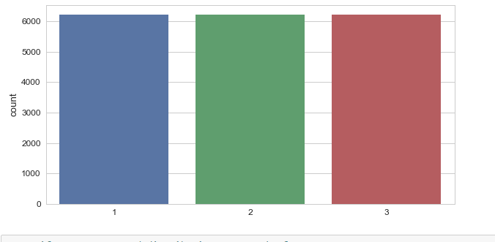
Class balance after Oversampling

Slide 27
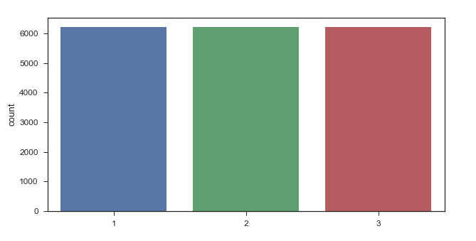
Class balance after Random oversampling

Slide 28
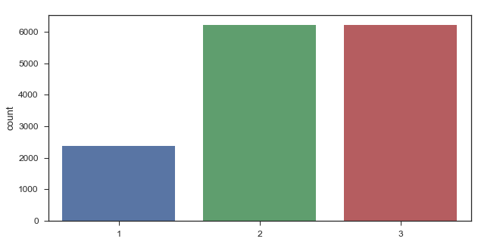
Class balance after SMOTE with SVM

Slide 29
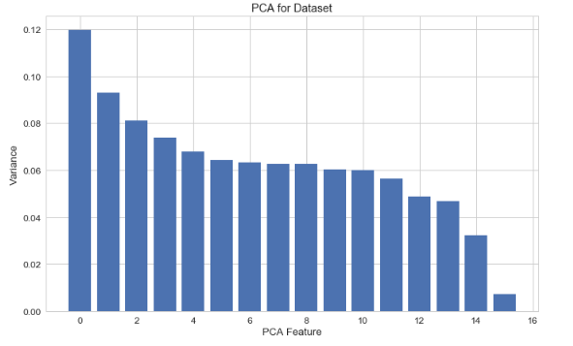
Features with PCA

Slide 30
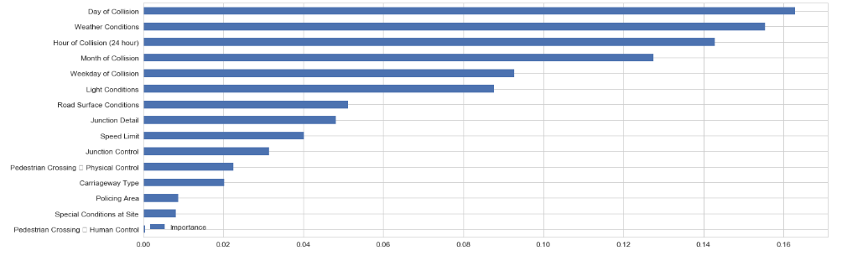
Features with Random forest

Slide 31
Preprocessing Techniques
Converting target variable into Factor
Remove unnecessary attributes i.e., ID
Convert the categorical variables into

Slide 32
Classification Models Used
Logistic regression
Random forest
Naive Bayes
Stochastic gradient
Linear SVC
Decision Tree
Gradian Boosting trees
Multilayer perceptron classifier
KNN classifier

Slide 33
How to find the tuning parameters?
RandomizedSearchCV
Top 5 models

Slide 34
Results (Imbalanced data)

Slide 35
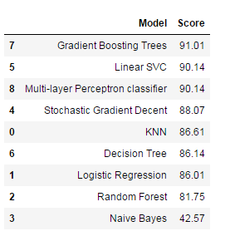
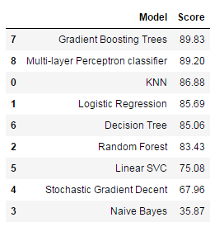
Accuracy scores

Slide 36
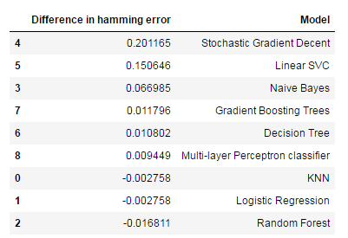
Difference between train and test error

Slide 37
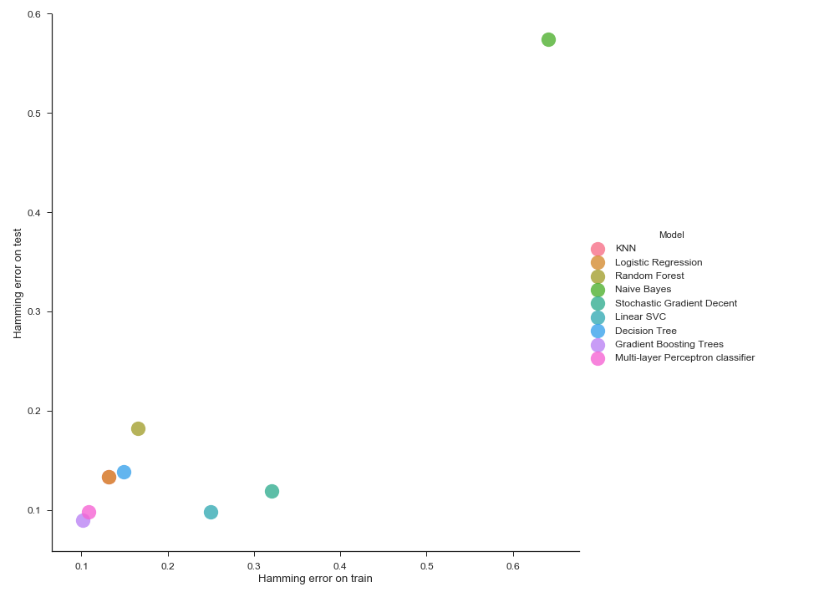
Contd..

Slide 38
Results (SMOTE Oversampling)

Slide 39
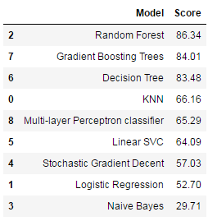
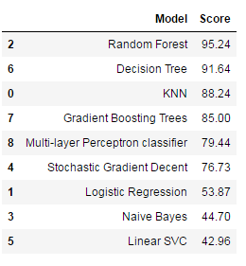
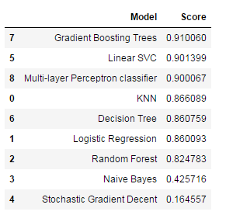
Accuracy scores

Slide 40
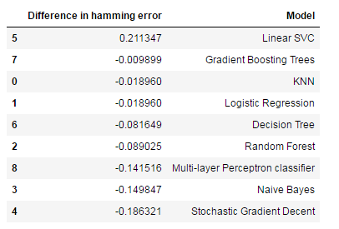
Difference between train and test error

Slide 41
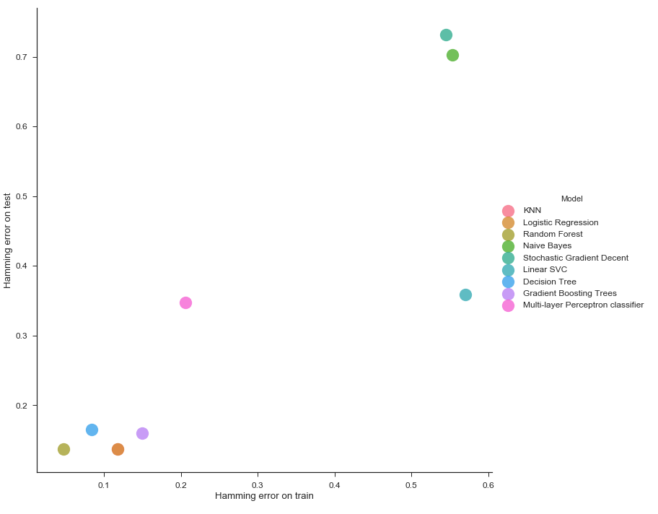
Contd..

Slide 42
Results (Random Oversampling)

Slide 43
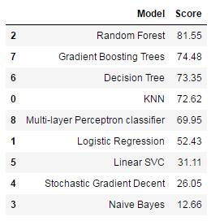
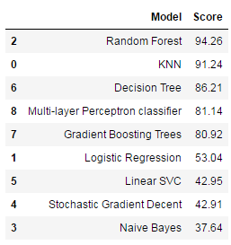
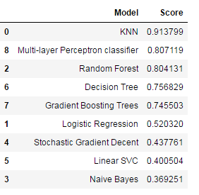
Accuracy scores

Slide 44
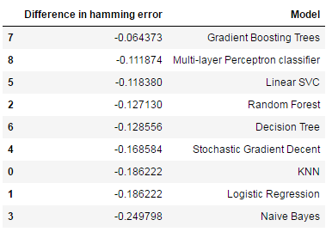
Difference between train and test error

Slide 45
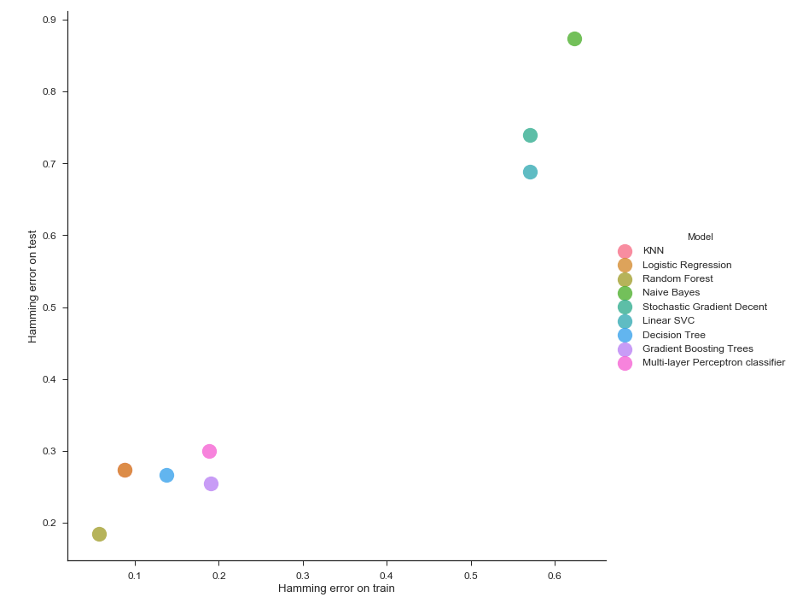
Contd..

Slide 46
Results (SOMTE Using svm)

Slide 47
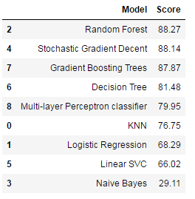
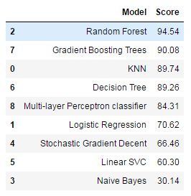
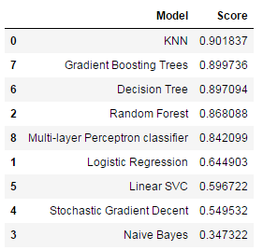
Accuracy scores

Slide 48
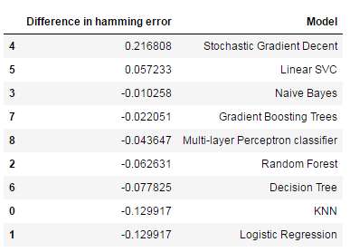
Difference between train and test error

Slide 49
Challenges
Time needed to find pruning values of models
SMOTE was not appropriate

Slide 50
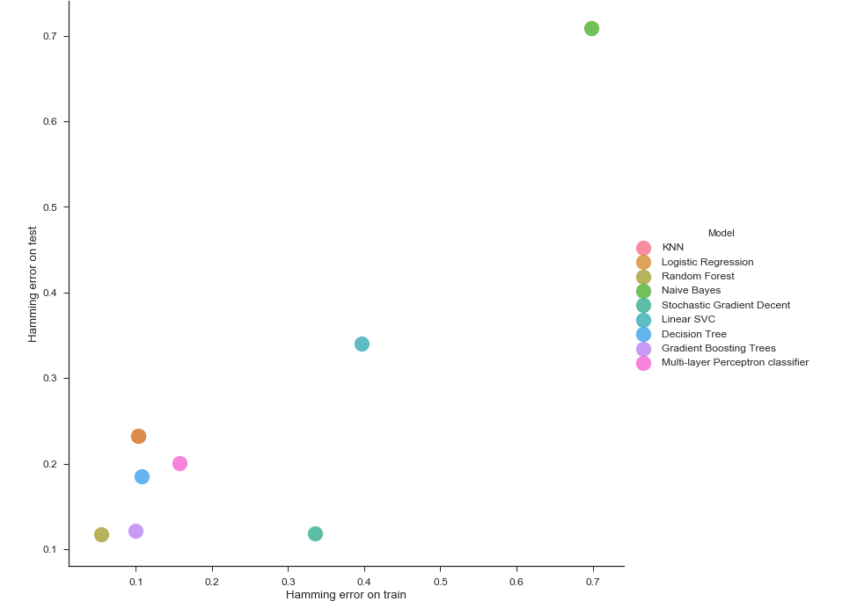
Contd..

Slide 51
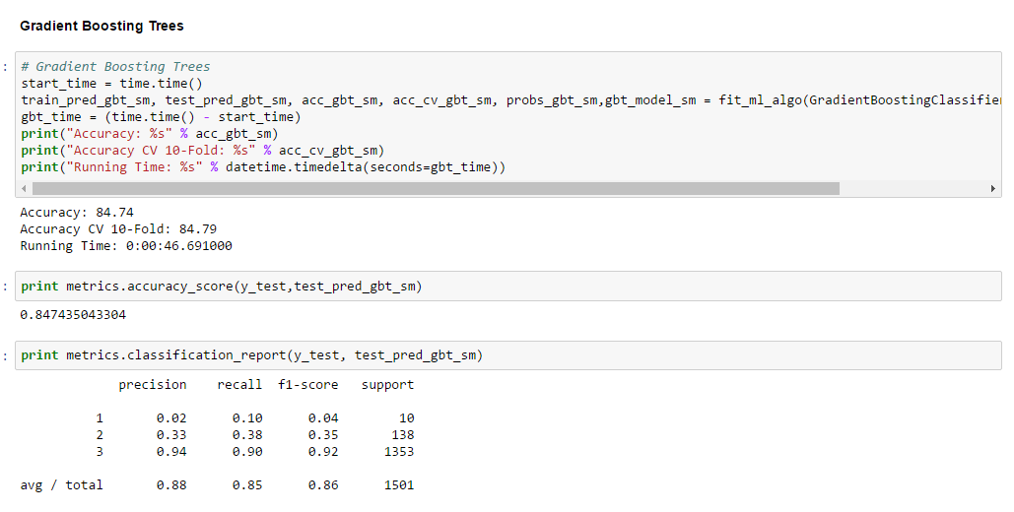
Results (SMOTE)

Slide 52
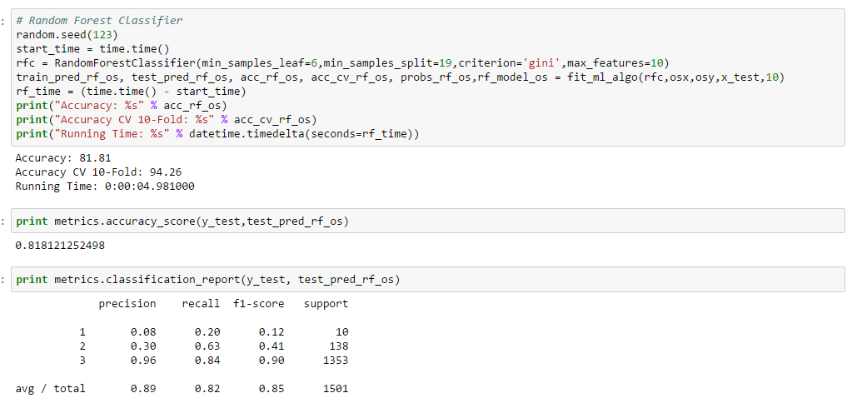
Results(Random Oversampling)

Slide 53
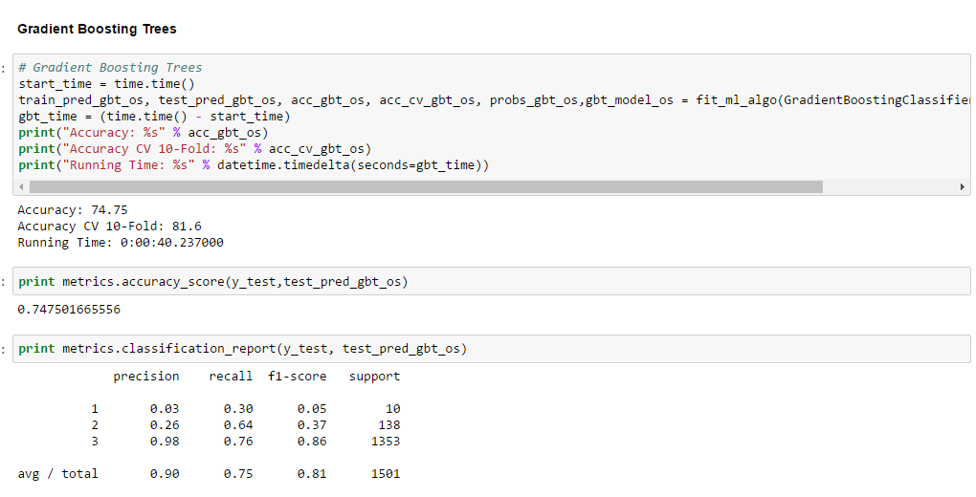
Contd..

Slide 54
Rule extraction
For rules extraction, the levels of attributes of base vehicle data has been reduced by dropping the extra levels.
For each of the attribute with more than 6 six levels, levels have been reduced to six by categorizing the common levels into one with the help of intuition.

Slide 55
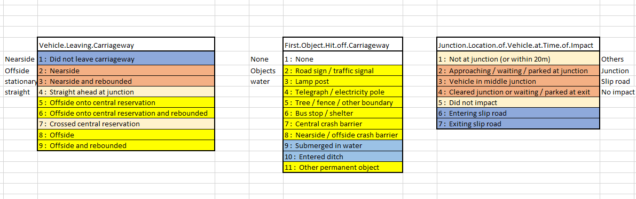
Dropping levels

Slide 56
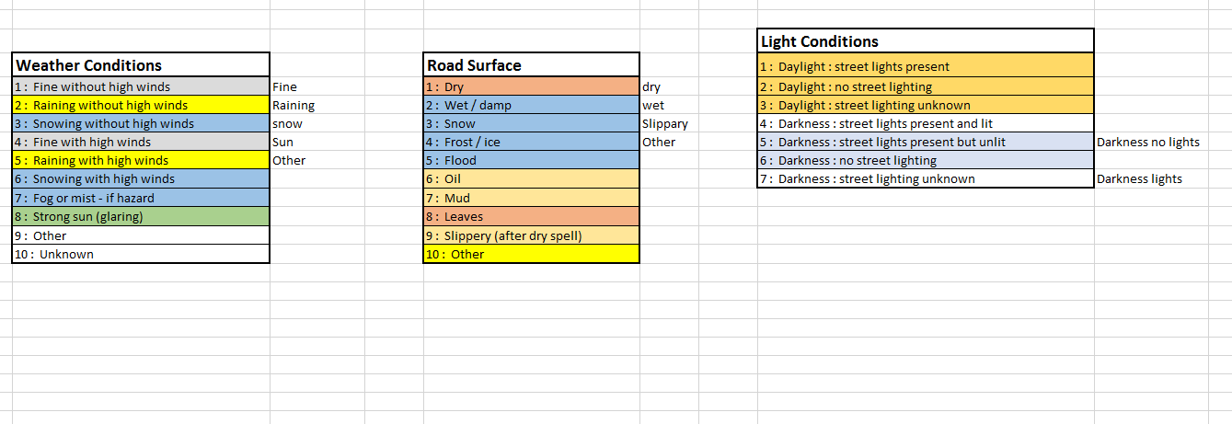
Contd..

Slide 57
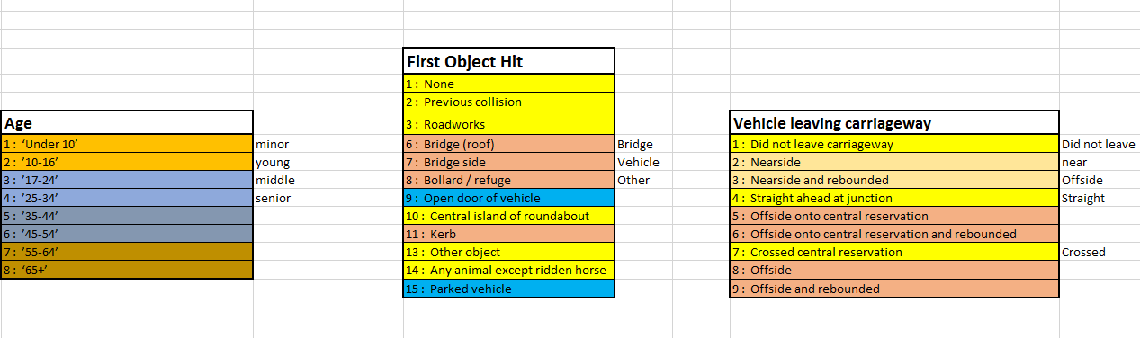
Contd..

Slide 58
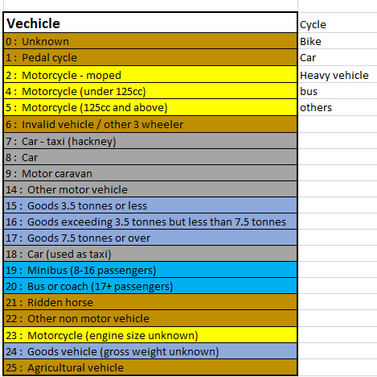
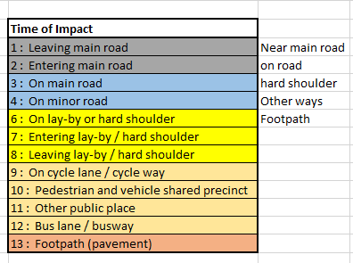
Contd..

Slide 59
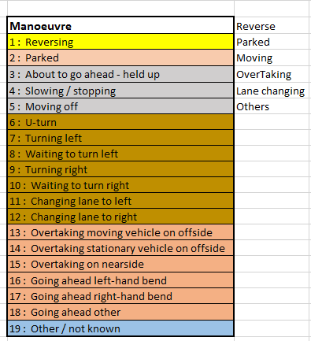
Contd..

Slide 60
Process
Common data from train_PHD and Base_Vehicle_Data_PHD has been obtained by joining the data sets with the help of collision reference number
Dummify all the columns by converting them into factors
Aggregate the data for each level of the attributes
Add the dataset to train and vehicle collision
Convert the observations into transaction
Apply apriori algorithm to get the rules
Obtain the rules with a threshold on lift, confidence and support

Slide 61
Future work
Implement neural networks
Using stacking to increase the predictive power of the model
Find a better approach to deal with multiclass imbalance
Try other methods of SMOTE

Slide 62
Q&A

Slide 63
Thank you

