Slide 1
POPULARITY PREDICTION ALGORITHM (PPA) FOR APTSTORE
CSN 505 | PROJECT LAB
Department of CSE, IIT Roorkee
(2020-2021)
Presented To –
Dr. Durga Toshniwal,
Professor,
IIT Roorkee
Presented By –
Dayanand Raut,
M. Tech. CSAE,
Enrollment No. : 20535010

Slide 2
CONTENTS
Problem Statement
Introduction
Algorithm
Implementation Details
Simulation of Input Data
Result
Visualization of Result
Conclusion
Repository
Reference

Slide 3
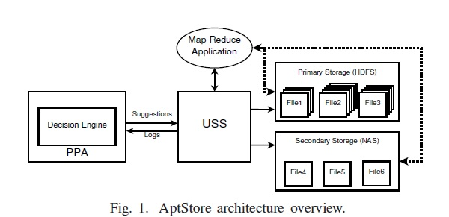
PROBLEM STATEMENT
In AptStore, a decision engine (DE) uses an algorithm to predict the expected popularity of files for the next reference time(RT) in the Hadoop cluster. This algorithm is called a popularity prediction algorithm (PPA). Based on the predicted popularity score of the files, DE can suggest USS on which files are to be kept in the primary storage and which ones to be kept in the secondary storage. It also gives insight to decide which files are to be replicated more and for which files replication is to be avoided. This decision helps in improving the i/o throughput as well as reducing the storage cost. Implement PPA which will predict the expected popularity of files using their initial popularity, access intervals, number of blocks and load in the cluster.

Slide 4
INTRODUCTION
Typical Hadoop setups employ Direct Attached Storage (DAS) with compute nodes and uniform replication of data to sustain high I/O throughput and fault tolerance.
However, not all data is accessed at the same time or rate. Thus, if a large replication factor is used to support higher throughput for popular data, it wastes storage by unnecessarily replicating unpopular data as well.
Conversely, if less replication is used to conserve storage for the unpopular data, it means fewer replicas for even popular data and thus lower I/O throughput.
Is there a way to improve overall I/O throughput while reducing storage cost?

Slide 5
AptStore : Dynamic Storage Management for Hadoop
AptStore is a dynamic data management system for Hadoop, which aims to improve overall I/O throughput while reducing storage cost.
A tiered storage is designed that uses the standard Direct Attached Storage (DAS) (primary storage) for popular data to sustain high I/O throughput, and network attached storage (NAS) (secondary storage) for cost-effective, fault-tolerant, but lower-throughput storage for unpopular data.
To determine how popular a file is, an algorithm is needed that can analyze the file system audit logs and predict the popularity of file. This is done by using a file popularity prediction algorithm (PPA). At every RT (Reference time), the PPA analyzes the access pattern for each file and predicts a expected popularity value for it for the next RT

Slide 6
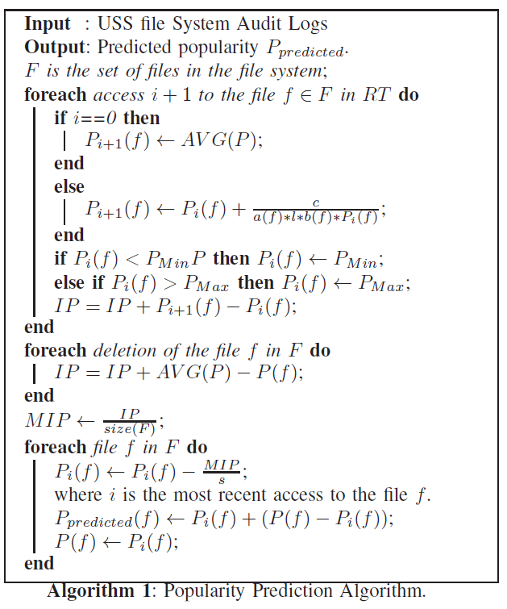

ALGORITHM
The popularity value Pi+1(f) of a file f varies with each access i + 1 to the file. Pi+1(f) is defined as
c: popularity constant
l: load in the cluster
a(f): function of access interval of f
b(f): function of number of blocks of f
s: scalability constant

Slide 7
IMPLEMENTATION DETAILS
Programming Language: Python (python3.8)
Dynamic Programming (Bottom-Up Approach)
def predict_popularity(accessed_files, deleted_files, popularity,block_numbers, l, c, s, Pmin, Pmax):
popularity: dictionary containing initial popularity of files
accessed_files: list of accessed files
deleted_files: list of deleted files
block_numbers: dictionary containing number of blocks in files
P : dictionary of list to store the expected popularity of each access of each file
P[i][f] = expected popularity of file f at ith access
i = len(P[f])-1
For i = 1, P[f][i] = average popularity in the cluster
For i>1, P[f].append( P[f][i] + c / access_interval(f) * l * block_number(f) * P[f][i] )

Slide 8
access_interval(f): the interval between current and last access of f
block_numbers(f): number of blocks in file f
Pred: dictionary to store expected predicted popularity of each file
Assumption: the first access of any file f from the accessed_file is assumed as the creation of file.

Slide 9
SIMULATION OF INPUT DATA
As the actual USS audit logs were not found, input data has been simulated by randomly generating the values for accessed_files, deleted_files, initial popularity, block_numbers
accessed_files[] : list of randomly generated files from 1 to 9 for a random number 14 to 18.
deleted_files[] : list of randomly chosen files from the accessed_files
block_numbers{}: a dictionary that maps random number (1,50) to each unique file of accessed_files
popularity{}: a dictionary that maps random number in the range of Pmin =0.1 to Pmax=0.9 ) each unique file of accessed_files
c = 10000
l = 9
s = 5

Slide 10
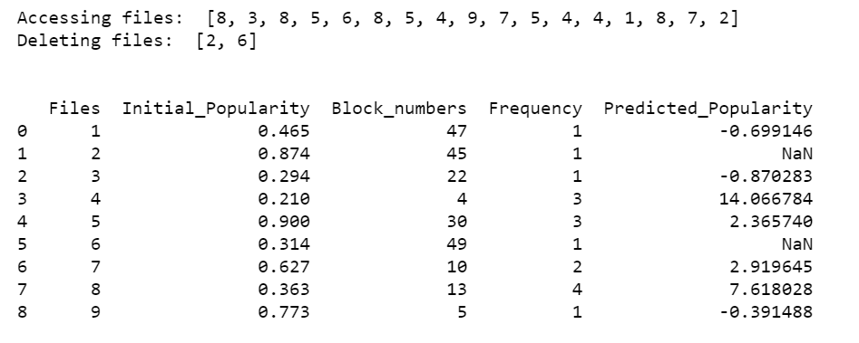
SIMULATED DATA
Files are generated randomly and added to accessed_files list
Some files were chosen randomly from the accessed_files and added to the deleted_files list
Now, for each unique file in accessed_file list, random values for initial popularity and number of blocks are generated

Slide 11
RESULT
File 4 has the highest value for the predicted_popularity as it has comparatively the least number of blocks and it has been accessed comparatively more number of times
Conversely, File 3 has the lowest value for the predicted_popularity as it has comparatively more number of blocks and it has been accessed only once. Also, it’s initial popularity is less.
NaN in Predicted_Popularity column denotes that the file has been deleted.

Slide 12
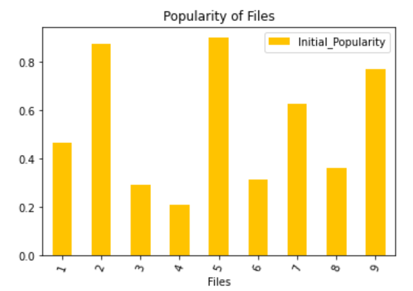
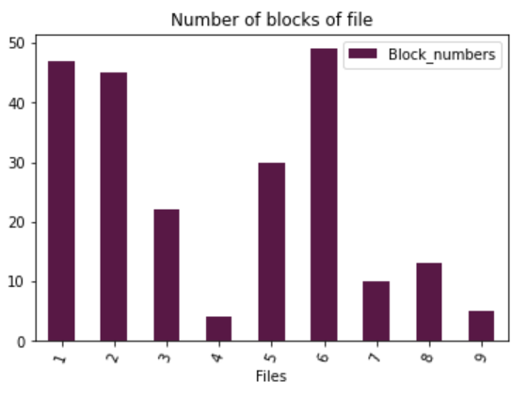
VISUALIZATION OF RESULTS
Initial Popularity of files
Number of blocks in files

Slide 13
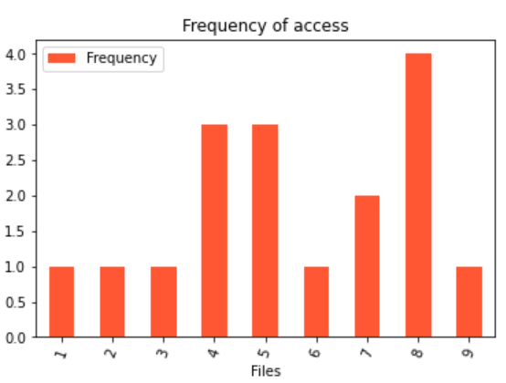
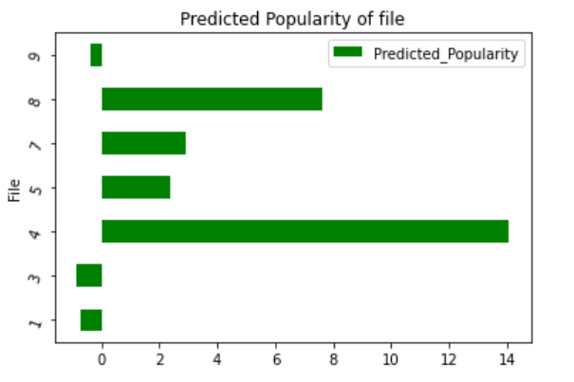
Output: Predicted popularity of files
Number of times files are accessed

Slide 14
CONCLUSION
Hence the file popularity prediction algorithm (PPA) was implemented in python which was able to predict the expected popularity of the files for next reference time based on the initial popularity, access interval, number of blocks, load in the cluster and popularity constant.
The data was simulated randomly and fed to the algorithm to get the result.
The results were explained and represented in the bar graph for better visualization.

Slide 15
REPOSITORY
Source code : https://github.com/dayanandraut/aptstore-popularity-prediction-algorithm
Jupyter Notebook : https://github.com/dayanandraut/aptstore-popularity-prediction-algorithm/blob/main/aptstore_popularity_prediction_algorithm.ipynb

Slide 16
REFERENCES
K. R. Krish, A. Khasymski, A. R. Butt, S. Tiwari and M. Bhandarkar, "AptStore: Dynamic storage management for hadoop," 2013 IEEE International Conference on Cluster Computing (CLUSTER), 2013, pp. 1-5, doi: 10.1109/CLUSTER.2013.6702657.
https://pandas.pydata.org/pandas-docs/stable/reference/api/pandas.DataFrame.plot.bar.html

