Slide 1
How Datawarehouse solving real-life problems

Slide 2
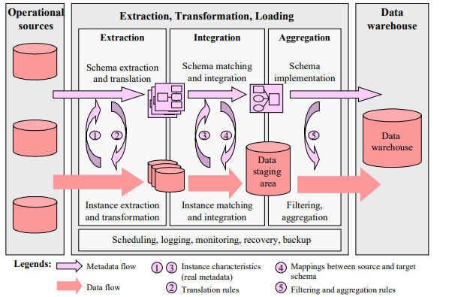

Slide 3
Scalability
- Its very simple and flexible is it to add/remove data sources and get them up and
running to match our business specific needs
- By adding more data sources – which will increase data scale & we can process data at Bulk

Slide 4
Enabling Real-time ETL
- Best Integration
- We can integrate many data sources together with DWH – where it will help us to club
incoming data flow & it gives exposure to load data in Realtime environment

Slide 5
Cost and Performance
- DWH will help us to reduce costing factor as it allows us to merge many sources & supports wide range of DB’s hence performance will also be much better

Slide 6
Security
- In DWH we can manage end-user access and permissions where we can have specific user
accesses to data Thus it will help us to manage security aspect.

Slide 7
OLAP Queries
A multi-pass SQL statement is made up of many smaller SQL statements that sequentially operate on a set of temporary tables,
- A multi-pass SQL statement is made up of many smaller SQL statements that sequentially operate on a set of temporary tables

Slide 8
Use cases :
HDFC Bank - Timely data analysis is being done at banks end
DWH OLAP - Thus at any DWH , multiple DB’s will provide access ML queries it helps us to do OLAP
Amazon Big Billionaire sale: Here too Data analysis is done
Target marketing – Credit card calls : Selected customers will get calls
Walmart Data analysis: In 1992 Walmart did Data analysis & they introduced Sales with Offers, esp during Christmas weeks.

