Slide 1
Rapid Web Development with Python/Django

Slide 2
Why Python?
Written in C – high performance, ability to link to C libraries for extensions
Interpreted script language compiled on the fly into bytecode
Easier to read coding standards – whitespace sensitive
Object Oriented

Slide 3
Introducing…Django
“The framework for perfectionists with deadlines”
MVC
Flexible template language that can be used to generate HTML, CSV, Email or any other format
Includes ORM that supports many databases – Postgresql, MySQL, Oracle, SQLite
Lots of extras included – middleware, csrf protections, sessions, caching, authentication

Slide 4
Django Concepts/Best Practices
DRY Principle – “Don’t Repeat Yourself”
Fat models, thin views
Keep logic in templates to a minimum
Use small, reusable “apps” (app = python module with models, views, templates, test)

Slide 5
Django Project Layout
django-admin.py startproject
<PROJECT_ROOT>
manage.py
<PROJECT_DIR>
__init__.py
settings.py
urls.py
wsgi.py

Slide 6
settings.py
Defines settings used by a Django application
Referenced by wsgi.py to bootstrap the project loading
Techniques for managing dev vs prod settings:
Create settings-dev.py and settings-prod.py and use symlink to link settings.py to the correct settings
Factor out common settings into base-settings.py and import. Use conditionals to load correct settings based on DEBUG or other setting

Slide 7
Sample Settings…
DEBUG = True
TEMPLATE_DEBUG = True
ALLOWED_HOSTS = []
# Application definition
INSTALLED_APPS = (
'django.contrib.admin',
'django.contrib.auth',
'django.contrib.contenttypes',
'django.contrib.sessions',
'django.contrib.messages',
'django.contrib.staticfiles',
)

Slide 8
Django Apps
Reusable modules
django-admin.py startapp <app_name>
Creates stub layout: <APP_ROOT> admin.py models.py templates (directory) tests.py views.py urls.py

Slide 9
Django Models
Defined in models.py
Typically inherit from django.db.models.Model
Example Model:
from django.db import models
class TestModel(models.Model):
name = models.CharField(max_length = 20)
age = models.IntegerField()

Slide 10
Models (cont’d)
Default is to set NOT NULL on all fields. Override by adding null = True to field definition:
name = models.CharField(max_length=20, null = True)
Relationships defined through special field types:
models.OneToOneField(model)
models.ForeignKey(model)
models.ManyToManyField(model)

Slide 11
Models (cont’)
Need Nulls in a Boolean Field? Use models.NullBooleanField()
Set Default value with “default”:
count = models.IntegerField(default = 0)
Use a inner Meta class to define additional options, especially useful for abstract classes:
class TestModel(models.Model):
class Meta:
abstract = True

Slide 12
Model Methods
model.save(self, *args, **kwargs)
model.delete(self, *args, **kwargs)
model.get_absolute_url(self)
model.__str__(self) [Python 3] model.__unicode__(self) [Python 2]
Override with super(MODEL, self).save(*args, **kwargs)

Slide 13
Activating a Model
Add the app to INSTALLED_APPS in settings.py
Run manage.py validate
Run manage.py syncdb
Migrations
Write custom script or manually handle migrations
Use South

Slide 14
Selecting Objects
Models include a default manager called objects
Manager methods allow selecting all or some instances Question.objects.all() Question.objects.get(pk = 1) Use try block, throws DoesNotExist exception if no match Question.objects.filter(created_date__lt = ‘2014-01-01’)
Returns QuerySet

Slide 15
Introspecting Legacy Models
manage.py inspectdb
Cut and paste generated code into models.py – Easy!!

Slide 16
Full Sample
from django.db import models from datetime import datetime
class TimestampedModel(models.Model): created_datetime = models.DateTimeField() updated_datetime = models.DateTimeField() def save(self, *args, **kwargs): if self.id is None: self.created_datetime = datetime.now() updated_datetime = datetime.now() super(TimestampedModel,self).save(*args, **kwargs) class Meta: abstract = True

Slide 17
Full Sample (cont’d)
class Question(TimestampedModel): question_text = models.CharField(max_length = 200)
def __str__(self): return self.question_text

Slide 18
Function vs. Class Views
Django allows two styles of views – functions or class based views
Functions – take a request object as the first parameter and must return a response object
Class based views – allow CRUD operations with minimal code. Can inherit from multiple generic view classes (i.e. Mixins)

Slide 19
Sample – Viewing a List of Questions
Function based:
from .models import Question from django.shortcuts import render_to_response def question_list(request): questions = Question.objects.all() return render_to_response(‘question_list.html’, { ‘questions’:questions})

Slide 20
Quick CRUD Operations with Generic Views
ListView
UpdateView
CreateView
If Model is specified, automagically creates a matching ModelForm
Form will save the Model if data passes validation
Override form_valid() method to provide custom logic (i.e sending email or setting additional fields)

Slide 21
Sample – As Class Based View
from .models import Question from django.views.generic import ListView class QuestionList(ListView): model = Question context_object_name = ‘questions’

Slide 22
Django Templates
Very simple syntax:
variables = {{variable_name}}
template tags = {%tag%}
Flexible – can be used to render html, text, csv, email, you name it!
Dot notation – template engine attempts to resolve by looking for matching attributes, hashes and methods

Slide 23
Question List Template
<!doctype html> <html lang=en> <head> <meta charset=utf-8> <title>List of Questions</title> </head> <body> {%if questions%} <ul> {%for q in questions%} <li>{{q.question_text}}</li> {%endfor%} </ul> {%else%} <p>No questions have been defined</p> {%endif%} </body> </html>

Slide 24
urls.py
Defines routes to send urls to various views
Can use regular expressions
Extract parameters from a url and pass to the view as a named parameter:
r(‘^question/(?P<question_id>\d+)/$’,’views.question_detail’)
Extensible – urls.py can include additional url files from apps: r(‘^question/’,include(question.urls))

Slide 25
Hooking up the Question List
from django.conf.urls import patterns, url, include
urlpatterns = patterns(‘’,
(r’^questions/$’,’views.QuestionList’)
)
OR:
from django.conf.urls import patterns from views import QuestionListView urlpatterns = patterns(‘’, (r’^questions/$’,’views.QuestionList.as_view())
)

Slide 26
Forms in Django
django.forms provides a class to build HTML forms and validation. Example:
from django import forms
class EditQuestionForm(forms.Form): question_text = forms.CharField(max_length = 200)
Often redundant when creating forms that work on a single model

Slide 27
ModelForms
Automatically generate a form from a model.
Handles saving a bound model
Can specify fields to be included or excluded in the form
Sample:
from django.forms import ModelForm from .models import Question class QuestionForm(ModelForm): class Meta: model = Question fields = [‘question_text’]

Slide 28
Using a ModelForm
Create an instance of an empty form: form = QuestionForm()
Create a form to update an existing instance of a model: question = Question.objects.get(pk = 1) form = QuestionForm(instance = question)
Pass the form into the template and use the form methods to render the form: form.as_p form.as_ul form.<field_name> form.<field_name>.errors

Slide 29
Request & Response
Request object encapsulate the request and provide access to a number of attributes and methods for accessing cookies, sessions, the logged in user object, meta data (i.e environment variables),
Response objects are returned to the browser. Can set content type, content length, response does not have to return HTML or a rendered template
Special response types allow for common functionality:
HttpResponeRedirect Http404 HttpStreamingResponse

Slide 30
Django Extras
CRSF Middleware – enabled by default. Include template tag in all forms: {%csrf_token%}
Authentication
Caching
Sessions
Messages
Email
Logging

Slide 31
Authentication
Django’s out of the box Auth system uses database authentication.
Changed extensively in Django 1.6 to allow custom User objects.
AUTHENTICATION_BACKENDS setting in settings.py allows overriding how User objects are authenticated
If using the Authentication middleware and context_processors the current user is available to code as request.user and {{user}} is defined in all templates

Slide 32
Auth Decorators
Live in django.contrib.auth.decorators
login_required @login_required def function_view(request): ….
user_passes_test (can be used with lambda functions for real power) – @user_passes_test(lambda u: u.is_staff) def function_view(request): …
has_perms – test for user permissions

Slide 33
Decorating CBVs
Decorator is applied to the dispatch method
Must be converted to a method_decorator – use django.utils.decorators.method_decorator function:
class MyView(ListView): @method_decorator(login_required) def dispatch(self, *args, **kwargs): super(MyView,self).dispatch(*args, **kwargs)

Slide 34
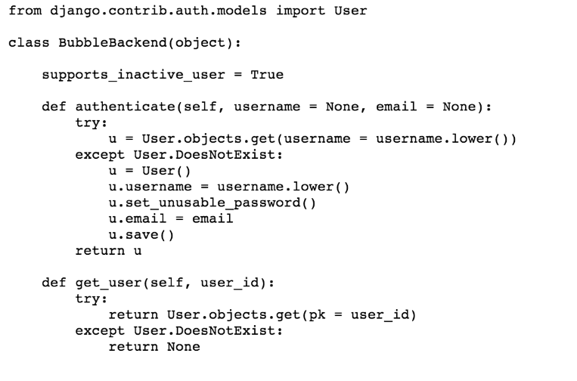
Custom Auth Backend for the Bubble

Slide 35
Sending Email
django.core.mail includes functions and classes for handling email
Set EMAIL_HOST in settings.py to outgoing mailserver
Import send_mail for simple mail: send_mail(subject, message, from, to_emails)
Use django.template.render_to_string to format a message using a template
Use EmailMultiAlternatives to create a text message and attach a html version as well.

Slide 36
Resources
Python – http://www.python.org
Django – http://www.djangoproject.com
Python Packages – https://pypi.python.org
Django Packages – https://www.djangopackages.com

Slide 37
Q & A

