Slide 1
Unit-4 Backtracking, Branch & Bound
CS-402
Analysis & Design Algorithm

Slide 2
Syllabus
Backtracking concept and its examples like 8 queen’s problem, Hamiltonian cycle, Graph coloring problem etc.
Introduction to branch & bound method, examples of branch and bound method like traveling salesman problem etc. Meaning of lower bound theory and its use in solving algebraic problem, introduction to parallel algorithms.

Slide 3
Backtracking

Slide 4
Backtracking
The backtracking approach is generally used in the cases where there are possibilities of multiple solutions.
Backtracking is an algorithmic technique that considers searching in every possible combination for solving a computational problem.
Backtracking is an important tool for solving constraint satisfaction problems, such as crosswords, Sudoku, and many other puzzles.
It is known for solving problems recursively one step at a time and removing those solutions that that do not satisfy the problem constraints at any point of time.
It is a brute force approach that tries out all the possible solutions using depth first search (DFS) and chooses the best possible ones out of them.

Slide 5
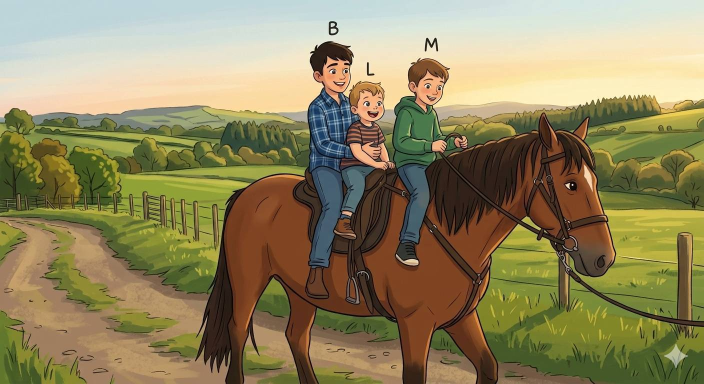
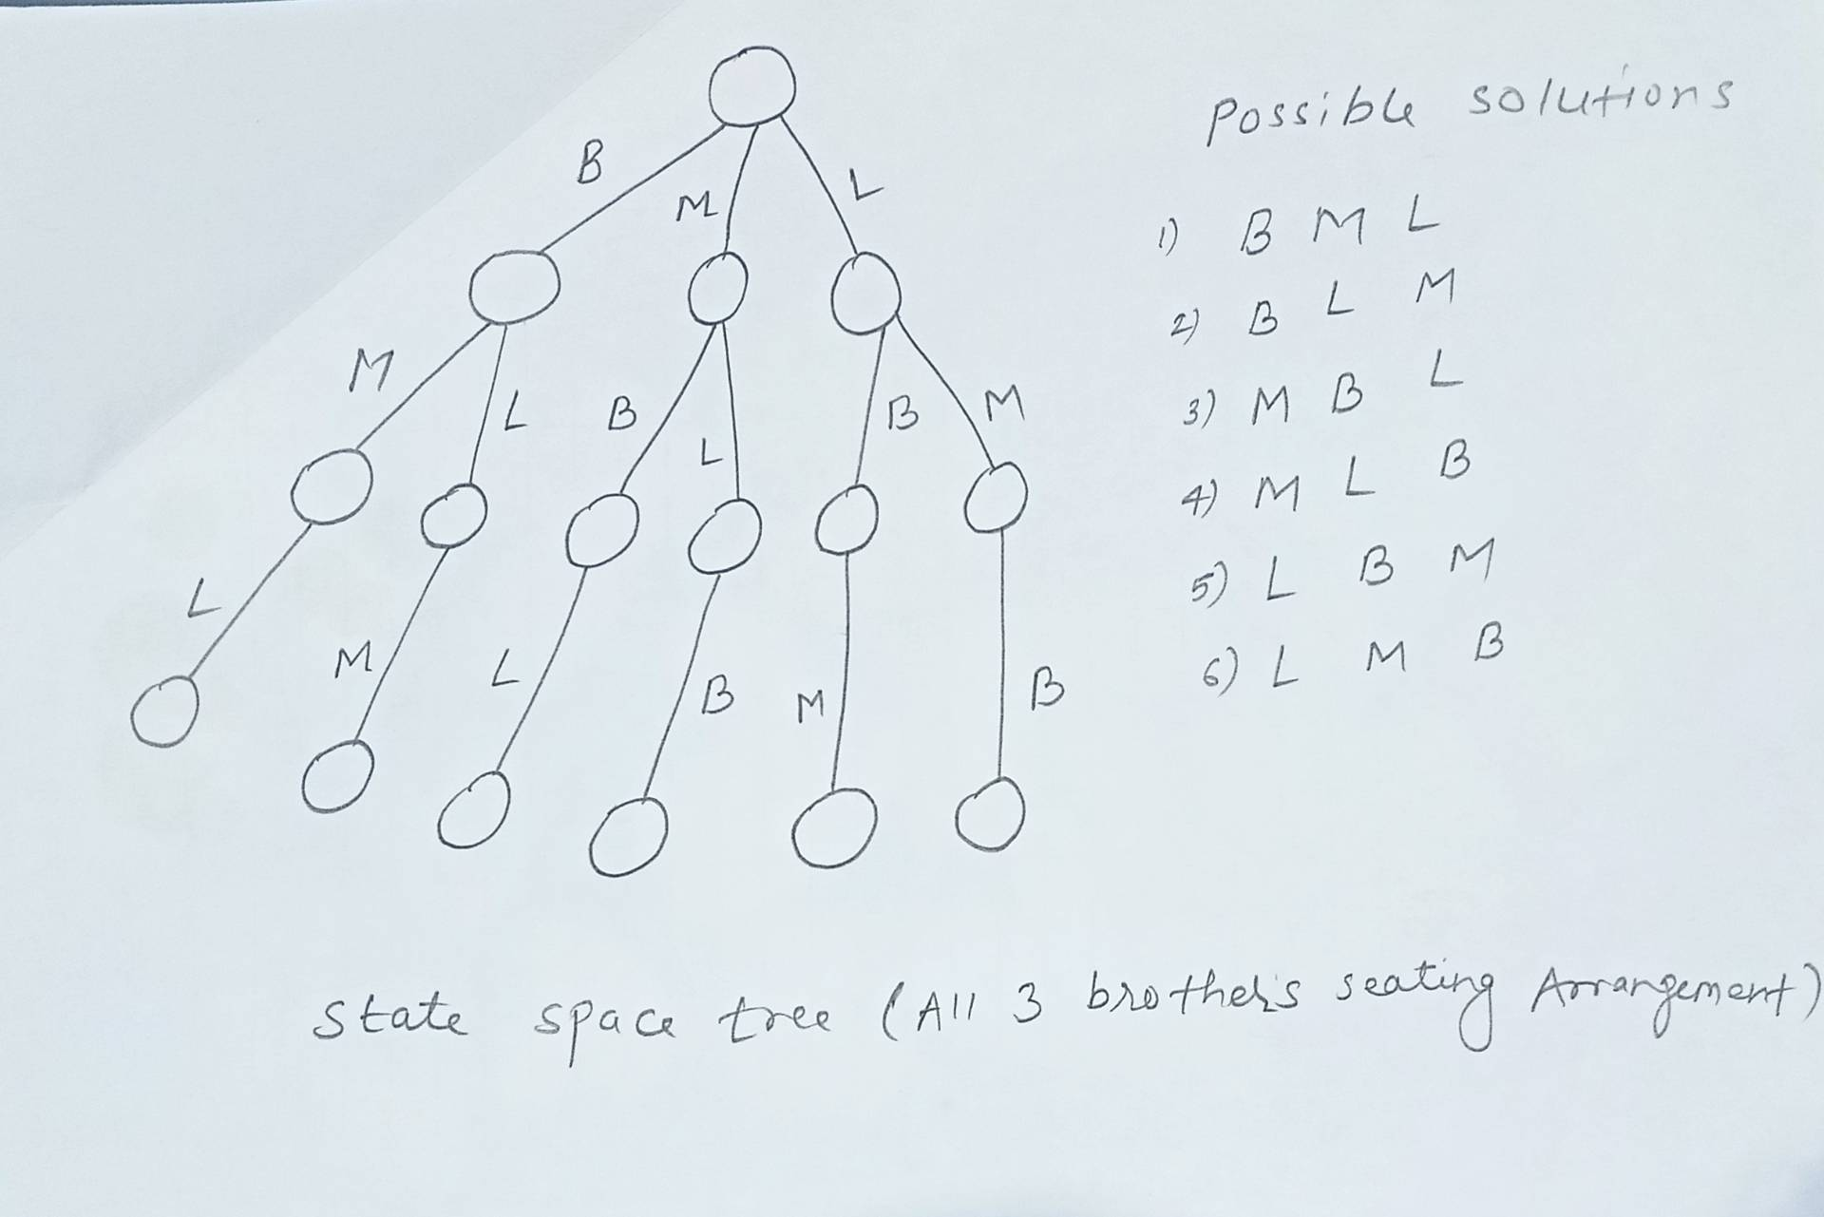
Backtracking
We have three distinct brothers:
B (Big Brother)
M (Middle Brother)
L (Little Brother)
Since there are 3 positions on the horse (Front, Middle, and Back), the total number of unique ways they can sit is 3! (3 factorial): 3 x 2 x 1 = 6

Slide 6
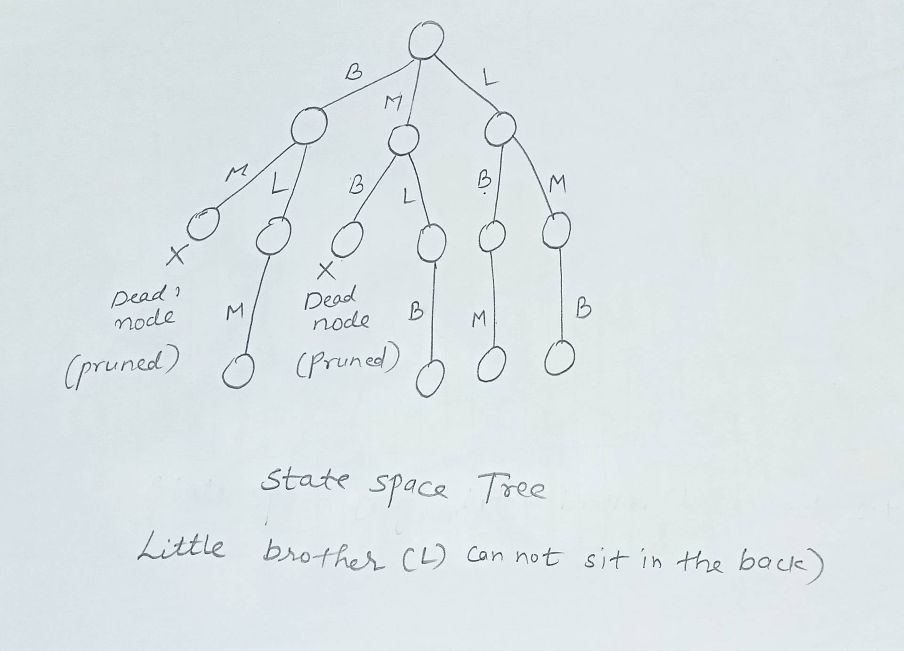
Backtracking
Constraint: Little Brother (L) cannot sit in the back seat,
Now there are exactly 4 valid ways for them to sit.
Total possible seating ways = 6
Ways with L in the back = 2
Valid ways remaining = 4
Invalid Arrangements (Filtered Out)
The algorithm will reject these two options because L is in the back:
[B, M, L] ❌
[M, B, L] ❌

Slide 7
Backtracking helps to solve following computer science problems
The N-Queens Problem (For Example 4-Queens or 8-Queens)
The Hamiltonian Cycle
The Graph Coloring Problem

Slide 8
Backtracking Algorithm: The 4-Queens Problem
Problem: Place 4-Queens into 4x4 chessboard so that no two queens can attack each other means no two queens are on the same row, same column or same diagonal.
Constraints:
Explicit Constraints
Given 4 x 4 chessboard
Where 4 is the no. of queens
1 <= xi <=4
Implicit constraints:
We have to place all the queens in such a way that:
No two queens should be in same row
No two queens should be in same column
No two queens should be in same diagonal
 | 1 | 2 | 3 | 4
1 | - | Q1 | - | -
2 | - | - | - | Q2
3 | Q3 | - | - | -
4 | - | - | Q4 | -
4 x 4 chessboard
One of the solution is: x[2 4 1 3]

Slide 9
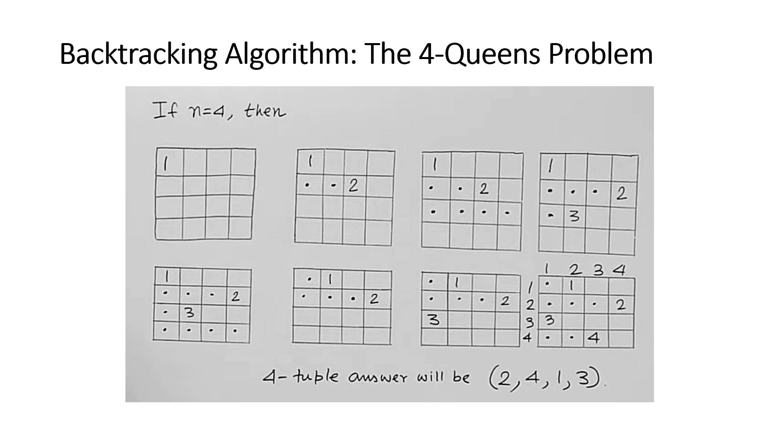

Slide 10
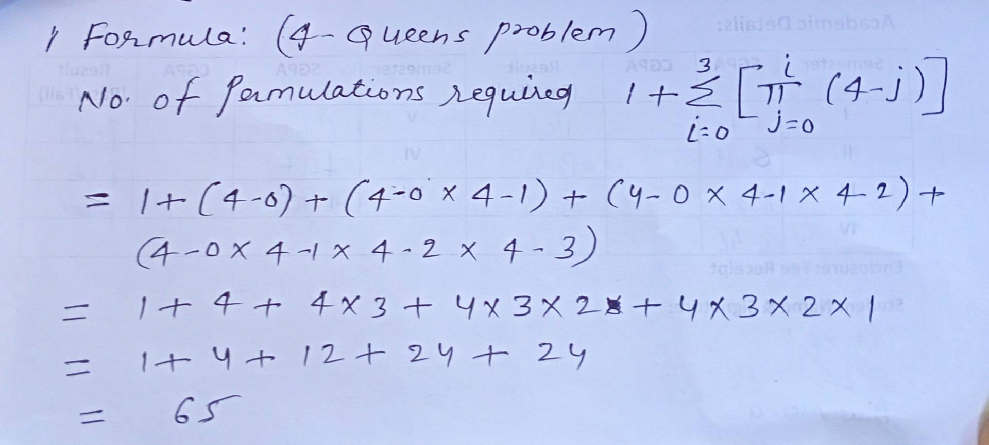
Backtracking Algorithm: The 4-Queens Problem

Slide 11
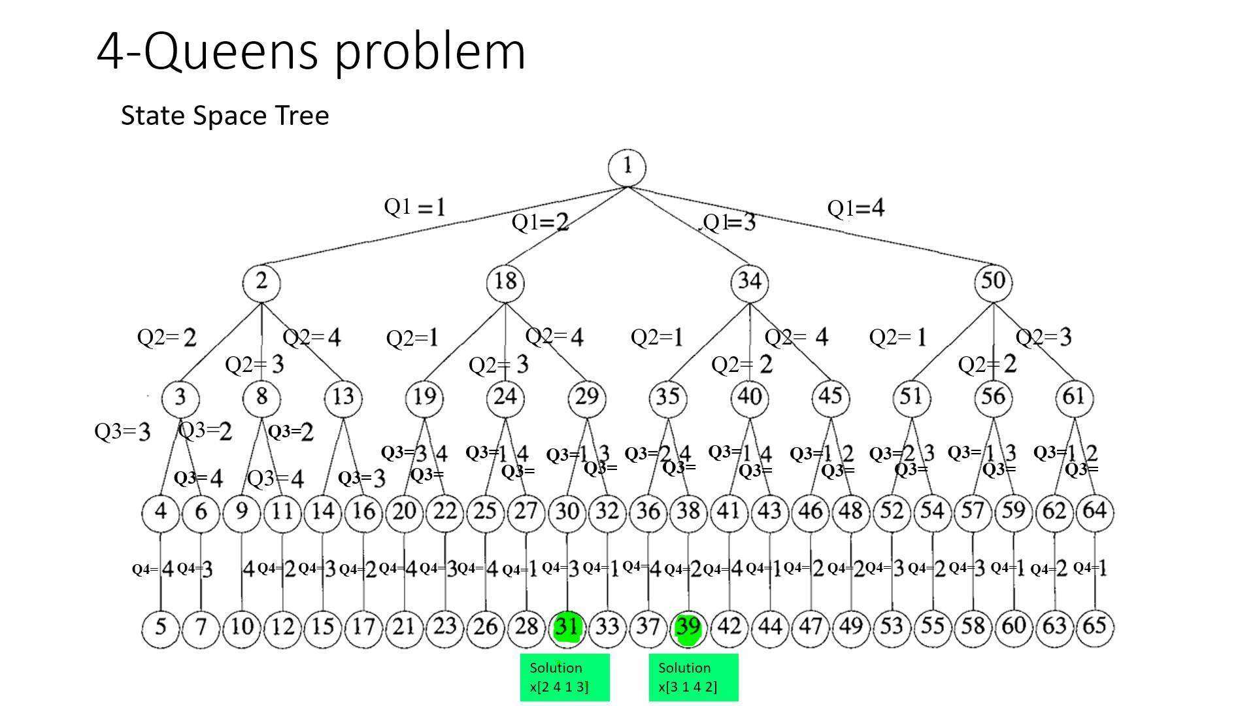
 | 1 | 2 | 3 | 4
1 | - | Q1 | - | -
2 | - | - | - | Q2
3 | Q3 | - | - | -
4 | - | - | Q4 | -
 | 1 | 2 | 3 | 4
1 | - | - | Q1 | -
2 | Q2 | - | - | -
3 | - | - | - | Q3
4 | - | Q4 | - | -
or Permutation tree
solution
x[2 4 1 3]
solution
x[3 1 4 2]

Slide 12
Backtracking Algorithm: The 4-Queens Problem
 | 1 | 2 | 3 | 4
1 | Q1
2 | Q2 | Q2
3 |  | Q3 | Q3
4 |  |  | Q4
 | 1 | 2 | 3 | 4
1
2 |  |  | Q2 | Q2
3 |  | Q3 | Q3
4 | Q4 | Q4
Check for two queens can not be in same diagonal
(1,1) (2,2) (3,3) (2,4) (3,3) (4,2)
(2,1) (3,2) (4,3) (2,3) (3,2) (4,1)
Lets consider any two points Lets consider any two points
(3,2) → (i,j) (3,3) → (i,j)
(4,3) → (k,l) (4,2) → (k,l)
i-j = k-l i+j = k+l
3-2 = 4-3 3+3 = 4+2
1 = 1 6 = 6
J-l = i-k j-l = k-i
(abs(j- l) == abs(k - i)))

Slide 13
Backtracking Algorithm: The 4-Queens Problem
// Algorithm : All solutions to the n-queens problem
NQueens(k,n)
for (i = 1 to n) do
if (Place(k, i))
x[k] = i
if (k == n) // If all queens are placed
print( x[1:n])
else
NQueens(k + 1, n)
 | 1 | 2 | 3 | 4
1 |  | Q1
2 | x | x | x | Q2
3 | Q3
4 | x | x | Q4
 | i=1 | i=2 | i=3 | i=4
NQueens (1,4) x[1] |  | 2
NQueens (2,4) x[2] | x | x | X | 4
NQueens (3,4) x[3] | 1
NQueens (4,4) x[4] | x | x | 3
Solution: x[2 4 1 3]
// Algorithm : Can a new queen be placed?
Place(k,i)
for (j = 1 to k - 1) do
// Check if same column or same diagonal
if ((x[j] == i) || (abs(x[j] - i) == abs(j - k)))
return false;
return true;
if ((x[j] == i) || (abs(x[j] - i) == abs(j - k)))
same column|| same diagonal
Worst-Case Time Complexity is: O(n!)
C Program Link
https://github.com/dayanandyadav205/CS-402-ADA/blob/main/PPT_Notes/Unit-4_Backtracking_Branch_and_Bound/N-Queens_Problem.c

Slide 14
Backtracking Algorithm: The 8-Queens Problem
Problem: Place 8-Queens into 8x8 chessboard so that no two queens can attack each other means no two queens are on the same row, same column or same diagonal.
Constraints:
Explicit Constraints
Given 8 x 8 chessboard
Where 4 is the no. of queens
1 <= xi <=8
Implicit constraints:
We have to place all the queens in such a way that:
No two queens should be in same row
No two queens should be in same column
No two queens should be in same diagonal
 | 1 | 2 | 3 | 4 | 5 | 6 | 7 | 8
1 | - | - | - | Q1 | - | - | - | -
2 | - | - | - | - | - | Q2 | - | -
3 | - | - | - | - | - | - | - | Q3
4 | - | Q4 | - | - | - | - | - | -
5 | - | - | - | - | - | - | Q5 | -
6 | Q6 | - | - | - | - | - | - | -
7 | - | - | Q7 | - | - | - | - | -
8 | - | - | - | - | Q8 | - | - | -
8 x 8 chessboard
One of the solution is: x[4 6 8 2 7 1 3 5]

Slide 15
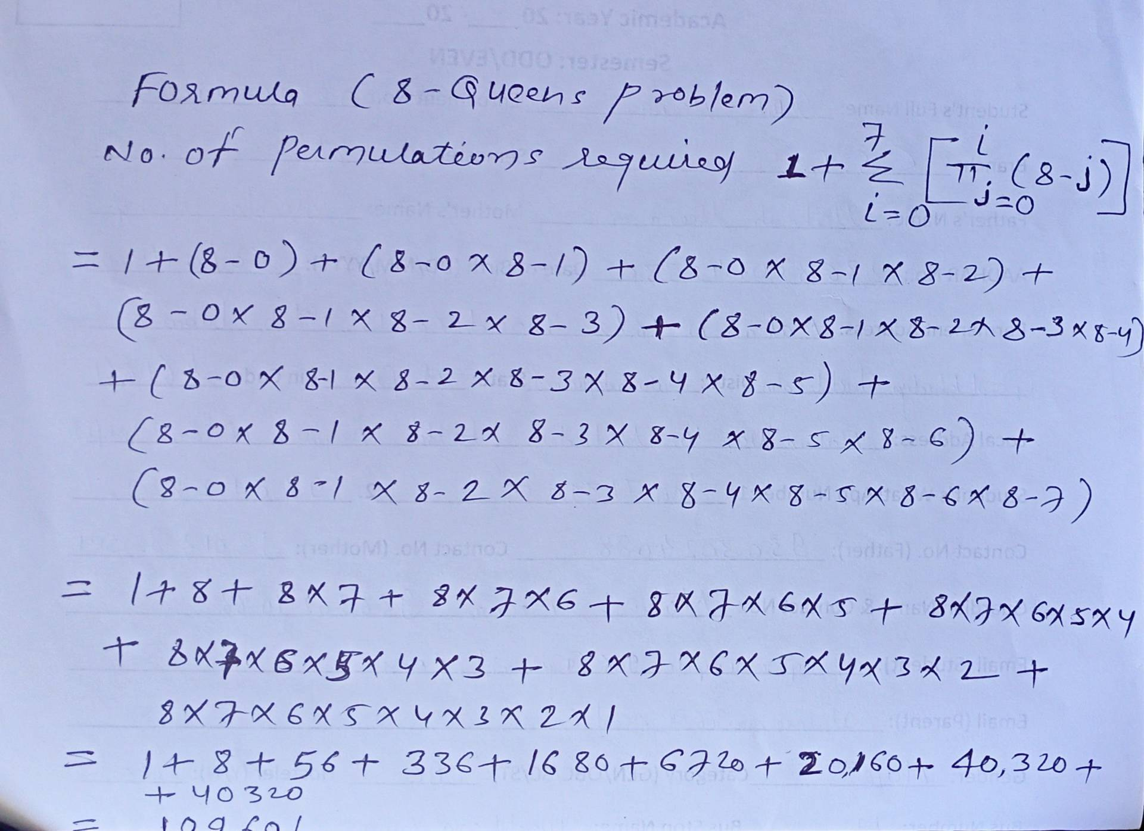
Backtracking Algorithm: The 8-Queens Problem
= 1,09,601

Slide 16
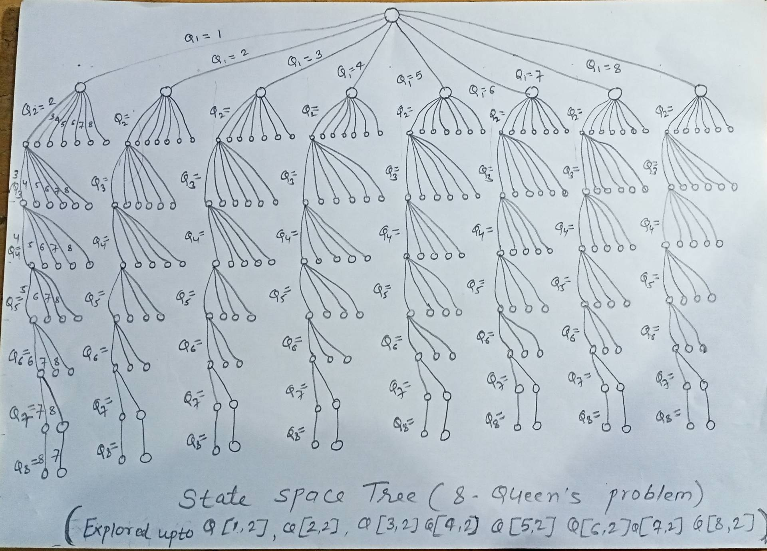
Backtracking Algorithm: The 8-Queens Problem
State Space Tree
or
Permutation tree

Slide 17
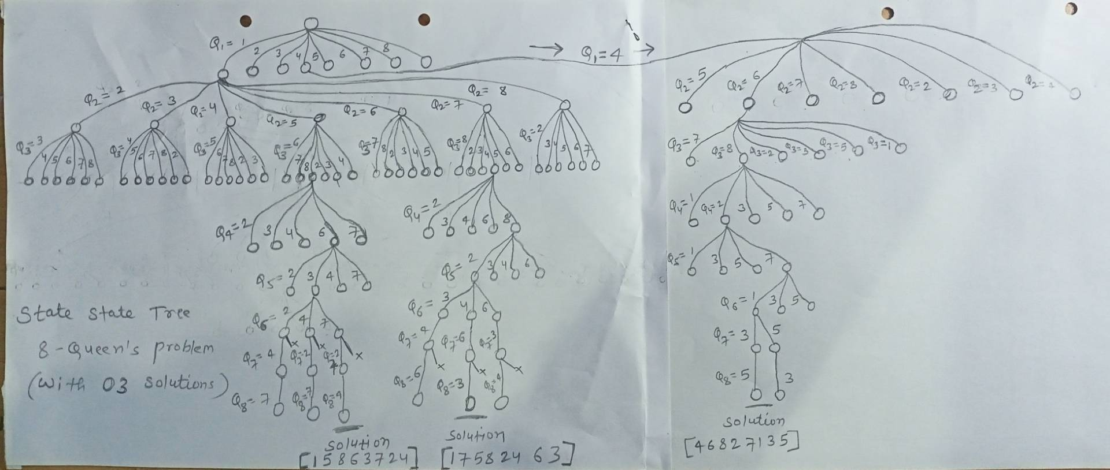
Backtracking Algorithm: The 8-Queens Problem
State Space Tree
or
Permutation tree
 | 1 | 2 | 3 | 4 | 5 | 6 | 7 | 8
1 | Q1 | - | - | - | - | - | - | -
2 | - | - | - | - | Q2 | - | - | -
3 | - | - | - | - | - | - | - | Q3
4 | - | - | - | - | - | Q4 | - | -
5 | - | - | Q5 | - | - | - | - | -
6 | - | - | - | - | - | - | Q6 | -
7 | - | Q7 | - | - | - | - | - | -
8 | - | - | - | Q8 | - | - | - | -
 | 1 | 2 | 3 | 4 | 5 | 6 | 7 | 8
1 | - | - | - | Q1 | - | - | - | -
2 | - | - | - | - | - | Q2 | - | -
3 | - | - | - | - | - | - | - | Q3
4 | - | Q4 | - | - | - | - | - | -
5 | - | - | - | - | - | - | Q5 | -
6 | Q6 | - | - | - | - | - | - | -
7 | - | - | Q7 | - | - | - | - | -
8 | - | - | - | - | Q8 | - | - | -
 | 1 | 2 | 3 | 4 | 5 | 6 | 7 | 8
1 | - | - | - | Q1 | - | - | - | -
2 | - | - | - | - | - | Q2 | - | -
3 | - | - | - | - | - | - | - | Q3
4 | - | Q4 | - | - | - | - | - | -
5 | - | - | - | - | - | - | Q5 | -
6 | Q6 | - | - | - | - | - | - | -
7 | - | - | Q7 | - | - | - | - | -
8 | - | - | - | - | Q8 | - | - | -
Solution x[1 5 8 6 3 7 2 4]
Solution x[1 7 5 8 2 4 6 3]
Solution x[4 6 8 2 7 1 3 5]

Slide 18
Backtracking Algorithm: The 8-Queens Problem
// Algorithm : All solutions to the n-queens problem
NQueens(k,n)
for (i = 1 to n) do
if (Place(k, i))
x[k] = i
if (k == n) // If all queens are placed
print( x[1:n])
else
NQueens(k + 1, n)
 | 1 | 2 | 3 | 4 | 5 | 6 | 7 | 8
1 |  |  |  | Q1
2 | x | x | x | x | x | Q2
3 | x | x | x | x | x | x | x | Q3
4 | x | Q4
5 | x | x | x | x | x | x | Q5
6 | Q6
7 | x | x | Q7
8 | x | x | x | x | Q8
 | i=1 | i=2 | i=3 | i=4 | i=5 | i=6 | i=7 | i=8
NQueens (1,8) x[1] |  |  |  | 4
NQueens (2,8) x[2] | x | x | x | x | x | 6
NQueens (3,8) x[3] | x | x | x | x | x | x | x | 8
NQueens (4,8) x[4] | x | 2
NQueens (5,8) x[5] | x | x | x | x | x | x | 7
NQueens (6,8) x[6] | 1
NQueens (7,8) x[7] | x | x | 3
NQueens (8,8) x[8] | x | x | x | x | 5
// Algorithm : Can a new queen be placed?
Place(k,i)
for (j = 1 to k - 1) do
// Check if same column or same diagonal
if ((x[j] == i) || (abs(x[j] - i) == abs(j - k)))
return false;
return true;
Solution: x[4 6 8 2 7 1 3 5]
if ((x[j] == i) || (abs(x[j] - i) == abs(j - k)))
same column|| same diagonal
Worst-Case Time Complexity is: O(n!)
C Program Link
https://github.com/dayanandyadav205/CS-402-ADA/blob/main/PPT_Notes/Unit-4_Backtracking_Branch_and_Bound/N-Queens_Problem.c

Slide 19
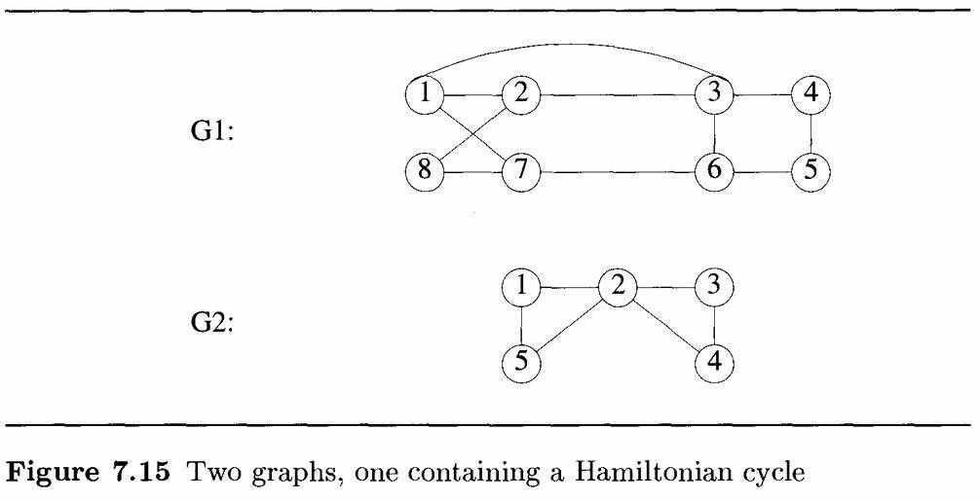
Hamiltonian Cycle
A Hamiltonian cycle is a path that visits every vertex exactly once and returns to the starting vertex.
Let G = (V, E) be a connected graph with n vertices. A Hamiltonian cycle (suggested by Sir William Hamilton) is a round-trip path along n edges of G that visits every vertex once and returns to its starting position. In other words if a Hamiltonian cycle begins at some vertex v ∈ G and the vertices of G are visited in the order v1, v2,….. vn+1.
The graph G1 of Figure 7.15 contains no Hamiltonian cycle. There is no known easy way to determine whether a given graph contains a Hamiltonian cycle. We now look at a backtracking algorithm that finds all the Hamiltonian cycles in a graph. The graph may be directed or undirected. Only distinct cycles are output.

Slide 20
Hamiltonian Cycle: Adjacency Matrix
Validation Rules
For any choice x[k], it must pass three checks in NextValue(k):
1. Edge Check: G[x[k-1]][x[k]] == 1
2. Distinct Check: x[k] must not be equal to any previous element x[1] to x[k-1].
3. Boundary Check: If k = 8, then G[x[8]][x[1]] must equal 1 to close the loop.
Graph G
 | 1 | 2 | 3 | 4 | 5 | 6 | 7 | 8
1 | 0 | 1 | 1 | ∞ | ∞ | ∞ | 1 | ∞
2 | 1 | 0 | 1 | ∞ | ∞ | ∞ | ∞ | 1
3 | 1 | 1 | 0 | 1 | ∞ | 1 | ∞ | ∞
4 | ∞ | ∞ | 1 | 0 | 1 | ∞ | ∞ | ∞
5 | ∞ | ∞ | ∞ | 1 | 0 | 1 | ∞ | ∞
6 | ∞ | ∞ | 1 | ∞ | 1 | 0 | 1 | ∞
7 | 1 | ∞ | ∞ | ∞ | ∞ | 1 | 0 | 1
8 | ∞ | 1 | ∞ | ∞ | ∞ | ∞ | 1 | 0
Adjacency Matrix of Graph G

Slide 21
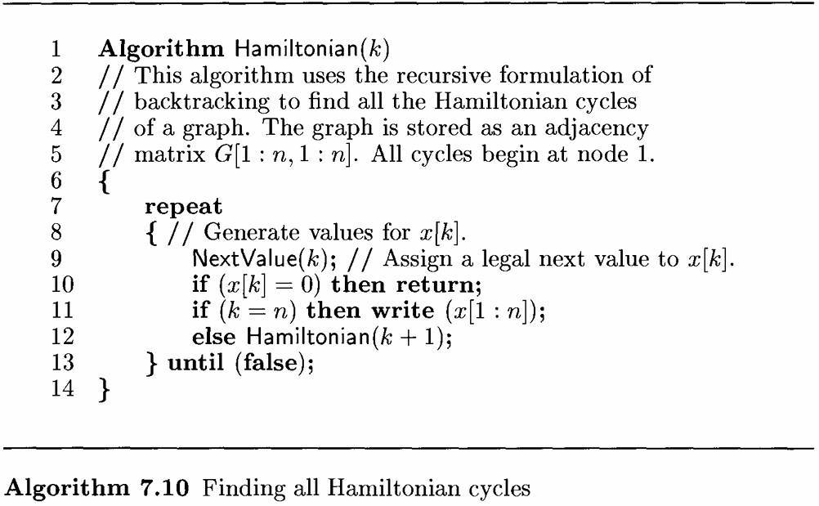
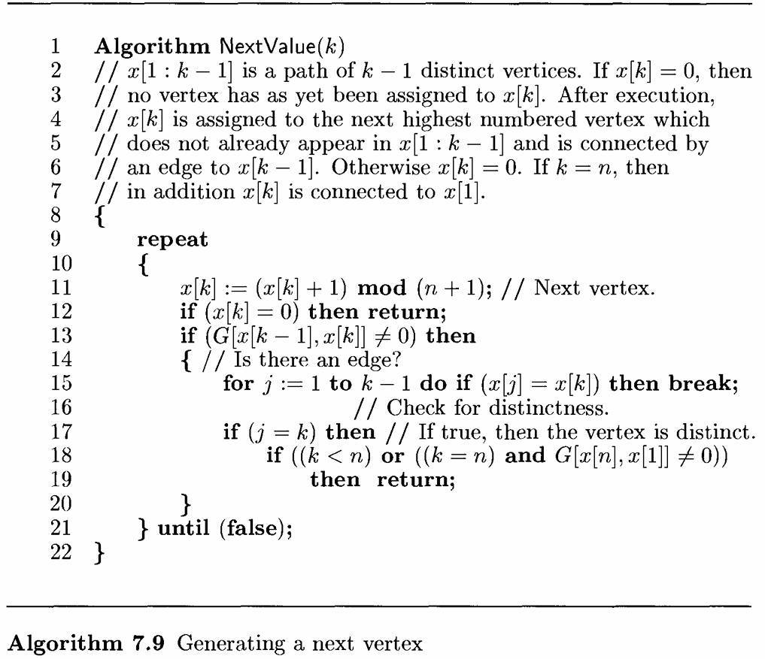
Hamiltonian Cycle: Algorithm
Graph G
[Pick a Spot] ➔ [Check if Already Used] ➔ [Check if Path is Full] ➔ [Link Back to Start]

Slide 22
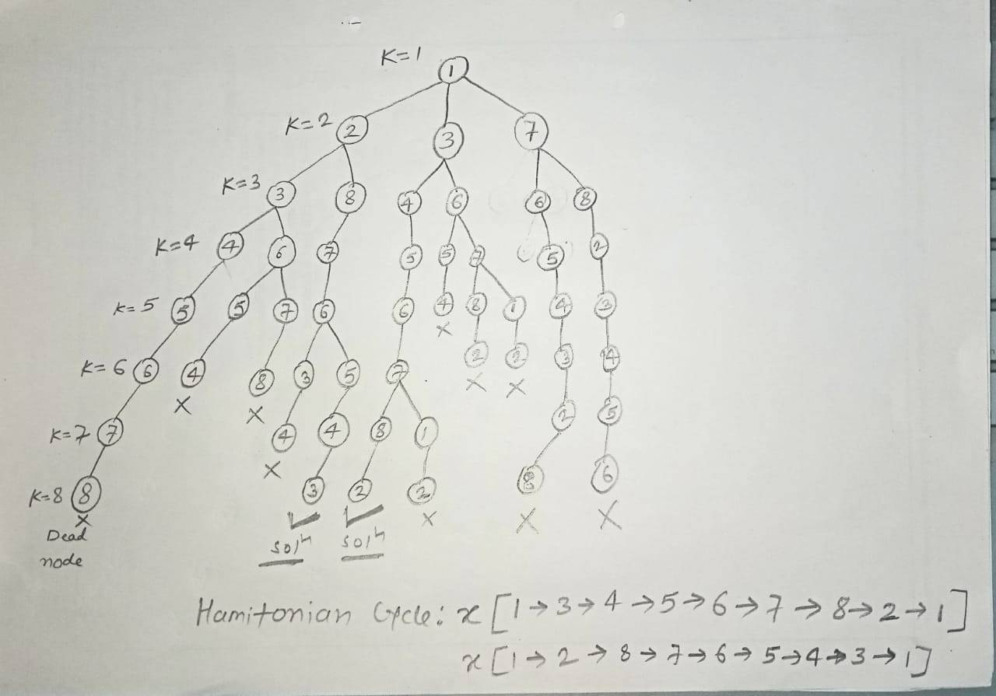
Hamiltonian Cycle: State Space Tree
Graph G
Worst-Case Time Complexity is: O(n!)

Slide 23
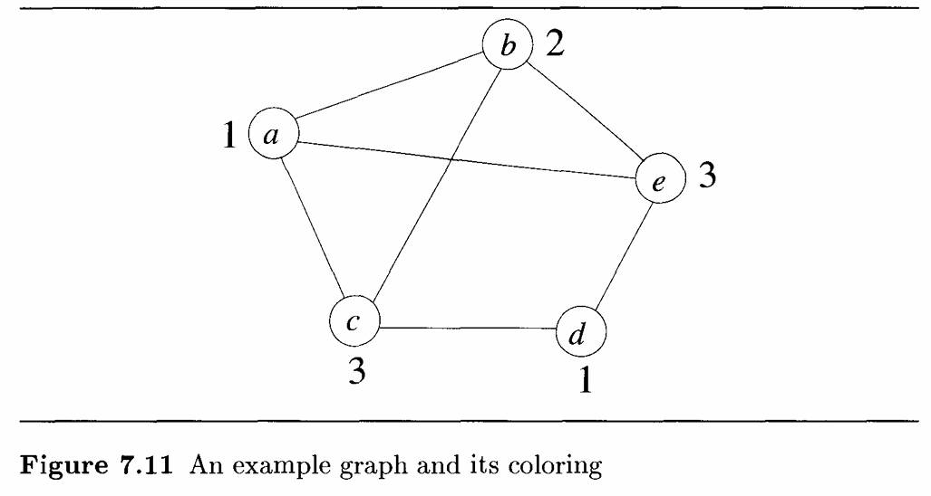
GRAPH COLORING
Let G be a graph and m be a given positive integer. We want to discover whether the nodes of G can be colored in such a way that no two adjacent nodes have the same color yet only m colors are used. This is termed the m-colorability decision problem.
Note that if d is the degree of the given graph, then it can be colored with d + 1 colors. The m-colorability optimization problem asks for the smallest integer m for which the graph G can be colored. This integer is referred to as the chromatic number of the graph. For example, the graph of Figure 7.11 can be colored with three colors 1, 2, and 3. The color of each node is indicated next to it. It can also be seen that three colors are needed to color this graph and hence this graph’s chromatic number is 3.

Slide 24
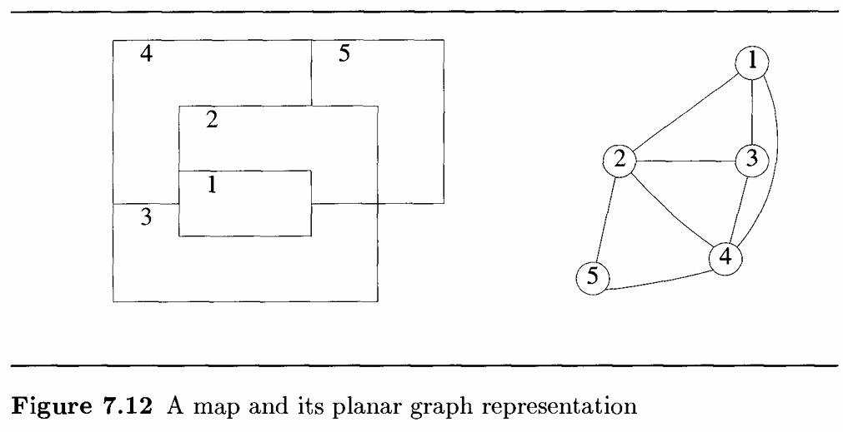
GRAPH COLORING
A graph is said to be planar iff it can be drawn in a plane in such a way that no two edges cross each other. A famous special case of the m colorability decision problem is the 4-color problem for planar graphs. This problem asks the following question: given any map, can the regions be colored in such a way that no two adjacent regions have the same color yet only four colors are needed? This turns out to be a problem for which graphs are very useful, because a map can easily be transformed into a graph. Each region of the map becomes a node , and if two regions are adjacent, then the corresponding nodes are joined by an edge. Figure7.12 shows a map with five regions and its corresponding graph. This map requires four colors. For many years it was known that five colors were sufficient to color any map, but no map that required more than four colors had ever been found. After several hundred years, this problem was solved by a group of mathematicians with the help of a computer. They showed that in fact four colors are sufficient. In this section we consider not only graphs that are produced from maps but all graphs. We are interested in determining all the different ways in which a given graph can be colored using at most m color.

Slide 25
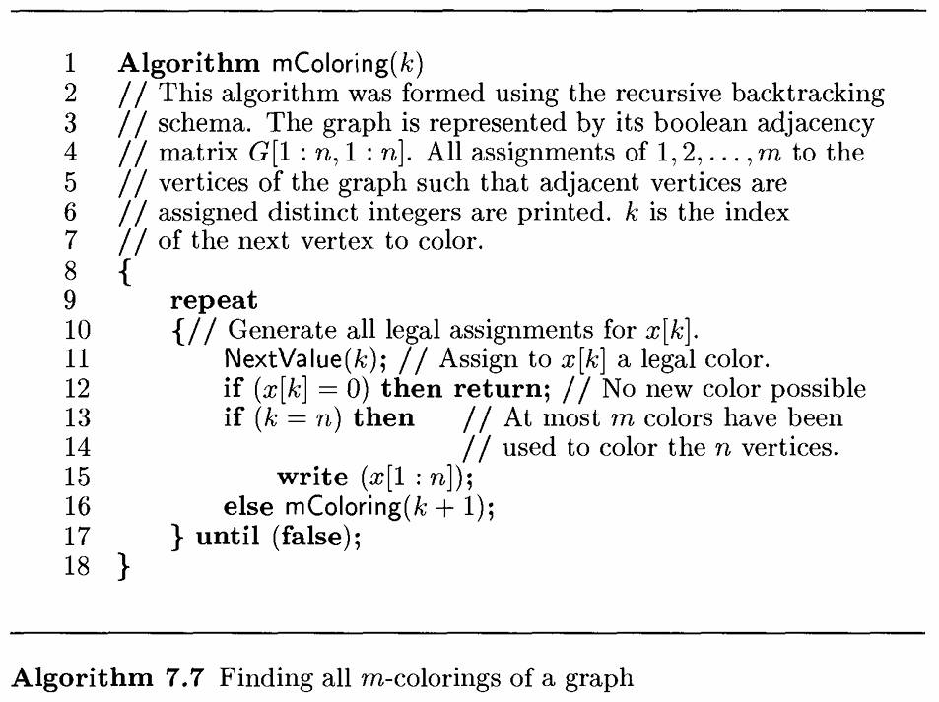
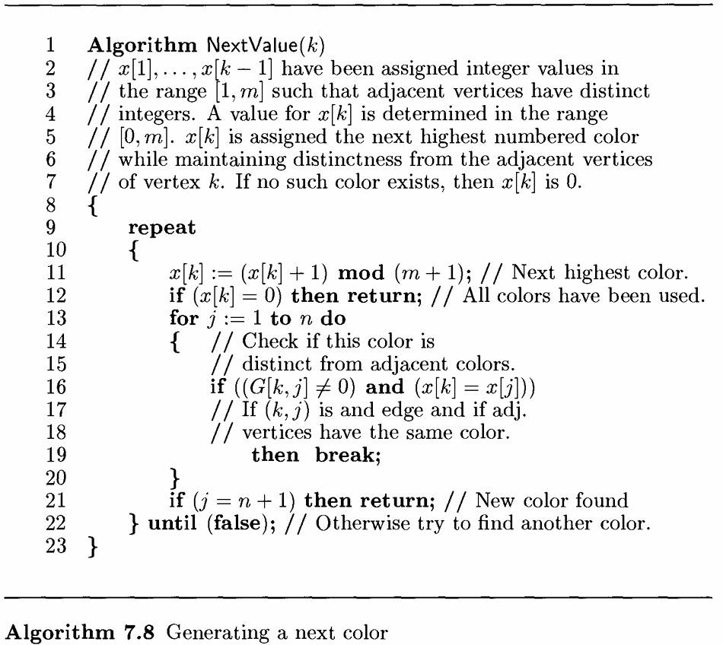
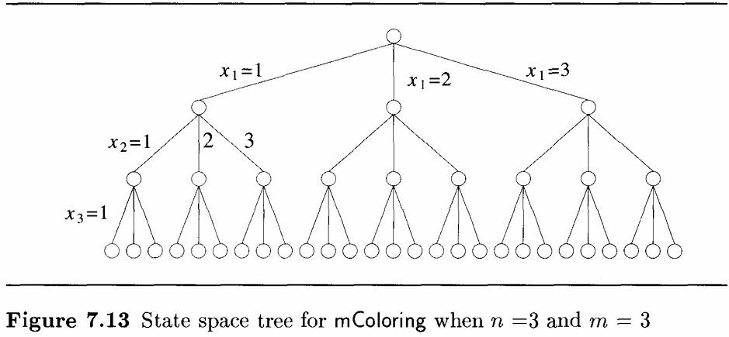
GRAPH COLORING Algorithm and State space Tree

Slide 26
Branch & Bound

Slide 27
Branch & Bound
The Branch and Bound (B&B) technique, as formalized in the classic text Fundamentals of Computer Algorithms by Ellis Horowitz and Sartaj Sahni, is a systematic algorithmic method designed primarily to solve hard combinatorial optimization problems.
It operates by intelligently pruning (bounding) the search space to find optimal solutions without testing every possibility.
It systematically explores all possible candidate solutions by breaking the problem into smaller subproblems (branching) and discarding those that cannot yield a better result than the best found so far (bounding).

Slide 28
Branch & Bound: Types of Nodes
L-Node (Live Node): A node which has been generated and all of those children have not yet been generated is live node.
E-Node (Expansion Node): The live node whose children are currently being generated is called the E-node(node being expanded).
D-Node (Dead Node) or Bounded Node: It is a generated node that is either not to be expanded further or one for which all of its children have been generated.
A-Node (Answer Node) or S-Node (Solution Node): Those solution states S for which path from root to S defines a tuple which is a member of the set of solutions (i.e., it satisfies the implicit constraints) of the problem.

Slide 29
Types of Branch & Bound
Generally THREE types of searching strategies used in Branch & Bound
FIFO (First-In-First-Out) Branch and Bound uses a Queue data structure to manage nodes, resulting in a Breadth-First Search (BFS) approach with moderate efficiency.
LIFO (Last-In-Last-Out) Branch and Bound employs a Stack data structure to explore nodes using Depth-First Search (DFS), also offering moderate efficiency.
Least Cost (LC) Branch and Bound utilizes a Priority Queue to select the node with the lowest bound, functioning as an intelligent or heuristic search that finds the optimal path with high efficiency.

Slide 30
FIFO-BB (First-In First-Out Branch & Bound) Queue
FIFO (First-In-First-Out) Search
BFS with QUEUE based Branch & Bound is called FIFO Branch & Bound.
In FIFO search the children of the root node are generated in the first iteration.
In the next step, children of the first child is generated.
If the children not already killed by bounding function then put it in the queue. Then the children of second child is explored.
Put all the children in the queue except for those children which are killed.

Slide 31
FIFO-BB (First-In First-Out - Branch & Bound) Queue
Start
Breadth First Search (BFS)
1
1
10
15
2
4
3
10
20
2
15
4
3
20
Solution-1
8
2
4
14
18
19
17
3
4
2
4
Goal
Solution-5
Solution-2
Graph
16
23
27
4
3
4
Solution-6
Solution-3
25
4
Optimal Solution: Solution-6 with Cost 16
State space Tree (Solution Tree)
Solution-4

Slide 32
LIFO-BB (Last-In First-Out - Branch & Bound) Stack
LIFO(Last-In-Last-Out) Search
DFS with stack based Branch & Bound is called LIFO Branch & Bound.
In LIFO search the children of the root node are generated in the first iteration.
In the next step, children of the first child is generated.
If the children not already killed by bounding function then put it in the stack. Then the children of second child is explored.
Put all the children in the stack except for those children which are killed.

Slide 33
LIFO-BB (Last-In First-Out - Branch & Bound) Stack
Depth First Search (DFS)
Start
1
1
10
15
2
4
3
10
2
15
20
4
3
20
Solution-1
8
2
4
14
18
19
17
3
4
2
4
Goal
Solution-2
Solution-3
Graph
16
27
4
4
Optimal Solution: Solution-4 with Cost 16
Solution-4
Solution-5
State space Tree (Solution Tree)

Slide 34
LC-BB (Least Cost - Branch & Bound) Priority Queue
LC(Least Cost Search)
In both FIFO and LIFO B&B the selection rule for the next E-node is fixed.
The rigid selection rule does not give any preference to a node which best and can search the answer node quickly.
The search for an answer node can be speeded by using a ranking function for live nodes.
The next E-node is selected on the basis of this ranking function.

Slide 35


LC-BB (Least Cost - Branch & Bound) Priority Queue
Start
Depth First Search (DFS)
1
1
10
15
2
4
3
10
20
2
15
4
3
20
Solution-1
8
2
4
14
18
Bounded
3
4
Goal
Solution-2
Graph
16
4
Solution-3
State space Tree (Solution Tree)
Optimal Solution: Solution-3 with Cost 16

Slide 36
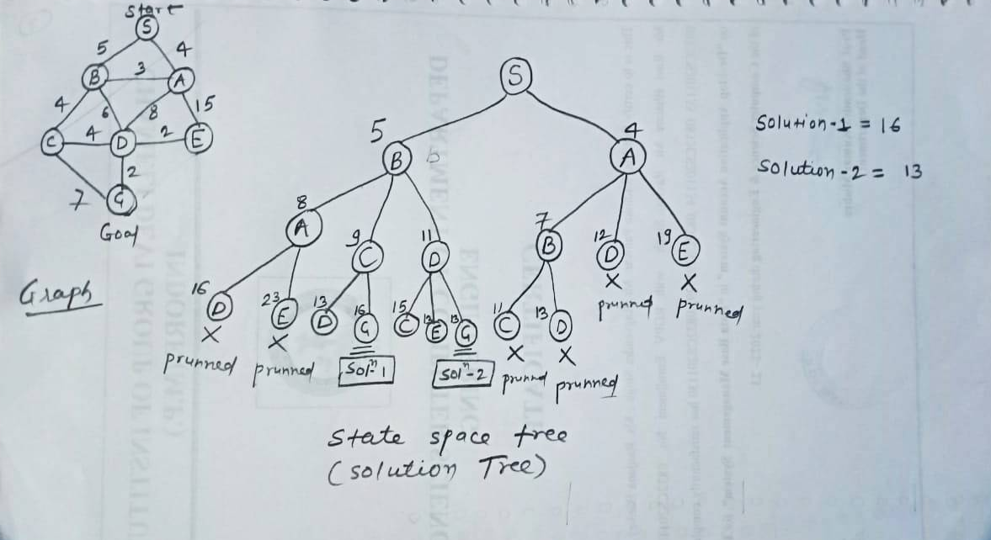
LC-BB (Least Cost - Branch & Bound) Priority Queue
Example 2
Optimal Solution: Solution-2 with Cost 13

Slide 37
Traveling Salesperson Problem (TSP) using the Branch and Bound (BB)
Given a set of cities and distance between every pair of cities, the problem is to find the shortest possible tour that visits every city exactly once and returns to the starting point.
In the Branch and Bound method, we explore the solution space as a state space tree where each node represents a partial tour. For every node, we compute a bound on the best possible solution that can be obtained from that node. If this bound is greater than the best solution found so far, the subtree rooted at that node is ignored (pruned) because it cannot produce a better solution. (Here we are applying LC-BB Least Cost Branch & Bound Technique)

Slide 38
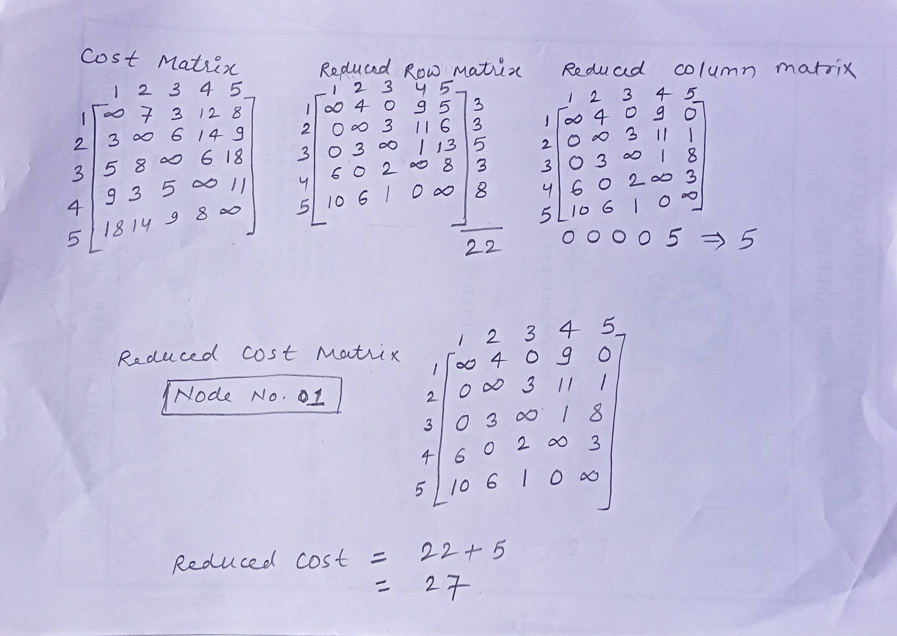
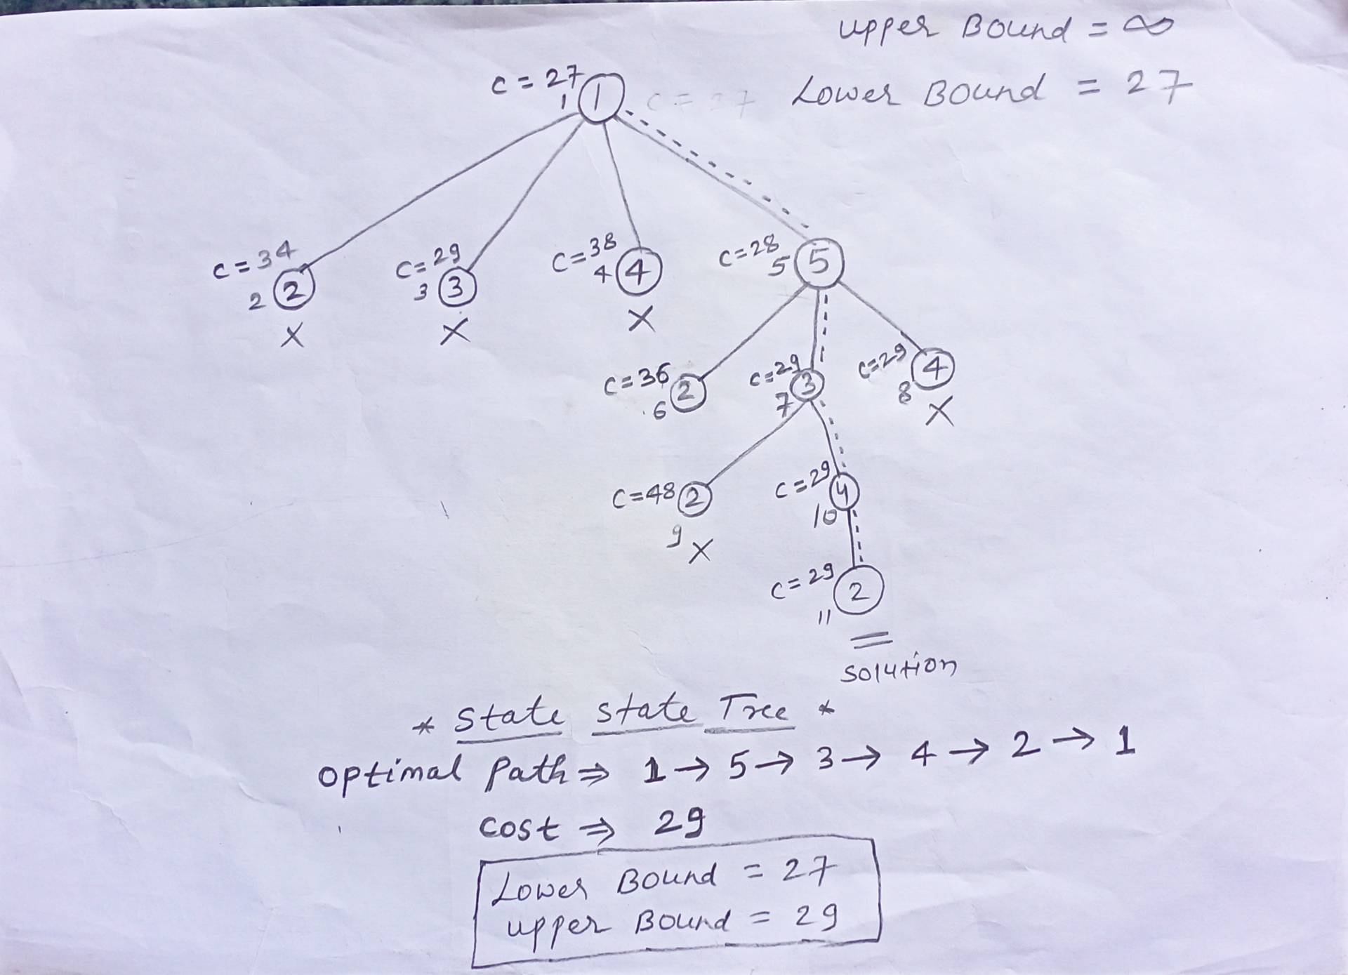


Traveling Salesperson Problem (TSP) using the Branch and Bound (BB)

Slide 39
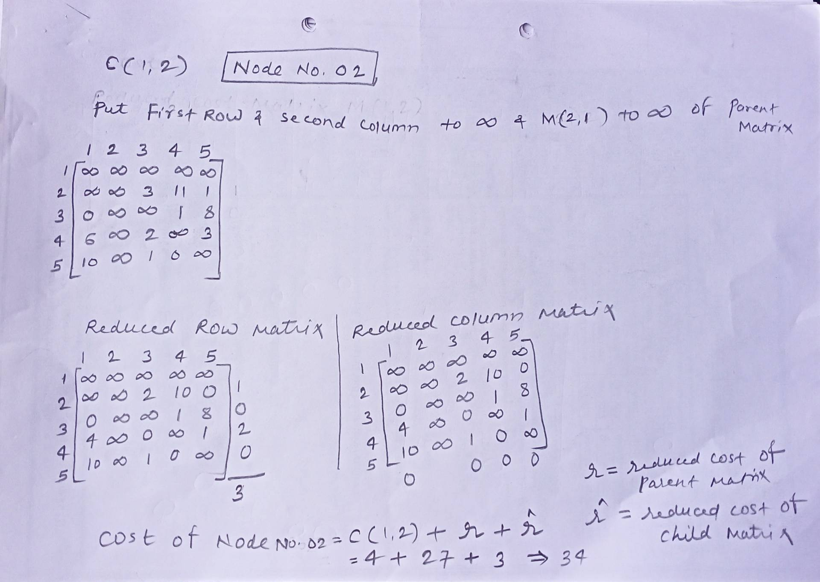



Traveling Salesperson Problem (TSP) using the Branch and Bound (BB)

Slide 40
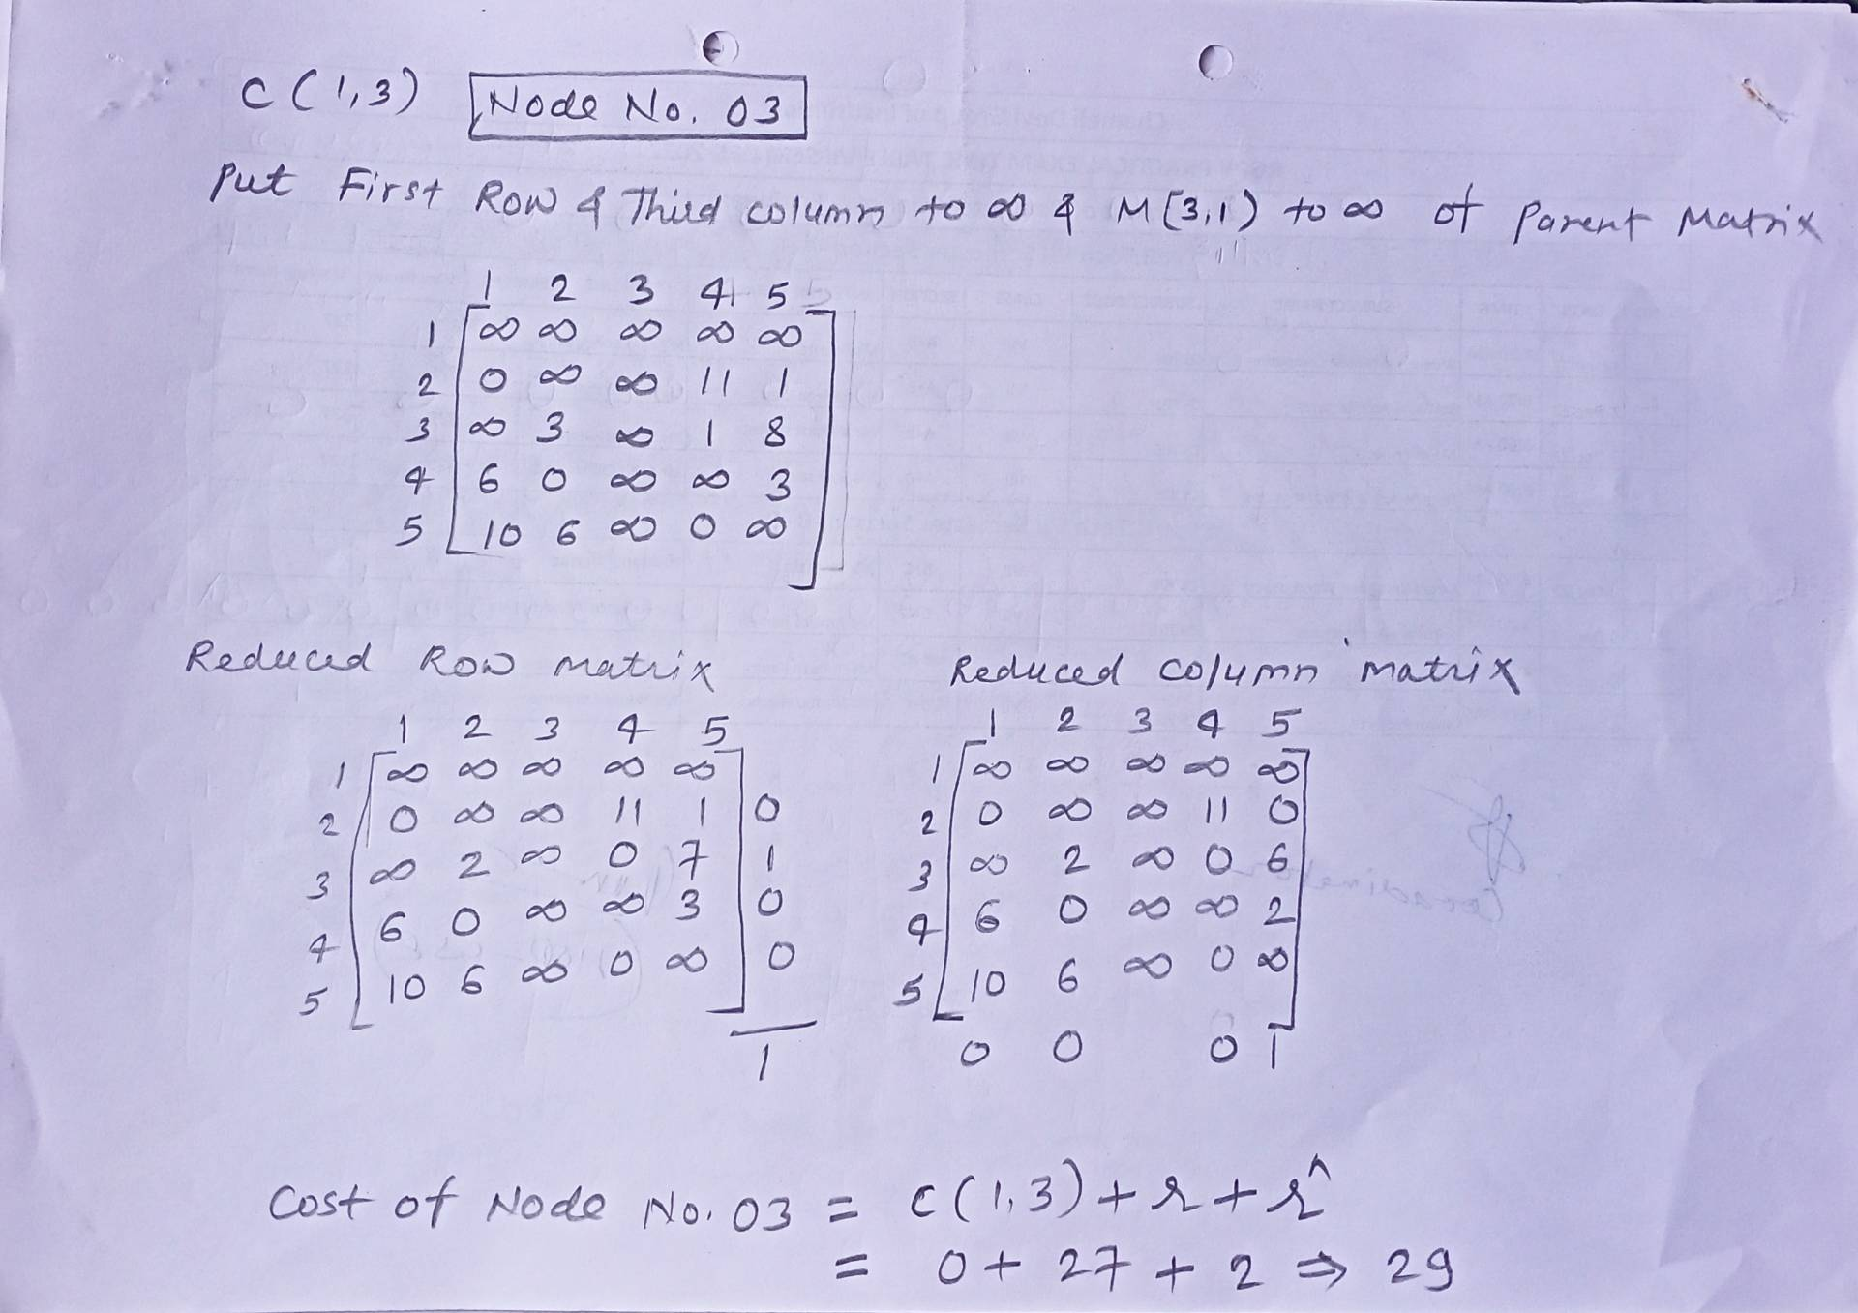


Traveling Salesperson Problem (TSP) using the Branch and Bound (BB)

Slide 41
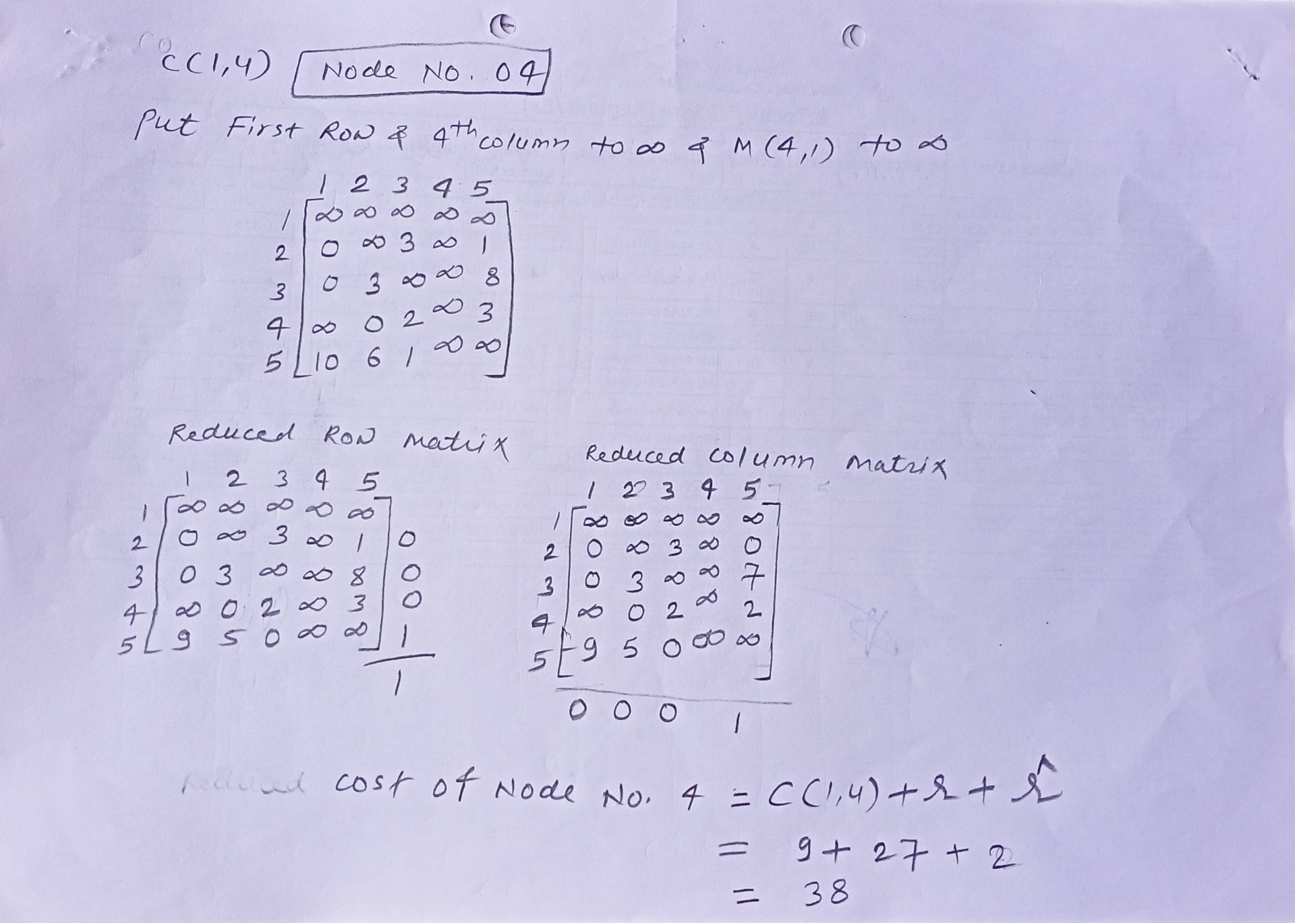


Traveling Salesperson Problem (TSP) using the Branch and Bound (BB)

Slide 42
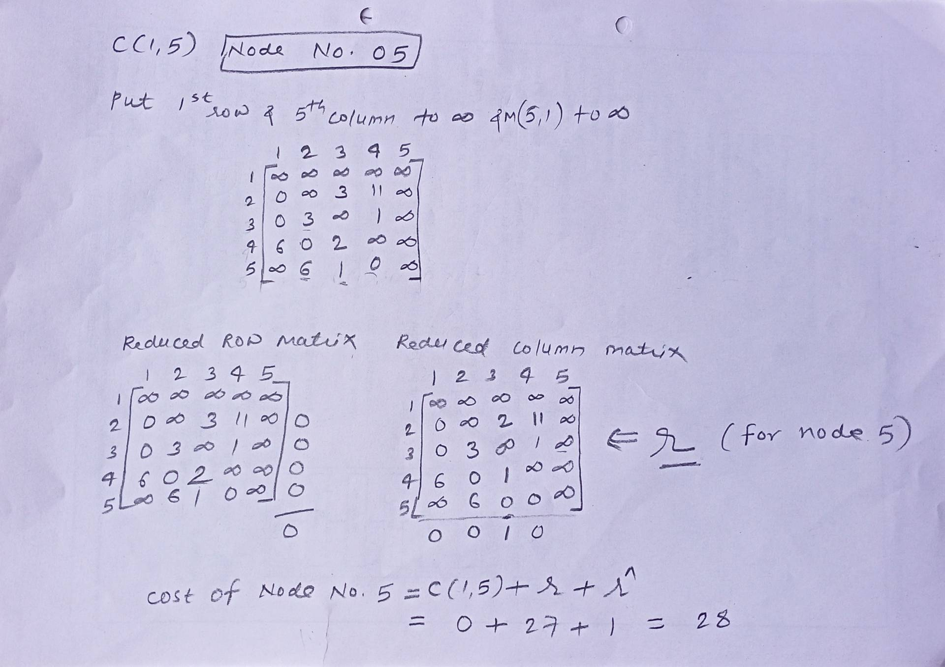


Traveling Salesperson Problem (TSP) using the Branch and Bound (BB)

Slide 43
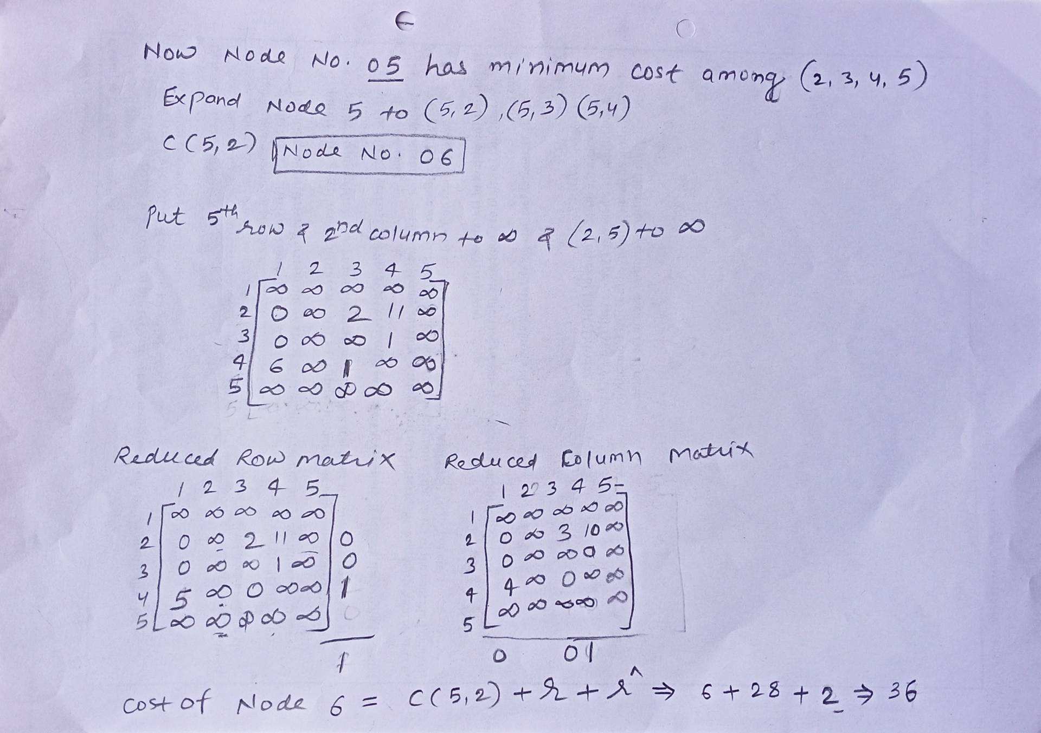


Traveling Salesperson Problem (TSP) using the Branch and Bound (BB)

Slide 44
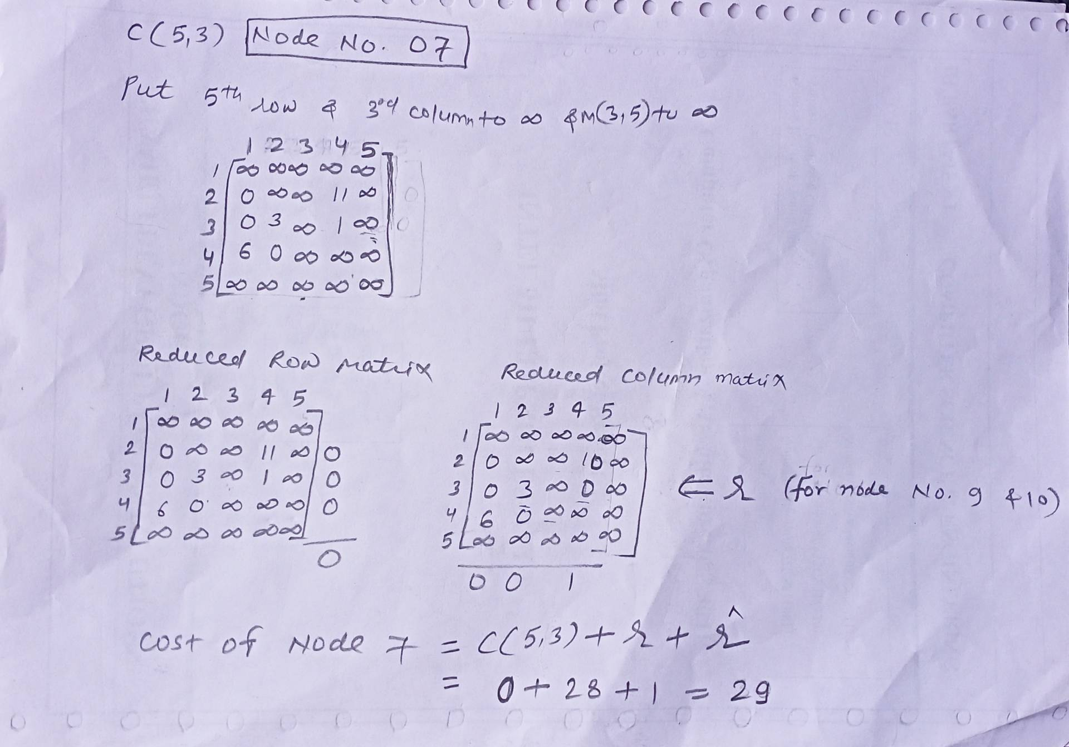


Traveling Salesperson Problem (TSP) using the Branch and Bound (BB)

Slide 45
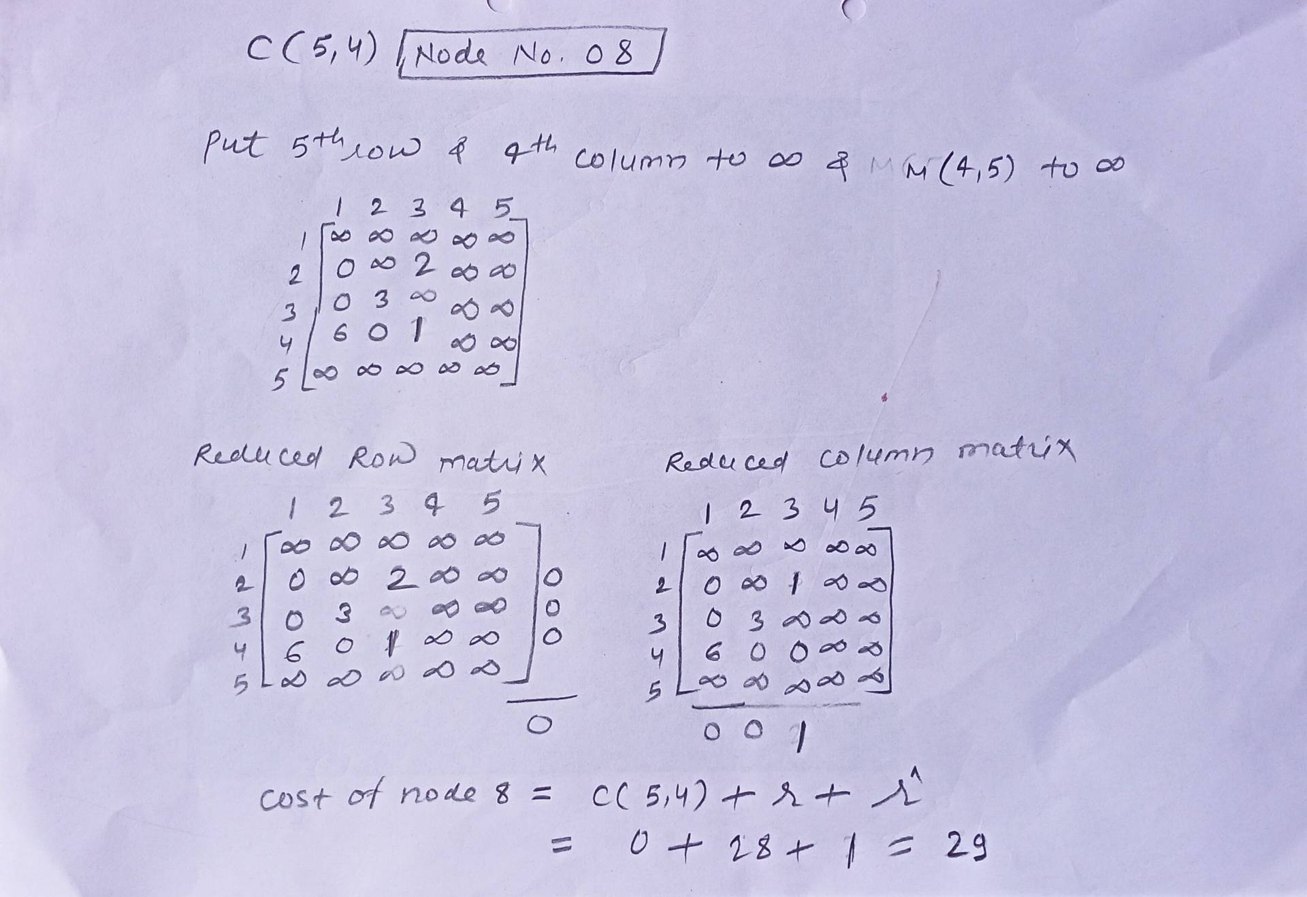


Traveling Salesperson Problem (TSP) using the Branch and Bound (BB)

Slide 46
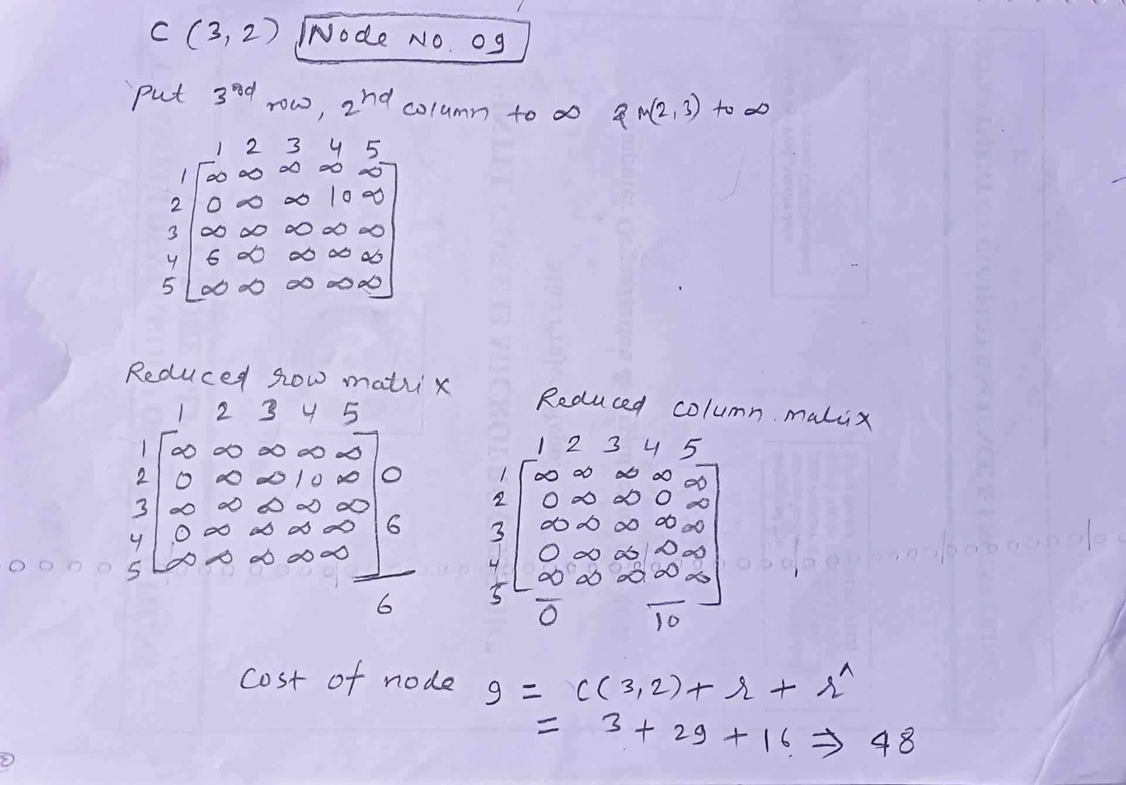


Traveling Salesperson Problem (TSP) using the Branch and Bound (BB)

Slide 47
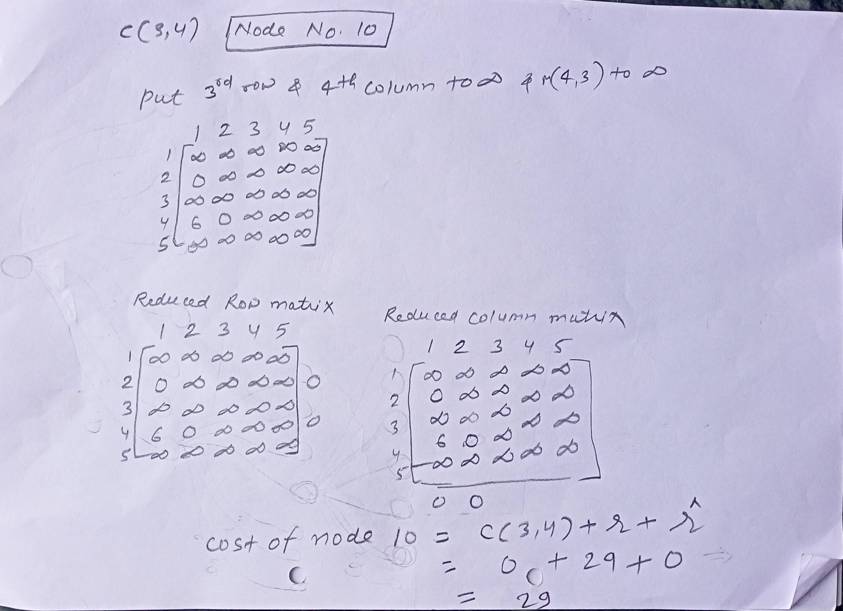


Traveling Salesperson Problem (TSP) using the Branch and Bound (BB)

Slide 48
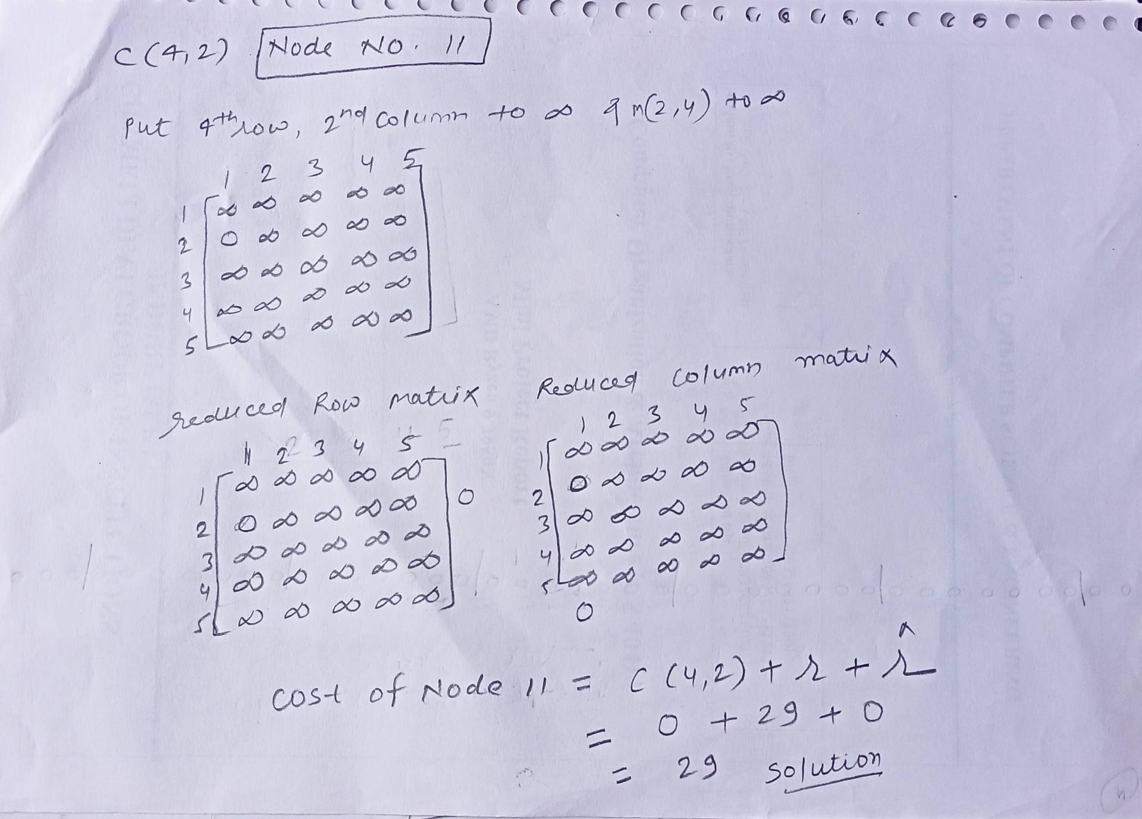


Traveling Salesperson Problem (TSP) using the Branch and Bound (BB)

Slide 49

Traveling Salesperson Problem (TSP) using the Branch and Bound (BB)

Slide 50
Lower Bound Theory
Lower Bound Theory Concept is based upon the calculation of minimum time that is required to execute an algorithm is known as a lower bound theory or Base Bound Theory.
According to the lower bound theory, for a lower bound L(n) of an algorithm, it is not possible to have any other algorithm (for a common problem) whose time complexity is less than L(n) for random input. Also, every algorithm must take at least L(n) time in the worst case. Note that L(n) here is the minimum of all the possible algorithms, of maximum complexity.
The Lower Bound is very important for any algorithm. Once we calculated it, then we can compare it with the actual complexity of the algorithm and if their order is the same then we can declare our algorithm as optimal.

Slide 51
Lower Bound Theory
Why Lower Bounds is Important
It sets a baseline. If you are looking for an optimal algorithm, the goal is to create one whose upper bound (worst-case time) matches the lower bound. An algorithm is deemed optimal if Upper Bound = Lower Bound.

Slide 52
Use of Lower Bound Theory in solving algebraic problem
Straight Line Program:
The type of program built without any loops or control structures is called the Straight Line Program.
For example
Sum(a, b)
{
//no loops and no control structures
c:= a+b;
return c;
}
Time Complexity
The lower bound time complexity is Omega(1) (Constant Time).

Slide 53

Use of Lower Bound Theory in solving algebraic problem
Algebraic Problem: Problems related to algebra like solving equations, come under algebraic problems. For example, solving equation ax²+bx+c with simple programming.
Algorithm pow(x, n)
{
p := 1;
//loop from 1 to n
for i:=1 to n
p := x*p;
return p;
}
Algorithm polynomial(A, x, n)
{
int p, v:=0;
for i:= 0 to n
//loop within a loop from 0 to n
v := v + A[i]*pow(x, i);
return v;
}
Example Equation: 2x²+5x+1
Why This Code Is Slow
This code has a loop inside of another loop.
The main loop runs n times.
Inside it, the pow loop also runs up to n times.
This means the computer has to do a lot of extra work. In computer science, this speed is called O(n^2) time.

Slide 54
Use of Lower Bound Theory in solving algebraic problem
Horner's Method.
Theorem: To prove that the optimal algo of solving a n degree polynomial is O(n)
Proof: The best solution for reducing the algo is to make this problem less complex by dividing the polynomial into several straight-line problems & has a time complexity of (O(n)).
It uses a famous, fast math trick called Horner's Method. Instead of calculating big exponents like x³ or x⁴ from scratch, it multiplies by x step-by-step to save time.
It has a time complexity of (O(n)).

Slide 55
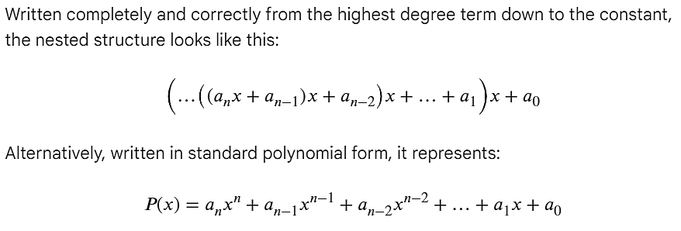
Use of Lower Bound Theory in solving algebraic problem
Horner's Method.
Now, the algorithm will be as, v=0 v=v+a_{n} v=v*x v=v+a_{n-1} v=v*x ... v=v+a₁ v=v*x v=v+a₀

Slide 56
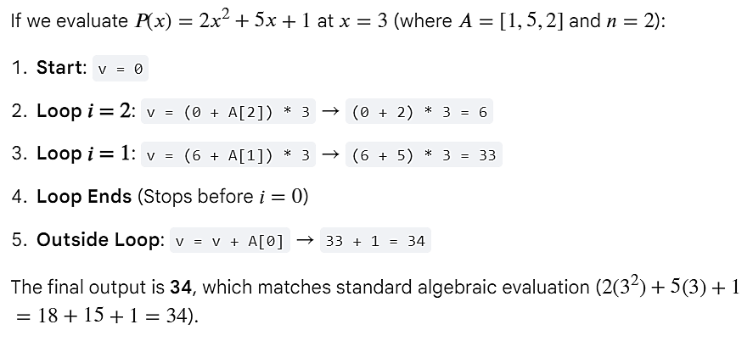
Use of Lower Bound Theory in solving algebraic problem
Algorithm polynomial(A, x, n)
{
int v = 0;
// Loop stops at 1 so the last multiplication by x happens to A[1]
for i = n to 1
{
v = (v + A[i]) * x;
}
// Add the final constant term outside the loop without multiplying by x
v = v + A[0];
return v;
}

Slide 57
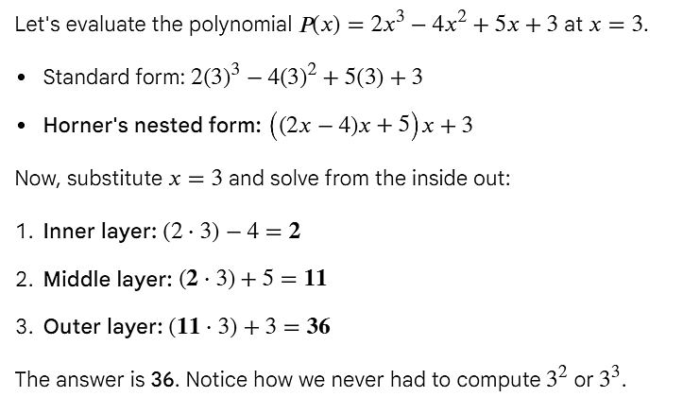
Use of Lower Bound Theory in solving algebraic problem

Slide 58
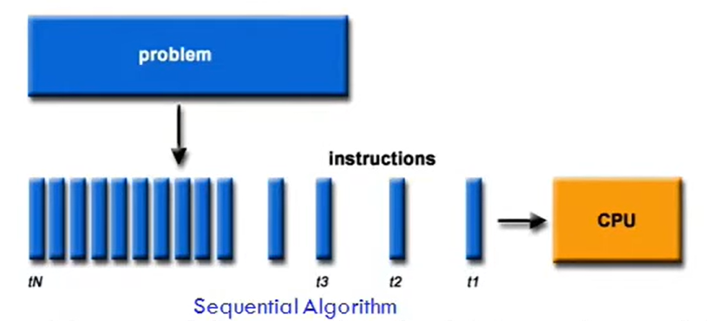
Introduction to parallel algorithms
An algorithm is a sequence of steps followed to solve a problem. It take inputs from the user and after some computation, produces an output.
Depending on the architecture of computers, we have two types of algorithms:
1. Sequential Algorithm: An algorithm in which some consecutive steps of instructions are executed in a chronological order to solve a problem.
2. Parallel Algorithm: The problem is divided into sub-problems and are executed in parallel to get individual outputs. Later on, these individual outputs are combined together to get the final desired output.

Slide 59
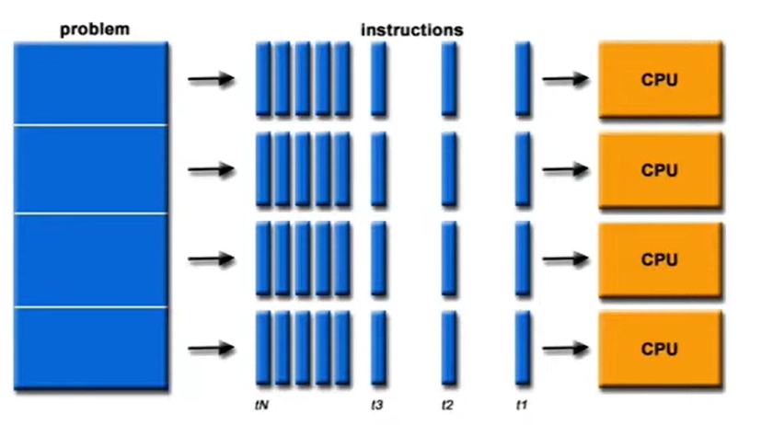
Parallel Algorithms
Parallel Algorithms are algorithms to be run on parallel machines
A parallel algorithm can be executed simultaneously on many different processing devices and then combined together to get the correct result.
Parallel algorithms are highly useful in processing huge volumes of data in quick time.

Slide 60
Parallel Algorithms
Core Architecture Models
PRAM (Parallel Random-Access Machine): A theoretical shared-memory model where multiple processors manipulate a centralized global memory space simultaneously.
Message Passing Model: Designed for distributed systems where processors utilize individual local memory and exchange information explicitly through data packets.

Slide 61
Parallel Algorithms
Main Processing Paradigms
Developers categorize algorithmic parallelism based on what part of the program is being split up.
Data Parallelism: The same exact operation is executed simultaneously across different chunks of a massive dataset. (e.g., Matrix multiplication, image filtering).
Task Parallelism: The program is broken down into distinct, independent functions that run concurrently on different processors. (e.g., Running a database backup while processing web requests).
Pipeline Model: Operations are performed in consecutive stages where the output of one processor feeds as the input to the next. Also known as the Producer-Consumer framework.

Slide 62
Thank You

