Slide 1
Unit-4 Backtracking, Branch & Bound
CS-402
Analysis & Design Algorithm

Slide 2
Syllabus
Backtracking concept and its examples like 8 queen’s problem, Hamiltonian cycle, Graph coloring problem etc.
Introduction to branch & bound method, examples of branch and bound method like traveling salesman problem etc. Meaning of lower bound theory and its use in solving algebraic problem, introduction to parallel algorithms.

Slide 3
Backtracking
The backtracking approach is generally used in the cases where there are possibilities of multiple solutions.
Backtracking is an algorithmic technique that considers searching in every possible combination for solving a computational problem.
Backtracking is an important tool for solving constraint satisfaction problems, such as crosswords, Sudoku, and many other puzzles.
It is known for solving problems recursively one step at a time and removing those solutions that that do not satisfy the problem constraints at any point of time.
It is a brute force approach that tries out all the possible solutions using depth first search (DFS) and chooses the best possible ones out of them.

Slide 4
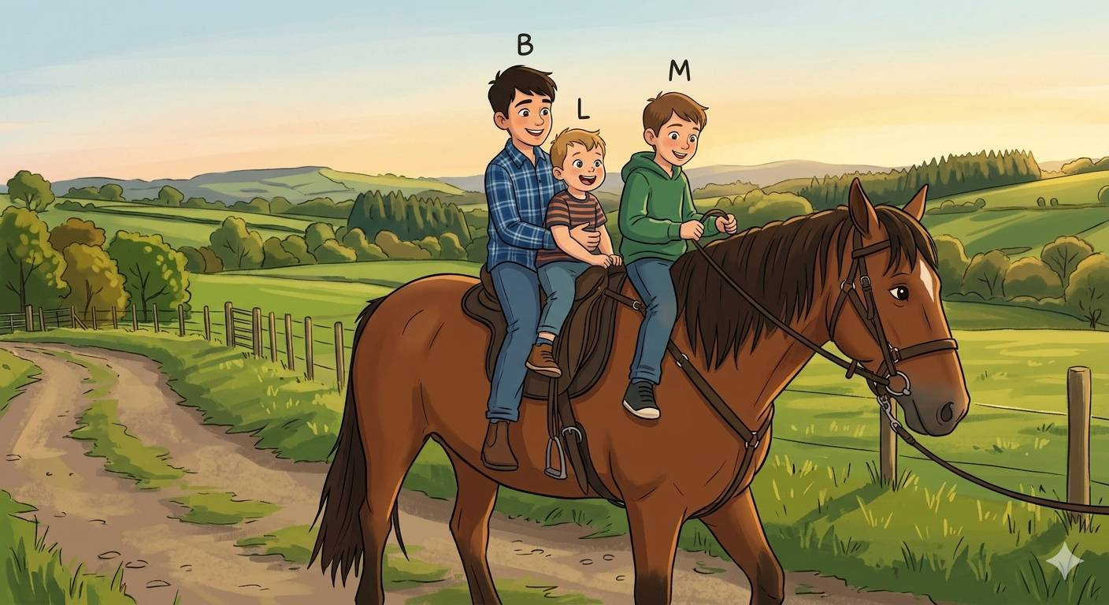
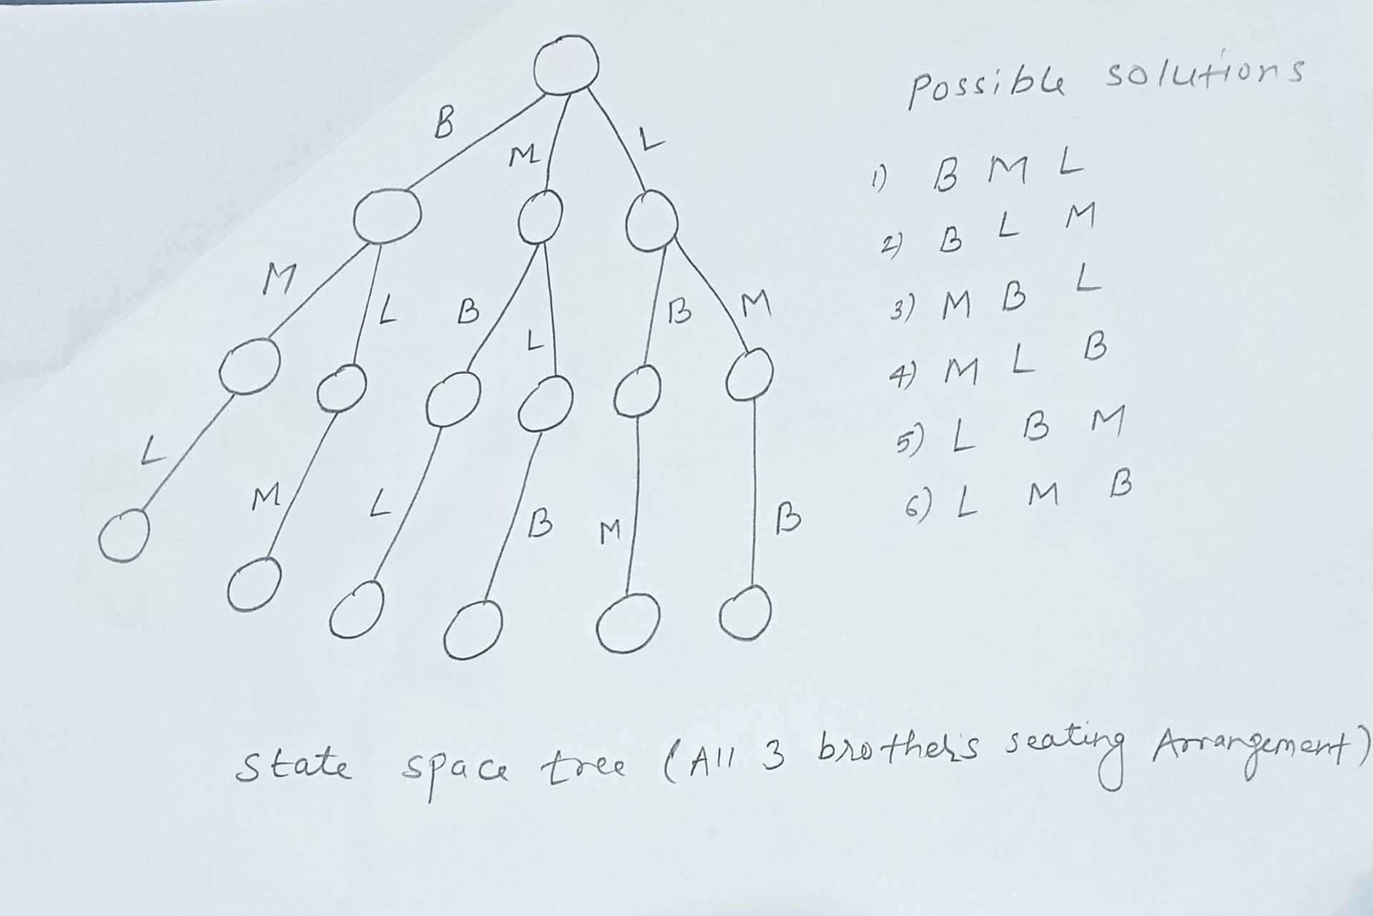
Backtracking
We have three distinct brothers:
B (Big Brother)
M (Middle Brother)
L (Little Brother)
Since there are 3 positions on the horse (Front, Middle, and Back), the total number of unique ways they can sit is 3! (3 factorial): 3 x 2 x 1 = 6

Slide 5
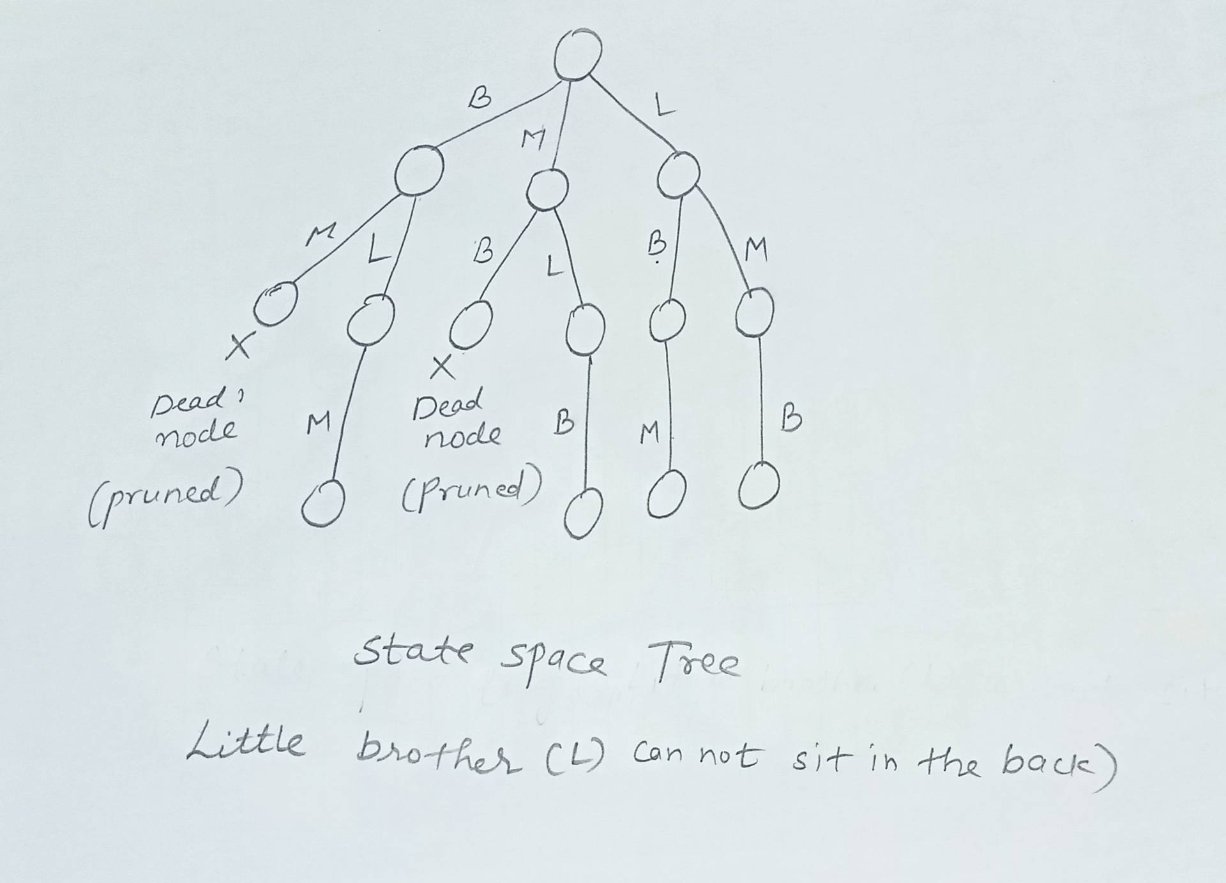
Backtracking
Constraint: Little Brother (L) cannot sit in the back seat,
Now there are exactly 4 valid ways for them to sit.
Total possible seating ways = 6
Ways with L in the back = 2
Valid ways remaining = 4
Invalid Arrangements (Filtered Out)
The algorithm will reject these two options because L is in the back:
[B, M, L] ❌
[M, B, L] ❌

Slide 6
Backtracking helps to solve following computer science problems
The 8-Queens Problem (N-Queens problem)
The Hamiltonian Cycle
The Graph Coloring Problem

Slide 7
Backtracking Algorithm: The 4-Queens Problem
Problem: Place N-queens into NxN chessboard so that no two queens can attack each other means no two queens are on the same row, same column or same diagonal.
Constraints:
Explicit Constraints
Given 4 x 4 chessboard
Where 4 is the no. of queens
1 <= xi <=4
Implicit constraints:
We have to place all the queens in such a way that:
No two queens should be in same row
No two queens should be in same column
No two queens should be in same diagonal
 | 1 | 2 | 3 | 4
1 | - | Q1 | - | -
2 | - | - | - | Q2
3 | Q3 | - | - | -
4 | - | - | Q4 | -
4 x 4 chessboard
One of the solution is: x[2 4 1 3]

Slide 8
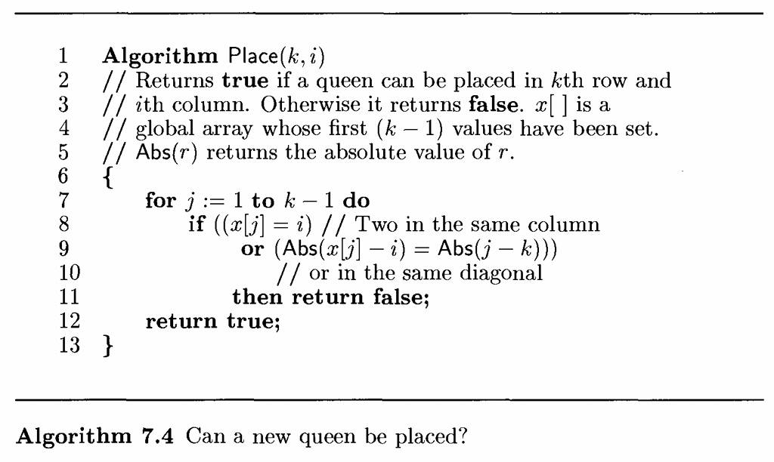
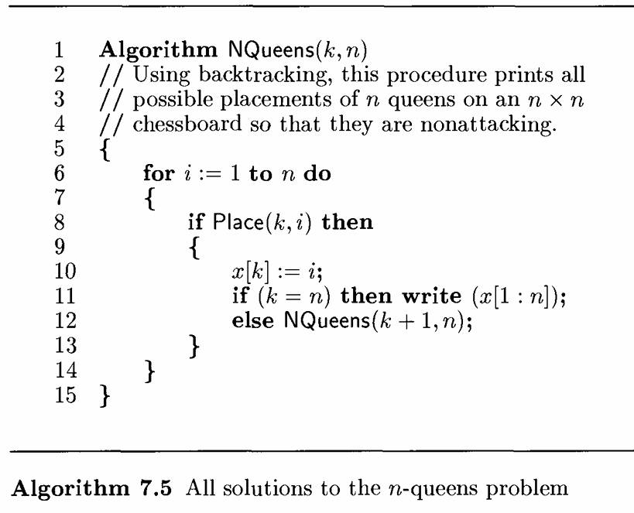
Backtracking Algorithm: The 4-Queens Problem
Below algorithms will be applicable for both 4-Queens & 8-Queens Problem
C Program Link:
https://github.com/dayanandyadav205/CS-402-ADA/blob/main/PPT_Notes/Unit-4_Backtracking_Branch_and_Bound/N-Queens_Problem.c

Slide 9
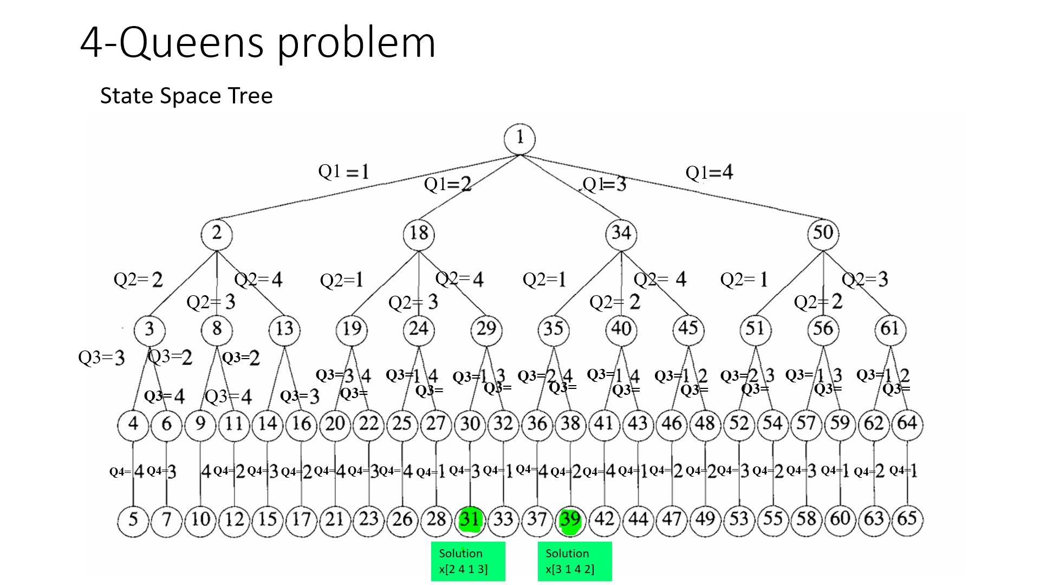
 | 1 | 2 | 3 | 4
1 | - | Q1 | - | -
2 | - | - | - | Q2
3 | Q3 | - | - | -
4 | - | - | Q4 | -
 | 1 | 2 | 3 | 4
1 | - | - | Q1 | -
2 | Q2 | - | - | -
3 | - | - | - | Q3
4 | - | Q4 | - | -
or Permutation tree
solution
x[2 4 1 3]
solution
x[3 1 4 2]

Slide 10
Backtracking Algorithm: The 8-Queens Problem
Problem: Place N-queens into NxN chessboard so that no two queens can attack each other means no two queens are on the same row, same column or same diagonal.
Constraints:
Explicit Constraints
Given 8 x 8 chessboard
Where 4 is the no. of queens
1 <= xi <=8
Implicit constraints:
We have to place all the queens in such a way that:
No two queens should be in same row
No two queens should be in same column
No two queens should be in same diagonal
 | 1 | 2 | 3 | 4 | 5 | 6 | 7 | 8
1 | - | - | - | Q1 | - | - | - | -
2 | - | - | - | - | - | Q2 | - | -
3 | - | - | - | - | - | - | - | Q3
4 | - | Q4 | - | - | - | - | - | -
5 | - | - | - | - | - | - | Q5 | -
6 | Q6 | - | - | - | - | - | - | -
7 | - | - | Q7 | - | - | - | - | -
8 | - | - | - | - | Q8 | - | - | -
8 x 8 chessboard
One of the solution is: x[4 6 8 2 7 1 3 5]

Slide 11
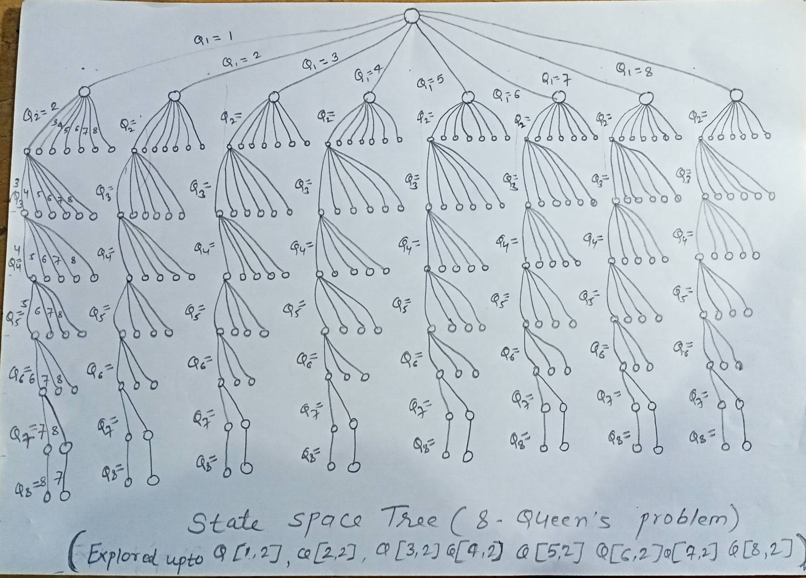
Backtracking Algorithm: The 8-Queens Problem
State Space Tree
or
Permutation tree

Slide 12
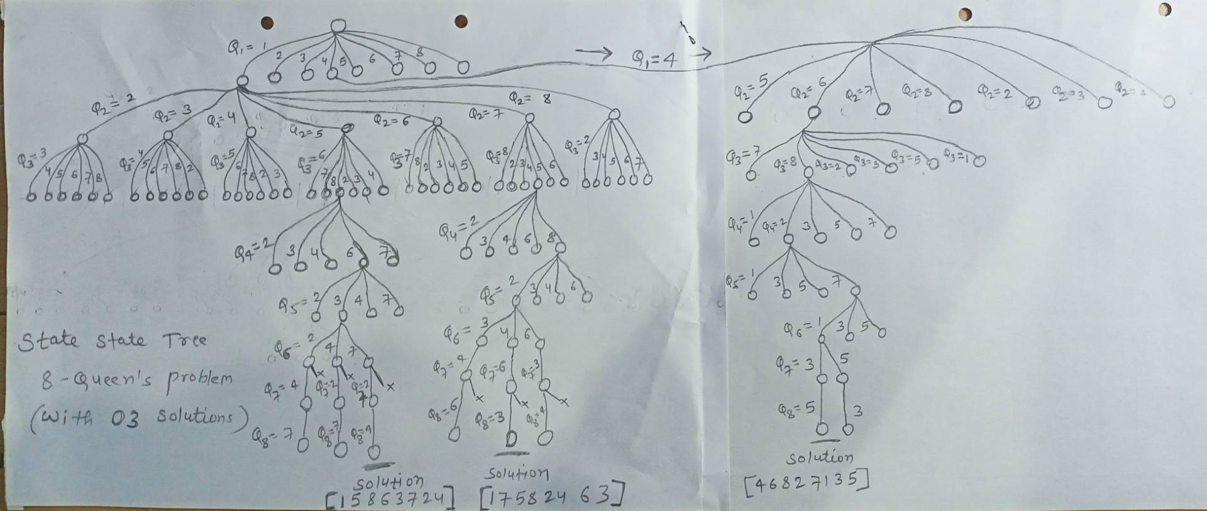
Backtracking Algorithm: The 8-Queens Problem
State Space Tree
or
Permutation tree
 | 1 | 2 | 3 | 4 | 5 | 6 | 7 | 8
1 | Q1 | - | - | - | - | - | - | -
2 | - | - | - | - | Q2 | - | - | -
3 | - | - | - | - | - | - | - | Q3
4 | - | - | - | - | - | Q4 | - | -
5 | - | - | Q5 | - | - | - | - | -
6 | - | - | - | - | - | - | Q6 | -
7 | - | Q7 | - | - | - | - | - | -
8 | - | - | - | Q8 | - | - | - | -
 | 1 | 2 | 3 | 4 | 5 | 6 | 7 | 8
1 | - | - | - | Q1 | - | - | - | -
2 | - | - | - | - | - | Q2 | - | -
3 | - | - | - | - | - | - | - | Q3
4 | - | Q4 | - | - | - | - | - | -
5 | - | - | - | - | - | - | Q5 | -
6 | Q6 | - | - | - | - | - | - | -
7 | - | - | Q7 | - | - | - | - | -
8 | - | - | - | - | Q8 | - | - | -
 | 1 | 2 | 3 | 4 | 5 | 6 | 7 | 8
1 | - | - | - | Q1 | - | - | - | -
2 | - | - | - | - | - | Q2 | - | -
3 | - | - | - | - | - | - | - | Q3
4 | - | Q4 | - | - | - | - | - | -
5 | - | - | - | - | - | - | Q5 | -
6 | Q6 | - | - | - | - | - | - | -
7 | - | - | Q7 | - | - | - | - | -
8 | - | - | - | - | Q8 | - | - | -
Solution x[1 5 8 6 3 7 2 4]
Solution x[1 7 5 8 2 4 6 3]
Solution x[4 6 8 2 7 1 3 5]

