Slide 1
Unit-5
CS - 402
Analysis & Design of Algorithms

Slide 2
Syllabus
Binary search trees, height balanced trees, 2-3 trees, B-trees, basic search and traversal techniques for trees and graphs (In order, preorder, postorder, DFS, BFS), NP-completeness.

Slide 3
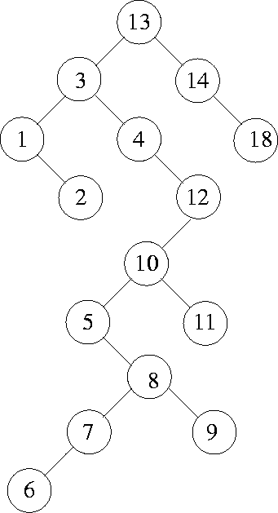
Binary Search Trees (BST)
DEF: A binary tree in which the nodes are labeled with elements of an ordered dynamic set and the following BST property is satisfied: all elements stored in the left subtree of any node x are less than the element stored at x and all elements stored in the right subtree of x are greater than the element at x.
An Example: Figure shows a binary search tree. Notice that this tree is obtained by inserting the values 13, 3, 4, 12, 14, 10, 5, 1, 8, 2, 7, 9, 11, 6, 18 in that order, starting from an empty tree.

Slide 4
Binary Search Trees (BST)
The lowest valued element in a BST can be found by traversing from the root in the left direction all along until a node with no left link is found (we can call that the leftmost element in the BST).
Search is straightforward in a BST. Start with the root and keep moving left or right using the BST property. If the key we are seeking is present, this search procedure will lead us to the key. If the key is not present, we end up in a null link.
Insertion in a BST is also a straightforward operation. If we need to insert an element x, we first search for x. If x is present, there is nothing to do. If x is not present, then our search procedure ends in a null link. It is at this position of this null link that x will be included.
If we repeatedly insert a sorted sequence of values to form a BST, we obtain a completely skewed BST. The height of such a tree is n - 1 if the tree has n nodes. Thus, the worst case complexity of searching or inserting an element into a BST having n nodes is O(n).

Slide 5
Binary Search Trees (BST)
Deletion in BST
Let x be a value to be deleted from the BST and let X denote the node containing the value x. Deletion of an element in a BST again uses the BST property in a critical way. When we delete the node X containing x, it would create a "void" that should be filled by a suitable existing node of the BST. There are two possible candidate nodes that can fill this void, in a way that the BST property is not violated: (1). Node containing highest valued element among all descendants of left child of X. (2). Node containing the lowest valued element among all the descendants of the right child of X. In case (1), the selected node will necessarily have a null right link which can be conveniently used in patching up the tree. In case (2), the selected node will necessarily have a null left link which can be used in patching up the tree. Figure illustrates several scenarios for deletion in BSTs.
For Figure go to next slide

Slide 6
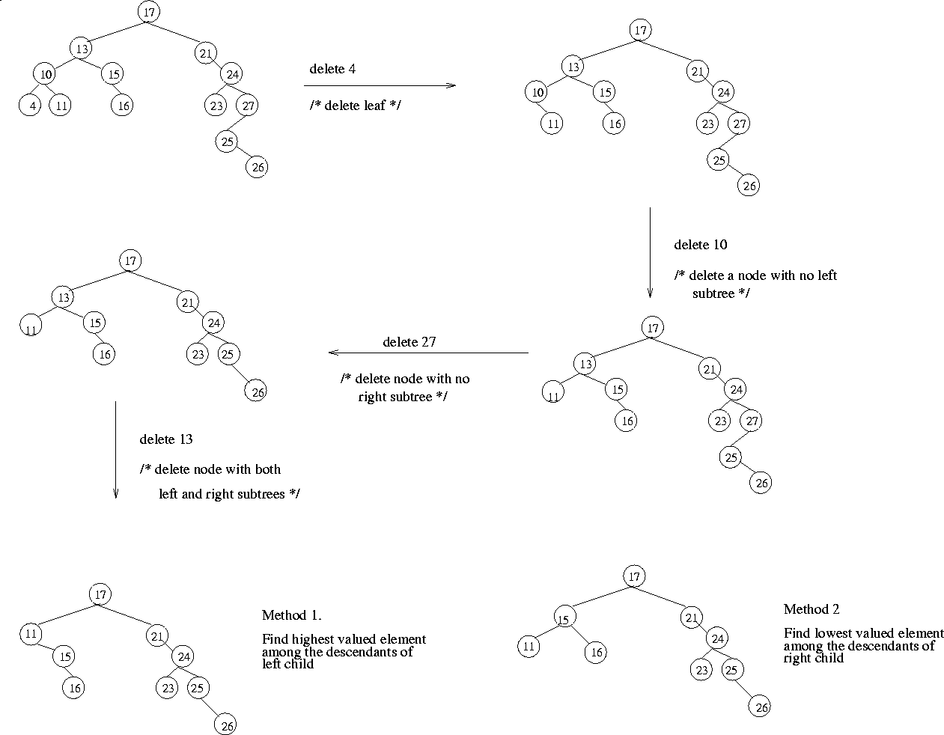

Slide 7
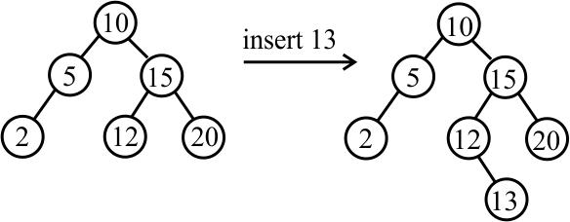
Inserting into a binary search tree
To insert a value, just find where that value would have been, had it already been in the tree, then add the value as a new leaf. For example, inserting 13 as shown below would result in the following change.
The actual insertion takes place when a null tree is encountered. The null tree is replaced by a leaf. If the value to be inserted is already in the tree, nothing is done.
Notice that parameter T is passed by reference. The first case needs to change the pointer that is stored in T. Also notice that there is no case for x = T->item since insert is supposed to do nothing when x already occurs in the tree.

Slide 8
Algorithm binary search tree Insertion
Algorithm BST_Insert(root, x)
// x is the value to be inserted
p := root
q := null // q will trail p, representing the parent node
// 1. Search for the insertion point
while p != null do
q := p
if x = p.data then
return false // Key already exists
else if x < p.data then
p := p.leftChild
else
p := p.rightChild
end if
end while
// 2. Allocate and initialize the new node
newNode := create new Node
newNode.data := x
newNode.leftChild := null
newNode.rightChild := null
// 3. Attach the new node to the tree
if root = null then
root := newNode
else if x < q.data then
q.leftChild := newNode
else
q.rightChild := newNode
end if
return true
end Algorithm

Slide 9
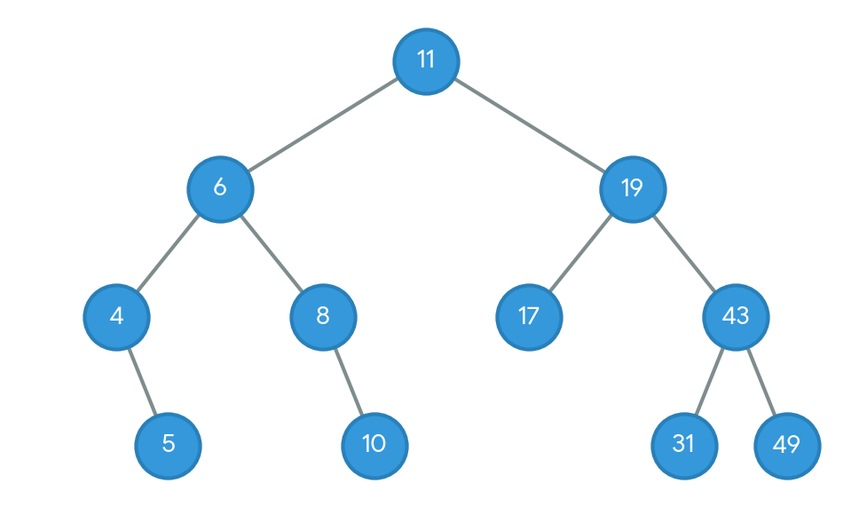
Inserting into a binary search tree
Draw a Binary Search Tree (BST) by inserting the following numbers from left to right: 11, 6, 8, 19, 4, 10, 5, 17, 43, 49, 31
Rules
Smaller numbers go Left.
Bigger numbers go Right.
Step 1: Start with 11, 6, 8
11 is the root.
6 goes left of 11.
8 goes left of 11, then right of 6.
Step 2: Add 19, 4, 10
19 goes right of 11.
4 goes left of 11, then left of 6.
10 goes left of 11, right of 6, then right of 8.
Step 3: Add 5, 17, 43
5 goes left of 11, left of 6, then right of 4.
17 goes right of 11, then left of 19.
43 goes right of 11, then right of 19.
Step 4: Add 49, 31
49 goes right of 11, right of 19, then right of 43.
31 goes right of 11, right of 19, then left of 43.

Slide 10
Deletion in Binary Search Tree (BST)
Given the root of a Binary Search Tree (BST) and an integer x, delete the node with value x from the BST while maintaining the BST property.
Deleting a node in a BST means removing the target node while ensuring that the tree remains a valid BST. Depending on the structure of the node to be deleted, there are three possible scenarios:
BST Deletion Cases
0 Children: Simply remove the leaf node.
1 Child: Replace node with its single child.
2 Children: Replace node with an inorder relative.
2-Children Deletion Strategies
Inorder Predecessor: Max value in left subtree.
Inorder Successor: Min value in right subtree.

Slide 11
Algorithm Deletion in Binary Search Tree (BST)
function Delete(pointer root, key x)
if root is NULL
return root
// Step 1: Search for the node to delete
if x < root.key
root.left = Delete(root.left, x)
else if x > root.key
root.right = Delete(root.right, x)
else
// Node found! Handle the 3 cases.
// Case 1 & 2: Node with 1 or 0 children
if root.left is NULL
temp = root.right
free(root)
return temp
else if root.right is NULL
temp = root.left
free(root)
return temp
// Case 3: Node with two children
// Find In-Order Successor (Minimum value in the right subtree)
temp = FindMin(root.right)
// Copy the Successor's content to this node
root.key = temp.key
// Delete the Successor node from the right subtree
root.right = Delete(root.right, temp.key)
return root

Slide 12
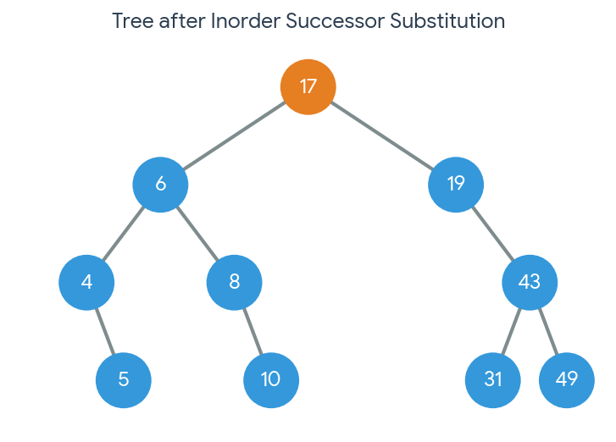
Binary Search Tree (BST) Deletion
Original Binary Search Tree
Lets delete the root 11.
In-order Successor: The smallest value in the right subtree.
In-order Predecessor: The largest value in the left subtree.
Let’s trace In-order Successor, which is the standard default approach:
Go to the right child of the target node (19).
Follow the left child pointers as far down as possible to find the minimum value.
Node 19 has a left child, 17. Node 17 has no left child.
17 is chosen as the successor

Slide 13
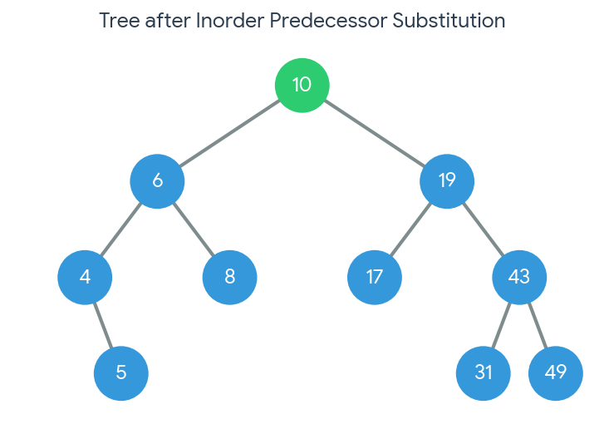
Binary Search Tree (BST) Deletion
Original Binary Search Tree
Lets delete the root 11.
Find the In-order Predecessor
To find the largest value in the left subtree:
Move to the left child of the target node (6).
Follow the right child pointers as far down as possible to find the maximum value.
Node 6 has a right child, 8. Node 8 has a right child, 10.
Node 10 has no right child.
10 is chosen as the predecessor

Slide 14
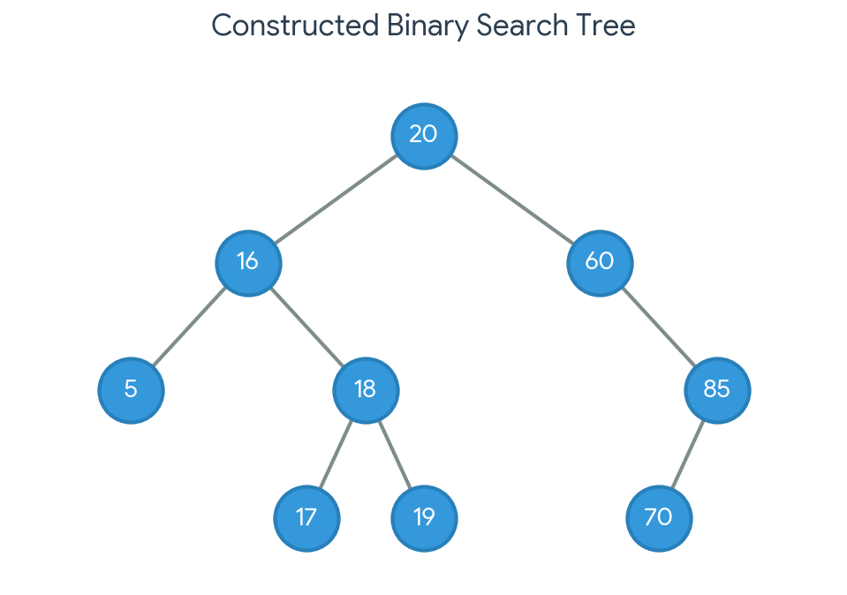
Exercise: Construction of BST
Construct a unique Binary Search Tree (BST) given only its Preorder traversal sequence: 20, 16, 5, 18, 17, 19, 60, 85, 70
Inorder: 5, 16, 17, 18, 19, 20, 60, 70, 85
Root: 20
Left Subtree (L): 5, 16, 17, 18, 19
Right Subtree (R): 60, 70, 85

Slide 15
Height-Balanced Tree or AVL Tree
A height-balanced tree (often an AVL tree) is a BST (binary search tree) where the height of the left and right subtrees of any node differ by at most 1. This structural rule limits the tree's height to O(log n), ensuring fast searching, insertion, and deletion times.
Balance Factor: For any node, the Balance Factor is defined as: Balance Factor = Height(Left Subtree) - Height(Right Subtree)
Condition: The Balance Factor of every node must be -1, 0, or 1.

Slide 16
Height-Balanced Tree or AVL Tree or Red-Black Tree
Rotations
Left Rotation (RR Imbalance): Occurs when a node gets inserted into the right subtree of a right child. A left rotation around node X brings Y up to balance the tree.
Right Rotation (LL Imbalance): Occurs when a node gets inserted into the left subtree of a left child. A right rotation around node Z brings Y up to balance the tree.
Balance Factor (BF): Calculated as Height(Left Subtree) - Height(Right Subtree). A tree is considered unbalanced if any node's BF goes outside the range [-1, 0, 1]

Slide 17
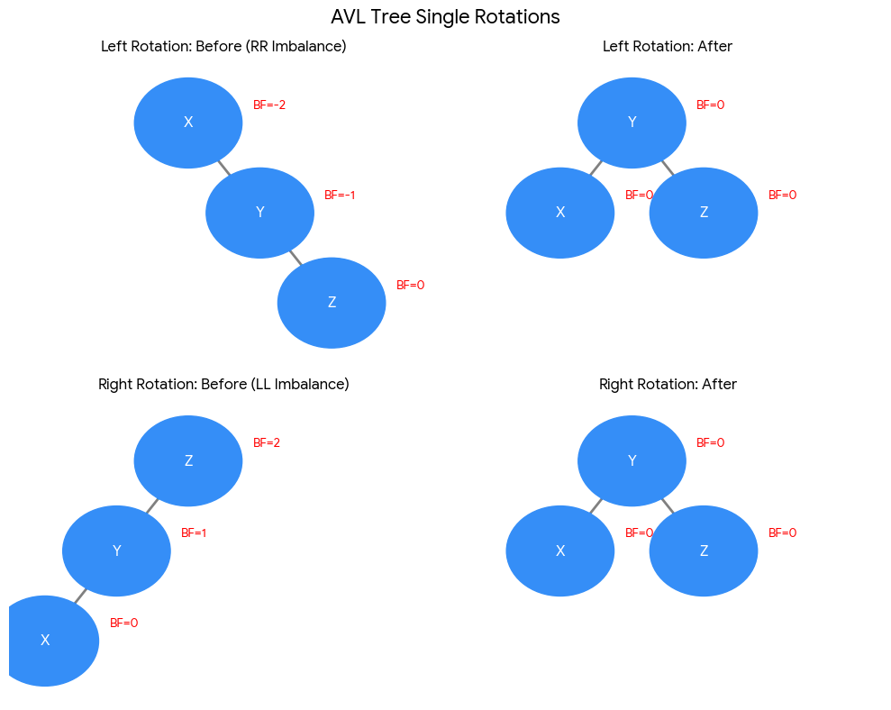

Slide 18
Height-Balanced Tree or AVL Tree or Red-Black Tree
Double Rotation
Left-Right (LR) Rotation:
When it occurs: A node is inserted into the right subtree of a left child.
How to fix: First, perform a Left Rotation on the child node (Y), converting it into an LL imbalance. Then, perform a Right Rotation on the parent node (X) to fully balance the tree.
Right-Left (RL) Rotation:
When it occurs: A node is inserted into the left subtree of a right child.
How to fix: First, perform a Right Rotation on the child node (Y), converting it into an RR imbalance. Then, perform a Left Rotation on the parent node (X) to fully balance the tree.

Slide 19
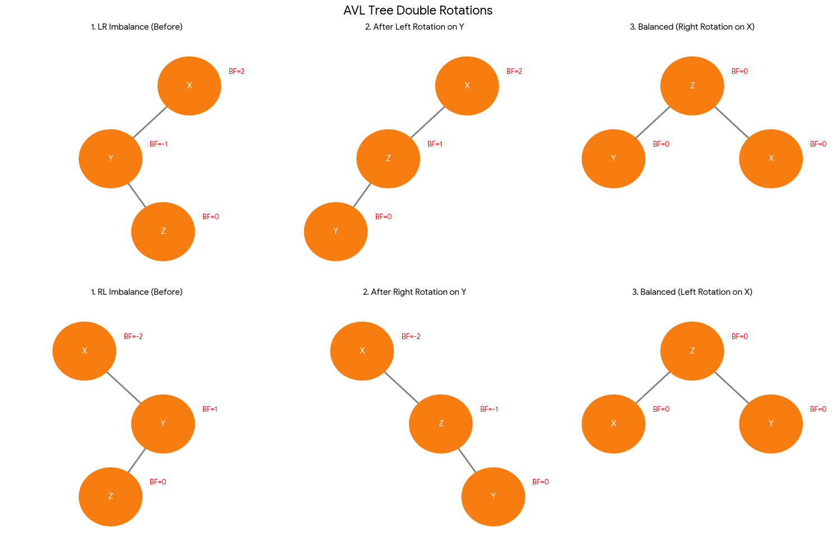

Slide 20
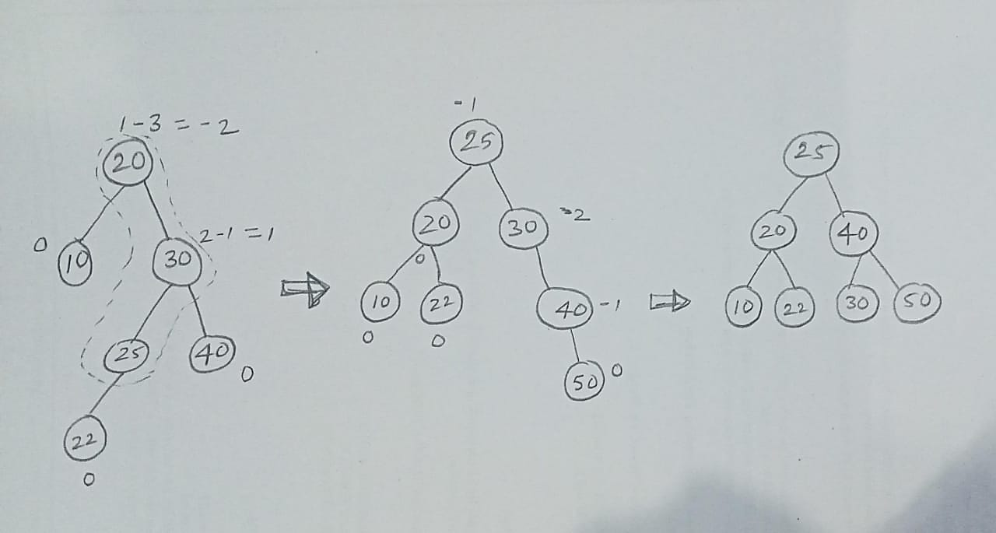
Height-Balanced Tree Insertion
Construct an AVL Tree using the keys: 40, 20, 10, 25, 30, 22, 50.
RL Imbalance at Root 20
After inserting 22, the root node 20 becomes imbalanced with a balance factor of -2 (1 - 3 = -2).
A Double Right-Left (RL) Rotation is performed around nodes 20, 30, and 25. Node 25 moves up to become the new root.
RR Imbalance at Node 30 after Inserting 50
After the RL rotation and the insertion of 50 under 40, we must check the balance factors again.
Node 30 has no left child (height 0) and a right subtree of height 2 (nodes 40 ->50).
This makes the balance factor of node 30 equal to -2 (0 - 2 = -2), creating a Right-Right (RR) Imbalance.
Final Balanced Tree
To resolve the RR imbalance at node 30, a Single Left Rotation is performed at node 30.
Node 40 moves up to take the place of 30, while 30 becomes its left child.

Slide 21
Algorithm: AVL Tree Insertion
Algorithm Insert(Tree, x)
// Inserts x into an AVL Tree. Rebalances if necessary.
If Tree == NULL
Return new Node(x)
If x < Tree.data
Tree.leftChild = Insert(Tree.leftChild, x)
If Height(Tree.leftChild) - Height(Tree.rightChild) == 2
If x < Tree.leftChild.data
Tree = LL_Rotate(Tree)
Else
Tree = LR_Rotate(Tree)
Else If x > Tree.data
Tree.rightChild = Insert(Tree.rightChild, x)
If Height(Tree.rightChild) - Height(Tree.leftChild) == 2
If x > Tree.rightChild.data
Tree = RR_Rotate(Tree)
Else
Tree = RL_Rotate(Tree)
Tree.height = Max(Height(Tree.leftChild), Height(Tree.rightChild)) + 1
Return Tree

Slide 22
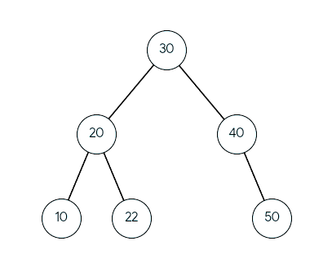
Height-Balanced Tree Deletion
delete the root key 25 .
Find the Substitute (Inorder Successor)
Since 25 has two children, we cannot just delete it. We must replace it with either its Inorder Predecessor (largest value in the left subtree) or its Inorder Successor (smallest value in the right subtree).
Let's choose the Inorder Successor:
Go to the right child (40).
Follow the leftmost path down. The smallest value is 30.
Check Balance Factors (BF)
We now calculate the Balance Factors from the bottom up, starting from where node 30 was removed:
Node 50: Has no children. BF=0-0=0
Node 40: Left height = 0, Right height = 1 (node 50). BF=0-1=-1
Node 22: Has no children. BF=0-0=0
Node 20: Left height = 0, Right height = 1 (node 22). BF=0-1=-1
Root Node 30: Left subtree height = 2 (path 20 ->22), Right subtree height = 2 (path 40 -> 50). BF 2-2 = 0
Replace and Remove
Copy the value 30 into the root node (overwriting 25).
Delete the original leaf node 30 from its old position

Slide 23
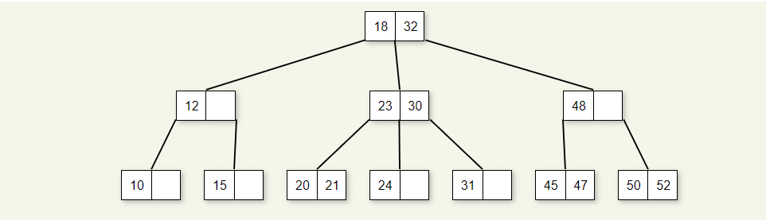
2-3 Trees
This section presents a data structure called the 2-3 tree. The 2-3 tree is not a binary tree, but instead its shape obeys the following definition:
A node contains one or two keys.
Every internal node has either two children (if it contains one key) or three children (if it contains two keys). Hence the name.
All leaves are at the same level in the tree, so the tree is always height balanced.

Slide 24
Insertion into a 2-3 tree
Insertion into a 2-3 tree is similar to insertion into a BST to the extent that the new record is placed in the appropriate leaf node. Unlike BST insertion, a new child is not created to hold the record being inserted, that is, the 2-3 tree does not grow downward. The first step is to find the leaf node that would contain the record if it were in the tree. If this leaf node contains only one value, then the new record can be added to that node with no further modification to the tree, as illustrated in the following visualization.

Slide 25
Insertion into a 2-3 tree

Slide 26
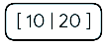
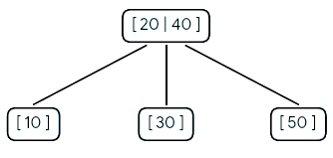
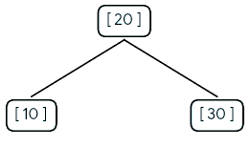
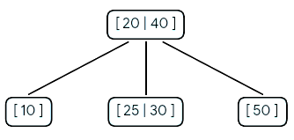
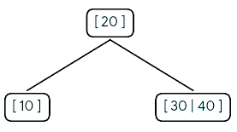
Construct a 2-3 Tree using the keys: 10, 20, 30, 40, 50, 25.
Insert 10, then Insert 20
Nodes can hold up to two values. Both keys fit inside the root node.
Insert 50
Adding 50 creates an overflow [30 | 40 | 50] on the right. The middle element (40) pushes up into the root node. The root becomes [20 | 40], which now has 3 child branches.
Insert 30
Adding 30 causes an overflow [10 | 20 | 30]. The middle value (20) pushes up to become the root, splitting 10 and 30 into left and right children.
Insert 25
The value 25 is between 20 and 40, so it takes the middle path to node [30]. Since there is vacant space inside that node, 25 slots cleanly into place to form the final structure.
Insert 40
Since 40 > 20, it goes to the right child. The right node has room, becoming a 3-node [30 | 40]

Slide 27
B-Trees
B-trees, or some variant of B-trees, are the standard file organization for applications requiring insertion, deletion, and key range searches. They are used to implement most modern file systems. B-trees address effectively all of the major problems encountered when implementing disk-based search trees:
The B-tree is shallow, in part because the tree is always height balanced (all leaf nodes are at the same level), and in part because the branching factor is quite high. So only a small number of disk blocks are accessed to reach a given record.
Update and search operations affect only those disk blocks on the path from the root to the leaf node containing the query record. The fewer the number of disk blocks affected during an operation, the less disk I/O is required.
B-trees keep related records (that is, records with similar key values) on the same disk block, which helps to minimize disk I/O on range searches.
B-trees guarantee that every node in the tree will be full at least to a certain minimum percentage. This improves space efficiency while reducing the typical number of disk fetches necessary during a search or update operation.

Slide 28
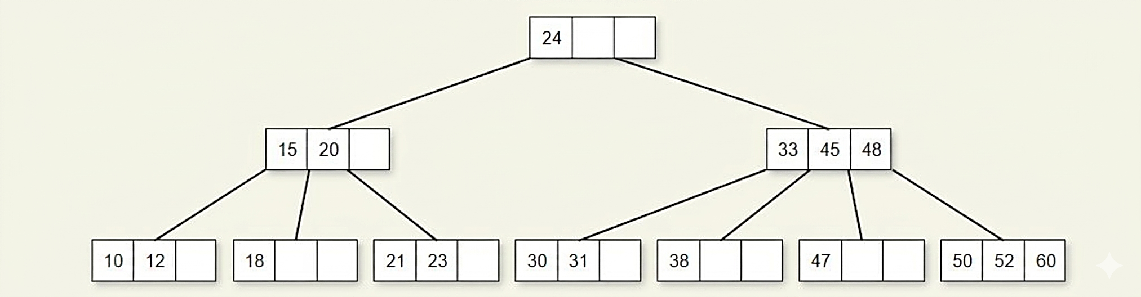
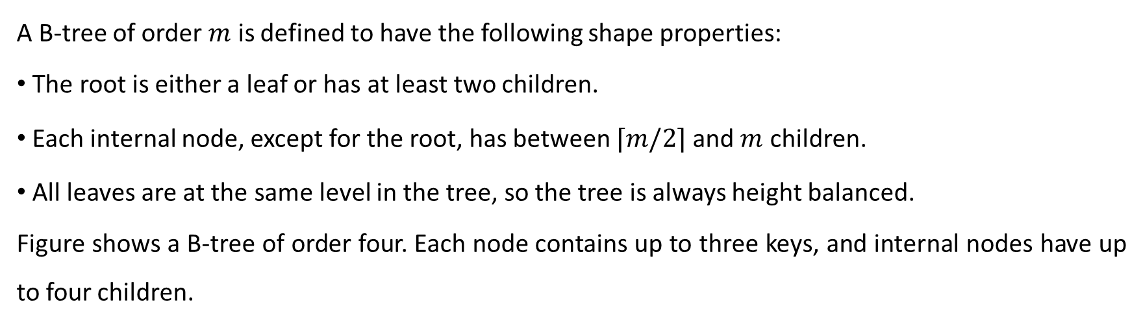
B-Trees
A B-tree of order $m$ is defined to have the following shape properties:
The root is either a leaf or has at least two children.
Each internal node, except for the root, has between $⌈m/2⌉$ and $m$ children.
All leaves are at the same level in the tree, so the tree is always height balanced.
Figure shows a B-tree of order four. Each node contains up to three keys, and internal nodes have up to four children.

Slide 29
Construct B tree of order 5 for the list of elements 2, 8, 5, 6, 13, 9, 14, 12, 19, 24, 18, 15, 5, 16, 20, 21
B-Tree Properties (Order m = 5)
Maximum keys per node: m - 1 = 4
Maximum children per node: m = 5
Minimum keys per non-root node: [m/2] - 1 = [5 / 2] - 1 = 2
Splitting criterion: When a node reaches 5 keys, the middle element (index 2, 0-indexed) moves up

Slide 30
Construct B tree of order 5 for the list of elements 2, 8, 5, 6, 13, 9, 14, 12, 19, 24, 18, 15, 5, 16, 20, 21
Step 1 (Insert 2, 8, 5, 6): Fits in root.
[2, 5, 6, 8]
Step 2 (Insert 13): Overflows [2, 5, 6, 8, 13]. Split at 6.
Root: [6]
Leaves: [2, 5] | [8, 13]
Step 3 (Insert 9, 14): Adds to right leaf.
Root: [6]
Leaves: [2, 5] | [8, 9, 13, 14]
Step 4 (Insert 12): Overflows right leaf. Split at 12 (moves to root).
Root: [6, 12]
Leaves: [2, 5] | [8, 9] | [13, 14]
Step 5 (Insert 19, 24): Adds to rightmost leaf.
Root: [6, 12]
Leaves: [2, 5] | [8, 9] | [13, 14, 19, 24]
Step 6 (Insert 18): Overflows rightmost leaf. Split at 18 (moves to root).
Root: [6, 12, 18]
Leaves: [2, 5] | [8, 9] | [13, 14] | [19, 24]
Step 7 (Insert 15): Adds to third leaf.
Leaf: [13, 14, 15]
Step 8 (Insert 5): Duplicate. Ignored.
Step 9 (Insert 16): Adds to third leaf.
Leaf: [13, 14, 15, 16]
Step 10 (Insert 20, 21): Adds to fourth leaf.
Leaf: [19, 20, 21, 24]
For complete B-Tree refer next slide

Slide 31
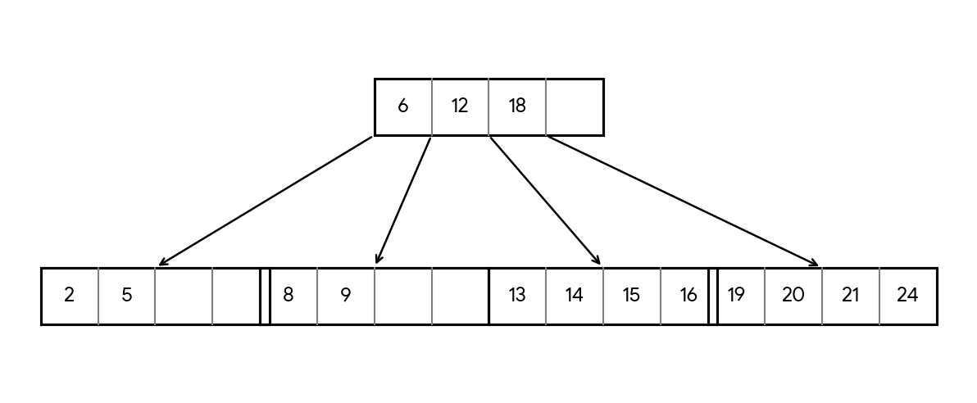
Construct B tree of order 5 for the list of elements 2, 8, 5, 6, 13, 9, 14, 12, 19, 24, 18, 15, 5, 16, 20, 21
Complete B-Tree

Slide 32
Basic search and traversal techniques for trees and graphs
Breadth-First Search (BFS) and Depth-First Search (DFS) for Binary Trees are ways to traverse nodes of the Binary Tree. This article aims to provide the basic difference between BFS and DFS for Binary Tree.
A Tree is typically traversed in two ways:
Breadth First Traversal (Or Level Order Traversal)
Depth First Traversals
Inorder Traversal (Left-Root-Right)
Preorder Traversal (Root-Left-Right)
Postorder Traversal (Left-Right-Root)

Slide 33
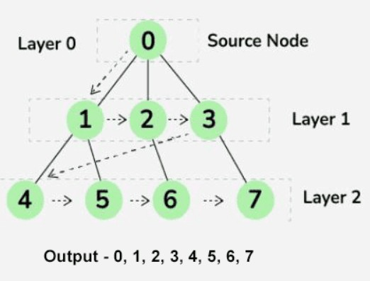
Breadth First Search (BFS)
Breadth First Search (BFS) is a graph traversal algorithm that starts traversing the graph from the root node and explores all the neighboring nodes at the present depth prior to moving on to the nodes at the next depth level.
How does BFS Tree Traversal work?
Breadth First Search (BFS) traversal explores all the neighboring nodes at the present depth prior to moving on to the nodes at the next depth level. In the context of a tree, BFS traversal works similarly.
Here's how BFS tree traversal typically works:
Start at the root node and add it to a queue.
While the queue is not empty, dequeue a node and visit it.
Enqueue all of its children (if any) into the queue.
Repeat steps 2 and 3 until the queue is empty.

Slide 34
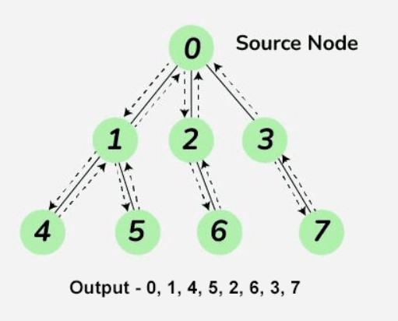
DFS (Depth-first search)
DFS (Depth-first search) is a technique used for traversing trees or graphs. Here backtracking is used for traversal. In this traversal first, the deepest node is visited and then backtracks to its parent node if no sibling of that node exists

Slide 35
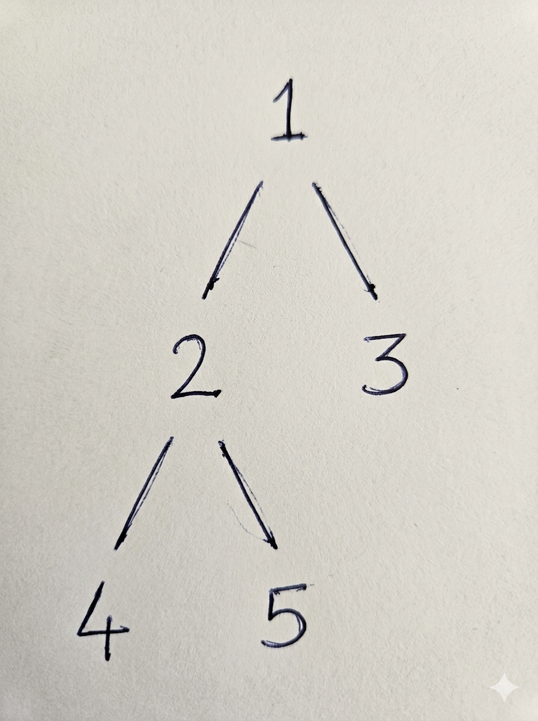
DFS (Depth-first search)
Preorder traversal
Preorder traversal is a type of Depth-First Search (DFS) for trees and graphs. It visits nodes in this specific sequence: Root → Left → Right. For each node, you process the current node first, then recursively traverse the entire left subtree, and finally the right subtree.
void preorder (tree_pointer ptr)
/* Given a binary tree pointed to by ptr, this algorithm
traverses the binary tree in preorder. */
{
if (ptr) {
visit(ptr); // Visit the root node
preorder(ptr->left); // Traverse the left subtree
preorder(ptr->right); // Traverse the right subtree
}
}
The preorder traversal would be: 1, 2, 4, 5, 3

Slide 36
DFS (Depth-first search)
Inorder traversal
Inorder traversal is another type of Depth-First Search (DFS) for trees. It visits nodes in this specific sequence: Left → Root → Right. For each node, you recursively traverse the entire left subtree first, process the current node, and finally traverse the right subtree.
Algorithm
procedure INORDER(ptr)
if ptr != NULL then
call INORDER(ptr->left)
print(ptr->data)
call INORDER(ptr->right)
end if
end INORDER
The inorder traversal would be: 4, 2, 5, 1, 3.

Slide 37
DFS (Depth-first search)
Postorder traversal
Postorder traversal is a Depth-First Search (DFS) method that visits nodes in this order: Left → Right → Root. You recursively traverse the left and right subtrees completely before processing the parent node.
Algorithm postorder(tree)
if tree == NULL then return
// Step 1: Traverse left subtree
postorder(tree->leftChild)
// Step 2: Traverse right subtree
postorder(tree->rightChild)
// Step 3: Process/Visit the root
visit(tree)
end postorder
The postorder traversal sequence is: 4, 5, 2, 3, 1

Slide 38
NP-completeness
NP-complete problems are the hardest computational problems in the class NP. They can be verified quickly but no efficient algorithm exists to solve them. Proving a problem is NP-complete shows it is highly likely unsolvable at scale, shifting focus to using heuristic or approximation algorithms
The Complexity Classes
P (Polynomial Time): Problems that a computer can solve efficiently (e.g., sorting a list or finding the shortest path using Dijkstra's algorithm).
NP (Nondeterministic Polynomial Time): Problems where a proposed solution can be checked/verified quickly. If a computer checks your answer in a reasonable timeframe, the problem is in NP. All problems in P are automatically in NP.
NP-Hard: Problems that are at least as hard as the hardest problems in NP. They are not necessarily in NP themselves (e.g., they may not have solutions that can be quickly verified).
NP-Complete: Problems that satisfy two conditions:
They are in NP (you can verify a solution quickly).
They are NP-hard (every other problem in NP can be translated/reduced into this problem efficiently)

Slide 39
The Power of Reduction
A "reduction" is a way of transforming one problem into another. If you have an algorithm to solve Problem B, you can use it to solve Problem A if you can translate the inputs of A into the inputs of B.
If you can efficiently reduce a known NP-complete problem to a new problem, you have effectively proven that the new problem is also NP-complete. This forms the basis of proving hardness across computer science, as outlined in classical textbooks like Introduction to Algorithms

Slide 40
P vs. NP
It remains unproven whether P = NP. If anyone discovers a fast (polynomial time) algorithm to solve even one NP-complete problem, it would mean that all NP problems can be solved quickly. Most computer scientists and complexity theorists strongly believe that P ≠ NP

Slide 41
Decision vs Optimization Problems
NP-Completeness is defined for decision problems because their difficulty is easier to compare. In many cases, solving the decision version efficiently also helps solve the corresponding optimization problem using a polynomial number of calls.
NP-completeness is defined for decision problems.
Decision problems are easier to compare than optimization problems.
Polynomial-time solutions to decision problems can help solve optimization problems.
Optimization problems can be reduced to decision problems using multiple queries.
Hence, the complexity of decision problems reflects the complexity of optimization problems.

Slide 42
Common Examples
Thousands of real-world problems have been proven to be NP-complete, typically involving resource allocation, routing, or combinations. Common examples include:
The Traveling Salesperson Problem (TSP): Finding the shortest possible route that visits a specific list of cities and returns to the origin city.
Knapsack Problem: Selecting a set of items with given weights and values to maximize the total value without exceeding a specific weight limit.

Slide 43
THANK YOU

