Slide 1

Application: Jobster
Type: Application Architecture
View: Logical View
Style: Layered Architecture Pattern
User
Delivery Channel
Core Business Processes
Data and Information
Technology Enablers
Home
(Basic search
& sign in/up)
Login Data
Cloud
Customers/Partner Data
Payment Getaway
Customers
Customize User/Partner Account
E-mail Services
Jobs Data
Web App
Customize User Account & Payments
Filtering Data
Real-time Bus
Partner Dashboard
Job Application Data
Tickets for Help Desk
Partners
Transactions
Job Search API
Help Desk
Internet
Subscription Information
Admin

Slide 2
Advance Search
Contact Form Data
Advance Search

Slide 3


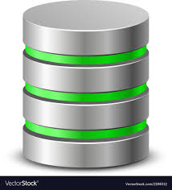



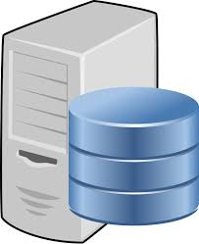
Application: Jobster
Type: Application Architecture
View: Logical View
Style: Layered Architecture Pattern
Application: Jobster
Type: Application Architecture
View: Logical View
Style: Layered Architecture Pattern
DMZ
Core
Secure Core
Customers
Web App
Web browser authenticates customers/partners
Admin
NAS & Storage
Monitor activities
Partners
Web Server
Authorizing users/partners
Handling exceptions
Secure configuration
Make business logic calculations
Internet
DB Server
App Server

