Slide 1
Interim Presentation - By Team 3 (2023)

Slide 2
Table of Contents

Slide 3
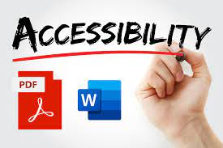
Introduction
Objective: Bridge the gap between standard documents and needs of those with learning disabilities (Focus: Dyslexia).
Social Impact: Aligns with the theme of "social good"; enhances user experience and inclusivity.
Primary Function: Transforms various document types (PPT, Word, Excel) into highly accessible formats.
Notes:
cheril

Slide 4
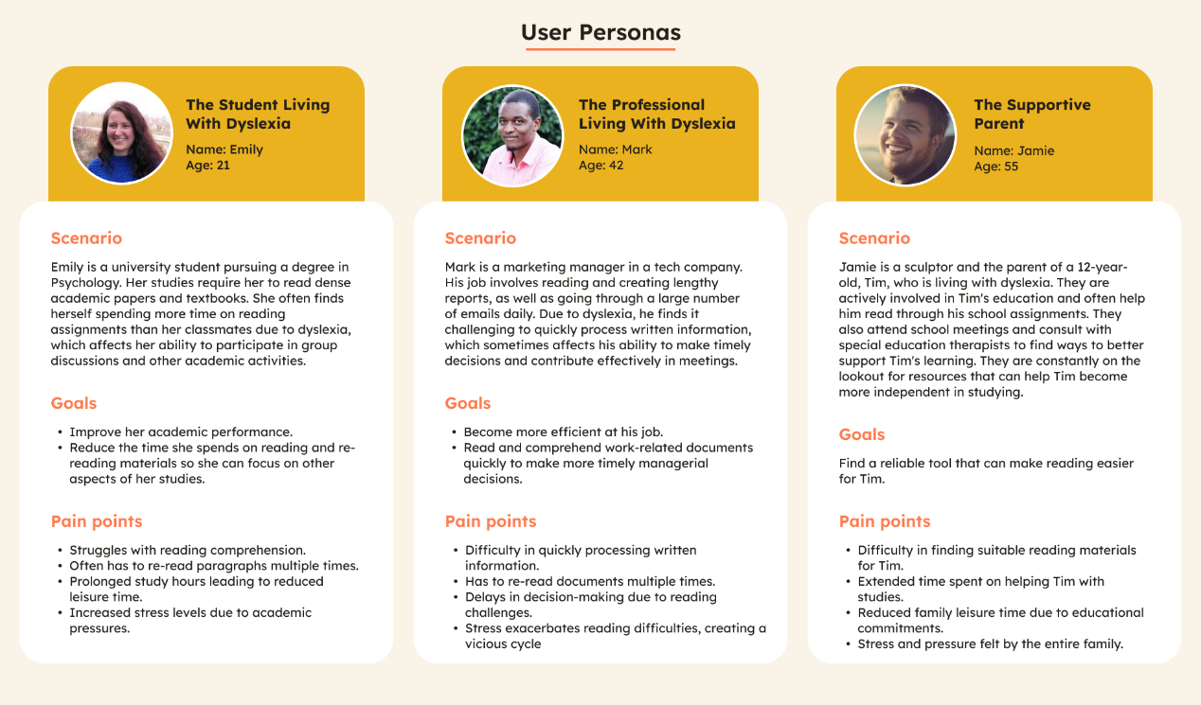
User Scenario: The Characters

Slide 5
Technical Problem: The Setting

Slide 6
Core technical problems
UI/UX
Prioritizes accessibility for all users.
Desktop-first approach with responsiveness for other devices.
Architecture
Cloud-based for scalability, flexibility, and security.
Document Optimization Features
Informed by research, user feedback, and technical feasibility studies.
Reason for Building the application
Addressing accessibility for individuals with dyslexia and other disabilities in various document formats.
Unique Features
Allows users to export reformatted, optimized documents for convenient re-reading.
Document Formats Supported
.doc, .docx, .ppt, .pptx, .xls, .xlsx

Slide 7
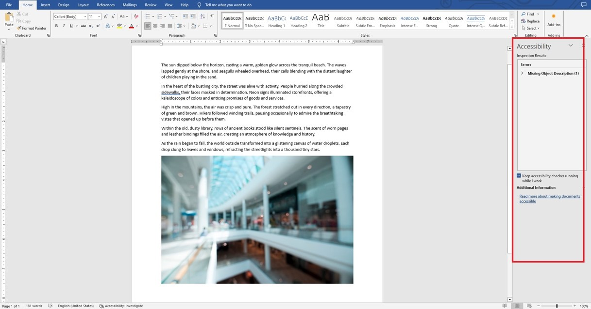
Comprehensive analysis of similar systems
Microsoft Office Accessibility Checker
Features
Auto-scans MS Office docs
Task Pane UI
Pros
Integrated in Office
User-friendly
Cons
MS Office files only
Not fully comprehensive

Slide 8
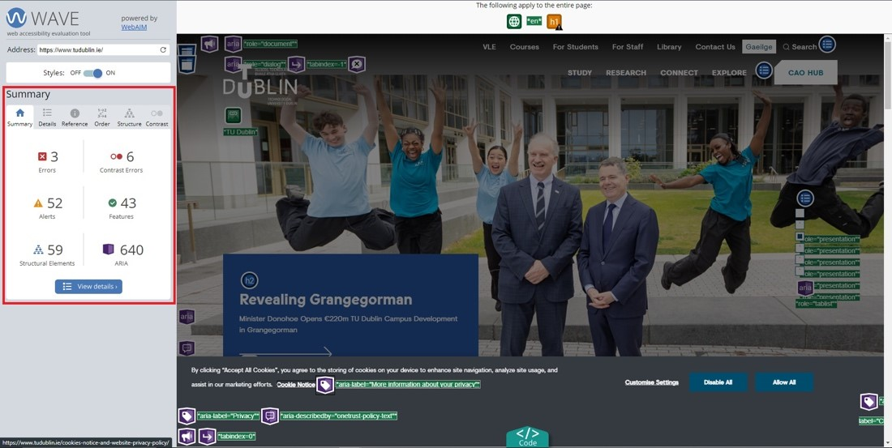
Comprehensive analysis of similar systems
WebAIM's WAVE Tool
Features
Web-based
Checks various issues
Visual overlay
Pros
Free
Easy to use
Comprehensive
Cons
Web content only
False positives
Notes:
cheril

Slide 9
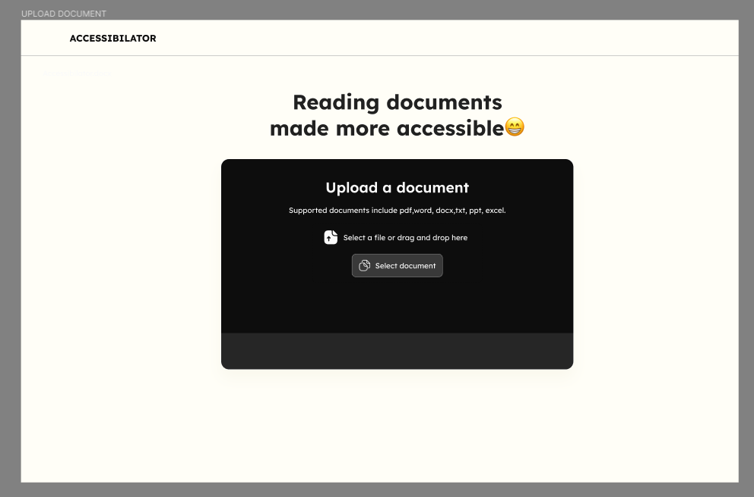
Comparison with the Accessibilator
Comprehensiveness
Accessibilator: Fixes colour, font for full accessibility
Others: Limited features
Ease of Use
Accessibilator: User-friendly
MS Office: Integrated but limited to MS
WAVE: Web-only
Price
Accessibilator: Free with extensive features
Others: Varies
Specialization
Accessibilator: Identifies and fixes issues
Others: Only identifies issues
Notes:
cheril

Slide 10
Technical Solution: The Plot

Slide 11
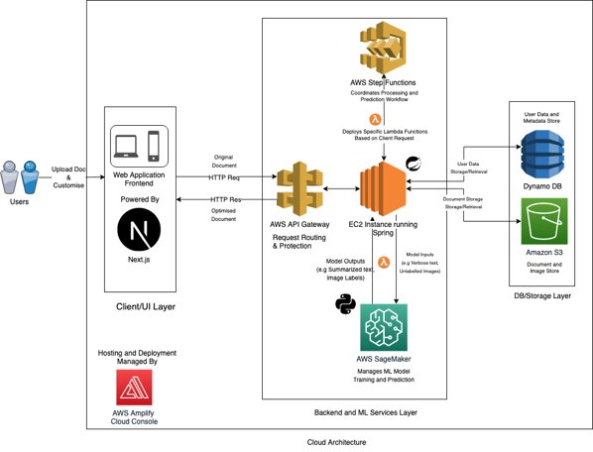
System Architecture
Notes:
cheril

Slide 12
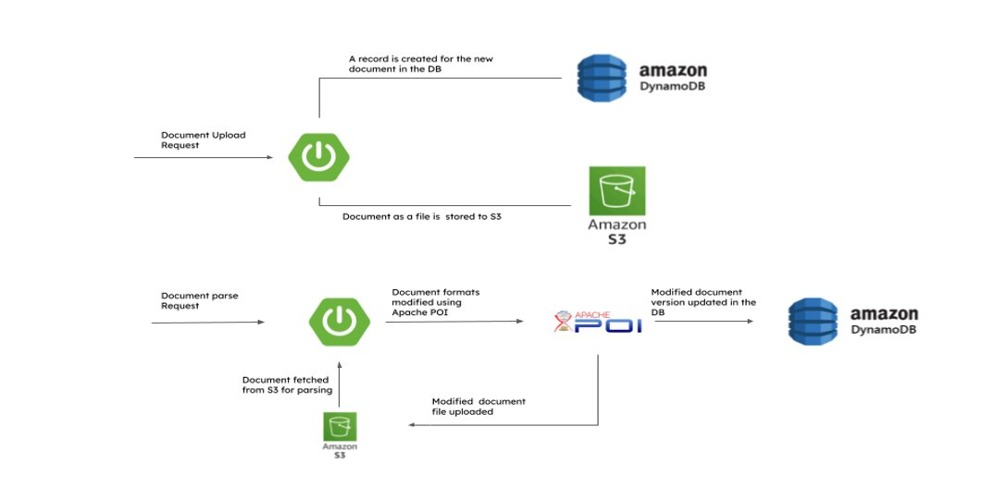
Backend Workflow
Notes:
cheril

Slide 13



Upload Document
Doc , Docx
Txt , Rtf
XLS, XLSX
CSV, XML, XLSB
PPT, PPTX
CSV, XML, XLSB
Technological Solution
Uploading the file via a REST API Endpoint and loading it to an AWS S3 Bucket to store it.
Notes:
cheril

Slide 14
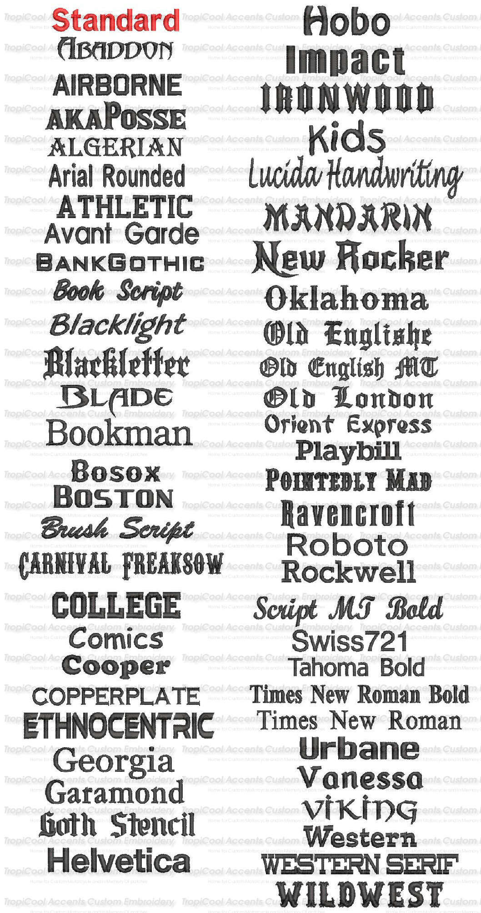

Font style and Size
Technical Solution
Font styles such as Lexend, Open Sans, Comic Sans OpenDyslexic, Dyslexie can be applied as per user preference using Apache POI's built-in methods. The default font style will be Open Sans.
The document's font size can be fetched and modified using Apache POI. The default setting for the new font size is 14 points, although this can be customized by the user
Arial
Comic Sans MS
Verdana
Notes:
deny

Slide 15
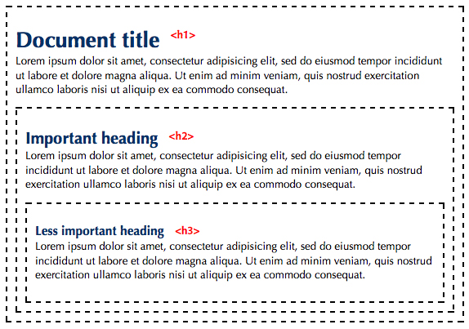
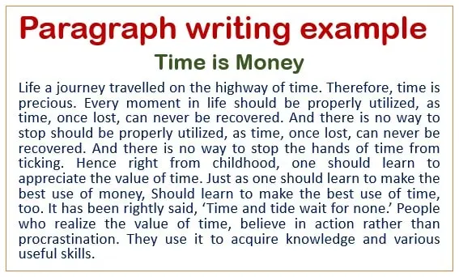
Headings Paragraph splitting
Technical Solution
.Efficiently create manageable chunks and simpler sentence structures.
Utilizing OpenAI's text completion and fine-tuning APIs.
Technical Solution
Automatic generation of contextually relevant, easy-to-understand headings
Utilizing Long Short-Term Memory (LSTM) model.
Hosted on Amazon SageMaker for scalability and integration.
Notes:
Deny

Slide 16
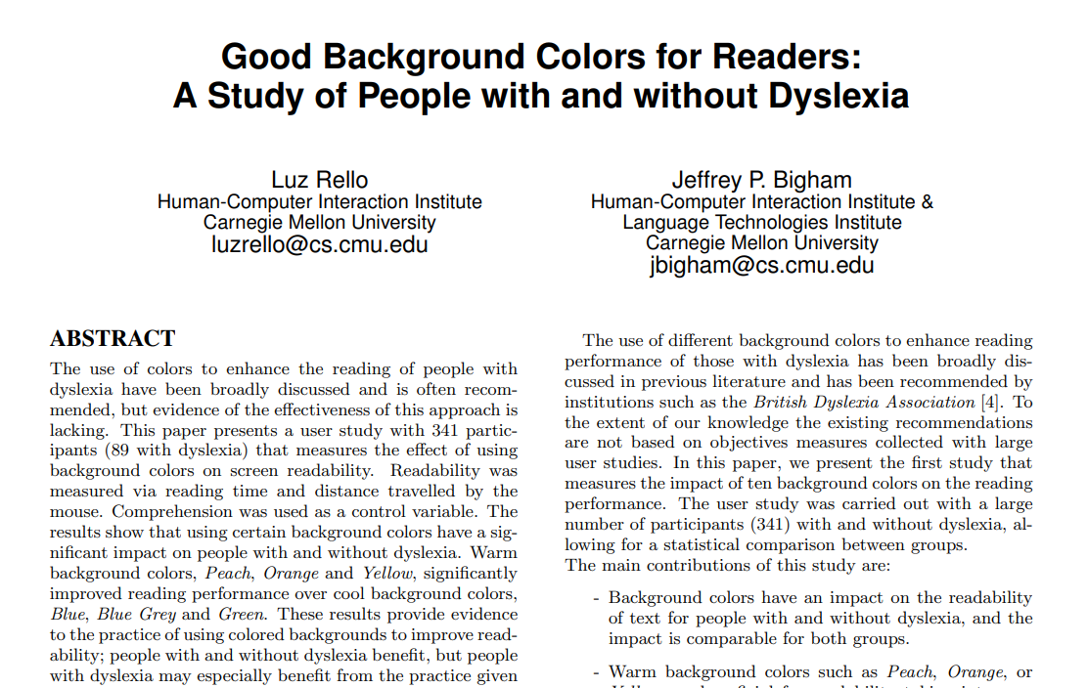
Colour Enhancement
Technical Solution
The Apache POI library allows you to fetch the current text colour for contrast analysis. Utilizing algorithms like the WCAG contrast ratio, you can assess and adjust the text and background colours for better readability
Notes:
Deny

Slide 17
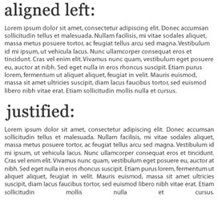
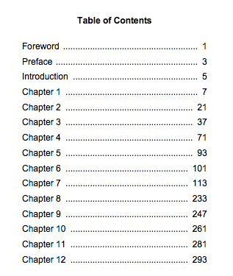
Layout - Alignment Table of Contents
Technical Solution
The document layout can be set to left-aligned using Apache POI's built in methods.
Technical Solution
Headings in the document can be identified by iterating through its paragraphs using the Apache POI.
A new paragraph is then created to list these headings in a numbered format, serving as the table of contents.
Notes:
deny

Slide 18

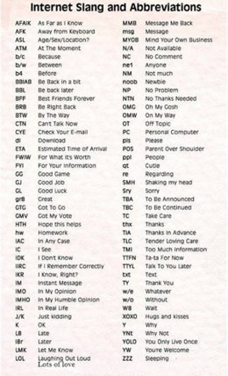
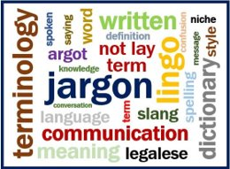
Bad Words
Expand Abbreviations and simplify Jargons
Technical Solution
Utilize Machine Learning to automatically expand or abbreviate text in documents.
Transform complex jargon into simple language for easier comprehension.
Technical Solution
Text sanitization techniques to remove or replace inappropriate language.
Python libraries: profanity-check, profanity filter, better_profanity.
Notes:
Joel

Slide 19
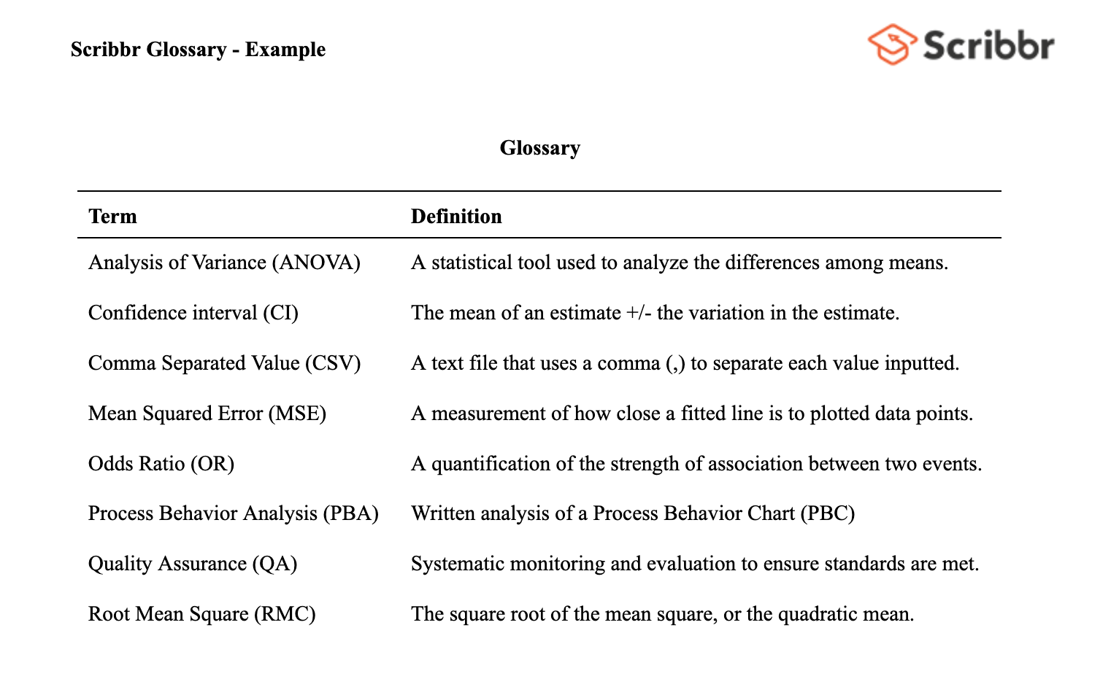
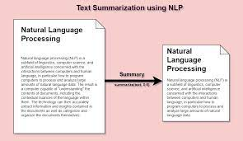
Glossary Auto-generation
Text summarization
Technical Solution
Concise yet informative summaries that retain original meaning.
Utilizing RNNs, LSTMs, and GRUs for deep learning-based summarization.
Technical Solution
Enhanced readability and quick reference guide for readers
Utilizing TF-IDF to identify key terms and phrases in documents.
WordNet API for fetching contextually relevant definitions.
Notes:
Joel

Slide 20
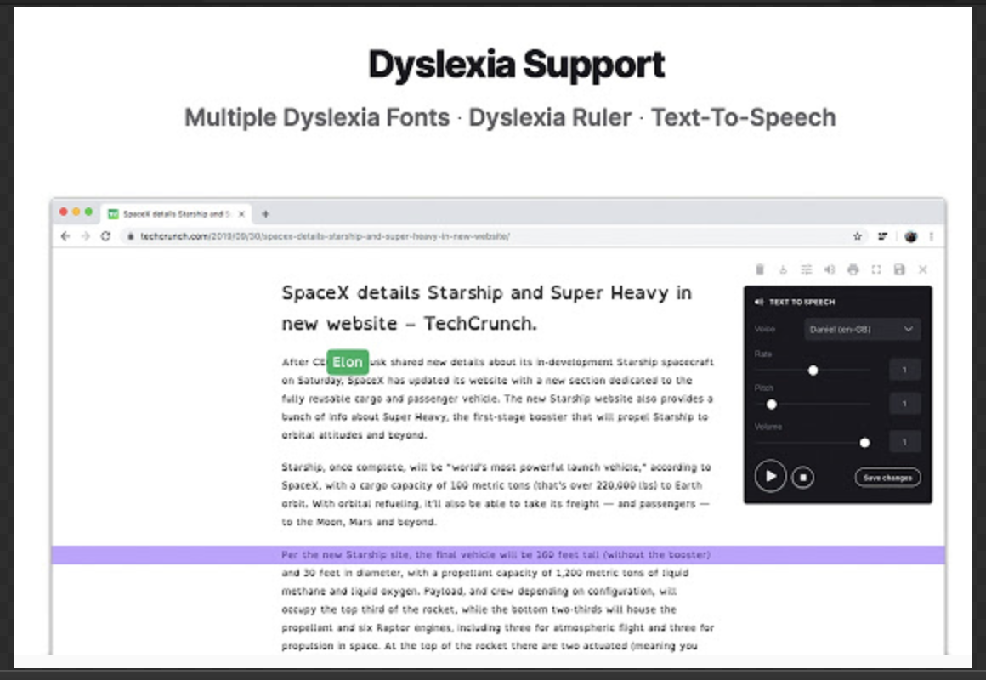
Dyslexia ruler with customisations
Technical Solution
Customization panel to alter the properties of the ruler. CSS and JavaScript will be used develop the same
Notes:
Joel

Slide 21
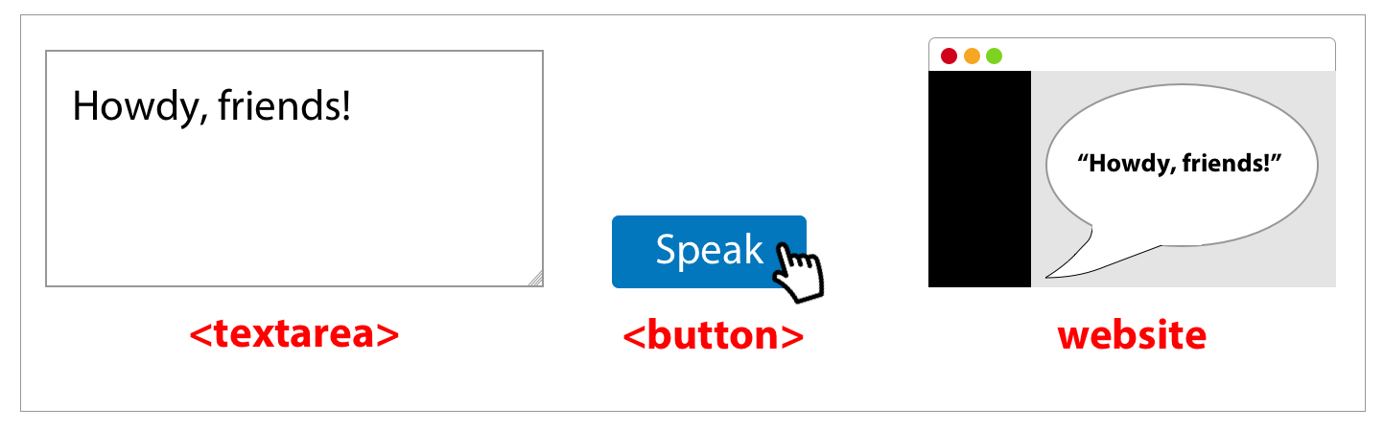

Text to speech Screen Reader
Technical Solution
Using CSS and JavaScript this issue can be resolved.
Technical Solution
Using Web Speech API in JavaScript as a solution
Notes:
Joel

Slide 22
User Evaluation: The Reviews

Slide 23
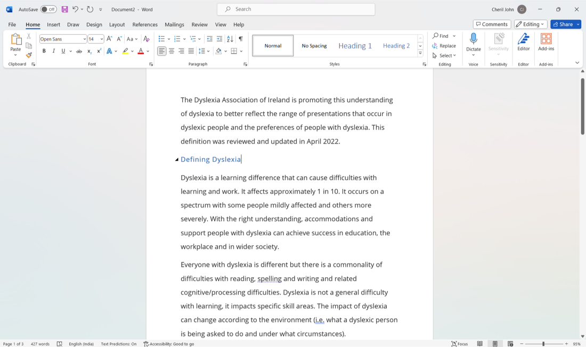
What does success look like for your system?
Success is multi-faceted: technical efficiency + meaningful user impact.
User-Centric Goals
Educate users on dyslexia-friendly formats.
Automated tools to adapt text, color, layout.
Inclusive impact across dyslexia spectrum.
Technical Goals
Efficient document parsing and optimization.
Seamless front-back-end integration.
AWS services like EC2, S3, and SageMaker for backend tasks.
Success Metrics
At least a 20% improvement in document accessibility scores.
Notes:
Joel

Slide 24

Evaluation
Front-end Evaluation
Tools: Google PageSpeed Insights.
Metrics: TTFB, FCP, Page Load Time.
Backend Evaluation
Tools: Amazon CloudWatch.
Metrics: CPU Utilization, Disk I/O, Network Throughput.
Alerts: CloudWatch Alarms for metrics thresholds.
Code Quality
Unit Testing
Functional Testing
Integration Testing
User Surveys
Post-interaction for ease of use, effectiveness, and experience
Case Studies
In-depth interviews with dyslexic users on reading experience
Usability Testing
Multi-method: Think-aloud and Task-Based Testing
Complemented by user surveys.
Feedback Loop
In-app feedback form for real-time qualitative data
Notes:
Joel

Slide 25
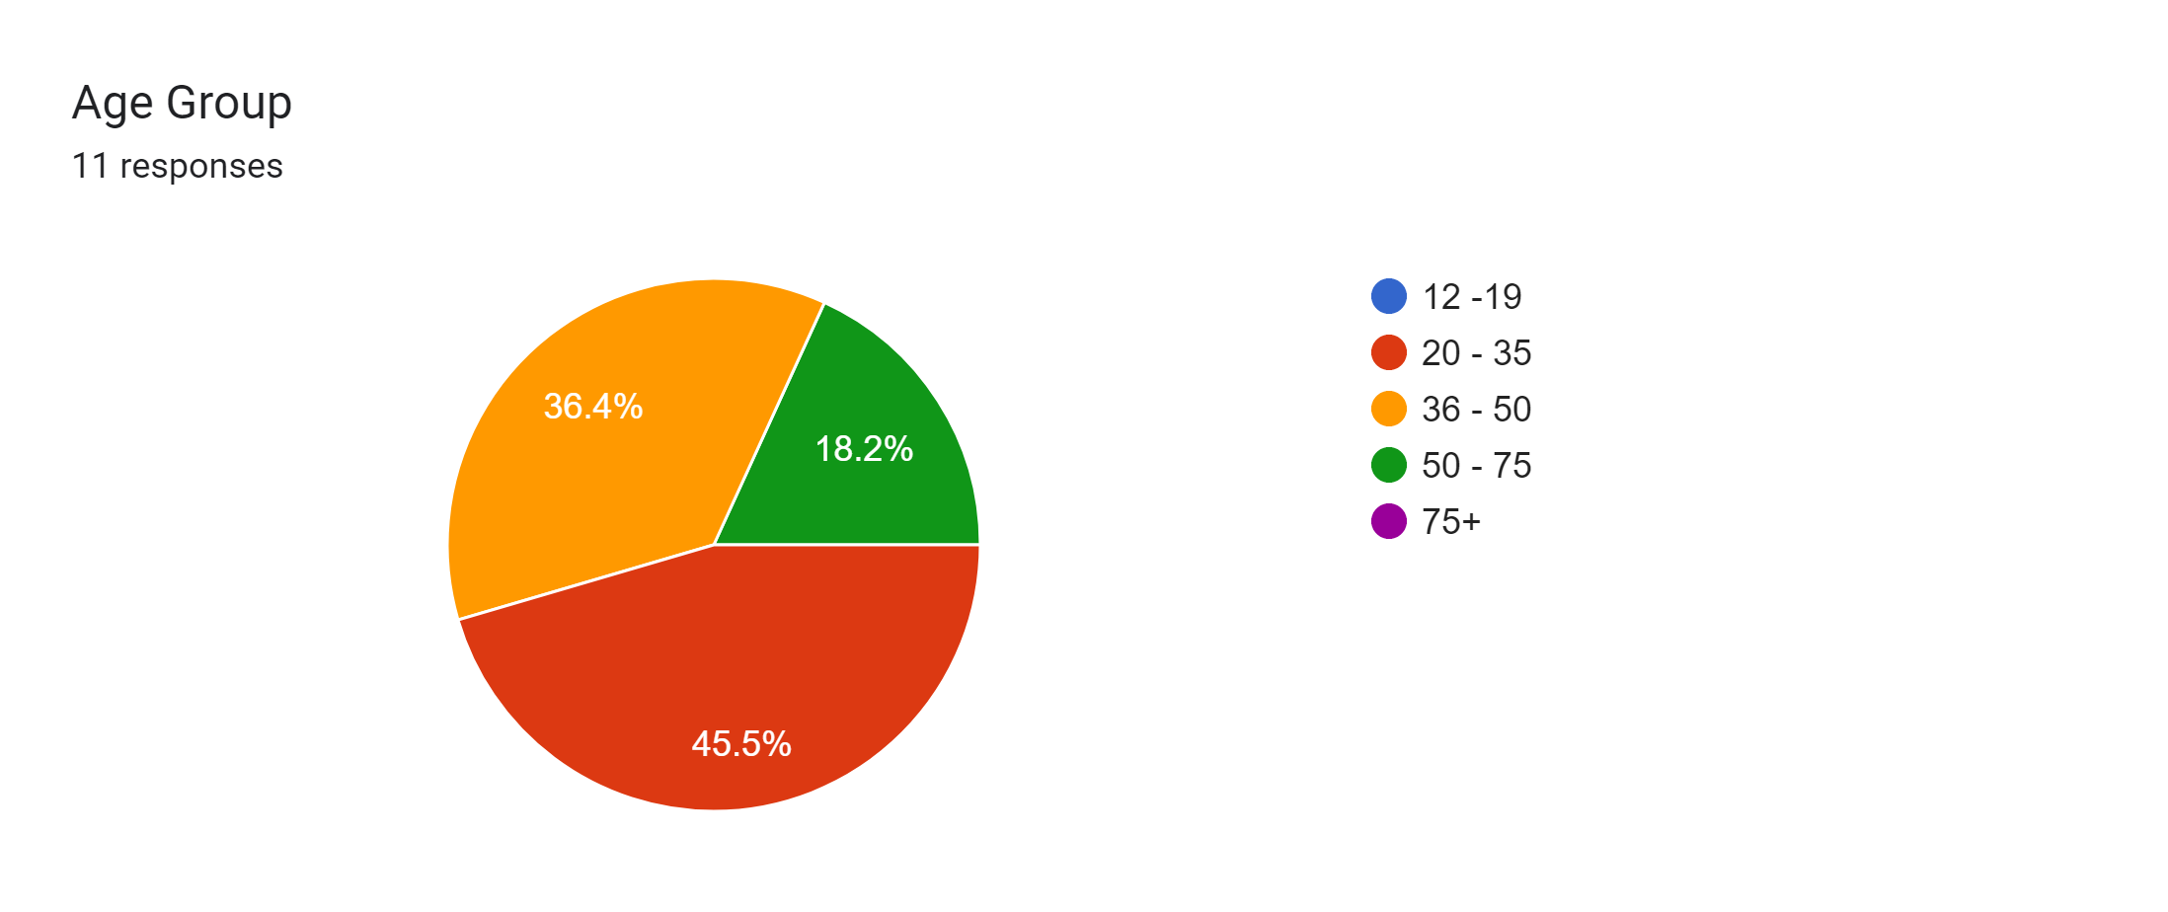
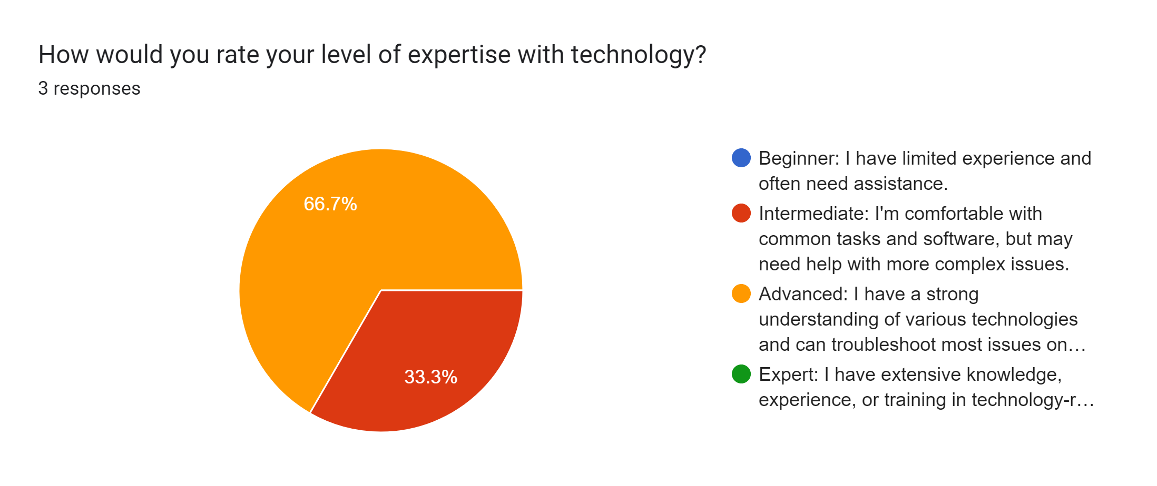
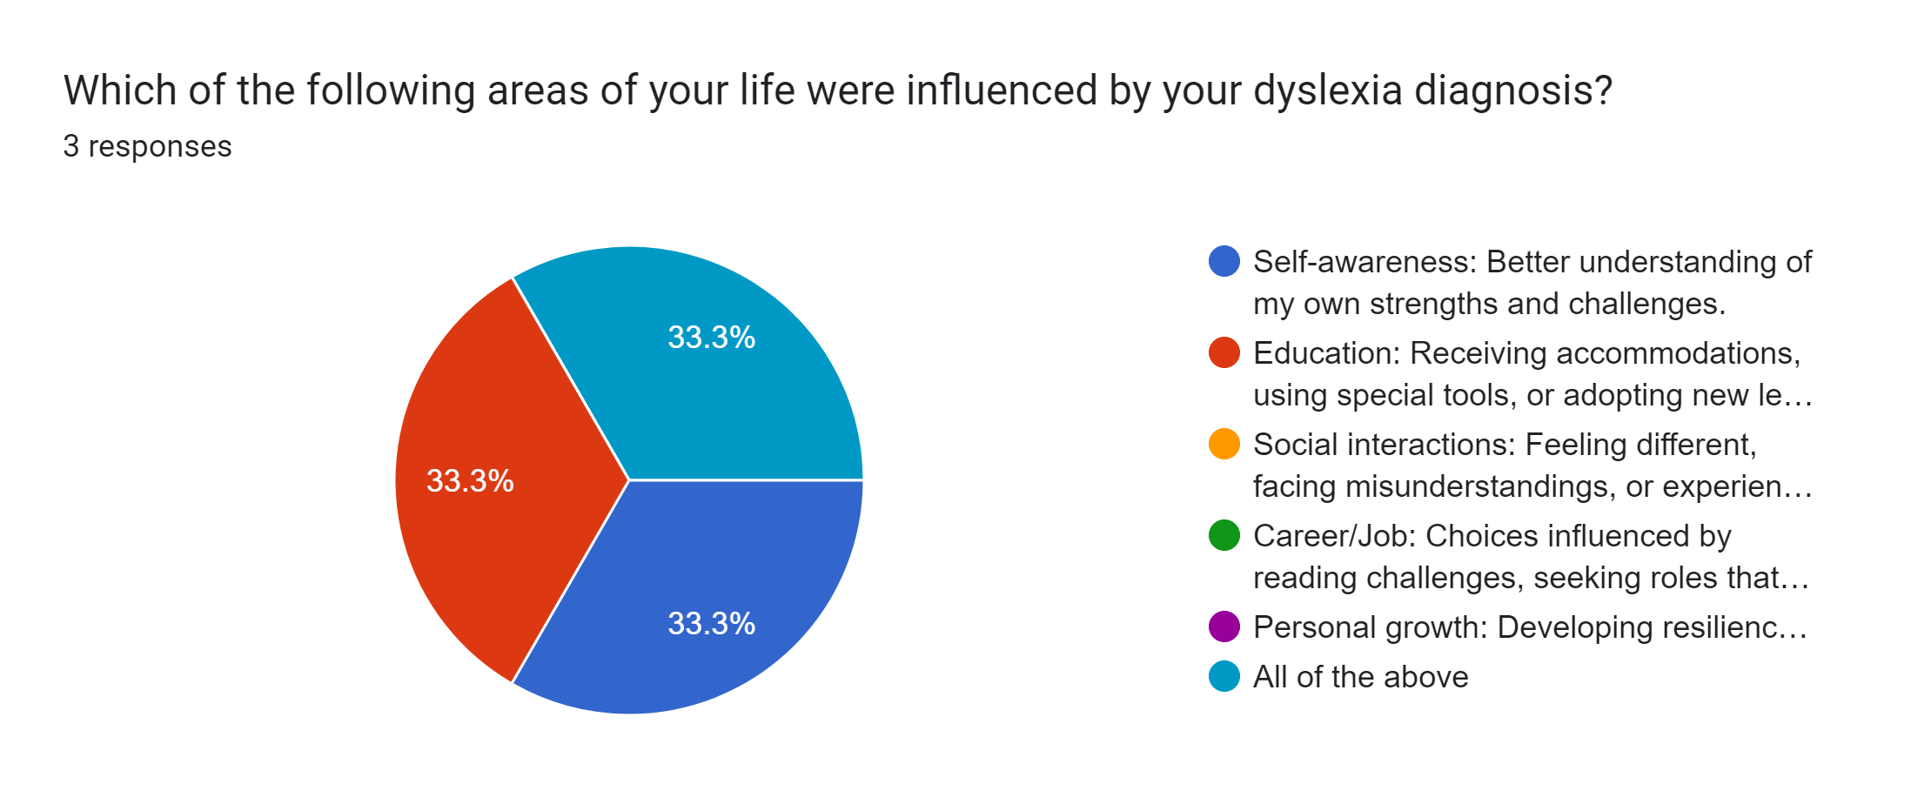
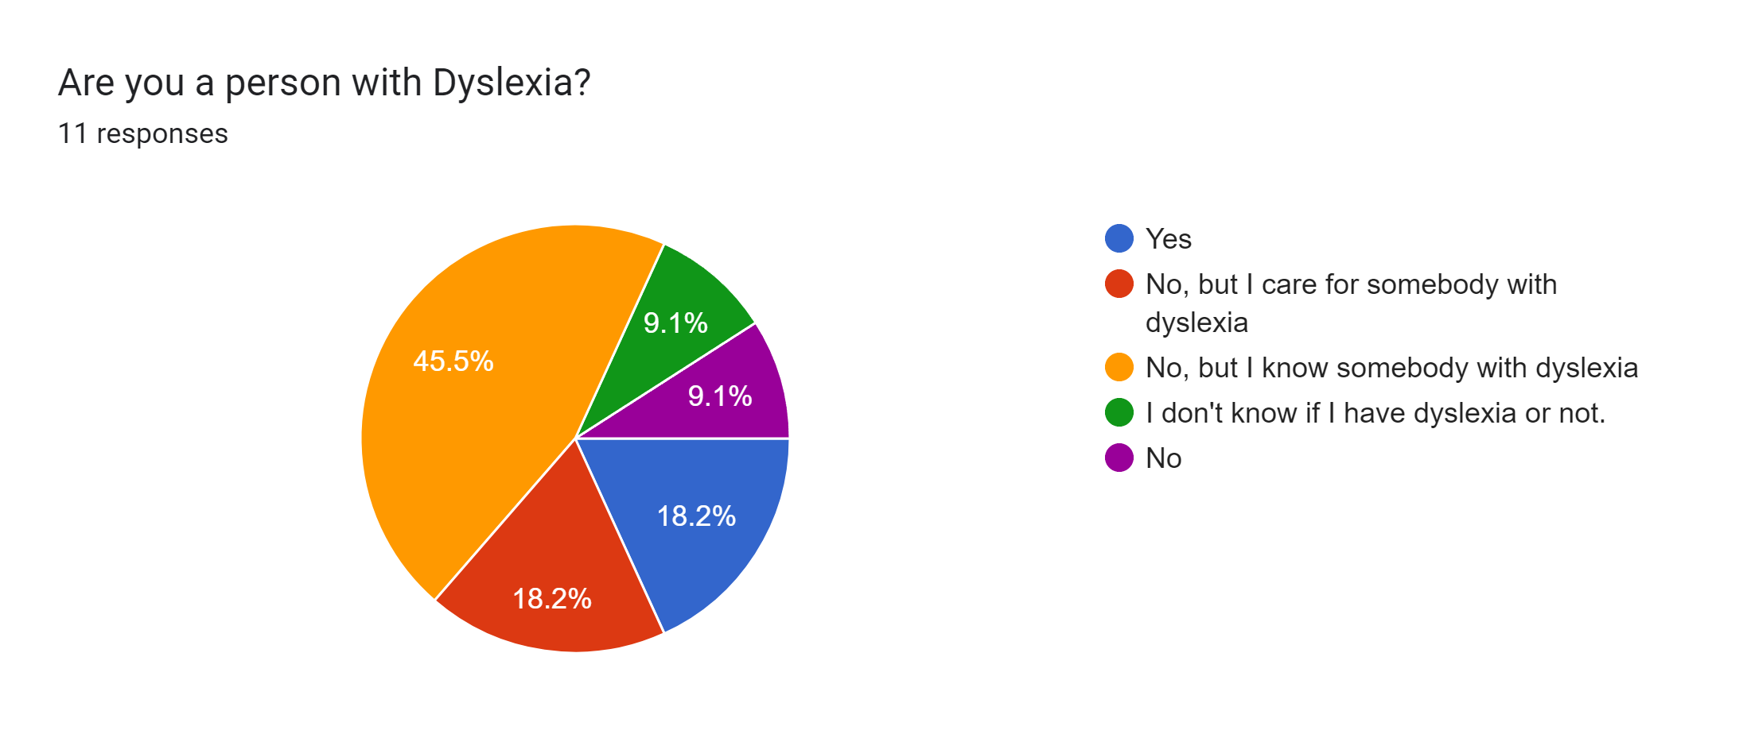
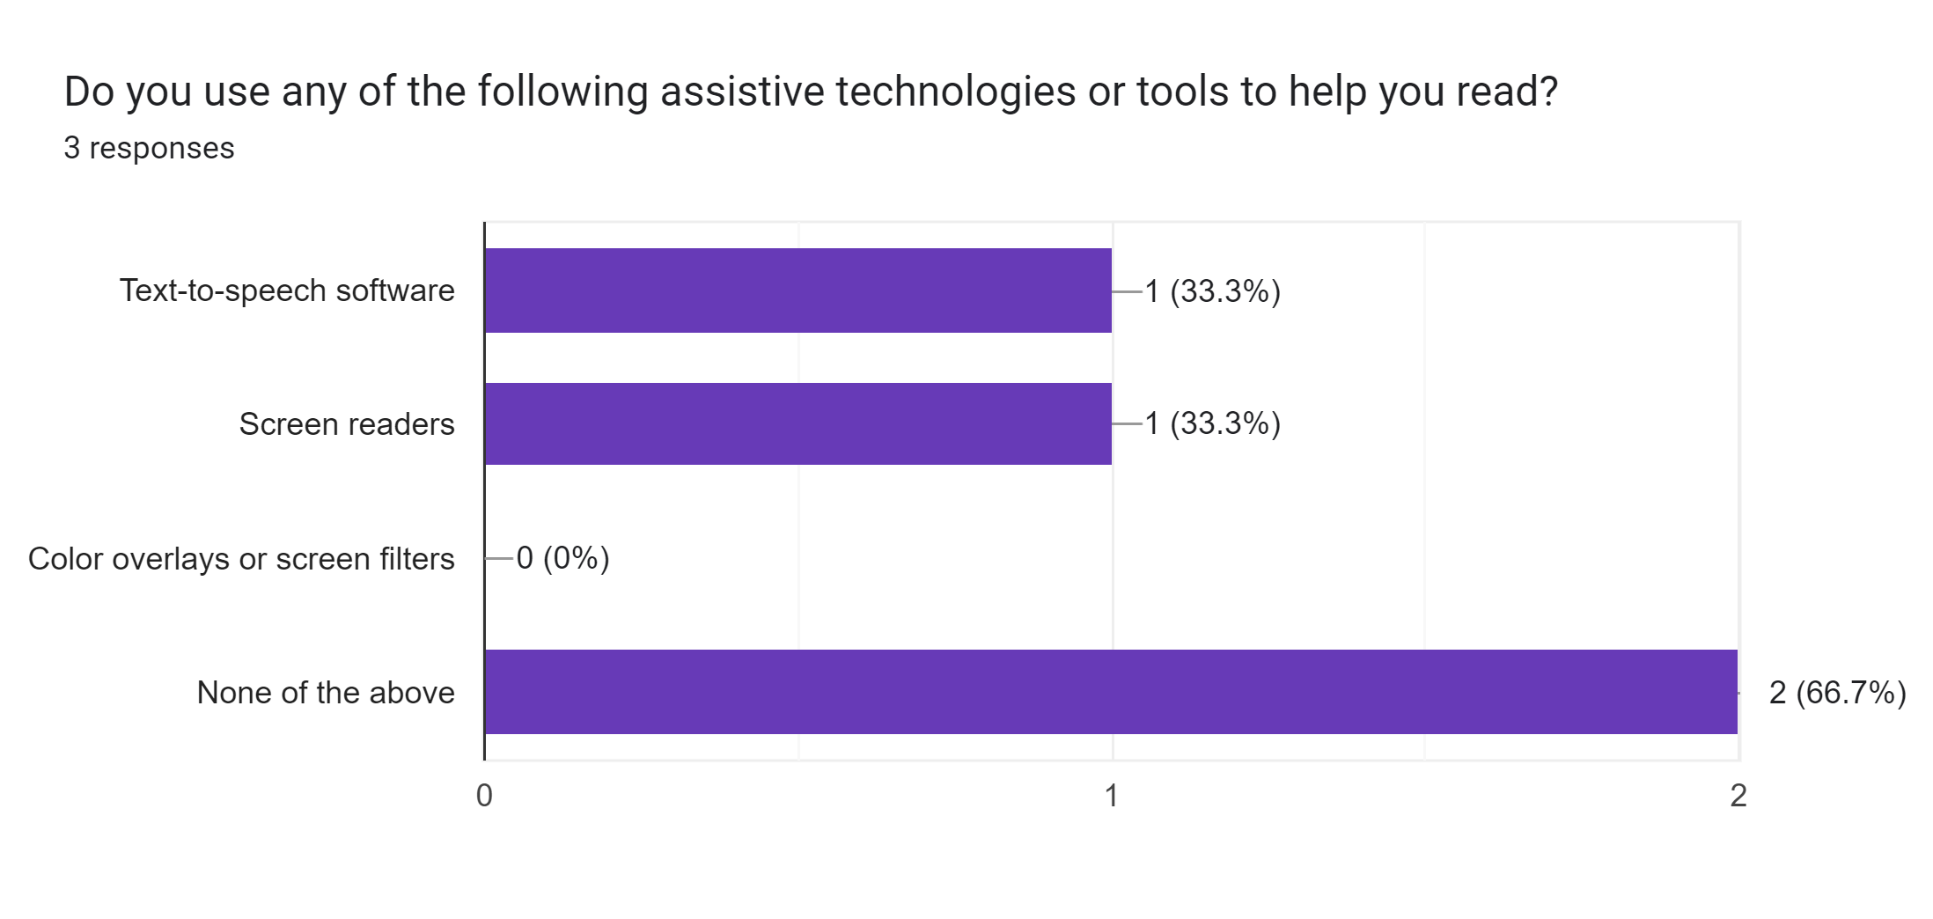
Survey Findings
Notes:
Joel

Slide 26
Thank you
Team 3
Cheril Miriam John (D22124272 - ASD)
David Ayang (D21127639 - ASD)
Joel Felix Quadras (D22125093 - DS)
Mountdenyraj Chelladurai Nadar (D22124430 - ASD)

