Slide 1
CONSTRUCTION PROJECT
MANAGEMENT SYSTEM
Detailed Client & System Presentation
Centralized control for projects, finance, site operations, labour, contractors, documents and client visibility.
95% COMPLETE
SPRING BOOT
REACT
MYSQL
JWT SECURITY
Prepared by Dayan Ganganath

Slide 2
Executive summary
What the client should understand within the first two minutes.
What it is
Why it matters
How it works
A centralized web-based construction management platform that brings commercial, site, labour, contractor, document and client information into one controlled system.
It reduces fragmented records, improves visibility, makes responsibility clearer, strengthens financial control and gives stakeholders role-specific access.
Users log in through secure role-based portals. Each action is restricted by role, assignment and ownership rules, while operational data is stored centrally.
One System → One Source of Project Truth
Management controls operations and finance • Site teams update execution • Contractors see assigned commercial data • Clients receive approved visibility

Slide 3
The business problems CPMS addresses
The system was designed around real construction workflow pain points—not around technology alone.
Scattered information
Delayed site visibility
Finance reconciliation risk
Project data can be spread across WhatsApp, spreadsheets, paper files, phone calls and personal devices.
Management and clients often depend on manual follow-ups before they know what happened on site.
Client receipts, expenses, contractor bills and actual payments can become difficult to reconcile consistently.
Unclear responsibility
Document confusion
Limited auditability
Without controlled access, it is difficult to identify who can view, update or approve each type of information.
Drawings, payment slips, photos and reports may exist in multiple locations and versions.
When status or visibility changes are informal, management has less traceability over operational decisions.

Slide 4
From fragmented work to controlled workflow
CPMS does not replace the construction process; it organizes and controls the information around it.
BEFORE
WITH CPMS
Separate spreadsheets
Central project records
Chat-based approvals
Structured status workflows
Manual payment tracking
Synchronized bill/payment data
Photos mixed in phones
STANDARDIZED
Project-based site gallery
Drawings shared ad hoc
Controlled document visibility
Client updates by follow-up
Dedicated client portal

Slide 5
What the system manages
A single platform spans commercial, operational, workforce, contractor and stakeholder workflows.
Clients
Projects
BOQ
Client records, assigned projects and portal access
Project details, status, assignments and summaries
Bill of quantities, items and project commercial baseline
Finance
Contractors
Labour
Expenses, client payments, accounts and site cost
Profiles, bills, ledgers, assignments and payments
Workers, attendance and labour payments
Site Operations
Documents
Control Layer
Progress, issues, photos and material requests
Drawings/files, secure download and visibility control
Notifications, audit logs and role-based security

Slide 6
Who uses CPMS—and what each person manages
Role-based access keeps operational responsibility clear and limits unnecessary exposure.
ROLE
WHAT THEY MANAGE / SEE
PURPOSE
ADMIN
Users, clients, projects, contractors, assignments, finance, audit and system-wide control
Full administrative control
MANAGER
Projects, BOQ, finance, contractors, labour, reports, site operations and documents
Management & commercial operations
SUPERVISOR
Assigned projects, daily progress, material requests, site issues, photos and documents
Site execution
CONTRACTOR
Assigned projects, bills, payments, material requests, visible documents and payment slips
Contractor commercial portal
CLIENT
Assigned projects, dashboard, progress, approved photos and client-visible documents
Approved project visibility

Slide 7
End-to-end project workflow
A typical construction project can be managed from onboarding through site execution and stakeholder visibility.
1. Client
2. Project
3. BOQ
4. Assign
Create client record
Create project & status
Set commercial baseline
Supervisor / contractor
5. Execute
6. Control
7. Finance
8. Report
Progress, labour, materials
Issues, photos, documents
Costs, bills, payments
Management & client visibility
Every stage writes back to the same database, so operational and financial information stays connected to the project.

Slide 8
SYSTEM ARCHITECTURE
How the platform is structured
A modern web architecture separates user interface, business logic, security, data storage and file access so the system can evolve safely.

Slide 9
Technical architecture
The system uses a clear frontend → API → service → database structure.
Users
React Frontend
Spring Boot API
MySQL
File Storage
Admin • Manager
Supervisor • Contractor • Client
Role-specific screens
Forms • Tables • Dashboards
Controllers • Validation
Business services
Projects • Finance
Users • Site data
Photos • PDFs
Drawings • Slips
Security layer
Business rules
Auditability
Spring Security + JWT authenticates users and checks role-based API access.
Services enforce project assignment, ownership, finance consistency and visibility rules.
Key management actions can generate notifications and audit records.

Slide 10
Secure request flow
Access is checked before protected project information is returned.
Login
JWT token
Role check
Project check
Response
Username + password
Issued after successful authentication
API verifies ADMIN / MANAGER / SUPERVISOR / CLIENT / CONTRACTOR
Assignment or ownership is validated when required
Only permitted data / file is returned
Important client protection
Client users receive approved project progress, approved photos and client-visible documents. Internal contractor, profit and sensitive cost information is kept outside the client portal.

Slide 11
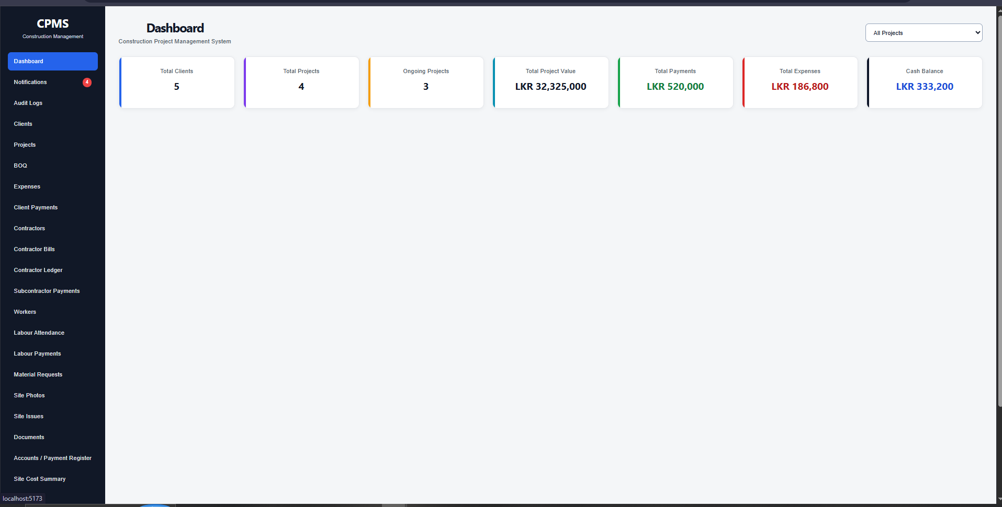
Admin portal
Central control for users, projects, finance, contractors, site operations and governance.
System control
Creates and manages core records, assignments and configuration.
Finance & operations
Accesses project finance, contractor bills, labour and reports.
Governance
Reviews notifications, audit logs and visibility decisions.
Client readiness
Controls what project information becomes visible externally.

Slide 12
Manager role
Management-level access focuses on operational and commercial control without full user administration.
Commercial & operational management
Site control & governance
Projects & clients
BOQ and progress
Expenses and client payments
Contractors, bills and ledger
Labour and site costs
Site reports
Material requests
Site issues and photos
Project documents
Audit logs & notifications
The Manager role is useful when the client wants management staff to operate the system without granting them full administrator privileges.

Slide 13
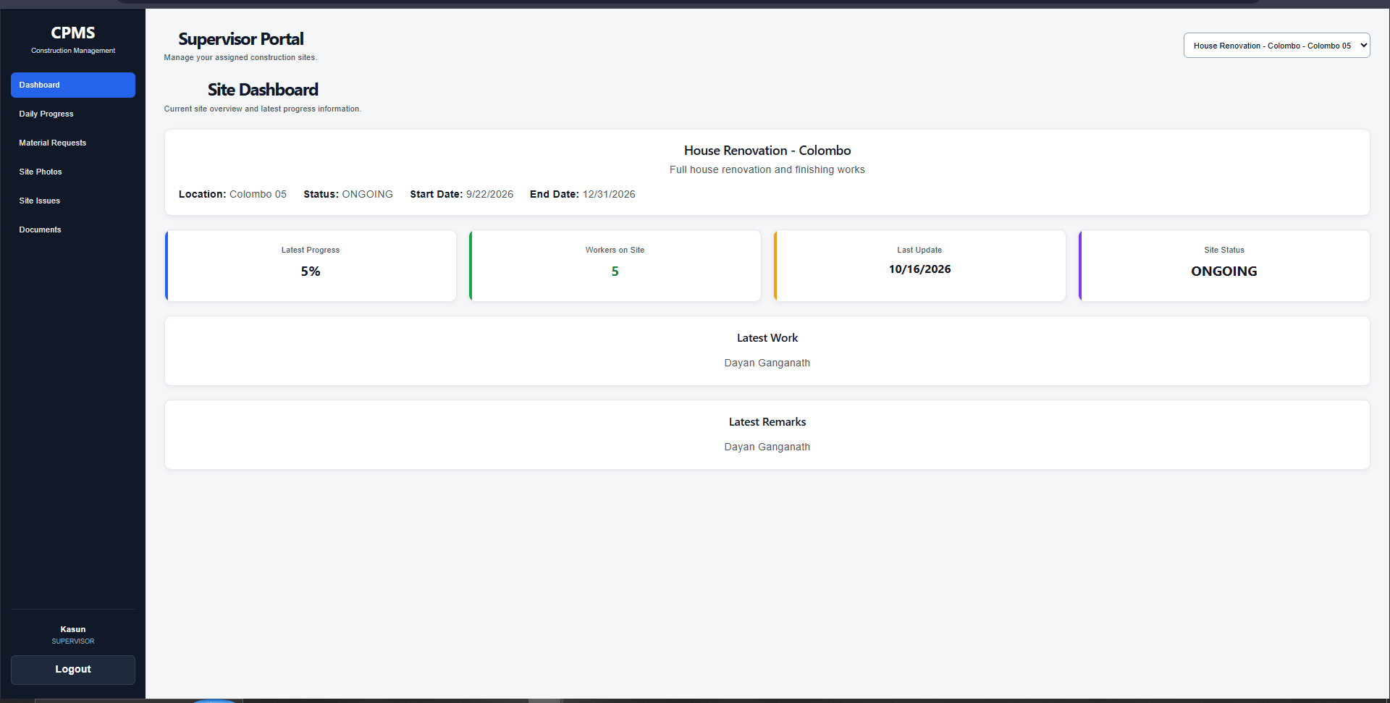
Supervisor portal
A focused workspace for people responsible for assigned construction sites.
Assigned projects only
Supervisors work only with projects assigned to their account.
Daily site updates
Records project progress and site execution information.
Raise site needs
Submits material requests and site issues for management action.
Evidence & documents
Uploads project documents and site information securely.

Slide 14
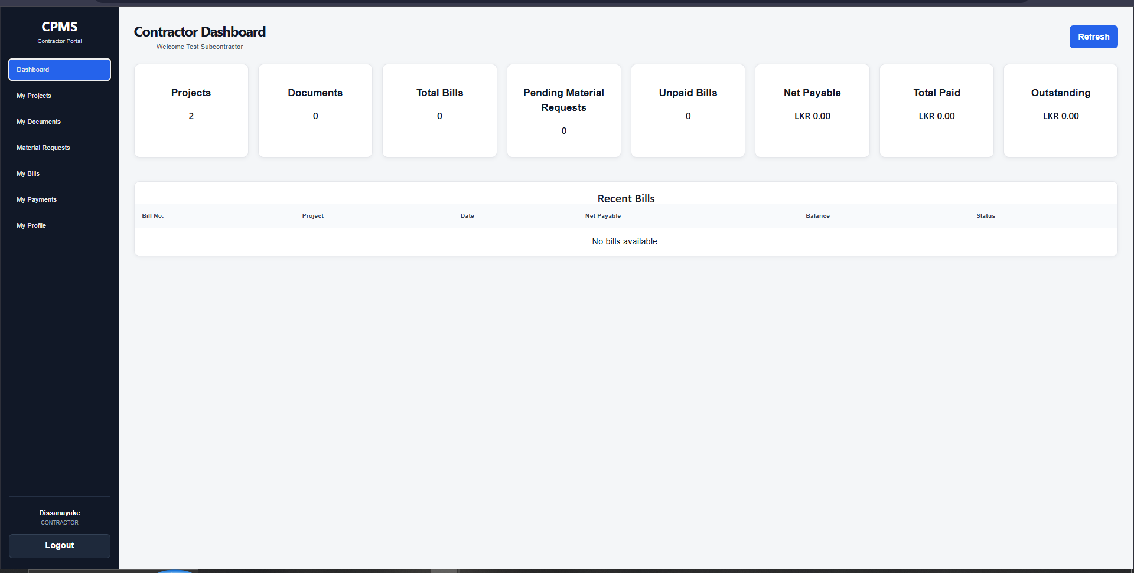
Contractor portal
A commercial portal for assigned work, bills, payments, requests and controlled documents.
Assigned work
Contractors see only projects assigned to their contractor account.
Bills & payments
Commercial dashboard separates bill values, paid values and outstanding balances.
Material requests
Contractors can raise project-specific material requests.
Secure downloads
Visible project documents and payment slips can be downloaded through protected endpoints.

Slide 15
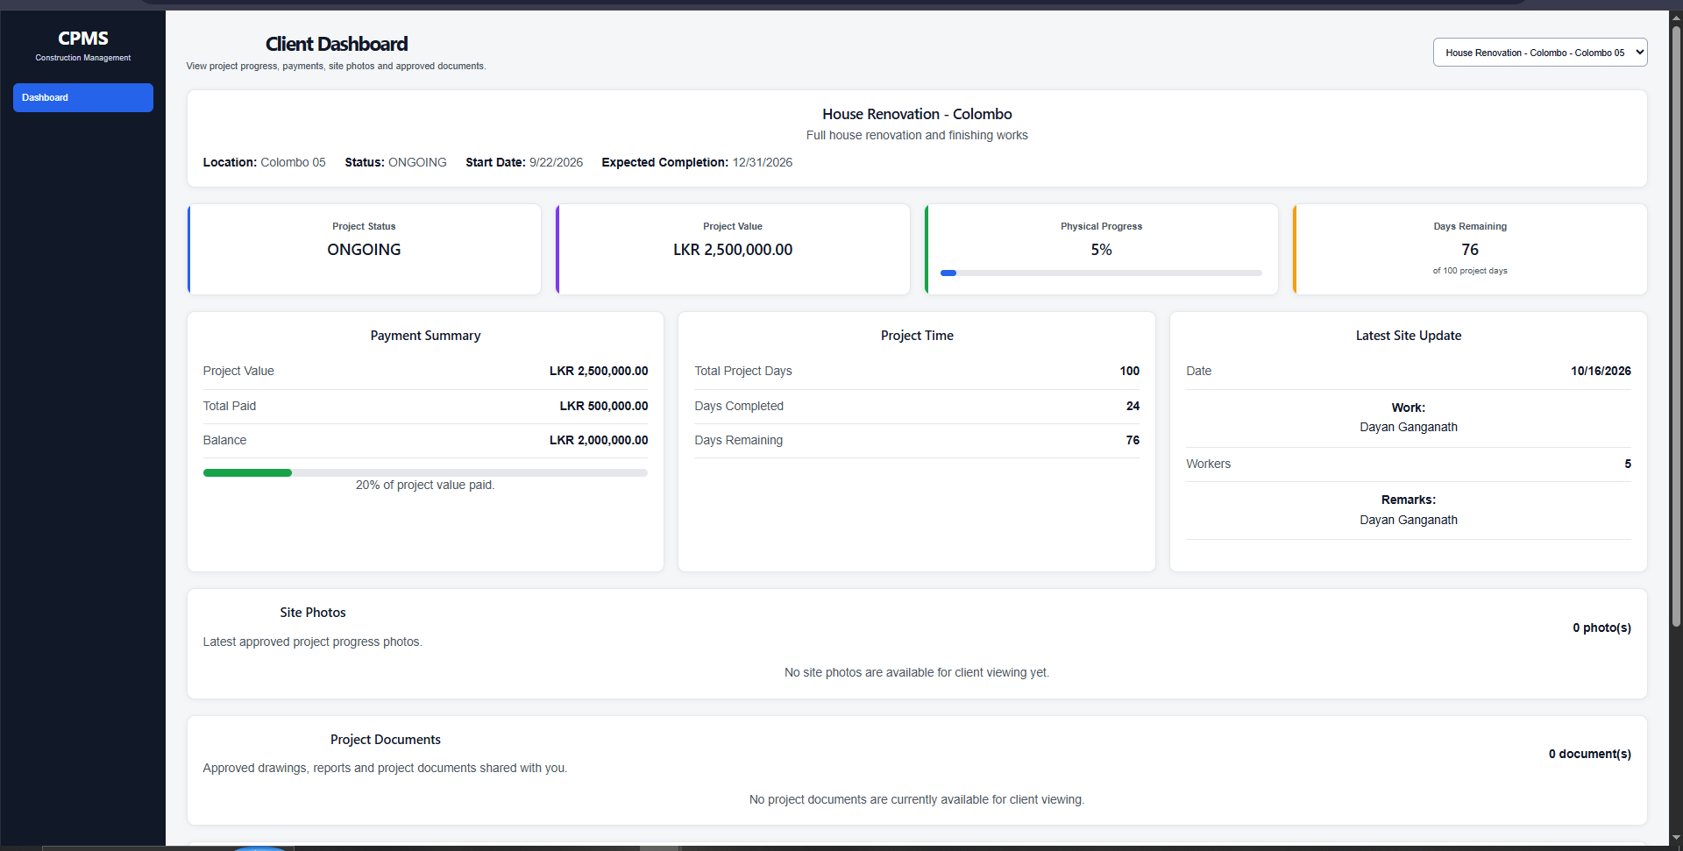
Client portal
A simplified portal that gives clients transparency without exposing internal management data.
Project visibility
Client sees only projects assigned to their account.
Progress dashboard
Key project progress information is presented in a client-friendly view.
Approved photos
Only photos approved for client visibility are shown.
Client documents
Only documents explicitly marked client-visible can be downloaded.

Slide 16
CORE SYSTEM FUNCTIONS
Module-by-module explanation
The following slides explain what each module stores, what it manages and how it supports the business process.

Slide 17
Module 1 — Client management
Creates the client identity that can later be linked to projects and a secure client portal account.
Data managed
Management purpose
Typical workflow
Client profile details
Contact information
Project relationship
Portal-related linkage
Maintain a reliable client register
Connect clients to project records
Support portal access
Avoid duplicate/disconnected client information
Create client → create project → assign project relationship → create/link user → client logs in → views approved project data

Slide 18
Module 2 — Project management & assignments
The project is the central record that connects commercial, site, workforce, contractor and client information.
Project identity & location
Project status monitoring
Client relationship
Supervisor assignment
Contractor assignment
Project-specific dashboard context
Project-based access control
Documents
Contractors
PROJECT
Central business record
Labour
BOQ
Progress
Finance

Slide 19
Module 3 — BOQ & progress baseline
The BOQ provides structured project commercial information that can support project value and progress understanding.
BOQ management
Progress tracking
Why it matters
Create project BOQ
Maintain BOQ items
Track quantities / rates / values where used
Keep commercial information project-specific
Daily progress records build a history of site execution
Management can review project progress in one place
Client portal receives permitted progress information
Commercial baseline + execution updates give management a clearer picture of project status than isolated spreadsheets or chat updates.

Slide 20
Module 4 — Project finance & accounts
The finance layer connects incoming client money, outgoing project costs and project-level reporting.
Expenses
Client Payments
Accounts Register
Record project expenditure and cost entries
Track receipts from clients by project
Consolidated payment/account records
Site Cost Summary
Financial Summary
Site Report
Summarize cost movement at project/site level
Management view of project financial position
Combine operational context with project information

Slide 21
Module 5 — Contractor bills, payments & ledger
Contractor finance is controlled so bill balances and payment transactions remain consistent.
Bill created
Net payable
Payment recorded
Bill paid amount
Balance / status
Gross + deductions
Calculated amount
Linked or unallocated
Updated only from payment records
Unpaid • Partial • Paid
Consistency rules
Ledger visibility
Contractor transparency
New bills start with zero paid amount. Updates cannot overwrite actual paid totals, and a bill cannot be reduced below money already paid.
The ledger distinguishes bill-paid values, total payment transactions and unallocated payments.
The contractor portal shows assigned commercial information without giving access to other contractors or projects.

Slide 22
Module 6 — Labour management
Daily labour information is organized so workforce activity can be connected to project cost control.
Workers
Attendance
Labour Payments
Accounts
Site Cost
Maintain worker records
Record daily attendance
Track labour-related payments
Reflect project cost movement
Include labour in site cost picture
Business purpose: reduce separate labour notebooks/spreadsheets and connect workforce records to the project financial picture.

Slide 23
Module 7 — Site operations
The supervisor portal turns site activity into structured records that management can review.
Daily Progress
Material Requests
Site Issues
Record what was completed on the assigned site
Raise needs and move them into management review
Report issues for management attention
Site Photos
Documents
Notifications
Capture visual evidence and optionally expose approved photos to clients
Upload project/site documents for controlled internal or external access
Alert relevant management users to important workflow events

Slide 24
Material request workflow
A site requirement becomes a structured request instead of a message that can be lost in chat.
Supervisor / Contractor
System
Management
Decision
Audit / Notification
Creates request
Links request to project and user
Reviews request
Approve / update status
Record important action
Management benefit
Requests remain project-specific, searchable and tied to a clear workflow instead of relying on memory or informal follow-up.

Slide 25
Module 8 — Document & drawing management
Project files can be stored once and exposed differently to internal teams, contractors and clients.
Client Visible
Client Download
Upload
Internal Record
Only when explicitly enabled
Secure client endpoint
Supervisor or management adds project file
Metadata + protected file path
Contractor Visible
Contractor Download
Separately controlled
Secure contractor endpoint
Key design decision: client visibility and contractor visibility are independent, so a document can be shared with one audience without automatically exposing it to the other.

Slide 26
Module 9 — Site photos & client visibility
Photos can support proof of progress while management retains control over what is shared externally.
Capture
Project Link
Management Review
Client Gallery
Site team adds project photo
Photo is stored against the project
Visibility is controlled
Approved photos appear in client portal
Why this matters
The client receives structured progress evidence without being exposed to every internal site image or internal operational record.

Slide 27
Module 10 — Notifications & audit logs
Two control mechanisms help management follow important events and retain traceability.
Notifications
Audit logs
Generated for important workflow events such as supervisor material requests, site issues, document uploads and contractor material requests.
Management can review unread items and mark notifications as read.
Important management actions can be recorded, including request reviews, issue status changes and document visibility changes.
This provides a clearer history of who changed what and when.
Together, these features support operational awareness + accountability.

Slide 28
Access-control matrix
A simplified view of how major areas are restricted by user role.
Area
Admin
Manager
Supervisor
Contractor
Client
Users
✓
—
—
—
—
Projects
✓
✓
Assigned
Assigned
Assigned
BOQ
✓
✓
—
—
—
Finance
✓
✓
—
Own view
Limited
Daily Progress
✓
✓
Assigned
—
View
Material Requests
✓
✓
Create
Create
—
Documents
✓
✓
Assigned
Visible only
Visible only
Audit Logs
✓
✓
—
—
—
Note: actual API access also checks assignment / ownership where applicable; this table is a client-friendly summary.

Slide 29
How the project files are organized
The codebase is separated into clear backend and frontend responsibilities, making maintenance easier.
Backend — Spring Boot
Frontend — React
config → security and application configuration
controller → REST API endpoints
dto → request/response transfer objects
entity / model → business data structures
repository → database access
security → JWT and authentication support
service → business rules and workflows
Purpose: receive requests, validate access, apply business logic and persist data.
pages → role-specific and module screens
components → reusable UI blocks
services → API communication
styles / CSS → visual styling
App.jsx → application routes and navigation
assets → static application resources
Purpose: present the system to users, capture actions and call secure backend APIs.

Slide 30
What happens when a user clicks “Save”
A simple example of the request lifecycle inside the application.
1. UI action
2. API call
3. Controller
4. Security
User submits a form in React
Frontend sends request with JWT
Receives the request
Checks authenticated role
5. Service
6. Repository
7. Response
Validates project/business rules
Reads/writes MySQL
Frontend refreshes data
This layered flow is why one UI screen can remain simple while the backend still enforces security, project ownership and finance rules.

Slide 31
Recommended live demo scenario
The best client demo is a story, not a tour of every menu.
1
Admin
Open project → show client / supervisor / contractor relationship
2
Supervisor
Open assigned project → add progress or show material request / document
3
Admin / Manager
Review operational item → show visibility controls / finance area
4
Contractor
Show assigned project, bill/payment dashboard and visible document
5
Client
Show progress, approved photo and client-visible document
Client takeaway: the same project is seen differently by each role, while management remains in control.

Slide 32
Business value to the client
The practical value is not “having software”; it is having controlled and connected project information.
Visibility
Financial control
Accountability
Faster access to project status, approved evidence and relevant records
Better organization of payments, bills, expenses and balances
Role ownership, audit records and structured workflows
Consistency
Security
Scalability
One project record connects site, commercial and document data
Sensitive information is separated by role and project assignment
More projects, users and contractors can be added into the same structure

Slide 33
Current project status & next stage
Core functionality and role-based regression testing are complete; remaining work focuses on production readiness.
95% COMPLETE
Core modules • role portals • finance consistency • security checks • document access • regression testing
Completed / stable
Final-stage work
Core CRUD modules
Role-based portals
Finance workflows
Supervisor & contractor document access
Client visibility controls
Security endpoint checks
Manual role-based regression testing
Production deployment configuration
Production database/environment setup
Deployment verification
Final UI/UX polish
Architecture diagram/documentation
Final proposal & presentation package

Slide 34
Client handover & training plan
A successful software handover includes people, process, access and documentation—not only the application.
1. Configuration
2. Data Setup
3. Role Training
Create production environment, database, file storage and secure secrets
Create users, projects, clients, contractors and initial assignments
Train Admin/Manager first, then Supervisor, Contractor and Client users
4. Acceptance
5. Go-Live
6. Support
Run agreed test scenarios and capture client sign-off
Move to production with backup and support procedure
Issue tracking, enhancements and controlled future releases

Slide 35
THANK YOU
Questions • Feedback • Next-step discussion
Construction Project Management System
Centralized • Role-based • Project-focused • Secure

