Slide 1


CMR TECHNICAL CAMPUS
UGC(Autonomous)
Kandlakoya,Medchal Road,Hyd-501 401 Department of Computer Science Engineering
Mini Project On
CROP RECOMMENDATION USING RANDOM FOREST ML ALGORITHM
BATCH NO : 08
Project Guide: BATCH MEMBERS:
Saba Sultana 217R1A05G1 KOPPULA VARSHINI
Assistant Professor, CSE Department 217R1A05F0 JANGALA POOJITHA
217R5A05E4 DARAMALLA DAYANIDHI
Project Coordinator:
K.Shilpa
Assistant Professor, CSE Department

Slide 2
CONTENTS
Abstract
Introduction
Existing System
Disadvantages of Existing System
Proposed System
Advantages of Proposed System
System Requirements
Novelty
System Architecture
Modules
UML Diagrams
Conclusion

Slide 3
ABSTRACT
Agriculture and its allied sectors are undoubtedly the largest providers of livelihoods in rural India. This project proposes a viable and user-friendly crop recommendation system for the farmers.
The proposed system provides connectivity to farmers via a web application. The user provides the area & soil nutrients as input.
Machine learning algorithms recommend the most profitable crop. To predict the crop, selected Machine Learning algorithms such as Support Vector Machine (SVM), Artificial Neural Network (ANN), Random Forest (RF), and K-Nearest Neighbour (KNN) are used. Among them, the Random Forest showed the best results with 95% accuracy.

Slide 4
INTRODUCTION
Agriculture has an extensive history in India. Recently, India is ranked second in the farm output worldwide . Agriculture-related industries such as forestry contributed for 20.2% of 2021 GDP and around 50% of the total workforce.
The crop prediction is a significant problem in the agriculture sector . Every farmer tries to know crop and whether it meets their expectations , thereby evaluating the previous experience of the farmer on the specific crop to predict the yield .
Agriculture yields rely primarily on weather conditions, pests, and preparation of harvesting operations. Accurate information on crop history is critical for making decisions on agriculture risk management .

Slide 5
EXISTING SYSTEM
Hybrid Crop Recommendation System
This system integrates multiple data sources, including field sensors, weather stations, and satellite imagery, to provide robust crop recommendations. It combines different machine learning techniques to enhance prediction accuracy and reliability.
Explainable AI Crop Recommendation (XAI-CROP)
This innovative system incorporates explainable artificial
intelligence principles to enhance transparency in crop recommendations. It provides clear insights into the reasoning behind its suggestions, helping farmers understand the decision-making process.
Fuzzy Logic-Based Crop Recommendation System
This system utilizes fuzzy logic to recommend crops based on soil type and other environmental factors. It helps in making decisions under uncertainty by evaluating various parameters that affect crop growth.

Slide 6
DISADVANTAGES OF EXISTING SYSTEM
Efficiency Issues: Many existing systems have low efficiency due to reliance on outdated algorithms or insufficient data integration, leading to suboptimal recommendations .
High Maintenance Costs: Some systems are hardware-based and require costly maintenance or infrastructure investments that may not be feasible for all farmers .
Limited Accessibility: Despite advancements, many applications remain complex or not user-friendly, making it difficult for farmers with limited technical knowledge to utilize them effectively .
Overfitting Risks: Machine learning models may overfit training data if not properly tuned, resulting in poor performance when applied to new or varied datasets

Slide 7
PROPOSED SYSTEM
Supervised learning approach is used to implement crop recommendation system. Established the correlation between multiple attributes selected from the historical which helps the system to increase the accuracy.
Rainfall and temperature are two factors which influence the crop yield. Recurrent Neural Network (RNN) and Long Short-Term Memory (LSTM) algorithms applied on these time series data to enhance the accuracy .
ARMA (Auto Regressive Moving Average), SARIMA (Seasonal Auto Regressive Integrated Moving Average) and ARMAX (ARMA with exogenous variables) methods are used to predict the temperature and rainfall using historical data.

Slide 8
ADVANTAGES OF PROPOSED SYSTEM
Enhanced Accuracy : The use of Recurrent Neural Networks (RNN) and Long Short-Term Memory (LSTM) algorithms allows the system to effectively analyze time series data related to rainfall and temperature, leading to more accurate crop recommendations.
Advanced Predictive Modeling : The integration of statistical methods such as ARMA, SARIMA, and ARMAX improves the prediction of environmental factors like temperature and rainfall, enhancing the reliability of the recommendations provided to farmers.
Support for Sustainable Agriculture : By recommending crops that are well-suited to local conditions and promoting optimal resource use, the system contributes to sustainable agricultural practices, reducing waste and enhancing productivity.
Increased Profitability : By suggesting the most profitable crops based on economic viability and environmental conditions, the system aims to maximize farmers' yields and improve their overall financial stability.

Slide 9
SYSTEM REQUIREMENTS
HARDWARE REQUIREMENTS
System : i3 or above.
Ram : 4 GB.
Hard Disk : 40 GB

Slide 10
SOFTWARE REQUIREMENTS
Operating system : Windows8 or Above.
Front-end : HTML,CSS
Back-end : Python
Framework : Flask

Slide 11
NOVELTY OF PROJECT
Integration of Time Series Analysis : By utilizing Recurrent Neural Networks (RNN) and Long Short-Term Memory (LSTM) algorithms, the system effectively processes time series data related to rainfall and temperature. This capability allows it to capture temporal dependencies and trends in environmental factors that influence crop yield.
Advanced Statistical Methods : The system incorporates advanced statistical methods such as Auto Regressive Moving Average (ARMA), Seasonal Auto Regressive Integrated Moving Average (SARIMA), and ARMAX (ARMA with exogenous variables) to predict temperature and rainfall based on historical data. This enhances the precision of environmental forecasts that are critical for crop selection.
Enhanced Accuracy : The combination of machine learning techniques with time series analysis aims to improve prediction accuracy significantly over existing systems, which may rely solely on static data or simpler models.

Slide 12
ARCHITECTURE
N,P,K Values
Temperature, Humidity values
Apply Machine Learning algorithm
Suggest suitable Crop
Rainfall,PH values

Slide 13
MODULES
User: user can get type of crop to cultivate to get more profit.
Upload the Dataset: It is used to predict the crop.
Data Preprocessing:Data cleaning, Data integration, Data selection, Data transformation.
Feature Extraction :Identifying and extracting relevant features from raw data to create a more informative dataset
Crop Recommendation: crop is recommended to user based on input values.

Slide 14
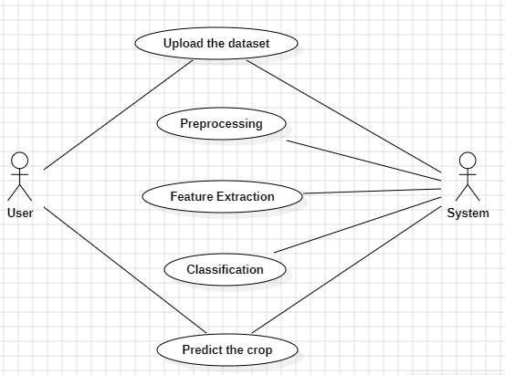
UML DIAGRAMS
USECASE DIAGRAM

Slide 15
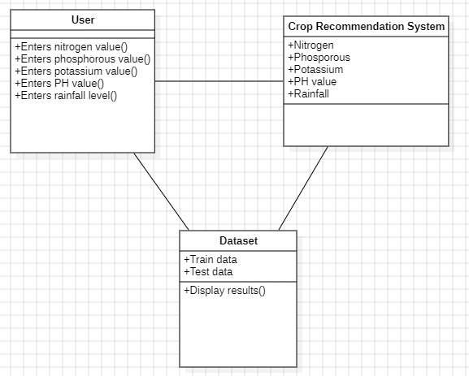
CLASS DIAGRAM

Slide 16
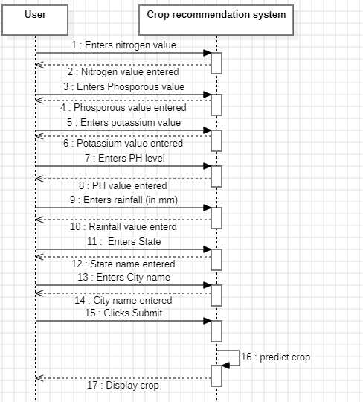
SEQUENCE DIAGRAM

Slide 17
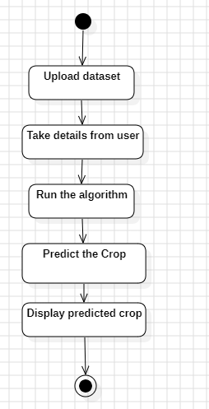
ACTIVITY DIAGRAM

Slide 18
CONCLUSION
This project highlighted the limitations of current systems and their practical usage on crop prediction. The proposed system provides connectivity to farmers via a web application.
The inbuilt recommender system allows a user exploration of the possible crops. For accuracy, various machine learning algorithms such as Random Forest, ANN, SVM and KNN were implemented.
The various algorithms are compared with their accuracy. The results obtained indicate that Random Forest algorithm is the best among the set of standard algorithms used on the given datasets with an accuracy of 95%.

Slide 19


