Slide 1


Raspberry Pi Based Image Acquisition System
Developed at Institute For Plasma Research, Bhat, Gandhinagar
Internal Guide
Prof. Bhavika Gambhava
Assistant Professor
Dept. of Comp. Engg.
External Guide
Mr. Vishnu Patel
Scientific Officer-E
Institute For Plasma Research

Slide 2
Contents
Introduction
Motivation of project
Objectives to achieve
Application of project
Important definitions/Acronyms related to project
System Overview
Design
Testing
Screenshots
Conclusion
Future extensions

Slide 3
Introduction
Raspberry Pi based Image Acquisition System is capturing image using Raspberry Pi camera and put it in EPICS record for further diagnostics.
Live captured image will be displayed in CS-Studio from EPICS record.
This project is aimed to develop image acquisition for image diagnostics in the Tokamak like machine.
Raspberry Pi is small multi-use computer.
EPICS is The Experimental Physics and Industrial Control System and it is a set of software tools and applications used to develop and implement distributed control systems to operate devices.

Slide 4
Motivation of project
The primary motivation to develop this project was to work with Raspberry Pi and explore its features.
The other inclination was to explore EPICS areaDetector module.

Slide 5
Objectives to achieve
To capture image from Raspberry Pi camera using python package.
Store captured image in EPICS record and stream it continuous or for number of images selected by user in Control System Studio(CS-Studio).

Slide 6
Application of project
To do live streaming of particular area where human can not go due to high radiation.
This system is used to get various diagnostics by monitoring and analysing images acquired through Raspberry Pi Camera.
Another application of this system is to provide simulation of machine like cryogenic plant used at Institute for plasma research.

Slide 7
Important Definitions and Acronyms
EPICS – EPICS(Experimental Physics and Industrial Control Systems) is an extensible set of software components and tools with which application developers can create a control system.
IOC – It hold and run database of records which represent either device or aspects of the device to be controlled. It is EPICS shell used to perform input/output operations to attached hardware device.
OPI – OPI(Operator Interface) is workstation which can run various EPICS tools.

Slide 8
Important Definitions and Acronyms (Cont’d)
Process Variable(PV) – Data held in the database of records are represented by unique identifiers known as Process Variable.
Channel Access(CA) – Channel Access provides network transparent access to IOC databases.

Slide 9
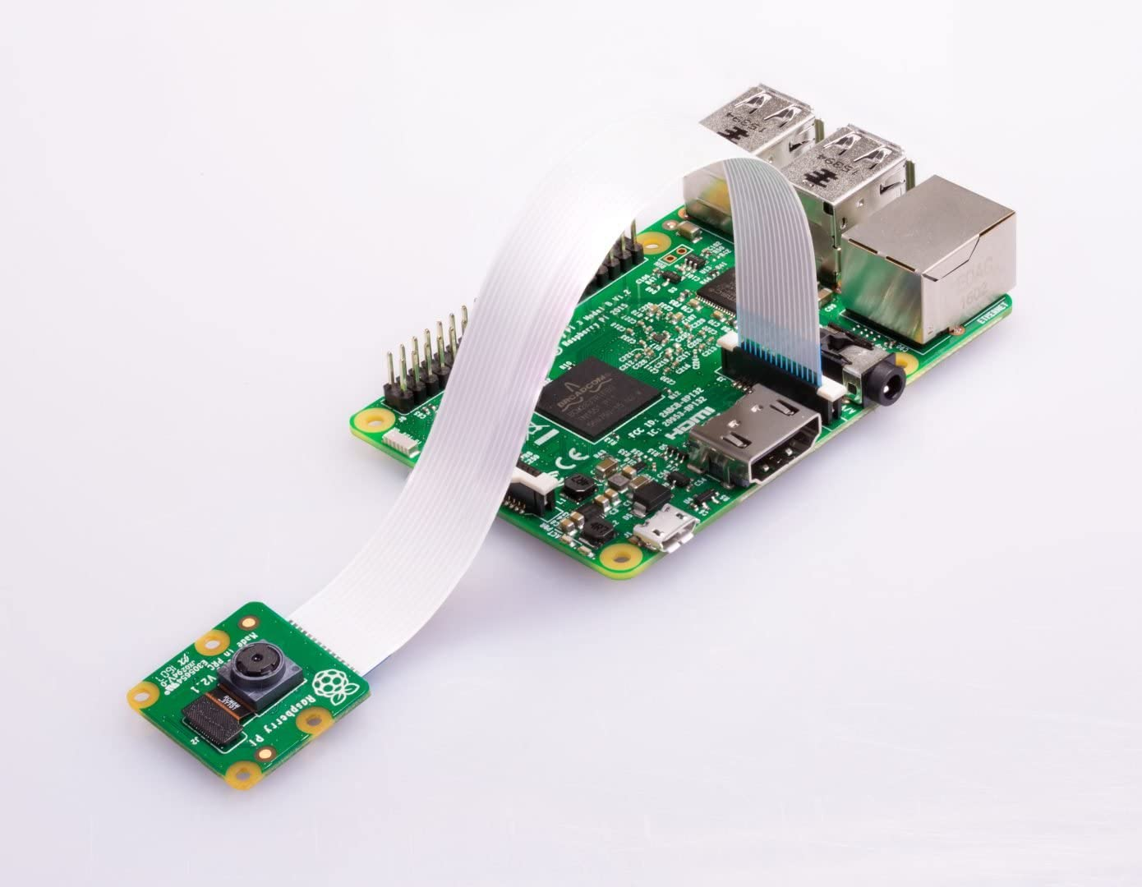
System Overview
Technology/Platform – Python language, Raspbian, EPICS, Ubuntu
Hardware – Raspberry Pi
Tool – Control System Studio(CS-Studio)
Raspberry Pi

Slide 10
Design
Camera Module
Control System Studio
(Live streaming)
IOC
Raspberry Pi
EPICS Record
Image Acquisition System

Slide 11
Design(Cont’d)
Camera Module:
The Raspberry Pi camera module is capable of taking full HD 1080p photo and video and can be controlled programmatically.
There are two way for image capturing: command line tool and python script.
In Raspbian, we have many command line tool like raspistill, raspivid and raspiyuv.
Picamera python package provides methods and module like capture method, PiRGBArray module which is used for image capturing.

Slide 12
Design(Cont’d)
Raspberry Pi:
It provides interface between camera module and EPICS Record.
Image is captured from camera and it is transfer to EPICS Record through python script which is running Raspberry Pi.

Slide 13
Design(Cont’d)
IOC(Input/Output Controller):
As its name implies, an IOC often performs input/output operations to attached hardware devices.
IOC associates the values of EPICS Process Variables with the results of these input/output operations.
IOC can perform sequencing operations, closed-loop control and other computations.

Slide 14
Design(Cont’d)
EPICS Record:
EPICS provides different type of records like ai(analog input), ao(analog output), waveform, calc and many more.
In this System, we have to put image of PiRGBArray form in waveform record of EPICS areaDetector.
PyEpics python package provides method to putting image in waveform record.

Slide 15
Design(Cont’d)
Control System Studio(CS-Studio):
Control System Studio is an Eclipse-based collection of tools to monitor and operate large scale control systems.
CS-Studio contains many tools: Alarm handler, archive engine, as well as several operator interface and control system diagnostic tools.
In this system, we have used CS-Studio BOY Widgets to control and display live streaming.

Slide 16
Testing
Some Test cases include:
Capturing Image.
Putting Image in EPICS waveform record.
Displaying Image in CS-Studio.
Continuous streaming of captured image.

Slide 17
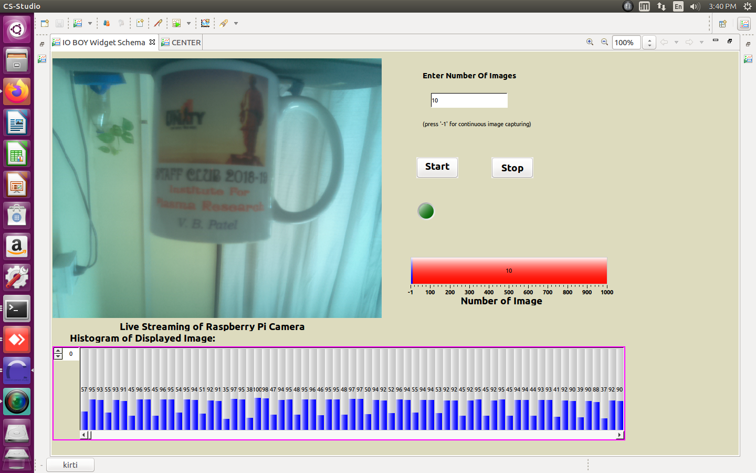
Screenshots
Streaming for limited number of images

Slide 18
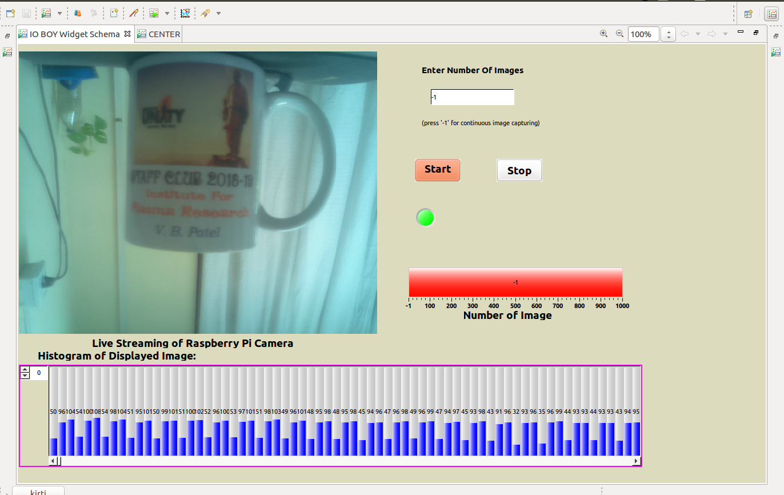
Screenshots(Cont’d)
Displaying continuous images

Slide 19
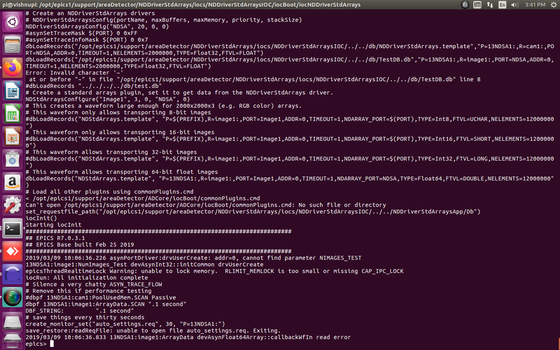
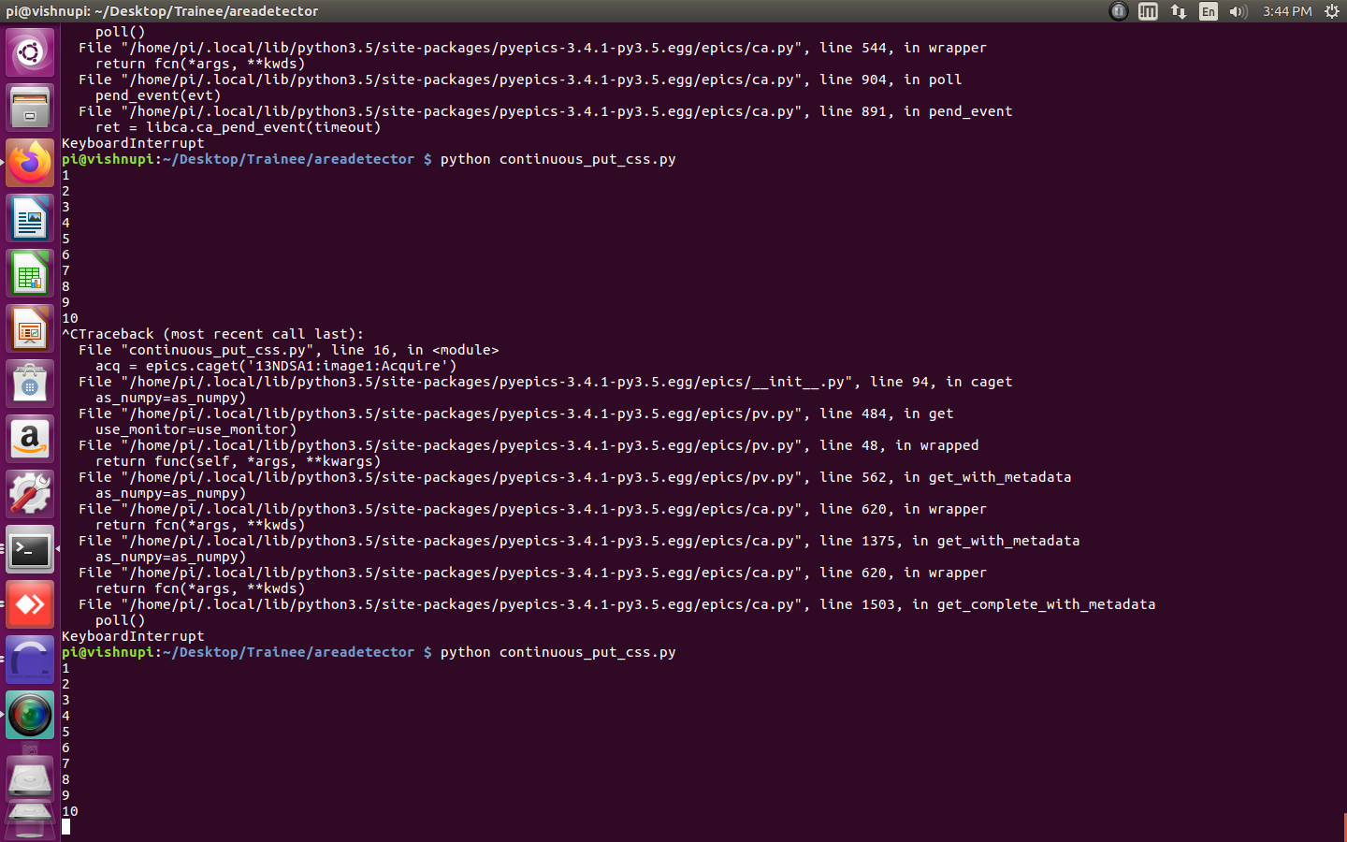
Screenshots(Cont’d)
Running IOC
Running Python Script

Slide 20
Conclusion
Raspberry Pi based Image Acquisition System is useful for monitoring and analyzing in high radiation area where human can not go easily.
It has same mechanism as many applications which are used for live streaming nowadays but through this system client can not only monitor but control the system without moving from his/her position.

Slide 21
Future Extension
Future work in this project involves object recognition in captured image, process capture image for scientific use and improve speed of image putting in EPICS areaDetector record.
Speed of live streaming can be improved by storing image into areaDetector record from ADProsilica driver.

Slide 22
References
Control System Studio Guide by Kay Kasemir and Gabriele Carcassi (Oak Ridge National Laboratory).
EPICS Architecture by L.R. Dalesio, M.R. Kraimer, A.J. Kozubal (Argonne National Laboratory, Los Alamos National Laboratory).
Raspberry Pi (www.raspberrypi.org)
EPICS areaDetector by Mark River

Slide 23
Thank You
Savan Anadani (CE04)
Ravi Dayani (CE21)

