Slide 1


Raspberry Pi Based Image Acquisition System
Developed at Institute For Plasma Research, Bhat, Gandhinagar
Internal Guide
Prof. Bhavika Gambhava
Assistant Professor
Dept. of Comp. Engg.
External Guide
Mr. Vishnu Patel
Scientific Officer-E
Institute For Plasma Research

Slide 2
Contents
Introduction
Motivation of project
Objectives to achieve
Application of project
Important definitions/Acronyms related to project
System Overview
Analysis
Design
Testing
Screenshots
Conclusion
Future extensions

Slide 3
Introduction
Raspberry Pi based Image Acquisition System is capturing image using Raspberry Pi camera and put it in EPICS record for further diagnostics.
Captured image will be displayed in CS-Studio from EPICS record.
This project is aimed to develop image acquisition for image diagnostics in the Tokamak like machine.
Raspberry Pi is small multi-use computer.
EPICS is The Experimental Physics and Industrial Control System and it is a set of software tools and applications used to develop and implement distributed control systems to operate devices.

Slide 4
Motivation of project

Slide 5
Objectives to achieve
To capture image from Raspberry Pi camera using python package

Slide 6
Application of project
To do live streaming of particular area where human can not go due to high radiation.
This system is used to get various diagnostics by monitoring and analysing images acquired through Raspberry Pi Camera.
Another application of this system is to provide simulation of machine like cryogenic plant used at Institute for plasma research.

Slide 7
Important Definitions and Acronyms
EPICS – EPICS(Experimental Physics and Industrial Control Systems) is an extensible set of software components and tools with which application developers can create a control system.
IOC – It hold and run database of records which represent either device or aspects of the device to be controlled. It is EPICS shell used to perform input/output operations to attached hardware device.
OPI – OPI(Operator Interface) is workstation which can run various EPICS tools.
Process Variable(PV) – Data held in the database of records are represented by unique identifiers known as Process Variable.

Slide 8
Important Definitions and Acronyms (Cont’d)
Channel Access(CA) – Channel Access provides network transparent access to IOC databases. Each IOC provides a Channel Access server which is willing to establish communication with an arbitrary number of clients.

Slide 9
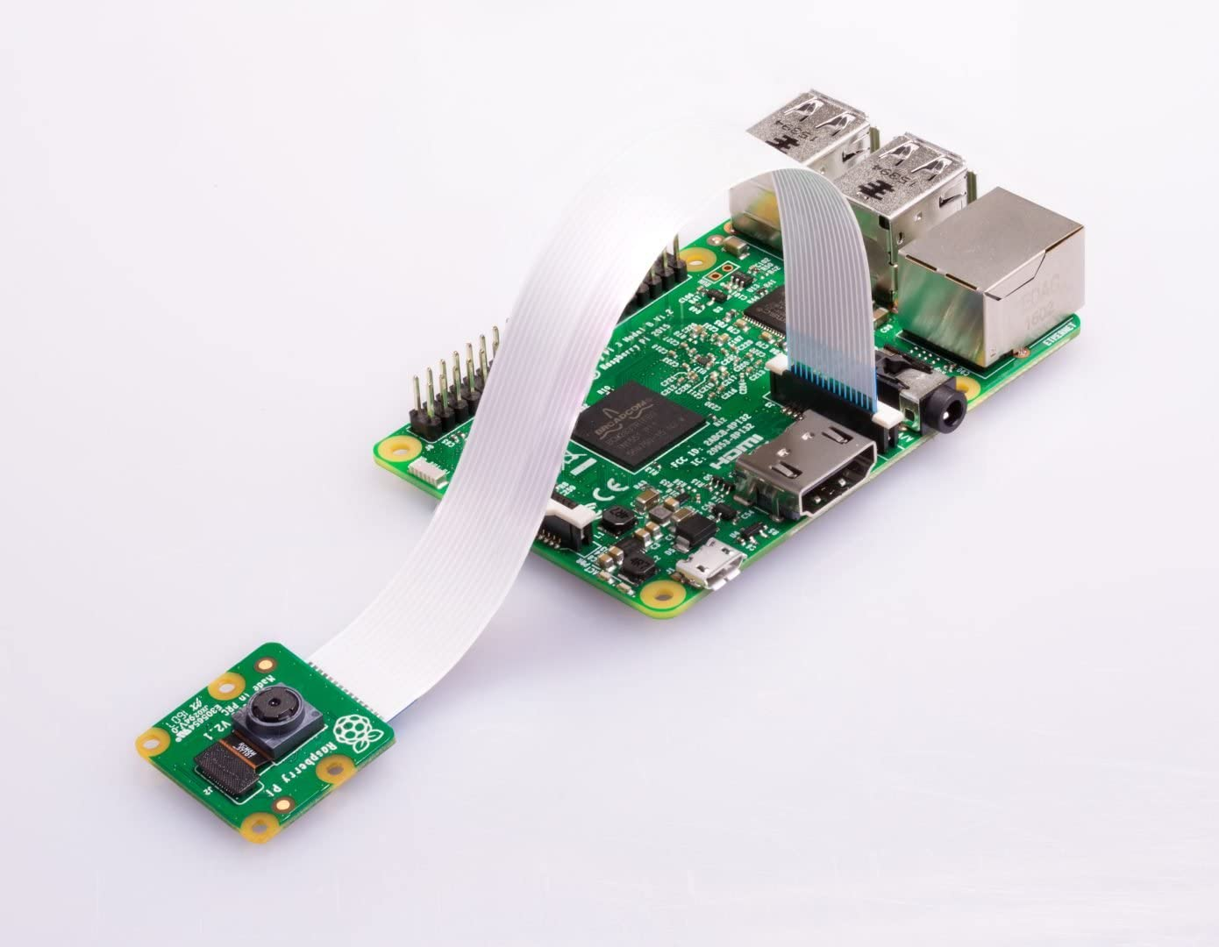
System Overview
Technology/Platform – Python language, Raspbian, EPICS
Hardware – Raspberry Pi
Raspberry Pi

Slide 10
Design

