Slide 1
SCRUM
101
Notes:
Hello Everyone, Welcome to Scrum 101

Slide 2
BEFORE WE START
Go To https://answergarden.ch/662825
Submit scrum concepts you learnt during the presentation.
Notes:
Before we start I’d like everyone to launch this URL on your phone and submit the scrum concepts that you learn during the presentation.

Slide 3
DEFINE
Notes:
Alright so let’s get started with a definition from the Scrum.org guide

Slide 4
Scrum (n): A FRAMEWORK within which people can address complex adaptive problems, while productively and creatively delivering products of the highest possible value.
Notes:
Keyword here is a framework , framework is guidelines describing roles and rule based upon principles to help facilitate in a non prescriptive way.

Slide 5
WHY?
Notes:
Why did we need another FRAMEWORK?

Slide 6
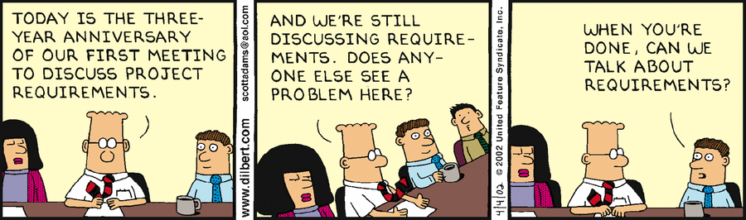
Source: www. dilbert.com
Notes:
I overheard a conversation from a famous resident technical expert and some of his coworkers , and this is what I heard

Slide 7
Waterfall
REQUIREMENTS
Customer interactions
DESIGN
DEVELOPMENT
VERIFICATION
DEPLOYMENT
Notes:
As Software development and engineering practices evolved thru the 60s, 70s and 80s the focus was to resolve the crisis in software development to produce good quality software on time and in a budget. We created a structured process of Waterfall methodology where we went into clearly defined phases in software development. We started with a formal requirements analysis session, followed by design and development before proceeding to formal verification process. As you can see from this chart the customer interactions are limited to Requirements and then finally verification and launch. This could mean months or possibly years had gone by before the customer actually saw the product. If a new feature was requested during design or development then again the analysis had to be done and adjust the plan using Change request management. Well this worked but started to unravel once internet and technology revolution began in the 90s and accelerated the need for 1) rapid innovation to keep pace with the technology evolution and 2) customer focussed product development as customer were now more educated and had access to more choices.

Slide 8
Need for agility?
Market Needs
Rapidly Evolving
Predictable
Technology
Notes:
To solve this gap software teams and organization needed more agile practices.
Prior to the internet revolution, the market needs were predictable or slow moving.
But with rapidly evolving markets and changing technology landscape the educated customer start demanding more innovation, This required software products and solutions to evolve and innovte more rapidly than the traditional methods and approaches.
This is when a group of leaders and proponents of lightweight methodologies came together to create the Agile philosophy for rapid and interative software development

Slide 9
WHAT?
Notes:
This brings us to the next question. What is Agile? Let’s again ask our resident expert for his opinion

Slide 10
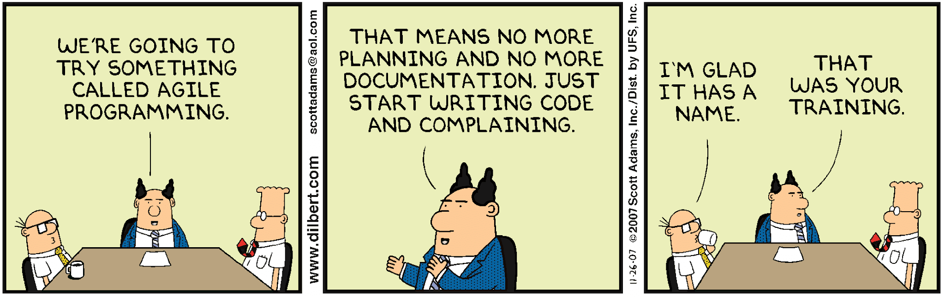
Source: www. dilbert.com

Slide 11
Agile Manifesto
Individuals and interactions over processes and tools
Satisfy Customer
Welcome Change
Deliver Frequently
Working software
over comprehensive documentation
Work Together
Trust Motivated Individuals
Face 2 Face Conversation
Working Software
Sustainable Development
Continuous Attention
Customer collaboration
over contract negotiation
Simplicity
Self Organizing Teams
Reflect and Adjust
Responding to change
over following a plan
Notes:
Agile philosophy was formalized in a manifesto that was based on the 4 core values and 12 principles
Which mean
We value Individuals and interactions vs process & tools , values a team based approach with Focus is on team responsibility. Teams will reflect and adjust based on variances.
Value working software over documentation. The value of agile approach is to produce a working Product increment that is of shippable quality, whether that PI is released or not to the customer.
Value collaboration vs contract negotiation. When customer requests a change contracts needed to changed and negotiated. This creates mistrust between stakeholders.
Respond to change vs following a plan. In agile approach planning is frequently updated and is a living breathing plan in terms of immediate sprint or long term product roadmap. Plans are not rigid. Goal is to create value and embrace change. The process of planning is more important than the plan itself. Continuous planning improves chances for success. Framework of feedback loops
How can we practice agile?

Slide 12
SCRUM
Most popular Agile Framework
Founded on empiricism
3 Pillars
Transparency
Inspection
Adaptation
Events , Roles & Artifacts
T
R
A
N
S
P
A
R
E
N
C
Y
I
N
S
P
E
C
T
I
O
N
A
D
A
P
T
A
T
I
O
N
Notes:
Scrum is the most popular Agile Framework used today, There are others such as Extreme Programming, Kanban, FDD etc..
Scrum is founded on empiricism which is primarily based on experience and making decisions based on what is known.
It is based on 3 pillars transparency, inspection and adaptation.
Transparency, significant aspects must be visible to scrum team responsible for the outcomes. E.g. common definition of done must be shared by those performing and accepting the work
Inspection, recommends frequent inspections and checkins to control variances
Adaptation, suggest that adjustments must be made based on variances noted by inspections
Inspection and Adaptation form a continuous improvement cycle throughout the Scrum

Slide 13
SCRUM Roles
Scrum Master
Servant Leader
Coach
Product Owner
Voice of the Customer
Manage Product Backlog
Development Team
Cross Functional (Developers, Testers, Design)
3 < Optimal Team Size < 9
Works on items in the Sprint Backlog
Notes:
ScrumMaster, can be thought of as a coach for the team, helping team members use the Scrum process to perform at the highest level. Concept of servant leader is he/she is a servant first and focuses on people’s needs, collaboration, coaching, facilitating and maximizing success vs leader first approach of directed authority from the top-down.
The product owner (PO) is the other role, and in Scrum software development, represents the business, customers or users, and guides the team toward building the right product. This role manages the Product backlog , elaborates features requests, reviews and approves the Product increments for each sprint.
Development team is a cross functional team of different resources that are working to build the product increment. This can includes front end , back end, full stack software engineers and UX design, and testing resources (as appropriate for that organization). All resources are required to help build the product increment. The optimal team size is greater than 3 and less than 9 typically around 7 . Development team is responsible for working on the Sprint backlog

Slide 14
SCRUM Events
Sprint
Sprint Planning
Daily Scrum
Sprint Review
Sprint Retrospective
Notes:
Sprint is at the heart of the Scrum, it is a time box 1-4 weeks not more than a month to produce a product increment i.e. working software which may be potentially released. Best to have consistent sprint duration i.e. organizations sets a 2 week sprint based on what works best for them. Sprint is like a mini-project, with goals of what needs to be built and plans that are flexible to achieve those goals, that are monitored frequently
Sprint includes Planning, Daily Scrum, development work, review and retrospective
Sprint planning performed at the start of each sprint with the entire Scrum team. Product Owner shares objective of Sprint. Take a look at the Product Backlog , ascertain capacity of the sprint and past performance and select items in the backlog that team can accomplish to achieve the objectives. What can be done? How will it be done?
Daily scrum, 15 min time boxed event to review 3 things each day with the Dev Team. What did I accomplish yesterday? What will I do today? Any impediments that prevent me from getting things done? Scrum master facilitates but Dev Team is responsible for running them. Improve communication, collaboration , key to inspect and adaptation.
Sprint Review, held at end of the sprint to review and inspect the Product increment .What has been done and what’s not done. Attended by team members and stakeholders.
Sprint retrospective, is held to reflect on things that went well in the current sprint and opportunities to improve in the next sprint. Includes inspection of people, process, tools, team collaboration

Slide 15
SCRUM Artifacts
Product Backlog
Sprint Backlog
Product Increment

Slide 16
HOW?
Notes:
How do all these Roles, Events, Artifacts come together, let’s see what our expert has to say on this?

Slide 17
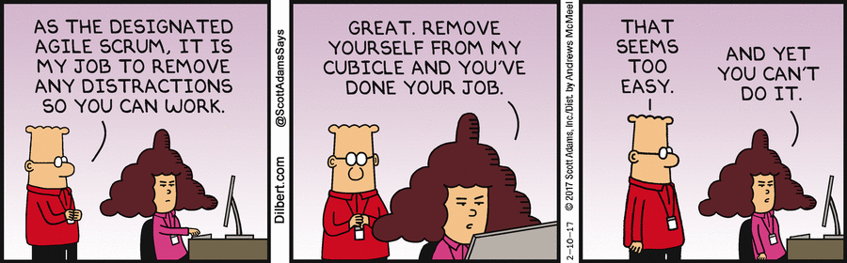
Source: www. dilbert.com

Slide 18
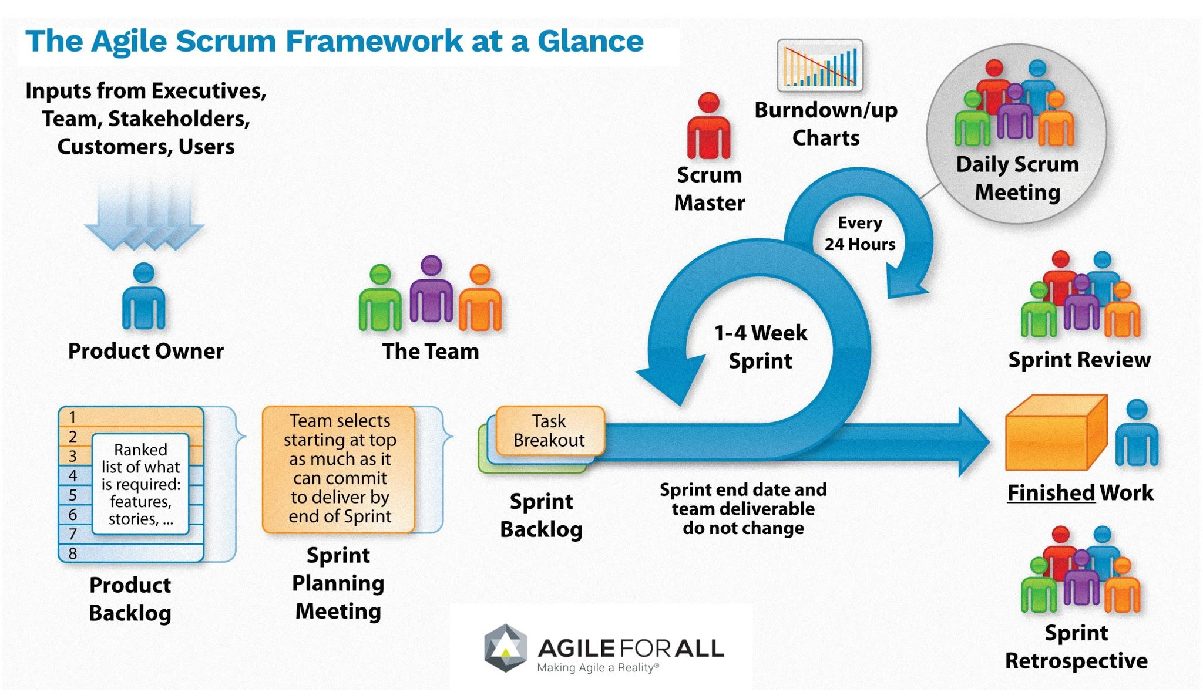
SCRUM - Bring it All Together
Source: Agile For All
Notes:
To bring it all together this is how a scrum process would work.
Request from customers, exec, team, stakeholder users etc are logged into the Product Backlog by the Product Owner
These request are logged as Stories or Epics (think of this as a short description in the format , as a <user>, I want some <function> so that I can realize the <benefit>
Request are ranked in terms of business benefits and costs and Product Owner will elaborate those requirements further to get them ready for sprint planning meeting
In Sprint planning meeting the team will select features they can accomplish in the next sprint based on their capacity and past velocity (history of what was planned vs achieved). Stories are estimated using story points and a tool Planning Poker.
The features are moved into the Sprint backlog and broken down into tasks for each story which doesnt exceed more than 24 hrs. Tools such as burndown chart is used to monitor how the sprint is progressing i.e. planned vs accomplished
The scrum master will facilitate the daily scrum meeting and team will inspect the daily progress for the sprint
At the end of the sprint Sprint review is conducted to demonstrate the product increment to the Product owner and stakeholders
This produces the product increment that is potentially ready to be shipped
Finally the sprint ends with the retrospective

Slide 19
ADOPTION

Slide 20

Shu-Ha-Ri Philosophy
Imitate
Adapt
Innovate
New
Spotify

Slide 21
RESOURCES

Slide 22
Resources
Guides, Links, Tools
Agile Manifesto
Scrum.org
ScrumAlliance.org
Mountain Goat Software
Trello
Kanban
Spotify Model
Certification
PSM, PSD [Free Assessment]
CSM , CSD

Slide 23
THANK YOU
Today’s Scrum word cloud
https://answergarden.ch/662825

