Slide 1



EV Charging Demand Prediction
Name: Dayasankar panigrahy
Student ID: bsp-23-018
AICTE ID: STU6838617087e781748525424

Slide 2

Learning Objectives
Analyze regional EV adoption trends using real-world registration data by county and city.
Engineer meaningful features such as EV counts by type and adoption year for predictive modeling.
Train a Random Forest Classifier to forecast electric vehicle adoption patterns based on historical attributes.
Evaluate model performance using Accuracy, Classification Report, and Confusion Matrix.
Visualize feature importance to identify key drivers influencing EV adoption.
Export trained models using joblib for future deployment and integration into applications.
GOAL
Source :
www.freepik.com/

Slide 3
Tools and Technology used
Language: Python 3.12.10
Environment: Jupyter Notebook
Libraries: Pandas, NumPy, Matplotlib, Seaborn, Scikit-learn, Joblib, Streamlit
Dataset Format: CSV files (raw and preprocessed data)
Web App: Streamlit for interactive deployment
Version Control: Git & GitHub for code management

Slide 4
Methodology
Steps:
Data Collection & Loading: Collected EV registration data (CSV) and loaded it using Pandas.
Data Preprocessing: Handled missing values, encoded categorical data, and created new features.
Exploratory Data Analysis (EDA): Explored data patterns and trends using visualizations with Matplotlib and Seaborn.
Model Training: Built a Random Forest Classifier to predict EV adoption using selected features.
Model Evaluation: Evaluated performance using accuracy, confusion matrix, and feature importance.
Deployment: Saved the trained model with Joblib and deployed an interactive web app using Streamlit.
Data Collection & Loading
Data Preprocessing
Exploratory Data Analysis
Model Training & Evaluation
Deployment

Slide 5
Problem Statement:
EV Charging Demand Prediction in Washington State
With the rapid growth of electric vehicles (EVs) across Washington State, predicting regional charging demand is essential for sustainable infrastructure planning.
The dataset 'Electric_Vehicle_Population_By_County.csv' includes EV registration data across approximately 311 counties in Washington.
Uneven EV distribution makes it challenging to determine where charging stations are most urgently needed.
This project aims to analyze EV population trends and develop a predictive model to estimate future EV charging demand across counties.
The insights will assist policymakers, urban planners, and energy providers in making data-driven decisions for optimizing charging infrastructure.

Slide 6
Solution:
Collected EV registration data for 311 counties from Washington State.
Preprocessed and engineered features like lag values, rolling averages, and growth slopes.
Trained multiple regression models — Decision Tree, SVR, and Random Forest.
Selected Random Forest Regressor based on best performance (R² = 0.94, MAE ≈ 98.5).
Forecasted EV adoption for the next 36 months at the county level.
Deployed the solution using an interactive Streamlit web app with forecasting and comparison features.
Github Repository Link:
https://github.com/dayasankarpanigrahy/Ev_charging_demand_prediction_project-

Slide 7
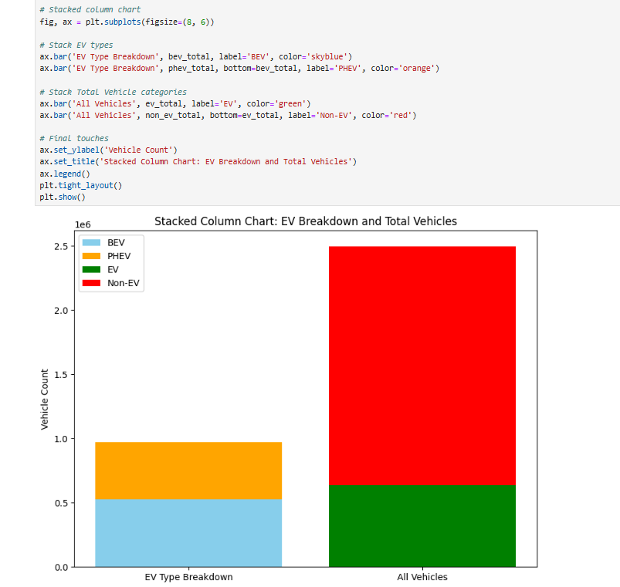
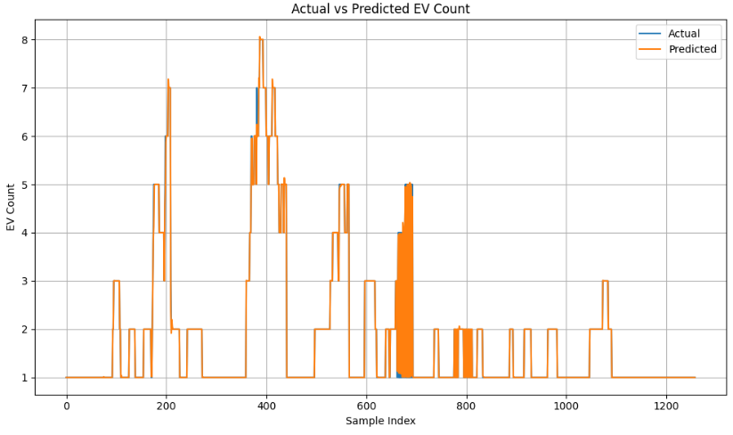
Screenshot of Output:

Slide 8
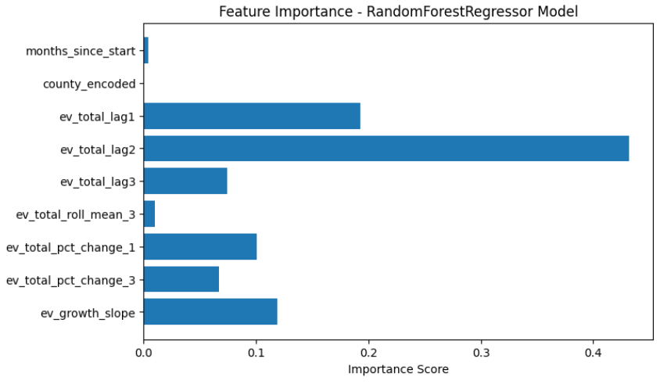
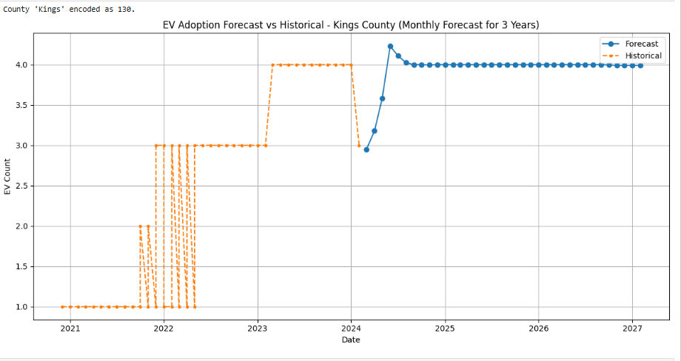
Screenshot of Output:

Slide 9
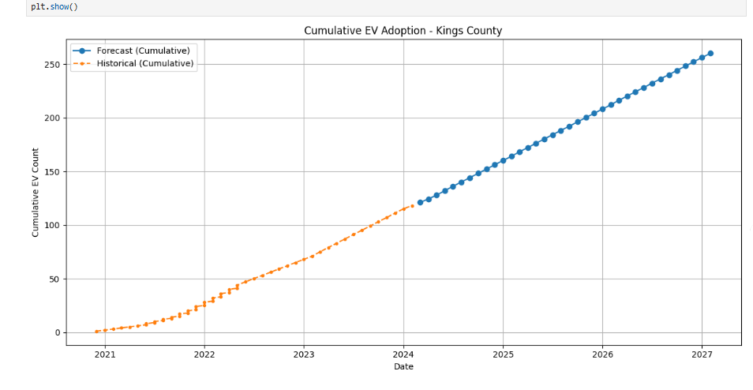
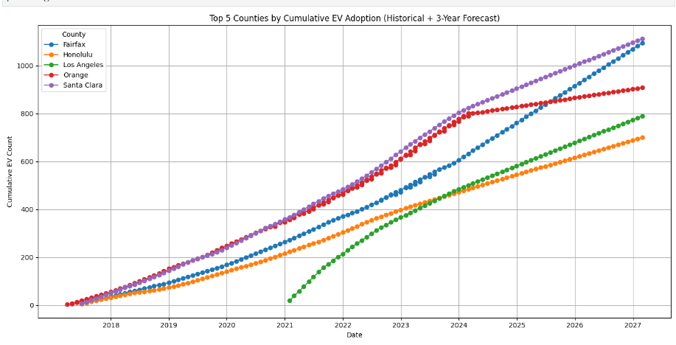
Screenshot of Output:

Slide 10
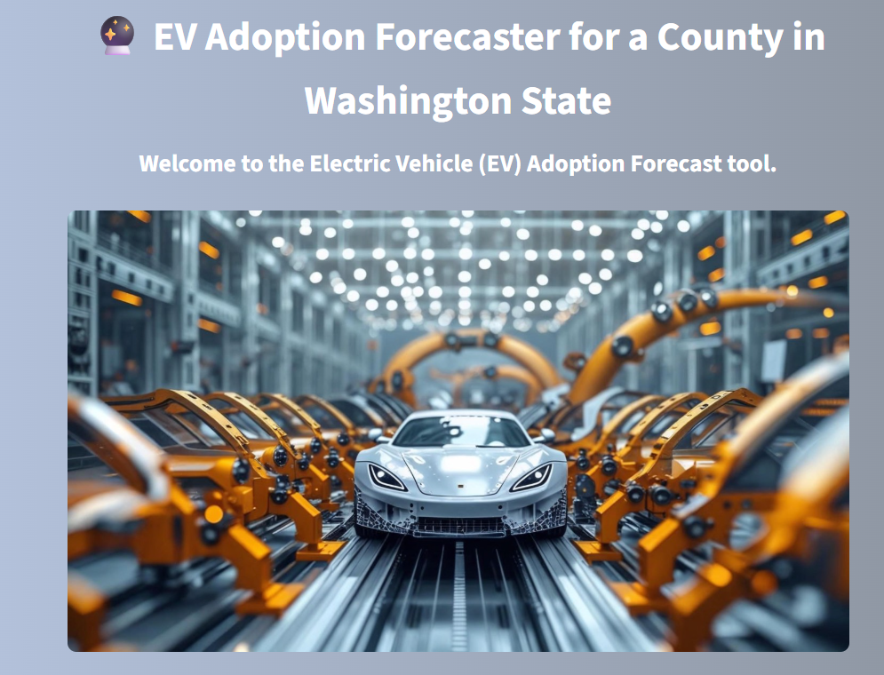
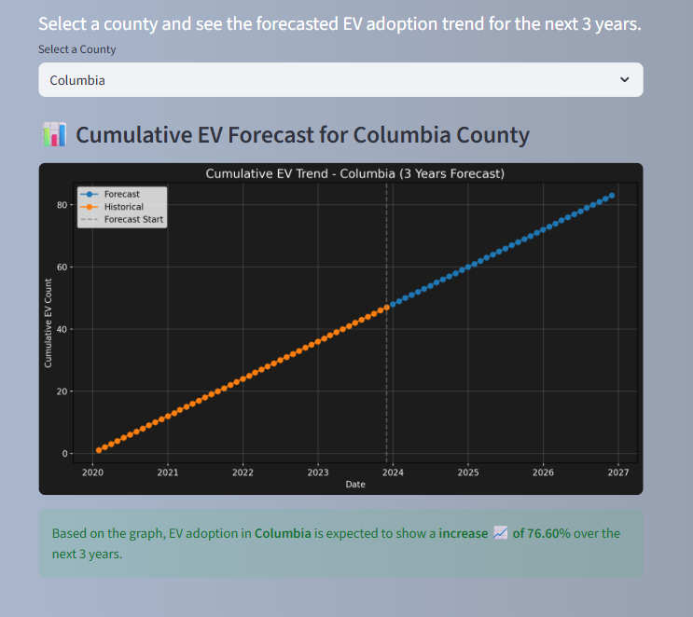
Screenshot of Output:

Slide 11
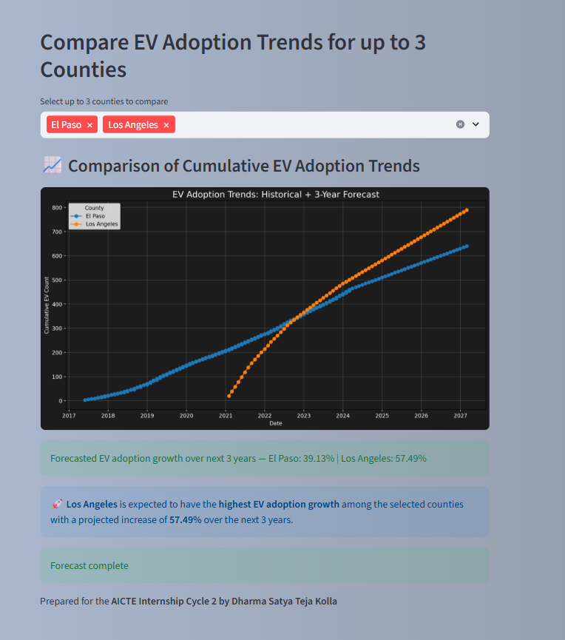
Screenshot of Output:

Slide 12
Conclusion:
Summary:
Forecasted electric vehicle (EV) adoption for 311 counties in Washington State using real-world registration data.
Performed time-series feature engineering including lag values, rolling averages, and EV growth trends.
Trained and evaluated a Random Forest Regressor, achieving a strong R² score of 0.94.
Built and deployed an interactive Streamlit app for county-wise EV forecasting and visualization.
Future Scope:
Explore more advanced models like Gradient Boosting or LSTM to capture complex patterns.
Integrate external factors such as charging station availability and policy changes to improve prediction accuracy

