Slide 1


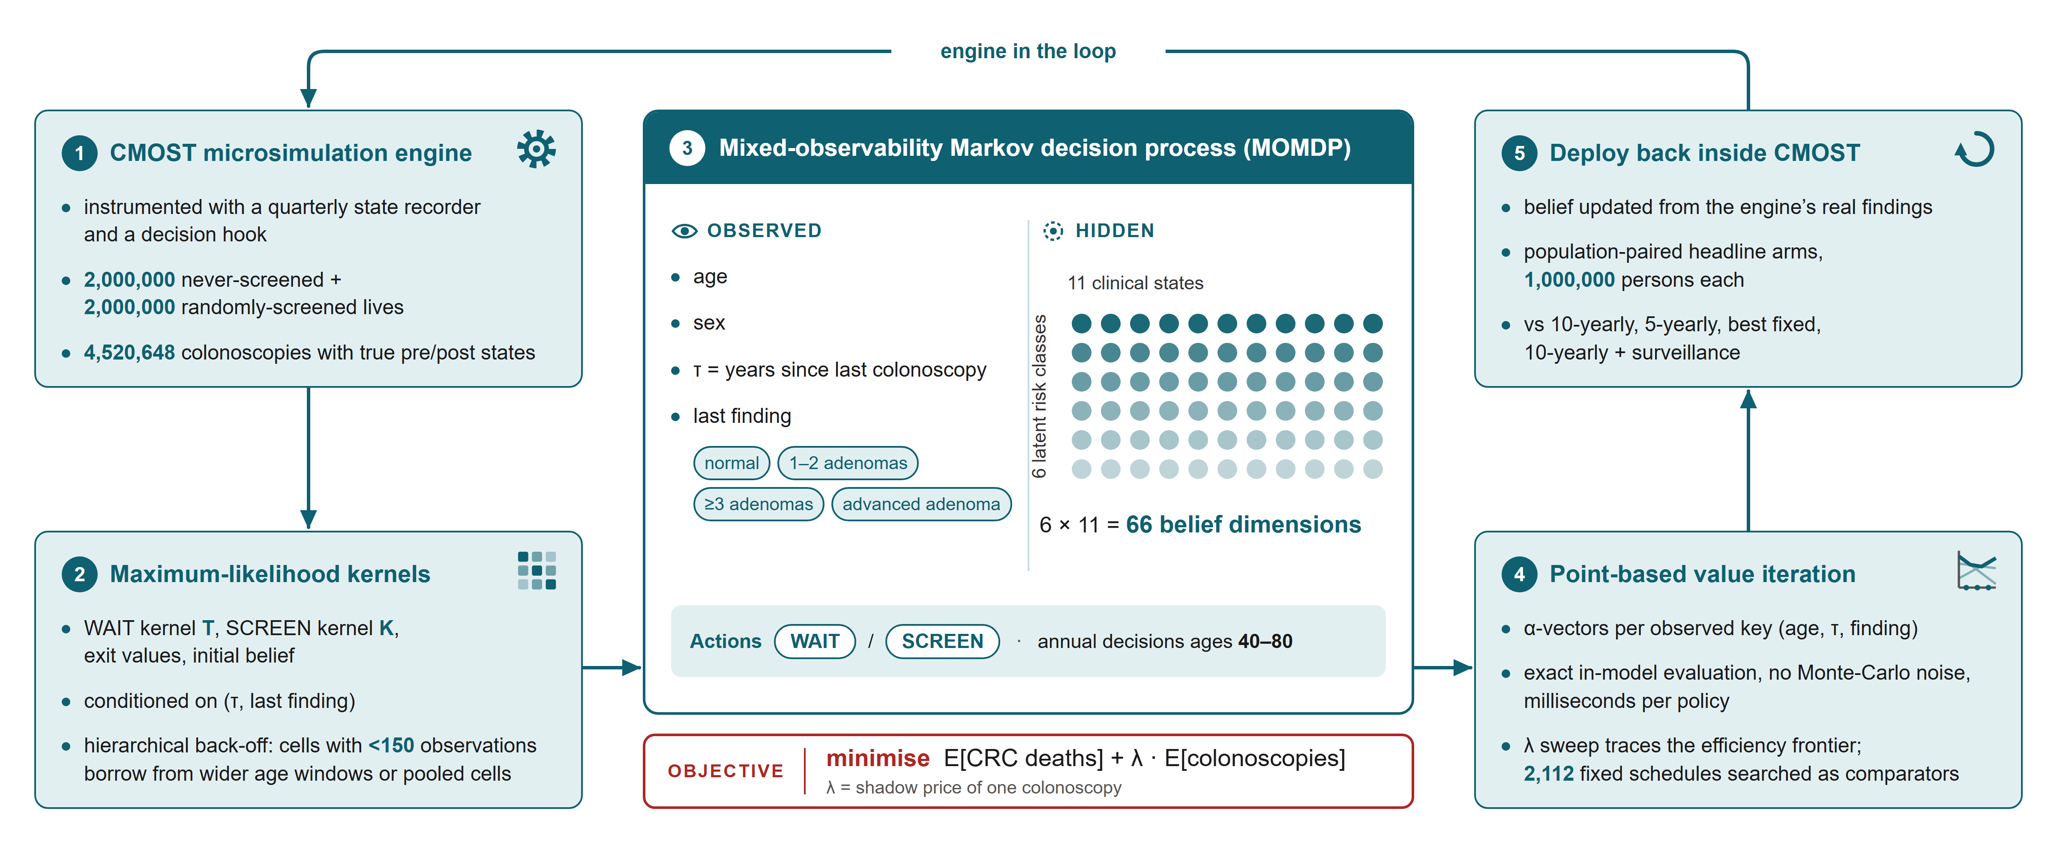
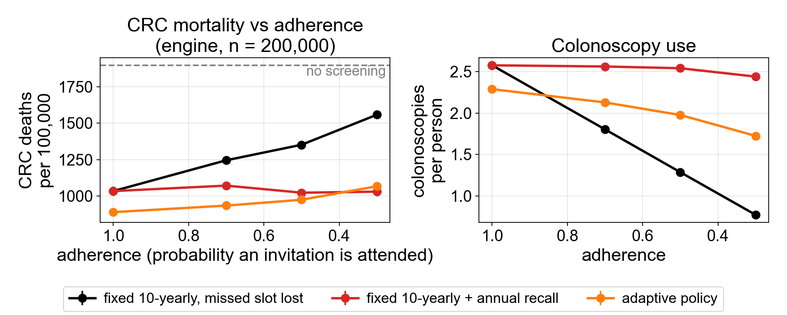
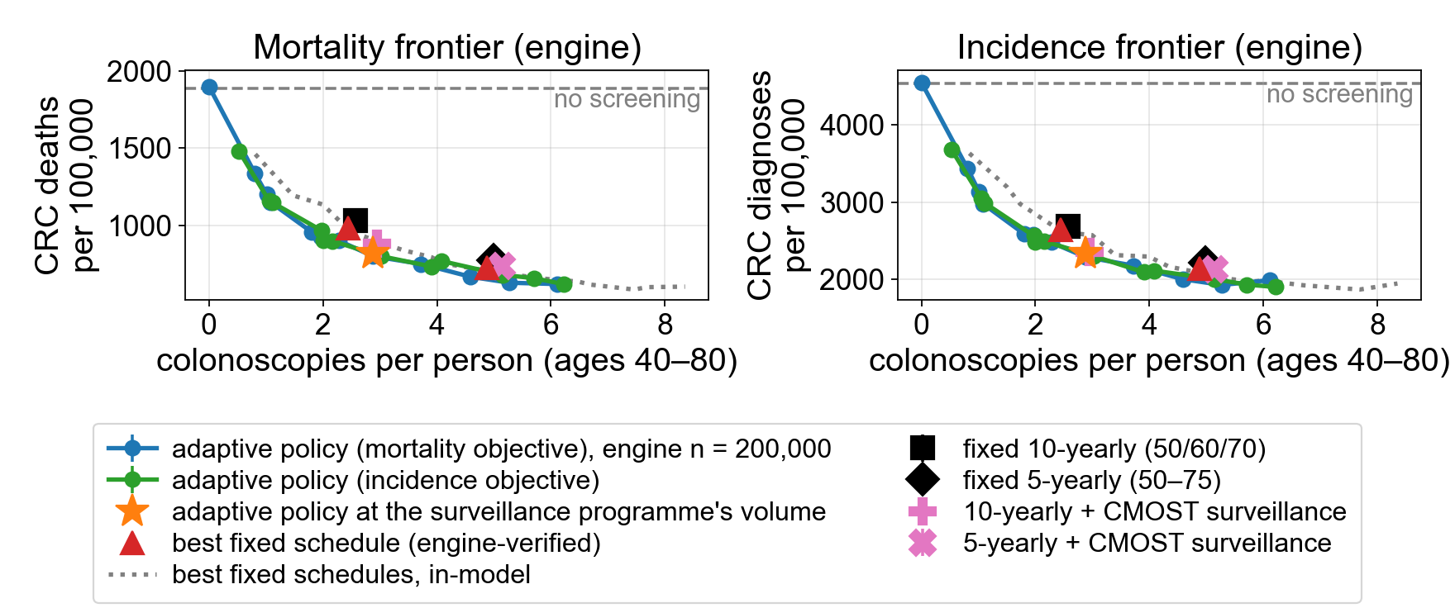
Adaptive Colonoscopy Screening From a Mixed-Observability Markov Decision
Process Built on the CMOST Microsimulation: More Cancers and Deaths
Prevented per Colonoscopy Than Any Fixed Schedule
Taehyung Lee¹, Inseo Choi², Jaehoon Shim³
¹ University of Ulsan College of Medicine ² Chosun University College of Medicine ³ Seoul National University
Email: daybreaker9502@gmail.com · Phone: 010-8023-3200
KoSAIM
2026
POSTER
Code
Problem
Motivation
Can adapting each person's next interval to their own findings beat the best fixed
schedule at equal or lower colonoscopy volume?
A colonoscopy is evidence. ≥3 adenomas lift the probability of the high-risk classes
from 0.05 to 0.93 in men (0.98 in women); a normal exam lowers it to 0.007 in men
and 0.017 in women.
Colonoscopy prevents colorectal cancer (CRC) but is scarce and invasive: judge it by
what it prevents per exam. Optimised schedules (Zaika et al. 2024) are fixed and
ignore what a person's colonoscopies found, the one signal screening itself generates.
23×
higher lifetime CRC incidence in the top 2% of latent risk than in the bottom half: a
gradient no fixed schedule can express, but one the policy infers from findings alone.
1
State. Observed: age, sex, years since last colonoscopy
(τ), last finding (normal / 1–2 / ≥3 / advanced adenomas).
Hidden belief: 6 risk classes × 11 clinical states. WAIT or
SCREEN yearly, ages 40–80.
METHOD
2
Kernels from the engine. Maximum-likelihood estimates
from 4,000,000 CMOST lives (4,520,648 colonoscopies),
conditioned on (τ, last finding).
3
Solve, then deploy. Point-based value iteration; the
shadow price λ sweeps the frontier. Every policy is re-run inside
CMOST on its simulated findings against 10-yearly and 5-yearly
screening, the best of 2,112 fixed schedules and 10-yearly +
surveillance (headline arms: 1,000,000 persons).
CMOST supplies the kernels; point-based value iteration solves the MOMDP; policies run back inside the engine.
Key Results
Robustness
Key numbers
PROGRAMME (ENGINE, 1,000,000 PER
ARM)
COLONOSCOPIES PER
PERSON
CRC DEATHS
PER 100,000
DEATHS AVERTED VS NO SCREENING PER
1,000 COLONOSCOPIES
+30%
Fixed 10-yearly (50/60/70)
2.58
1032.1
3.32
Best fixed, no surveillance
2.44
980.9
3.71
Adaptive policy (ours)
2.29
899.8
4.32
CRC deaths averted per 1,000
colonoscopies vs 10-yearly
screening
10-yearly + surveillance
2.95
879.8
3.42
Adaptive, matched volume
2.87
818.1
3.72
Mortality and colonoscopy use vs adherence; n =
200,000.
−132
−201
18%
mortality cut by fixed 10-yearly screening
(missed slot lost) at 30% attendance,
down from 46%; the adaptive policy, not
re-solved, holds 44–53%.
CRC deaths per 100,000 vs
10-yearly
CRC diagnoses per 100,000
vs 10-yearly
−11%
44–53%
colonoscopies per person vs
10-yearly
mortality cut at attendance
0.3–1.0 (n = 200,000)
Model ablation. Policies from three simpler
models still beat 10-yearly screening by 121–
172 deaths per 100,000 (n = 200,000).
−81
+18%
Efficiency frontiers in the engine: CRC deaths (left) and diagnoses (right).
CRC deaths per 100,000 vs
best fixed, no surveillance
deaths averted per
colonoscopy vs 5-yearly
screening
What the policy does
Risk information vs adaptivity
COLONOSCOPY AGES ALONG EACH
OBSERVATION PATH (λ = 0.001561)
MEN
WOMEN
If the risk class were observable at baseline, the policy would target it explicitly: 6.34
deaths averted per 1,000 colonoscopies, none for the lowest-risk half and 7.49 for
the highest-risk 5% (mortality 5,535 under 10-yearly to 1,956 per 100,000).
all normal
49, 69, 78
58, 73
1–2 adenomas, then normal
49, 58, 67, 75
58, 63, 73, 80
≥3 adenomas, then normal
49, 50, 57, 64, 75
58, 59, 63, 69, 74, 79
CRC DEATHS / 100,000 (IN-MODEL)
NO SCORE
SCORE (AUC 0.60)
SCORE BUYS
advanced adenoma, then normal
49, 52, 64, 75
58, 63, 73, 80
Best fixed schedule
972
942
−30
advanced adenoma twice
49, 52, 53, 61, 67, 75
58, 63, 67, 71, 76, 80
Adaptive policy
892
867
−24
Graded, immediate response: 1–2 adenomas bring the next exam in 9 years (men) or
5 (women); an advanced adenoma in 3 or 5.
Adaptivity buys
−80
−74
SO WHAT → A clean first exam earns 15–20 years; ≥3 adenomas pull the next exam to within 1–4 years (1 here); the sexes are offset by ~9 years (49 vs 58).
3×
more benefit from adaptivity than from a realistic baseline risk score; the two gains are
nearly additive.
In the engine (n = 200,000) the two cannot be told apart (+6.5 ± 25.1 per 100,000).
Takeaway
Individualising colonoscopy timing on realised findings prevents more cancers and deaths per colonoscopy than any fixed schedule, including schedules optimised
for the same simulator, and the gain survives imperfect adherence.
The solved policy is a legible three-tier surveillance rule with a sex offset: a 15–20-year interval after a clean first exam, 3–9 years after 1–2 or advanced adenomas, and re-
examination within 1–4 years after ≥3 adenomas. Limitations: all results are internal to CMOST and inherit its calibration, and non-attendance is modelled as random. Life-years did not
differ significantly between adaptive and fixed schedules, an honest null reported alongside the positive findings.

