Slide 1

Moradabad Institute Of Technology, Moradabad
Project : Image Filters
Submitted By :
Yash Bhatnagar
2nd year
2000820100156
Submitted To :
Ms. Prachi Gupta
Ms. Richa Saxena
(Assistant professor)

Slide 2
Training Details
Topic : Programming Foundations with JavaScript, HTML and CSS
Mode of Training : Online
Platform : Duke University (Coursera)
Start Date : 3 September 2021
End Date : 30 September 2021
Duration : 4 week
Marks Obtained : 91.42 %

Slide 3
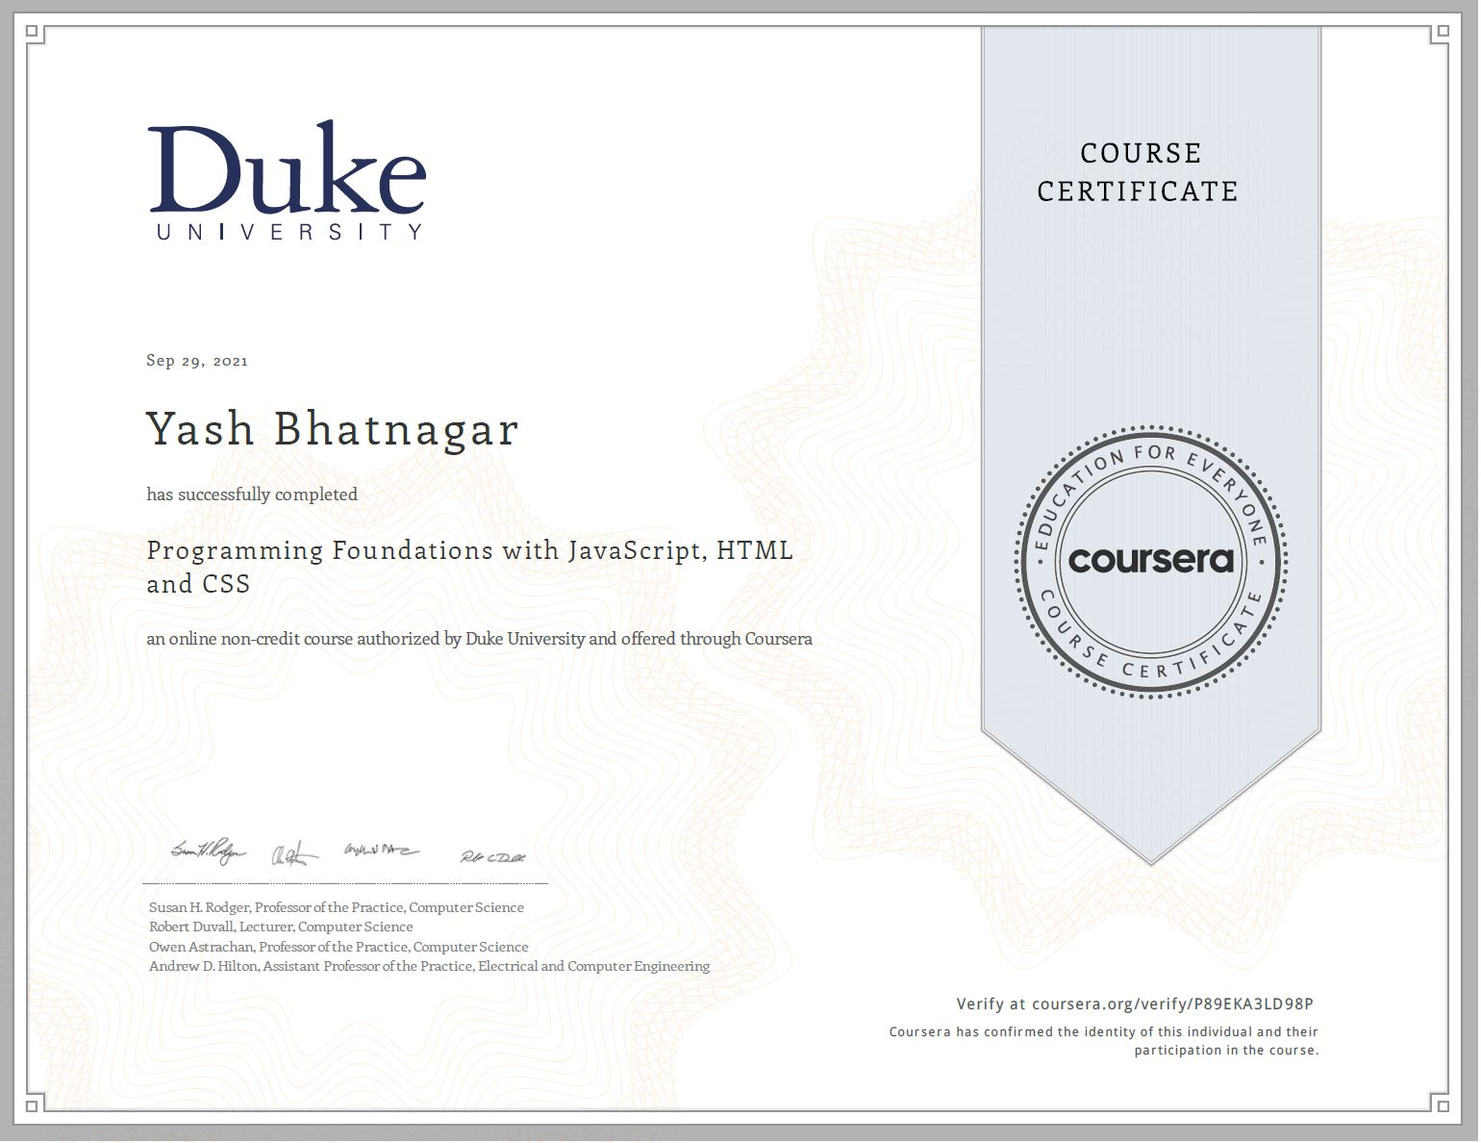
Course Completion Certificate

Slide 4
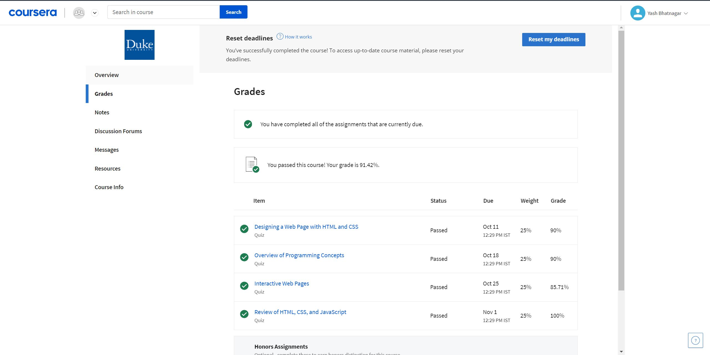
GRADES

Slide 5
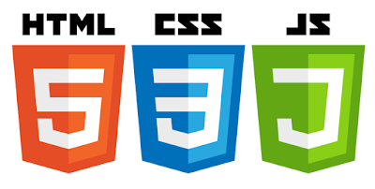
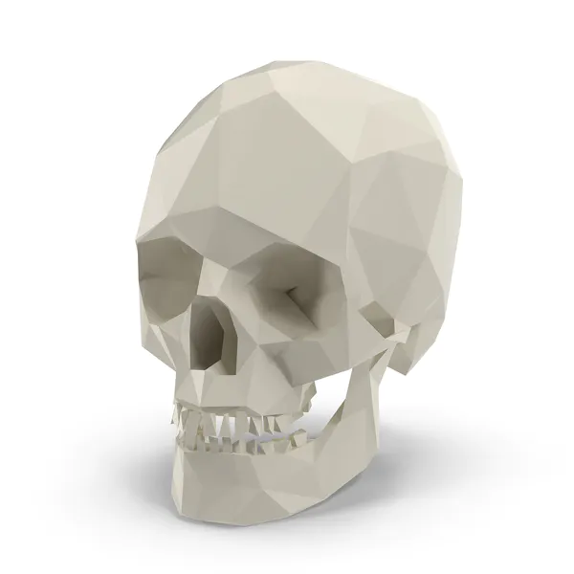
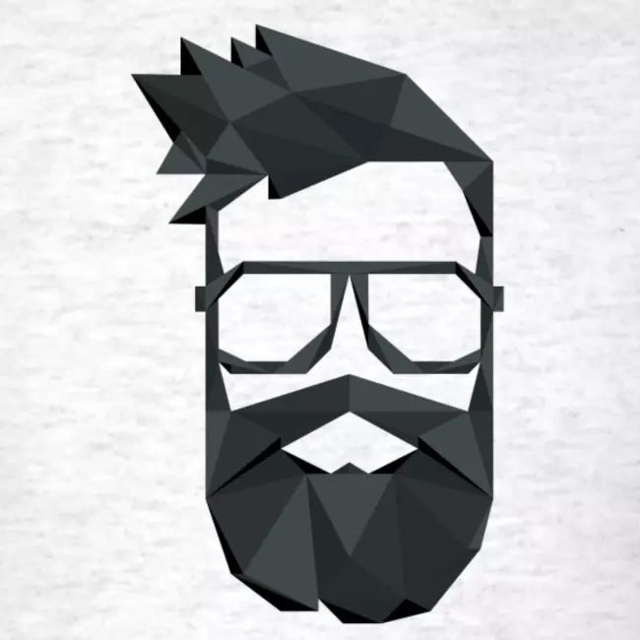
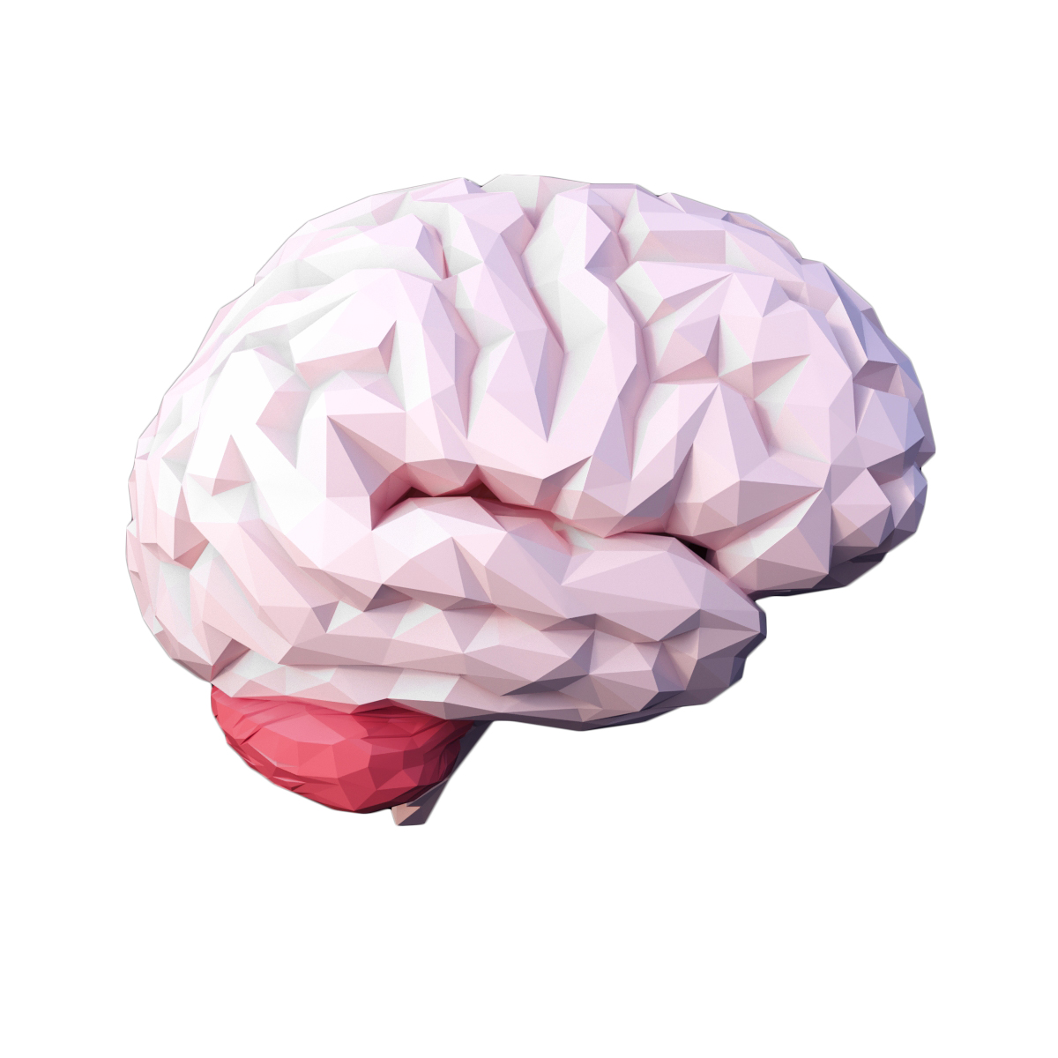
Web Technologies used
HTML to create the document structure and content
CSS to control is visual aspect
Javascript for interactivity

Slide 6
HTML
HTML means Hyper Text Markup Language.
The HTML allow us to construct the visible part of a website.
HTML is NOT a programming language, it’s a markup language, which means its purpose is to give structure to the content of the website.
It is a series of nested tags that contain all the website information (like texts, images and videos).
The HTML defines the page structure.

Slide 7
CSS
CSS stands for Cascading Style Sheets.
Allows to specify how to present (render) the document info stored in the HTML.
Allows to controls all the aspects of the visualization and some other features:
Colors: content, background, borders
Margins: interior margin, exterior margin
Position: where to put it
Sizes: width, height

Slide 8
Javascript
A regular programming language, easy to start, hard to master.
Allows to give some interactivity to the elements on the web.
Syntax similar to C or Java but with no types.
You can define what the each click by the user could do on the webpage. This can be done by making(defining) different functions & codes in JavaScript.
You can even send or retrieve information from the internet to update the content of the web.

Slide 9
About the Project
Advantages
As the project title, Image Filters, suggests the project is all about a webpage with which user can apply different fun filters on the images upload by the user(client).
The webpage is made on front-end web technologies – HTML, CSS & JavaScript.
Also, thanks to Duke University as they have provided the JavaScript file that contains the code which is used as a kind of library file in the project.
The webpage can be used to apply the different filters on the image which the user can download (if needed).
The downloaded image is of the same resolution as the uploaded (original) image. Hence there is no loss of quality in the output images during the whole process.
The user now no more required to download any third-party software which might breach the user privacy & could the access to the user’s personal images.

Slide 10
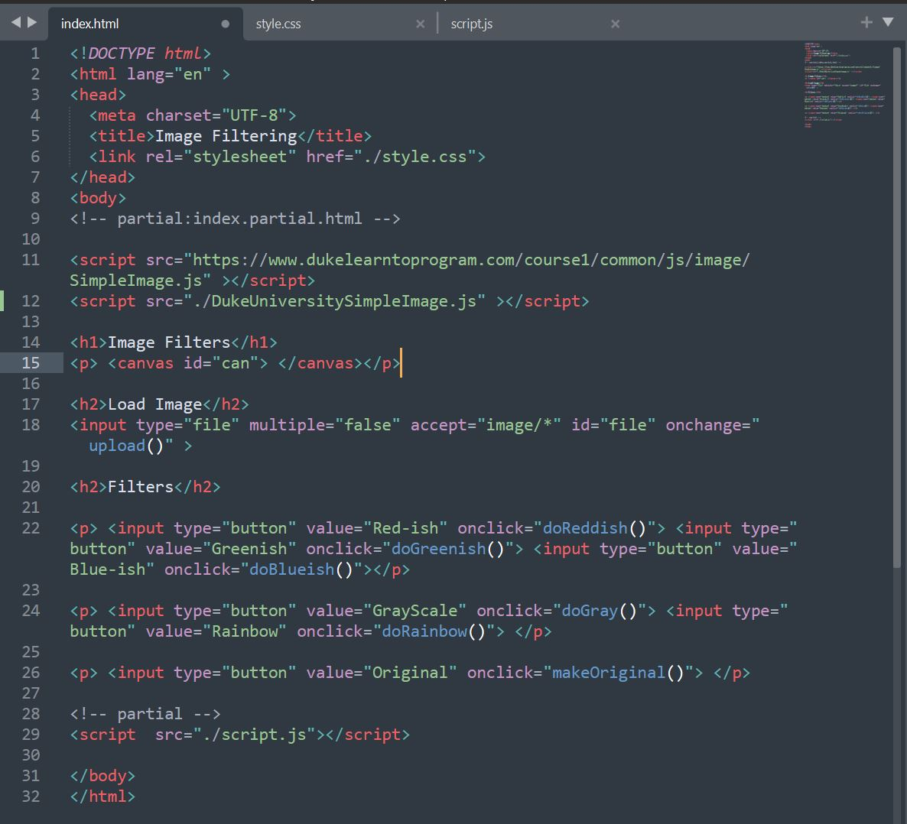
Code used in
HTML

Slide 11
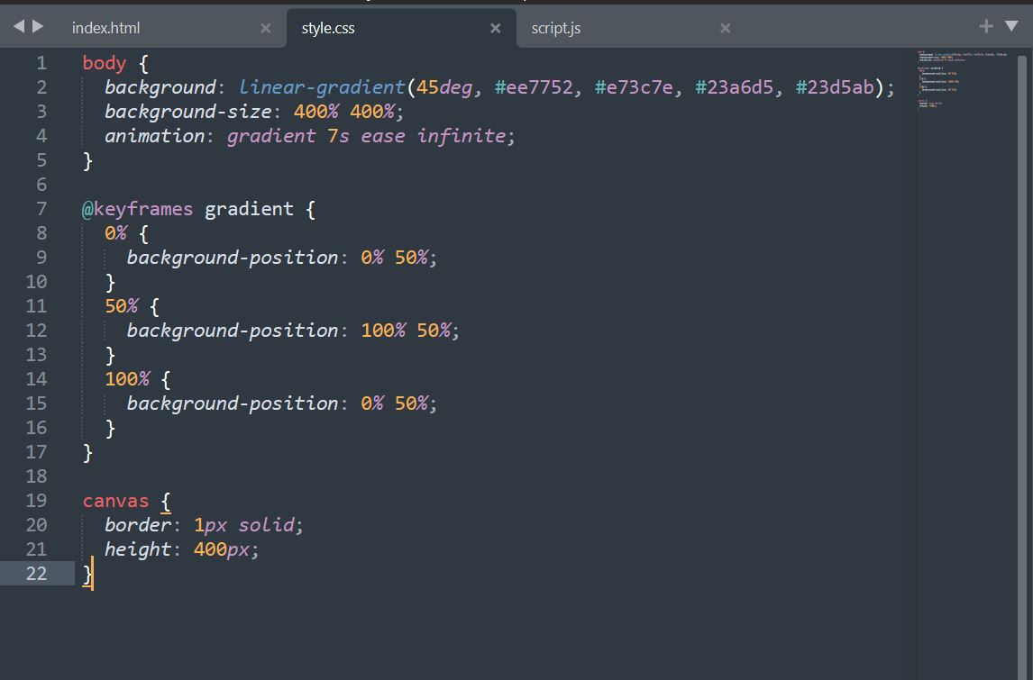
Code used in CSS

Slide 12
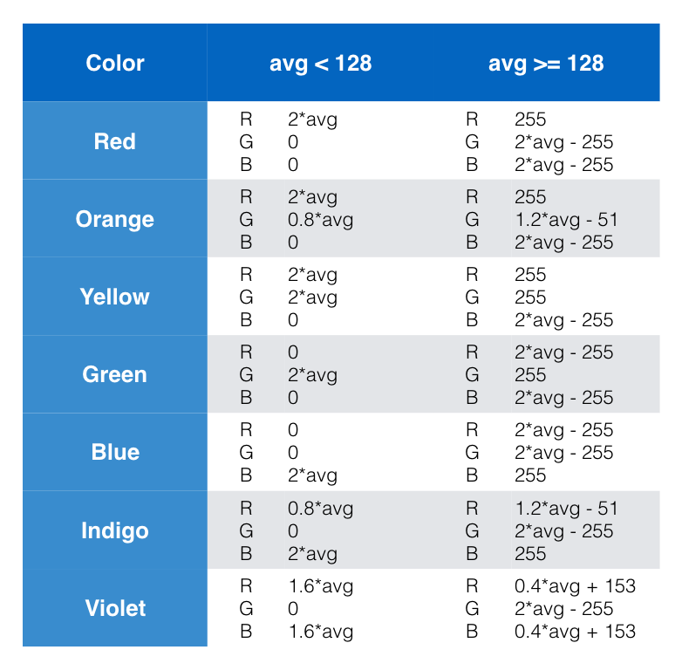
Logic used in
JavaScript code

Slide 13
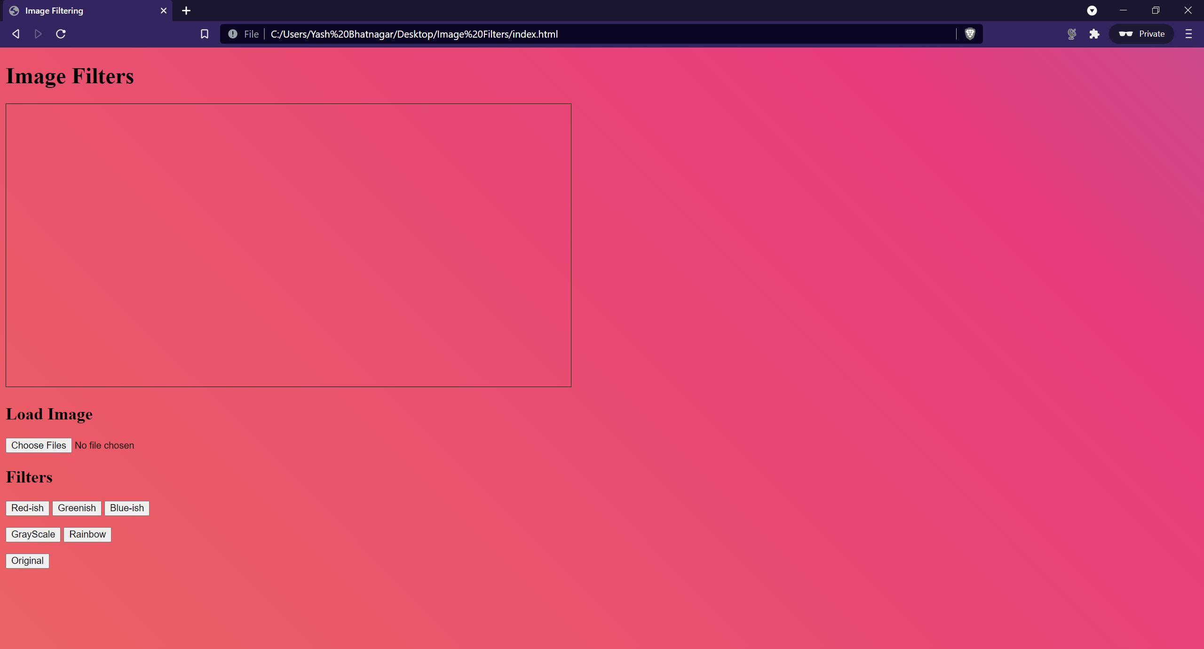
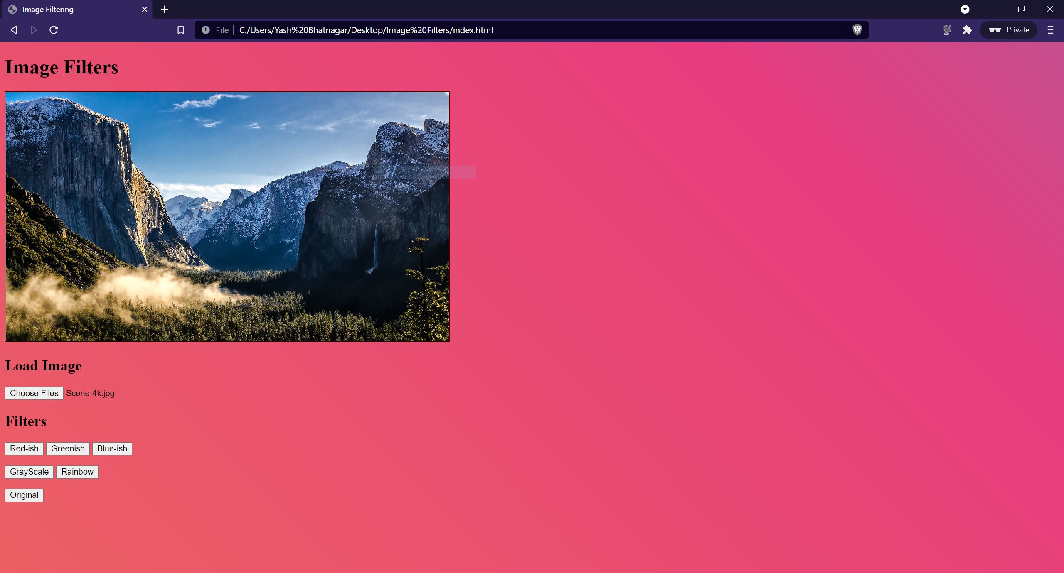
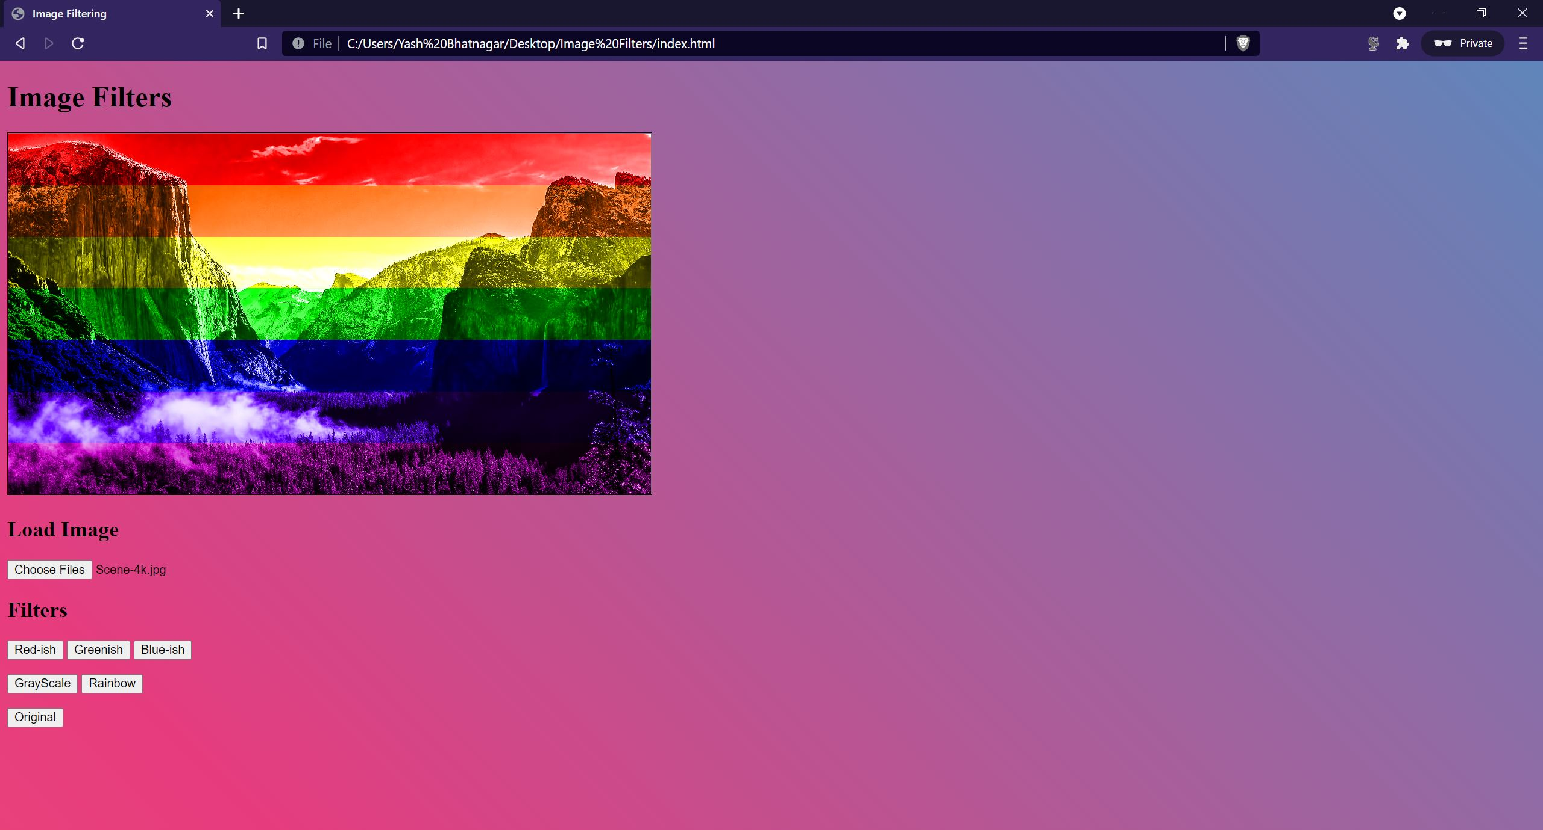
Final Webpage
1
2
Clicked on the ‘Choose Files’ Button & upload the image named ‘Scene-4k.jpg’.
Clicked on the ‘Rainbow’ Button & the rainbow filter is applied on the uploaded image.

Slide 14
Bibliography
https://www.coursera.org/learn/duke-programming-web/home/welcome
https://codepen.io/
https://www.w3schools.com
https://www.dukelearntoprogram.com/course1/doc
https://developer.mozilla.org/en-US/docs

Slide 15
THANK YOU!

