Slide 1
AOS论文阅读总结
ZBD

Slide 2
Linux kernel vulnerabilities: State-of-the-art defenses and open problems (2011)

Slide 3
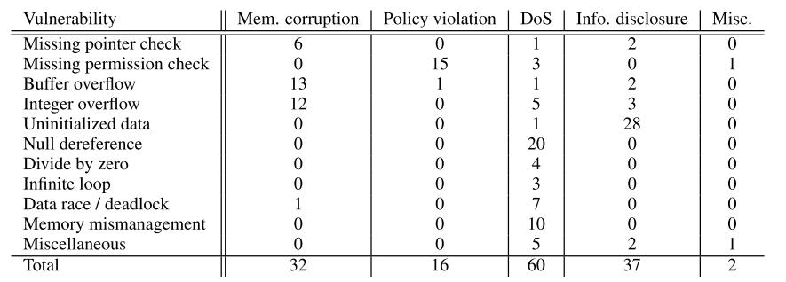
Linux kernel vulnerabilities
Categorizing (from January 2010 to March 2011)
2/3 in kernel modules or drivers, and 1/3 in the core kernel

Slide 4
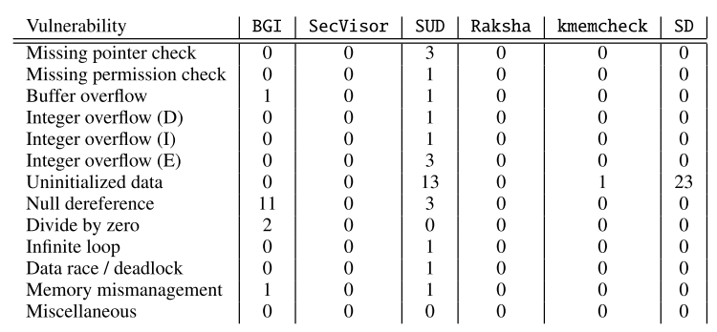
Linux kernel vulnerabilities
STATE-OF-THE-ART PREVENTION
Runtime tools
Compile-time tools
Notes:
BGI可以隔离内核模块，控制内核模块之间的交互，但是防不了core中的漏洞或者只在一个module范围内的漏洞。
SecVisor通过一个小的hypervisor来监控所有内核模式执行的代码来源，但可以被控制流劫持、破坏内存数据等攻击绕过。
SUD在用户态运行设备驱动，虽然防止了驱动漏洞影响内核，但是还是会形成DoS攻击。
Rakasha会监控内核代码使用不信任的输入，只能防御控制流替换这一类攻击
Kmemcheck通过kernel memory allocator跟踪内存每字节的初始化情况。
Secure deallocation周期性的将内核栈置0。两种方法都只能缓解漏洞，并不能完全防御。
静态分析工具会产生大量误报，而且解决不了语义漏洞，但是在空指针引用、缓冲区溢出、死锁、死循环检测上有了良好效果

Slide 5
Linux kernel vulnerabilities
Open problems
Semantic vulnerabilities
Denial-of-service vulnerabilities

Slide 6
KLEE: Unassisted and Automatic Generation of High-Coverage Tests for Complex Systems Programs (2008)

Slide 7
KLEE
Symbolic execution + concolic execution
Opensource tools
Check 89 programs in the GNU COREUTILS
high line coverage—on average over 90% per tool

Slide 8
KLEE
Challenges
The number of paths grow dramatically
path schedule
Cost of constraint solver
Environmental Dependencies

Slide 9
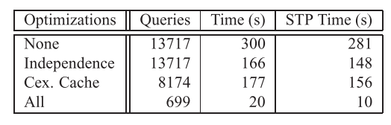
KLEE
Optimization
Compact state representation
copy-on-write
Query optimization
Expression Rewriting
Constraint Set Simplificatio
Implied Value Concretization
Constraint Independence
Counter-example Cache
State scheduling
RandomPath Selection
Coverage-Optimized Search
Notes:
KLEE的state调度策略使用的是两个策略轮询的方式：
1）随机路径选择：KLEE用二叉树表示所有state里的程序路径，在每个分支等概率的随机选择一条路径，这种方法可以保证较高位置的节点（约束更少）更容易被选择，而且不会出现节点一直不被执行的问题。
2）路径覆盖策略：这种策略会对每个state计算一个权值，权值计算根据离未执行代码最小距离、state调用栈、是否最近执行过新代码等信息。

Slide 10
KLEE
EnvironmentModeling
models written in C code
redirect calls to models
Notes:
KLEE的state调度策略使用的是两个策略轮询的方式：
1）随机路径选择：KLEE用二叉树表示所有state里的程序路径，在每个分支等概率的随机选择一条路径，这种方法可以保证较高位置的节点（约束更少）更容易被选择，而且不会出现节点一直不被执行的问题。
2）路径覆盖策略：这种策略会对每个state计算一个权值，权值计算根据离未执行代码最小距离、state调用栈、是否最近执行过新代码等信息。

Slide 11
Designing New Operating Primitives to Improve Fuzzing Performance (2017)

Slide 12
bottlenecks in AFL
Fork()
Frequently called
Expensive
R/W to disk file system frequently
Sync test cases with AFL instances
Notes:
black box
ANTLR parser generator framework

Slide 13
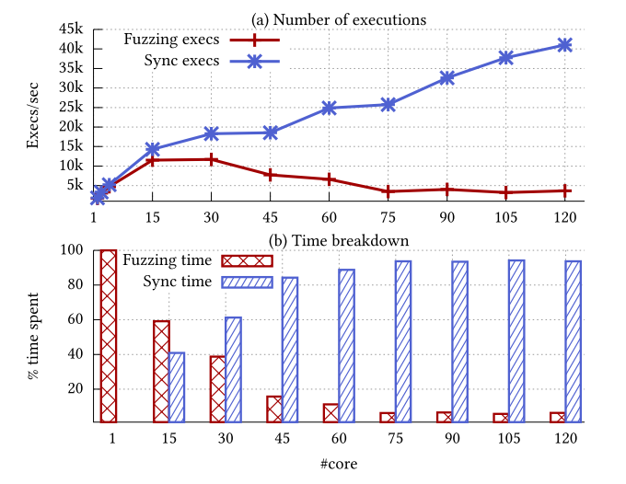
bottlenecks in AFL
Notes:
black box
ANTLR parser generator framework

Slide 14
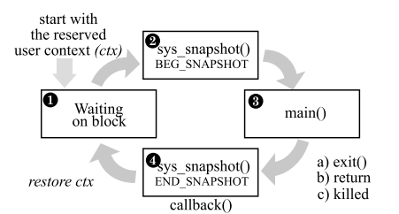
Optimization
Snapshot System Call
3 phases
loop & callback
Dual File System Service
memory file system
Shared In-memory Test-Case Log
Notes:
black box
ANTLR parser generator framework

Slide 15
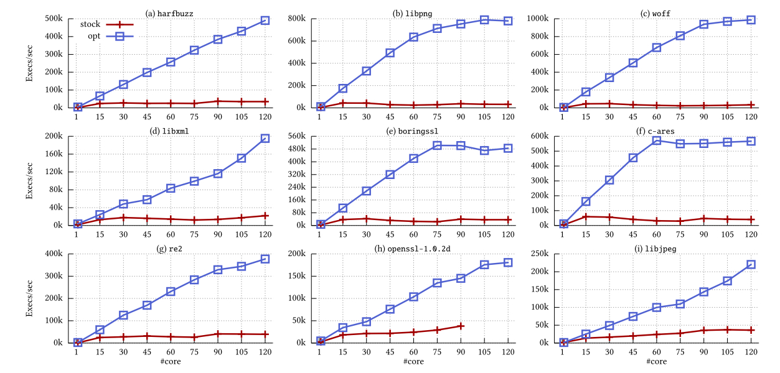
Evaluation
Snapshot System Call
3 phases
loop & callback
Dual File System Service
memory file system
Shared In-memory Test-Case Log
Notes:
black box
ANTLR parser generator framework

Slide 16
Expriment
Compile custom linux kernel (4.8.10)
in vmware
in server (failed)
error when call snapshot()
debug system call...
Run AFL
failed
hard to debug
Give up...

Slide 17
kAFL: Hardware-Assisted Feedback Fuzzing for OS Kernels (2017)

Slide 18
Challenges for kernel fuzzing
fuzzing should not be interrupted by a crash
no-determinism behavior
interact with kernel
closed source
Notes:
不能插桩

Slide 19
Previous approaches were not portable
Slow
No feedback
Rely on certain drivers or recompilation
Notes:
fuzz 输入尽量分散，随机，触发漏洞

Slide 20
kAFL
用Intel PT来获取路径覆盖率信息
用Intel VT-x进行虚拟化
Notes:
不能插桩

Slide 21
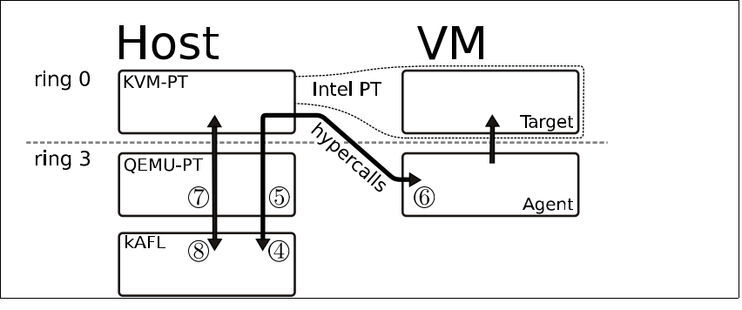
kAFL Overview
Notes:
不能插桩

Slide 22
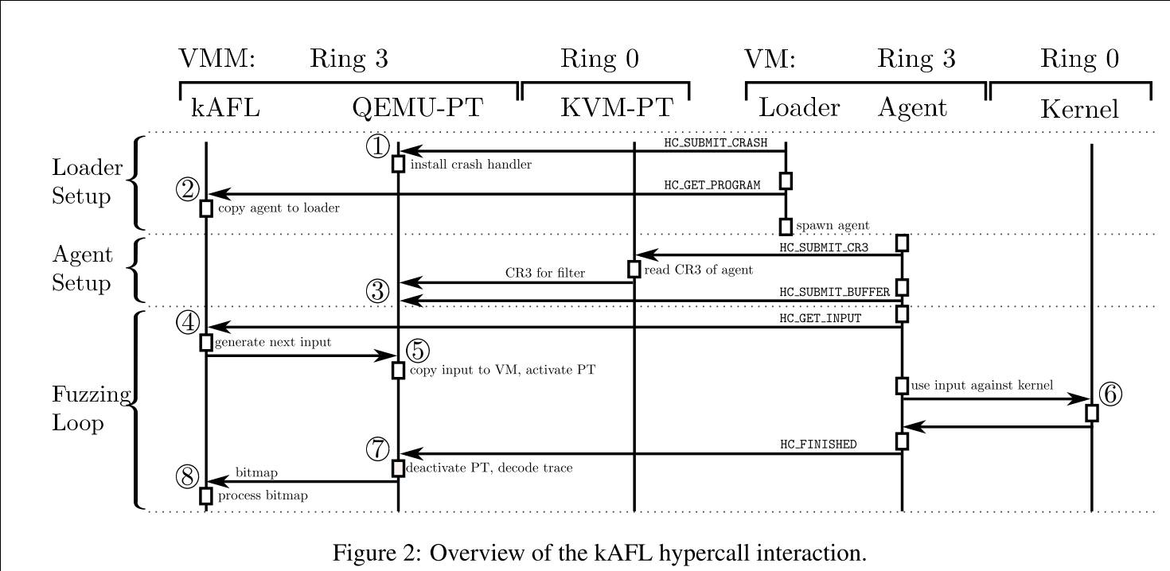
kAFL工作流程
Notes:
不能插桩

Slide 23
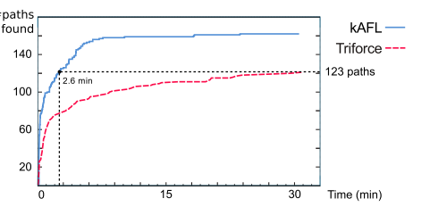
Evaluation
Notes:
不能插桩

Slide 24
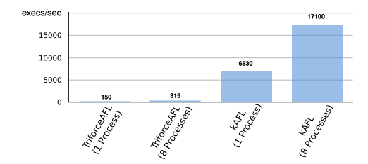
Evaluation
Notes:
不能插桩

Slide 25
The Scalable Commutativity Rule: Designing Scalable Software for Multicore Processors (2013)

Slide 26
Evaluating the scalability
The state of the art for evaluating
with complete software
hard to identify scalability bottlenecks
Scalability in multicore server
conflict-free
commute
Notes:
fuzz 输入尽量分散，随机，触发漏洞

Slide 27
Interface-driven scalability
The scalable commutativity rule
Formalization of the rule and proof of its correctness
SIM commutativity
commuter

Slide 28
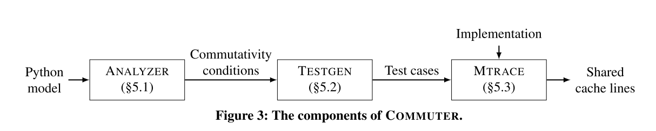
Commuter
Notes:
fuzz 输入尽量分散，随机，触发漏洞

Slide 29
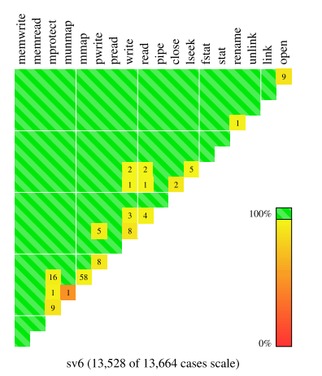
Evaluation
18 targets
13664 testcases
sv6
Notes:
fuzz 输入尽量分散，随机，触发漏洞

Slide 30
Hyperkernel: Push-Button Verification of an OS Kernel (2017)

Slide 31
Push-Button Verification of an OS Kernel
验证正确性 <----> 生成内核（可用性）
Z3 SMT求解器
挑战
接口设计
虚拟内存管理
C语言
方案
内核接口设计finite
内核空间和用户空间内存分离
LLVM IR
Notes:
可以通过语法分析检测

Slide 32
Push-Button Verification of an OS Kernel
验证正确性
trap handlers
状态机
计算fspec(python model)和fimpl(symbolic execution)
验证定理1表达式
∀Sspec,x. P(Sspec)⇒P(fspec(Sspec,x))
验证后的代码和未验证的可信代码生成kernel
Notes:
可以通过语法分析检测

Slide 33
Hyperkernrl
Dune + exokernels + seL4
内存分离
减少内核中断处理
用户进行资源申请
内核负责验证(finite)
Typed pages内存分区
Notes:
可以通过语法分析检测

Slide 34
KLEE实验

Slide 35
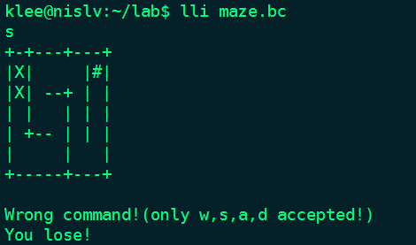
Solve maze with KLEE
Notes:
概率上下文敏感语法
use the code coverage as the criterion to perform seed selection
变异叶节点

Slide 36
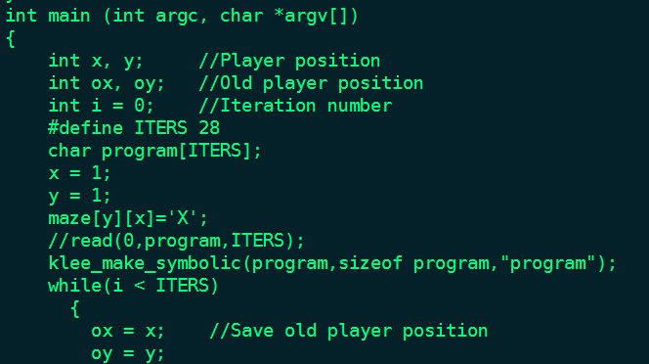
Solve maze with KLEE
klee_make_symbolic
Notes:
概率上下文敏感语法
use the code coverage as the criterion to perform seed selection
变异叶节点

Slide 37
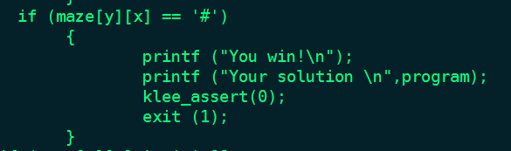
Solve maze with KLEE
klee_make_symbolic
Notes:
概率上下文敏感语法
use the code coverage as the criterion to perform seed selection
变异叶节点

Slide 38
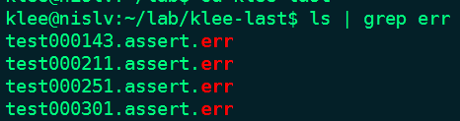
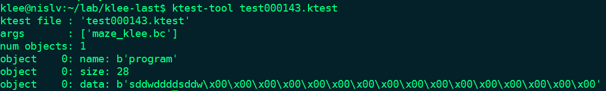
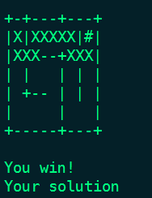
Solve maze with KLEE
Notes:
概率上下文敏感语法
use the code coverage as the criterion to perform seed selection
变异叶节点

Slide 39
Hyperkernel实验

Slide 40
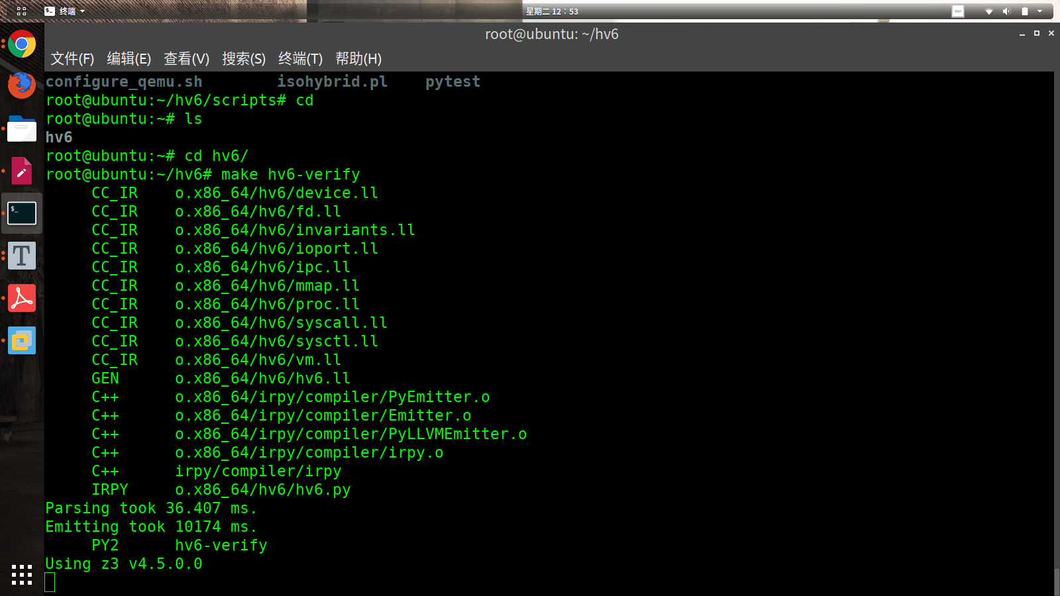
Hyperkernel
Notes:
概率上下文敏感语法
use the code coverage as the criterion to perform seed selection
变异叶节点

Slide 41
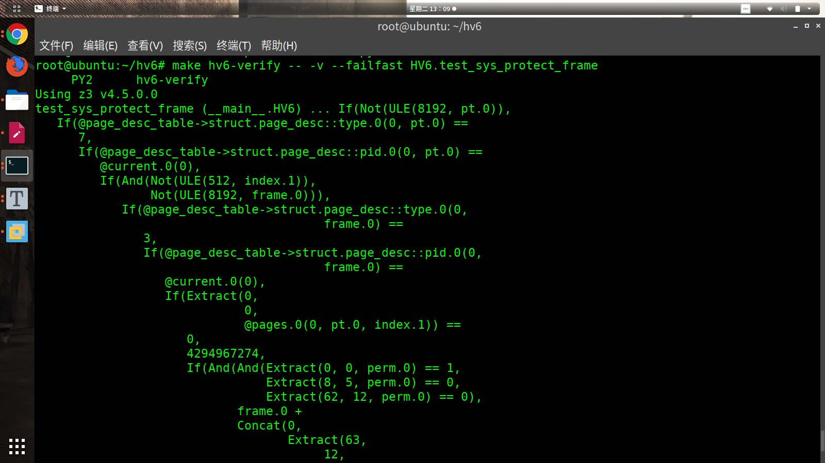
Hyperkernel
Notes:
概率上下文敏感语法
use the code coverage as the criterion to perform seed selection
变异叶节点

Slide 42
Thanks!

