Slide 1
20%
30%
100%
毕业答辩
12.30
3.04
5.06
开题报告
We are here
中期检查
10%
60%

Slide 2
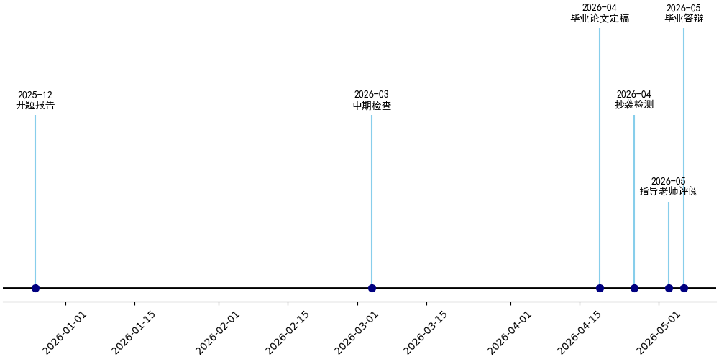
We are here

