Slide 1
C/C++ Program Design
Lab 2, data types and arithmetic operators
王大兴，廖琪梅

Slide 2
Data types and arithmetic operators
Commonly used data types (integers, floats, ...).
Overflow
Test integer range
Conversion between char and integer
Test float number precision

Slide 3
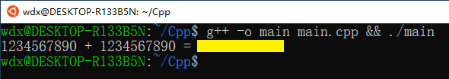
Commonly used data types: integer
Declaring integers and doing simple arithmetic operations:
#include <iostream>
using std::cout;
using std::endl;
int main() {
int a = 1234567890;
int b = 1234567890;
int sum = a+b;
cout<<a<<" + "<<b<<" = "<<sum<<endl;
return 0;
}
Run the following command in your terminal and see what happens:

Slide 4

Commonly used data types: float
Declaring floating point numbers and doing simple arithmetic operations:
#include <iostream>
using std::cout;
using std::endl;
int main() {
float a = 1234567.0;
float b = 1.0;
float sum = a+b;
cout<<a<<" + "<<b<<" = "<<sum<<endl;
return 0;
}
Run the following command in your terminal and see what happens:

Slide 5
Integer overflow
Integers are stored in memory as a few number of bytes.
The range of integers that can be properly represented is limited.
Calculating numbers outside this range causes errors.

Slide 6

Conversion between char and integer
The character type of c++ is char. Char and int can be converted.
Characters are a type of integers in memory.
#include <cstdio>
int main() {
char c = 'C';
int i = c;
printf("Convert '%c' to integer: %d\n", c, i );
return 0;
}
Run the following command in your terminal and see what happens:

Slide 7
Conversion between char and integer
You already know the integer value of character ‘C’, but why?
ASCII table.

Slide 8

Floating point precision
The range of floating point numbers is also limited.
Floating point numbers also have precision problems.
#include <iostream>
using std::cout;
using std::endl;
int main() {
float a = 0.1;
float sum = a+a+a+a+a+a+a+a+a+a;
cout<<"sum: "<<sum<<endl;
cout<<"sum equals to 1? "<<(sum==1.0)<<endl;
return 0;
}
Try the code on the left to see what happens.
Note that (sum==1.0) is a bool value, 1 means “true” and 0 means “false”.

Slide 9
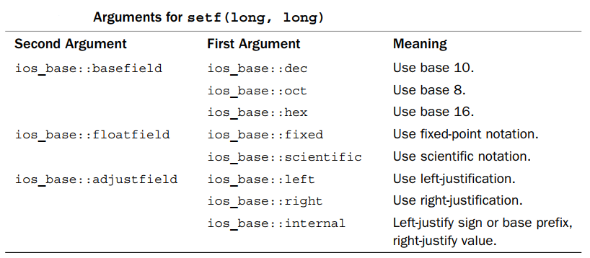
C++ provides two methods to control the output formats
Using member functions of ios class
Using iomanip manipulators
Using member functions of ios class
1. cout.setf( fmtflags, fmtflags)

Slide 10
Using member functions of ios class
2. cout.width(len) //set the field width
3. cout.fill(ch) // fill character to be used with justified field
4. cout.precision(p) // set the precision of floating-point numbers

Slide 11
Using iomanip manipulators
#include <iomanip>
1. setw(p)
2. setfill(ch)
3. setprecision(d)

Slide 12
cout.unsetf( )

Slide 13
1. Compile and link the following multiple files into one executable file, run the file. What is the result? Is that reasonable? Correct the error(s) and run again.
Exercises
main.cpp
#include <iostream>
#include "mul.hpp"
using namespace std;
int main()
{
int a, b;
int result;
cout << "Pick two integers:";
cin >> a;
cin >> a;
result = mul(a, b);
cout << "The result is " << result << endl;
return 0;
}
mul.hpp
#pragma once
int mul(int a, int b);
mul.cpp
#include "mul.hpp" int mul(int a, int b)
{
return a * b;
}

Slide 14
2. sizeof operator returns the size, int bytes, of a type or a variable.
Exercises
Compile the following program, what are the warnings? How to correct them?
#include <stdio.h>
#include <stdbool.h>
int main()
{
printf("\nPrint size of the fundamental types:\n");
printf("-----------------------------------------");
printf("The sizeof(char) is:%d bytes.\n", sizeof(char));
printf("The sizeof(short) is:%d bytes.\n", sizeof(short));
printf("The sizeof(int) is:%d bytes.\n", sizeof(int));
printf("The sizeof(long) is:%d bytes.\n", sizeof(long));
printf("The sizeof(long long) is:%d bytes.\n", sizeof(long long));
printf("The sizeof(float) is:%d bytes.\n", sizeof(float));
printf("The sizeof(double) is:%d bytes.\n", sizeof(double));
printf("The sizeof(long double) is:%d bytes.\n", sizeof(long double));
printf("The sizeof(bool) is:%d byte.\n", sizeof(bool));
return 0;
}

Slide 15
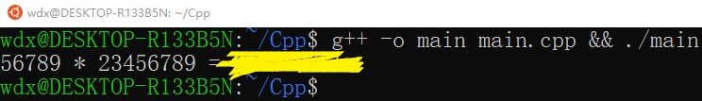
3. Calculate 56789 x 23456789
Exercises
Write code to calculate 56789 multiply 23456789
Try to output something like this in the terminal, feel free to format the output the way you like.

Slide 16
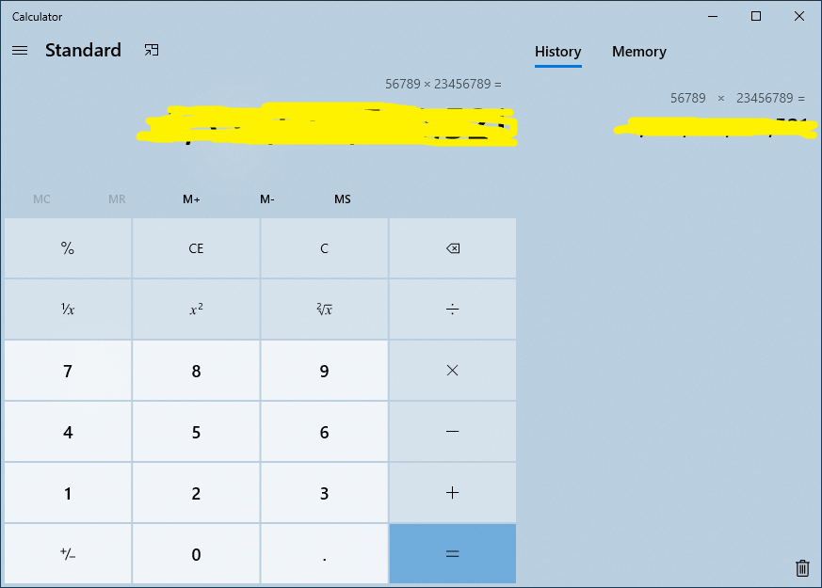
Verify the result using a calculator.
Congratulations if you get the right result!
If the result is wrong, what could be the reason?

Slide 17
4. Write a program to find the integer range of your computer.
Exercises
Find the interval [MIN, MAX] such that integer operations within this range is correct, while operations outside this range might be incorrect.
Suppose X is the maximum integer for type “int” on your computer, what is the result of X+1?
Suppose Y is the minimum integer for type “int” on your computer, what is the result of Y-1?
Are they the same with the value you have expected?

Slide 18
5. Try conversions between char and int
Exercises
Choose some integers you like. Convert then to chars and print them.
Or you can choose some chars and convert them to ints.
There are some special characters in the table, try some of them!
https://www.tutorialspoint.com/html/ascii_table_lookup.htm

Slide 19
6.Test the precision of floating point numbers
Exercises
Try and find some floating point numbers and perform some arithmetic operations on them. Show that the operations are not precise due to the choice of the numbers.
https://courses.physics.illinois.edu/cs357/sp2020/notes/ref-4-fp.html

Slide 20
Be careful with the output. You may need to see the exact binary presentation of the float to proof that it’s a floating point precision problem.
The following code can show the binary presentation of a float in some mainstream architecture.
int main() {
float f1 = 1.0;
cout<<"f1 = "<<f1<<endl;
cout<<"The binary presentaion of f1"<<" is:"<<endl;
printFloat(f1);
cout<<endl;
float a = 0.1;
float f2 = a+a+a+a+a+a+a+a+a+a;
cout<<"f2 = "<<f2<<endl;
cout<<"The binary presentaion of f2"<<" is:"<<endl;
printFloat(f2);
cout<<endl;
return 0;
}
void printFloat(float num)
{
int inum = *(int*)&num;
for (int i = 0; i < 32; ++i) {
cout << ((inum&0x80000000) ? 1 : 0);
if (i == 0 || i == 8)
cout << " ";
inum <<= 1;
}
cout << endl;
}

