Slide 1
C/C++ Program Design
Lab 3, Loops and Branching Statements
王大兴，廖琪梅

Slide 2
Loops and Branching Statements
Making a calculator
Makefile

Slide 3
Making a calculator
Software requirement.
System design.
Design data types.
Performance issue.
User interface?
Test.

Slide 4
Making a calculator: Software requirement
Be clear of what you want with a calculator.
integers, floating point numbers, complex numbers?
addition, substraction, multiplication, division, sine, cosine,...,power?
graphic user interface, drawing graphs, storing variables?

Slide 5
Making a calculator: Design system
You need to design basic framework of your system.
Which one do you prefer? Left or right?
Panel panel();
Button button1;
Button button2;
Button button3;
......
Button buttonEquals;
buttonEquals.addActionListener(...)
int main() {
prepareUI();
while( true ) {
string s = getQuestionFromInput();
processQuestion(s);
wait(16);
}
}

Slide 6
Making a calculator: Design data types
Which data types do you choose? int, float, long long?
It’s inevitable that user will need number larger than max value of long long int.
Need to use high precision calculation.

Slide 7
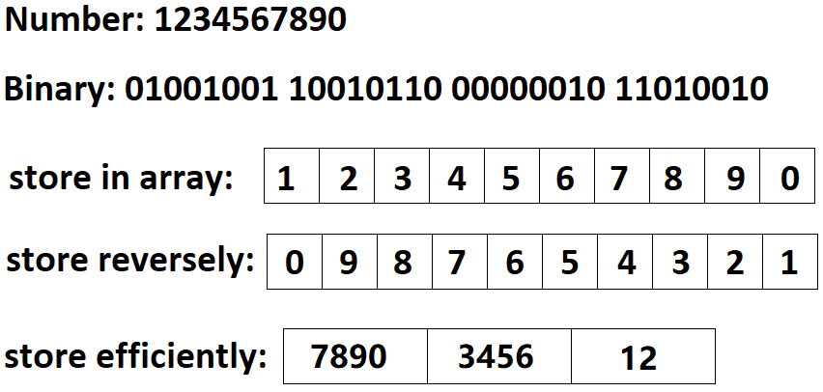
Making a calculator: Design data types
Need to use high precision calculation.
Use arrays to store an integer (be very careful with array index).

Slide 8
Making a calculator: Design data types
What about floating point?
Again we are expecting something larger than double.
Possible solution:
BigInteger number;
int scale;
The actual value is: number x 10^scale

Slide 9
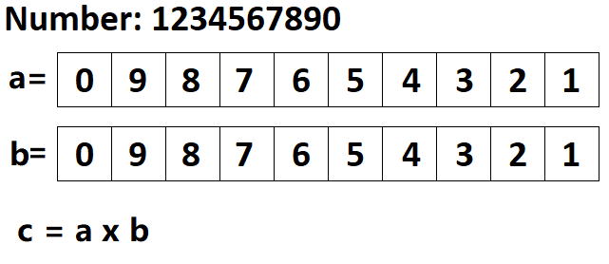
Making a calculator: Performance issue
How to do multiplications with reversely arranged array?

Slide 10
Making a calculator: Performance issue
How to do multiplycations with reversely arranged array?
Suppose a and b both have length n, the following code takes O(n²)
for ( int i = 0; i < a_size; ++ i ) {
for( int j = 0; j < b_size; ++ j ) {
c[i+j] += a[i]*b[j];
if( c[i+j] >= 10 ) {
c[i+j+1] += c[i+j]/10;
c[i+j] = c[i+j] % 10;
}
}
}

Slide 11
Making a calculator: Performance issue
How to do multiplycations with reversely arranged array?
Karatsuba algorithm has running time about Θ(n^{1.585}) for large array.
https://brilliant.org/wiki/karatsuba-algorithm/
For larger array, you may choose Toom Cook algorithm.

Slide 12
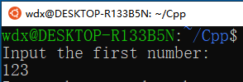
Making a calculator: User interface
You may want to use some GUI framework for better look.
Possible choice: https://www.qt.io/home
Or if you use command line:
int main() {
char a[20];
char b[20];
cout<<"Input the first number:"<<endl;
cin>>a;
cout<<"Input the second number:"<<endl;
cin>>b;
return 0;
}

Slide 13
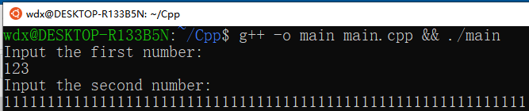
Making a calculator: User interface
Or if you use command line:
How to deal with unexpected input?
int main() {
char a[20];
char b[20];
cout<<"Input the first number:"<<endl;
cin>>a;
cout<<"Input the second number:"<<endl;
cin>>b;
return 0;
}

Slide 14
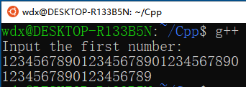
Making a calculator: User interface
How to deal with unexpected input?
#include <iostream>
#include <iomanip>
using namespace std;
int main() {
char a[20];
cout<<"Input the first number:"<<endl;
cin >> setw(20) >> a;
return 0;
}

Slide 15
Makefile
What is a Makefile?
Makefile is a tool to simplify or to organize for compilation. Makefile is a
set of commands with variable names and targets . You can compile your
project(program) or only compile the update files in the project by using
Makefile.

Slide 16
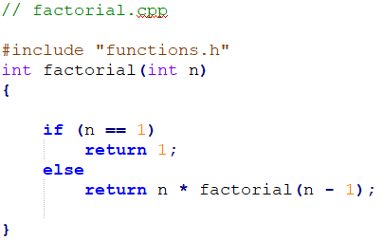
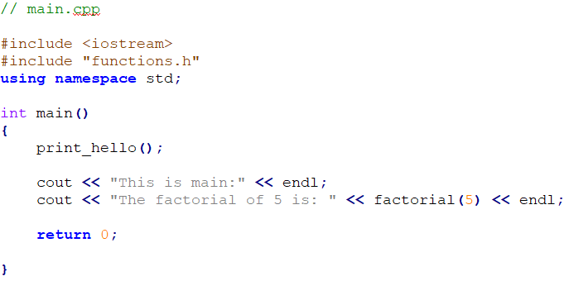
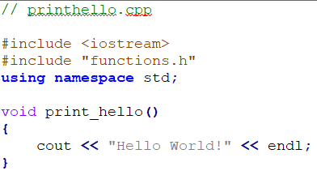

Suppose we have four source files as follows:
Normally, you can compile these files by the following
command:

Slide 17
How about if there are hundreds of files need to compile? Do you think it is
comfortable to write g++ or gcc compilation command by mentioning all
these hundreds file names? Now you can choose makefile.
The name of makefile must be either makefile or Makefile without extension.
You can write makefile in any text editor. A rule of makefile including three
elements: targets, prerequisites and commands. There are many rules in the
makefile.

Slide 18
A makefile consists of a set of rules. A rule including three elements: target,
prerequisites and commands.
targets : prerequisites
<TAB> command
The target is an object file, which is generated by a program.
Typically, there is only one per rule.
The prerequisites are file names, separated by spaces, as input to create the target.
The commands are a series of steps that make carries out.
These need to start with a tab character, not spaces.

Slide 19
comments begins with #
prerequisites
target
Put the
makefile
together
with your
programs.
commands
g++ is compiler name, -o is linker flag and hello is binary file name.

Slide 20
Type the command make in VScode
If you don’t install make in VScode, install it first according to the instruction.
Run the commands in the makefile automatically.
Run your program
output

Slide 21
Defining Macros/Variables in the makefile
To improve the efficiency of the makefile, we use variables.
variables
Write target, prerequisite and commands by variables using ‘$()’

Slide 22
If only one source file is modified, we need not compile all the files. So, let’s
modify the makefile.
If main.cpp is modified, it is compiled
by make.
targets

Slide 23
All the .cpp files are compiled to the .o files, so we can modify the makefile like this:
$@: Object Files
$^: all the prerequisites files
$<: the first prerequisite file
This is a model rule, which indicates that all the .o objects depend on the .cpp files

Slide 24
Using phony target to clean up compiled results automatically
Because clean is a label not a target, the command make clean can execute the clean part. Only make command can not execute clean part.
Adding .PHONY to a target will prevent making from confusing the phony target with a file name.

Slide 25
Functions in makefile
Search all the .cpp files in the current directory, and return to SRC
wildcard: search file
for example:
SRC = $(wildcard ./*.cpp)
All .cpp files in the current directory

Slide 26
patsubst(pattern substitution): replace file
$(patsubst original pattern, target pattern, file list)
Replace all .cpp files with .o files
for example:
OBJ = $(patsubst %.cpp, %.o, $(SRC))
Replace all .cpp files with .o files

Slide 27
All .h files are in inc
All .cpp files are in src
-I means search file(s) in the specified folder i.e. inc folder
GNU Make Manual
http://www.gnu.org/software/make/manual/make.html

Slide 28
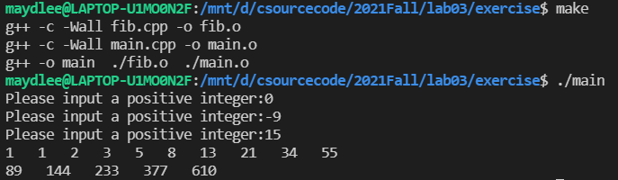
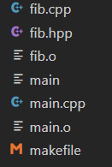
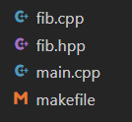
1. The Fibonacci numbers are : 1,1,2,3,5,8……. Please define a function named fib.cpp to compute the nth Fibonacci number. In main.cpp, prompts the user to input an integer n, print Fibonacci numbers from 1 to n, 10 numbers per line. Write a makefile to complete the compilation.
Exercises
Before clean:
After clean:

Slide 29

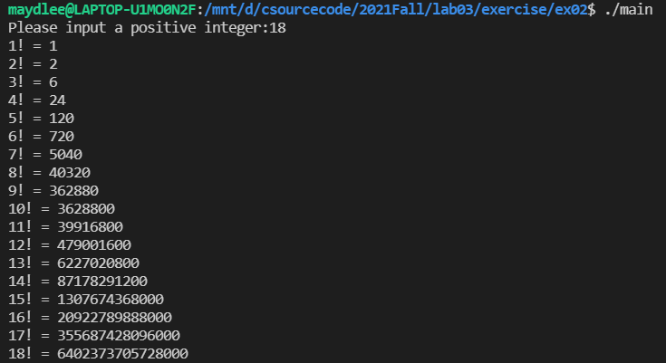
2. Define a function named fac.cpp to compute the factorial of an integer. In main.cpp, prompts the user to input an integer n, print factorials from 1 to n, one factorial per line. Write a makefile to complete the compilation.
Exercises
If you input an integer that is greater
than 20, how about the result? Is that
correct? How to fix the error?

Slide 30
3. Write a program to implement a simple calculator. Print five arithmetic operators as a menu for user to select. When the user inputs an operator and two operands(suppose both are integers and in the int range),show the answer on the screen. After that, ask the user whether the operation needs to continue. The operation will be over if the user wants to exit. Every operation must be define as a function. Your program must use switch statement to select an operator and can handle if the dividend is zero. Write a makefile to complete the compilation.
Exercises

Slide 31
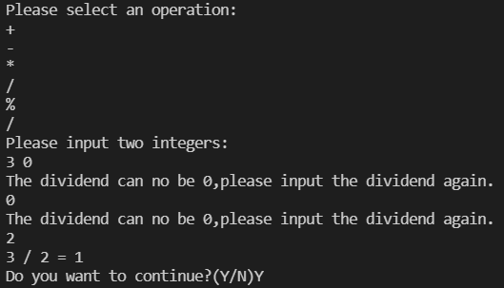
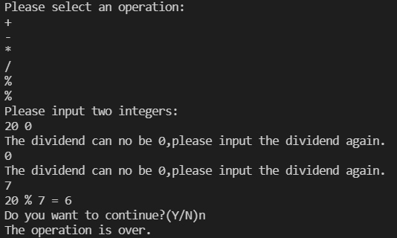
Output sample:

