Slide 1
C/C++ Program Design
Lab 10, operator overloading and friend function
廖琪梅，王大兴

Slide 2
Operator overloading and friend function
Operator overloading
Friend function
Overloading << operator

Slide 3
Operator overloading
In C++, the overloading principle applies not only to functions, but to operator.
Operator overloading extends the overloading concept to operators, letting you assign multiple meanings to C++ operators.
Operators can be extended to work not just with built-in types, but also classes.
To overload an operator, use a special function form called an operator function.
return type operator op(argument-list)
op is the symbol for the operator being overloaded

Slide 4
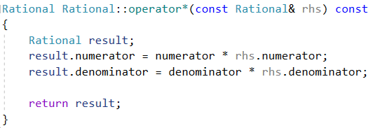
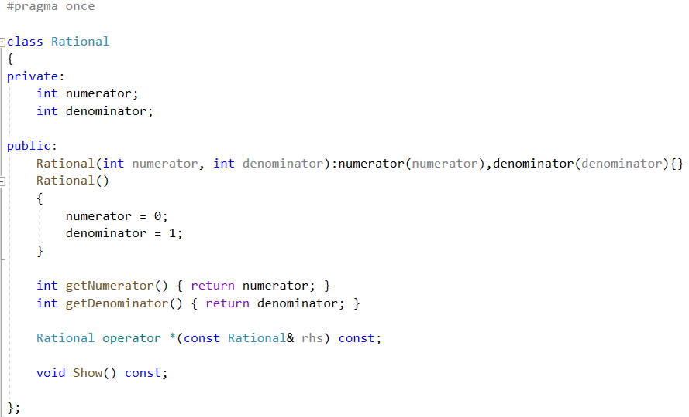


You can return local object to the caller
Operator function definition
Operator overloading works as function
operator function prototype

Slide 5
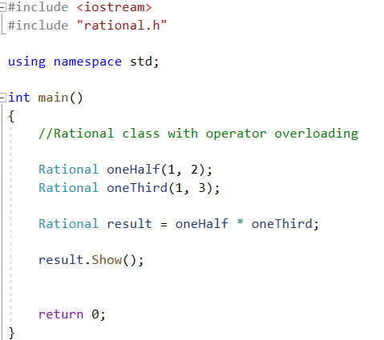
oneHalf.operator*(oneThird)
The left operand is the invoking object
Operator overloading

Slide 6
Consider the following two cases, can the previous operator function available?
Case 1: oneThird * 2
Case 2: 2 * oneThird
The previous operator function can not deal with such two cases. Because it needs the object as its argument(for case 1) and it must be invoked by an object other than primitive types (for case 2).
For the first case, we have two solutions. One is to define another overloading operator function whose parameter is an integer. Another is to use the constructor with one argument which acts as a conversion function.

Slide 7
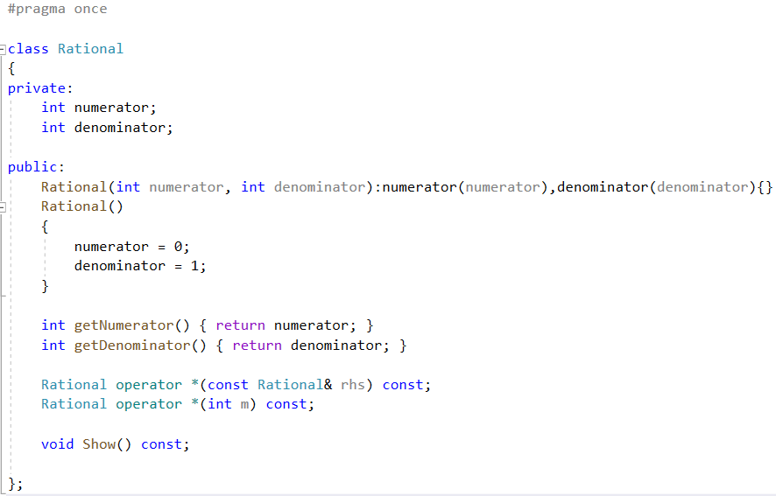

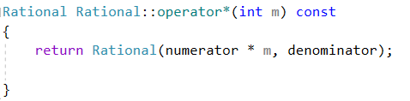
Using overloading operator function
oneThird.operator*(2)
The left operand is the invoking object

Slide 8
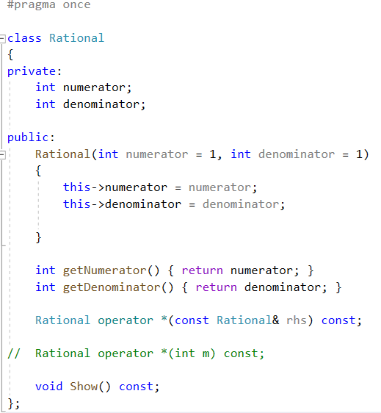
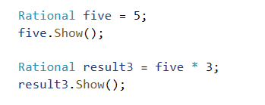
Using the conversion function
A constructor that can be used with just one argument works as a conversion function.
It can convert the primitive type data to the object type. The conversion is implicit.
A constructor with default arguments
Convert implicitly int to Rational type
with one argument constructor

Slide 9
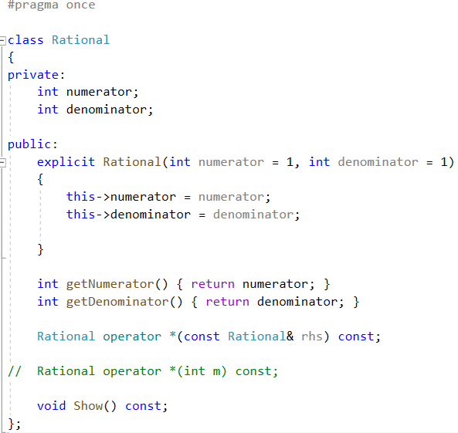
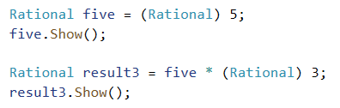
The keyword explicit indicates that the implicit conversion can not be allowed.
Use explicit conversion instead if you want to convert primitive type to object type.
Convert explicitly int to Rational type
with one argument constructor

Slide 10
Case 1: oneThird * 2
Case 2: 2 * oneThird
For the second case, remember, the left operand is the invoking object, but number 2 is not an object. So the compiler cannot replace the expression with a member function call.
We can use friend function to solve this problem.

Slide 11
Friend function
If a function is defined as a friend function of a class, that function can access all the private and protected data.
By using the keyword friend compiler knows the given function is a friend function.

Slide 12
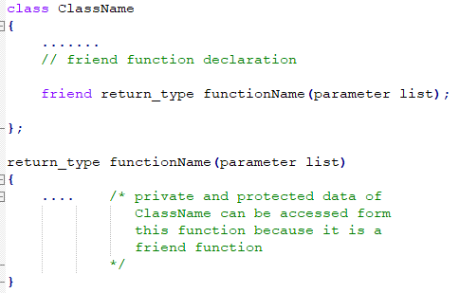
Friend Function in C++
The friend function is preceded by keyword friend,
and is declared in the class
The function can be defined anywhere in the program like a normal C++ function. The function definition does not use either the keyword friend or scope resolution operator.

Slide 13
The first step toward creating a friend function is to place a prototype in the class declaration and prefix the declaration with the keyword friend:
friend Rational operator *(int m, const Rational& other);
This prototype has two implications:
Although the operator *() function is declared in the class declaration, it is not a member function. So it isn’t invoked by using the membership operator.
Although the operator *() function is not a member function, it has the same access rights as a member function.

Slide 14
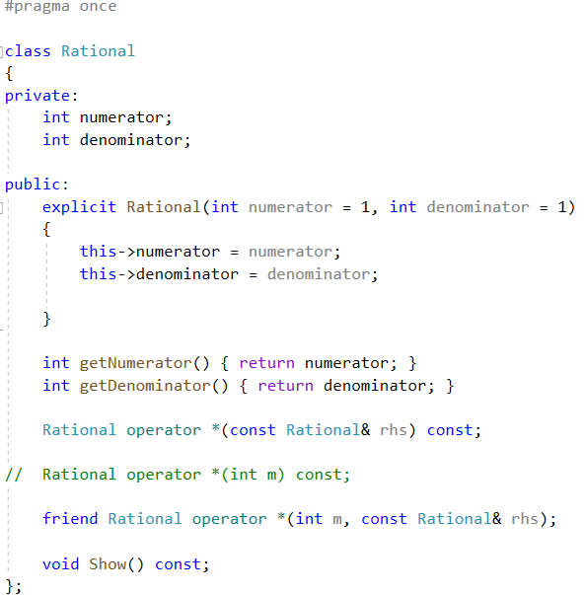
friend function declaration in Rational class definition

Slide 15
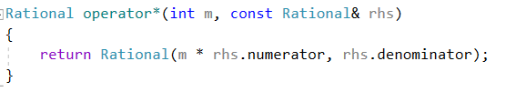

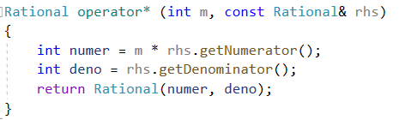
The second step is to write the function definition. Because it is not a member function, you don’t use the Rational:: qualifier. Also you don’t use the friend keyword in the definition.
friend function definition
You can also define a non-member operator overloading function to deal with the second case. However, this function can not access the private member of the class, the public member functions must be used to get data members.

Slide 16
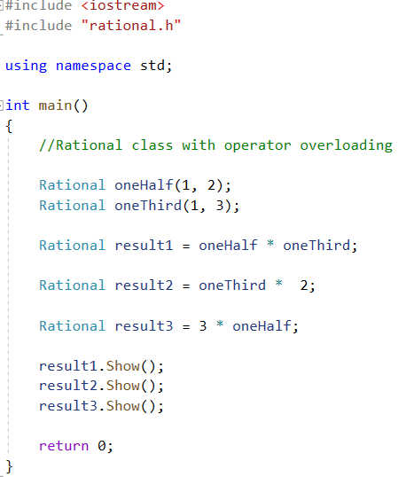
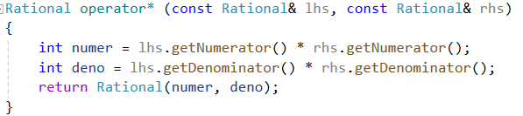

Actually, you can define only one non-member operator overloading function with two object arguments to deal with three cases.
Note: In this example, the Rational class must have
one argument constructor without explicit keyword.
Otherwise, the int type can not be converted to the
object type.

Slide 17
member function, non-member function, friend function
Only non-member operator overloading function can implement type conversion on its left argument, so if a function need convert type on its left argument, define the function as non-member function; if the function must get the non-public members of the class, define it as a friend function of the class.
Other cases beyond the above, define the function as a member function.

Slide 18
Overloading the << operator for output
One very useful feature of classes is that you can overload the << operator, so that you can use it with cout to display an object’s contents.
You would remember that the left operand is the invoking object, so if you define the overloading << operator function as a member function, the object must be put in front of the operator <<, that not fit the convention.
Define the function as non-member function or friend function.
In this example, the function can access the private members of the Rational class, so the << operator is defined as friend function.

Slide 19
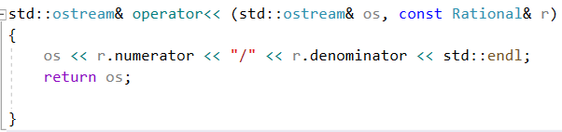
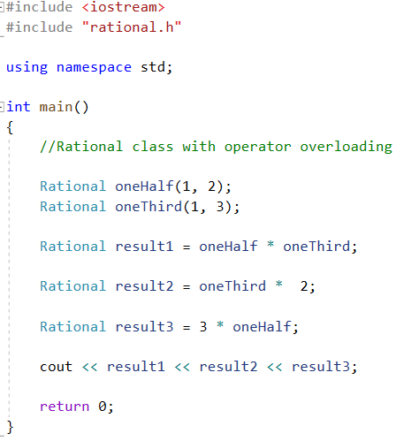
friend function declaration
friend function definition
Return the reference of
ostream can make it
available to output
several objects in one
statement.

Slide 20

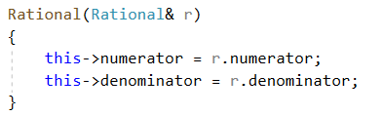
Memberwise initialization and objects assignment
If you use a existing object to initialize a new object, the compiler will invoke the copy constructor to implement the memberwise initialization. The data members of the class are copied in turn. This is called default memberwise initialization.
Invoke copy constructor implicitly
other.numerator = oneHalf.numerator;
other.denominator = oneHalf.denominator;
The copy constructor of Rational class
If you don’t provide the copy constructor, the compiler will provide a default one
and implement the memberwise initialization.
This copy constructor is the same as the default copy constructor.
If the data member includes a pointer, you must provide the copy constructor
in your class.

Slide 21

Memberwise initialization and objects assignment
If you use an equal sign to assign one object to another, this is called assign one object to another. In this case, the copy constructor is not invoked.
Assignment statement
same.numerator = oneThird.numerator;
same.denominator = oneThird.denominator;
Although this operation is also memberwise assignment, but it does not invoke the copy constructor. The assignment operator(=) can be overloaded. If the data member includes a pointer, you must overload the assignment operator in your class.

Slide 22
Exercise:
Create a class called Complex for performing arithmetic with complex numbers. Write a program to test your class. Complex numbers have the form
realPart + imaginaryPart * i
Develop a complete class containing proper constructor functions as well as setter and getter functions. The class should also provide the following overloaded operator capabilities:
(1) Overload the addition operator (+) to add two Complex numbers.
(2) Overload the subtraction operator (-) to subtract two Complex numbers.
(3) Overload the assignment operator to assign one Complex to another.
(4) Overload the multiplication operator (*) to multiply two Complex numbers.

Slide 23
Exercise:
(5)Overload the == and != operators to allow comparisons of complex numbers.
(6) Modify the class to enable input and output of complex numbers via overloaded >> and << operators, respectively.
Write a test program to test your Complex class.

