Slide 1
C/C++ Program Design
Lab 2, data types and arithmetic operators
王大兴，廖琪梅

Slide 2
Data types and arithmetic operators
Commonly used data types (integers, floats, ...).
Overflow
Test integer range
Conversion between char and integer
Test float number precision

Slide 3
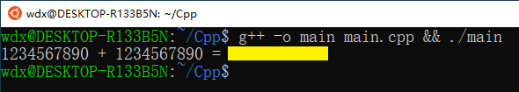
Commonly used data types: integer
Declaring integers and doing simple arithmetic operations:
#include <iostream>
using std::cout;
using std::endl;
int main() {
int a = 1234567890;
int b = 1234567890;
int sum = a+b;
cout<<a<<" + "<<b<<" = "<<sum<<endl;
return 0;
}
Run the following command in your terminal and see what happens:

Slide 4

Commonly used data types: float
Declaring floating point numbers and doing simple arithmetic operations:
#include <iostream>
using std::cout;
using std::endl;
int main() {
float a = 1234567.0;
float b = 1.0;
float sum = a+b;
cout<<a<<" + "<<b<<" = "<<sum<<endl;
return 0;
}
Run the following command in your terminal and see what happens:

Slide 5
Integer overflow
Integers are stored in memory as a few number of bytes.
The range of integers that can be properly represented is limited.
Calculating numbers outside this range causes errors.

Slide 6

Conversion between char and integer
The character type of c++ is char. Char and int can be converted.
Characters are a type of integers in memory.
#include <cstdio>
int main() {
char c = 'C';
int i = c;
printf("Convert '%c' to integer: %d\n", c, i );
return 0;
}
Run the following command in your terminal and see what happens:

Slide 7
Conversion between char and integer
You already know the integer value of character ‘C’, but why?
ASCII table.

Slide 8

Floating point precision
The range of floating point numbers is also limited.
Floating point numbers also have precision problems.
#include <iostream>
using std::cout;
using std::endl;
int main() {
float a = 0.1;
float sum = a+a+a+a+a+a+a+a+a+a;
cout<<"sum: "<<sum<<endl;
cout<<"sum equals to 1? "<<(sum==1.0)<<endl;
return 0;
}
Try the code on the left to see what happens.
Note that (sum==1.0) is a bool value, 1 means “true” and 0 means “false”.

Slide 9
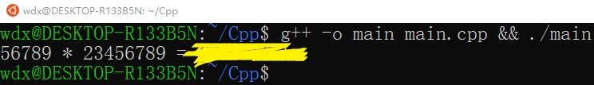
Exercise: calculate 56789 x 23456789
Write code to calculate 56789 multiply 23456789
Try to output something like this in the terminal, feel free to format the output the way you like.

Slide 10
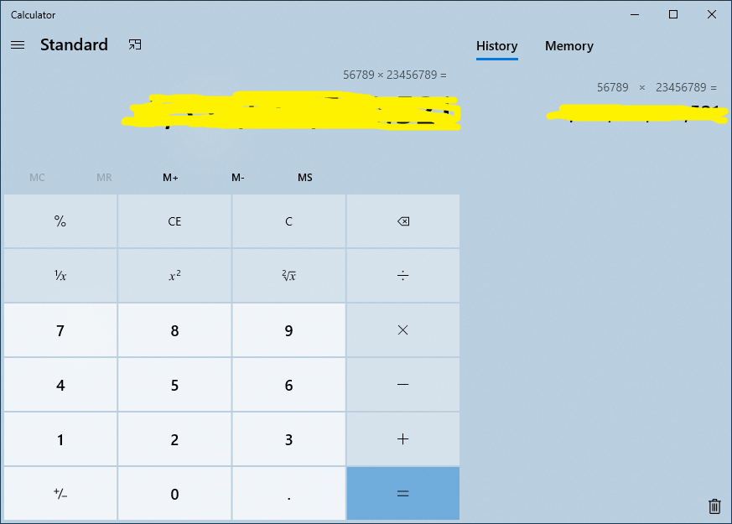
Exercise: calculate 56789 x 23456789
Verify the result using a calculator.

Slide 11
Exercise: calculate 56789 x 23456789
Congratulations if you get the right result!
If the result is wrong, what could be the reason?

Slide 12
Exercise: find the integer range of your computer
Find the interval [MIN, MAX] such that integer operations within this range is correct, while operations outside this range might be incorrect.

Slide 13
Exercise: find the integer range of your computer
Suppose X is the largest integer for type “int” on your computer, what special properties should X have?
After finding the values of MIN and MAX, are they the same with the value you have expected?

Slide 14
Exercise: try conversions between char and int
Choose some integers you like. Convert then to chars and print them.
Or you can choose some ints and convert them to chars.
There are some special characters in the table, try them!

Slide 15
Exercise: test the precision of floating point numbers
Try and find some floating point numbers and perform some arithmetic operations on them. Show that the operations are not precise due to the choice of the numbers.

Slide 16
Exercise: test the precision of floating point numbers
Be careful with the output. You may need to see the exact binary presentation of the float to proof that it’s a floating point precision problem.
The following code can show the binary presentation of a float in some mainstream archtecture.
void printFloat(float num)
{
int inum = *(int*)&num;
for (int i = 0; i < 32; ++i) {
cout << ((inum&0x80000000) >> 31);
if (i == 0 || i == 8)
cout << " ";
inum <<= 1;
}
cout << endl;
}

