Slide 1
C/C++ Program Design
Lab 5, pointers and dynamic memory
廖琪梅，王大兴

Slide 2
Pointers and Dynamic Memory
Pointers
Dynamic Memory
Debugging with gdb
Debugging with vscode

Slide 3
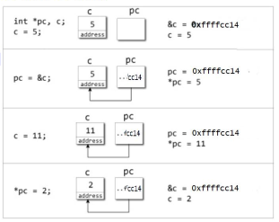
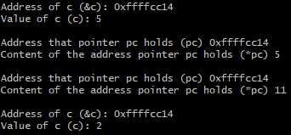
Pointers
A pointer is a special type who holds the address of a value.
Note:
1. Reference operator(&) gives the address of a variable.
2. Dereference operator(*) gets the value stored in the memory address.
3. The (*) sign used the declaration of pointer is not the dereference pointer. It is just a similar notation that creates a pointer.

Slide 4
Pointers to structure
Creates a pointer ptr of type structure Distance.
ptr must pointes to the Distance variable.
These two ways can both access the members of structure, but -> notation is more common.
Sample output:
Note: Since pointer ptr is pointed to variable d in this program, (*ptr).inch ,ptr->inch
and d.inch are exact the same.

Slide 5
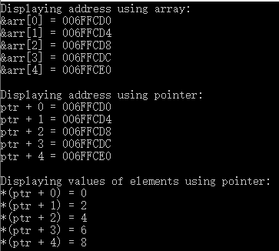
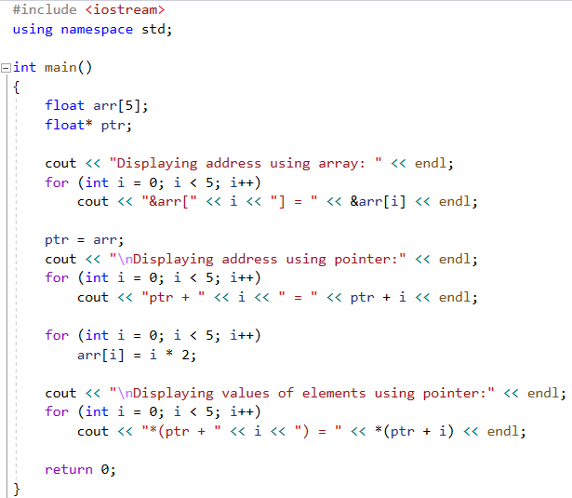
Pointers and array
Access the address of each element by array.
ptr pointes to the array.
Access the address of each element by pointer.
Access the values of elements by pointer using * operator.

Slide 6
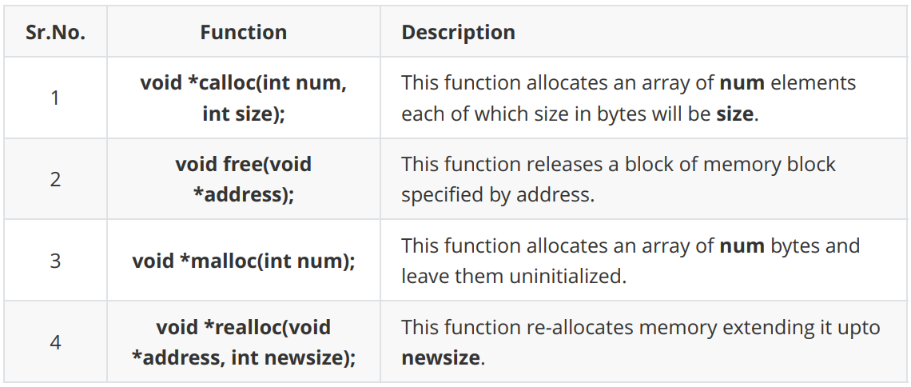
Dynamic Memory
C Dynamic Memory
These functions can be found in the <stdlib.h> header file.
When you are not in need of memory any more, you should release
that memory by calling the function free().

Slide 7
1. Allocating Memory Dynamically
When you declare an array, you must specify the number of the elements. Sometimes you
don’t know the amount of the elements, you can declare a pointer, and let it point to the
memory which allocated dynamically.
Declare an array with 100 elements.
Declare a pointer.
Let the pointer point to the memory.
You can use calloc(200, sizeof(char)) to
replace malloc function.
Copy a string to the memory.
Release the memory.
Sample output:

Slide 8
2. Resizing Memory
You can increase or decrease the size of an allocated memory block by calling the function
realloc().
Resizing the memory.
Concatenate the string.
Release the memory.
Sample output:

Slide 9
C++ Dynamic Memory
1. new and delete Operators
new data-type;
Use new operator to allocate memory dynamically for any data-type.
data-type could be any built-in data type including an array or any user defined data types such as structure or class.
delete pointer variable;
Use delete operator to de-allocate memory that was previously allocated by new operator.
Sample out:

Slide 10


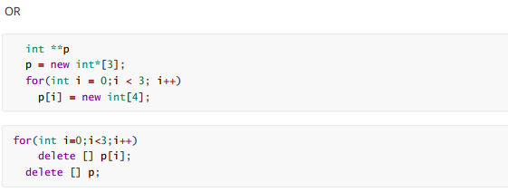
2. Dynamic Memory Allocation for Arrays

Slide 11
Allocate the memory to store 10 integers, and assign its address to the pointer pArray.
Assign 10 values to the memory by the pointer pArray.
If you access the value by * operator, be sure do not move the pointer which assign the address by new.
Release the memory.
Sample out:

Slide 12
100
101
102
103
104
105
106
107
108
109
pArray
After for loop, the pointer is now pointed to the memory out of the range you have requested.

Slide 13
There is no output in VScode, just a message of
“Segmentation fault (core dumped)”

Slide 14
100
101
102
103
104
105
106
107
108
109
pArray
The memory you release will not what you requested.

Slide 15
100
101
102
103
104
105
106
107
108
109
memory leak
内存泄漏
pArray

Slide 16
Many times, you are not aware in advance how much memory you
will need to store particular information in a defined variable, but
the size of required memory can be determined at run time.
Sample out:

Slide 17
3. Dynamic Memory Allocation for Structures
Create an unnamed structure of the inflatable type and assign its address to ps pointer using new operator
Access the structure members using -> or (*).
Sample output:
Release the memory.

Slide 18
Structured array
Create an unnamed structured array of the Employee type and assign its address to DynArray pointer using new operator
nothrow constant, this constant value is used as an argument for [operator new] and [operator new[]] to indicate that these functions shall not throw an exception on failure, but return a null pointer instead.
Release the memory.
Sample output:

Slide 19
Debugging with gdb
Debugging is a common process in the software development process.
Let us assume we don’t know why the following code went wrong:
#include<iostream>
using std::cout;
using std::endl;
int plus( int a, int b ) {
return a + b;
}
int main() {
int a = 1234567890;
int b = 1234567890;
int c = plus(a, b);
cout<<"a + b = "<<c<<endl;
return 0;
}
a + b = -1825831516

Slide 20
Debugging with gdb
One common way of debugging: inserting “cout” everywhere.
Simple to understand.
After you find the bug, you need to remove all
the “cout”, could take a lot of time.
Using gdb could be a better choice.
int plus( int a, int b ) {
cout<<"in plus "<<a<<endl;
cout<<"in plus "<<b<<endl;
return a + b;
}
int main() {
int a = 1234567890;
cout<<"in main "<<a<<endl;
int b = 1234567890;
cout<<"in main "<<b<<endl;
int c = plus(a, b);
cout<<"a + b = "<<c<<endl;
return 0;
}

Slide 21
Debugging with gdb
First step of using gdb:
Compile the program with -g, tell the compiler to include the symbol table. You can not debug the program without -g.
For example, run the following command to compile main.cpp:
g++ -g -o main main.cpp

Slide 22
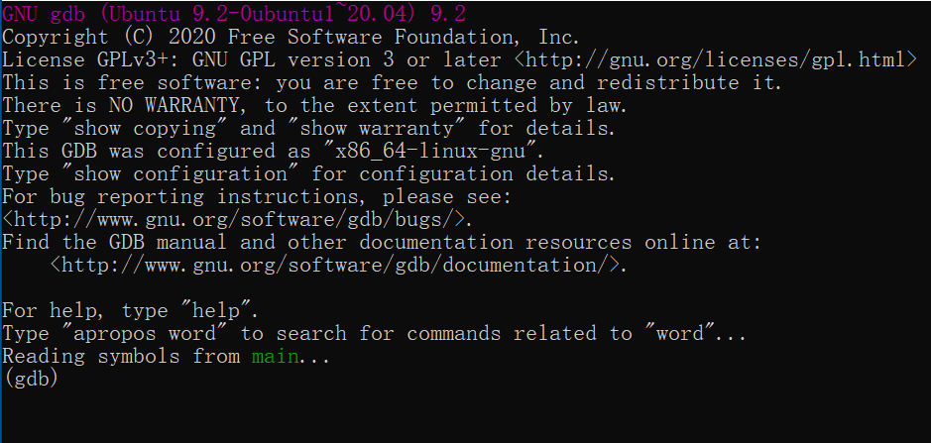
Debugging with gdb
Next, running the compiled program with gdb:
gdb program_name
For example, if your executable name is “main”, then run:
gdb main
You see something like
this:

Slide 23
Debugging with gdb
Now gdb is running, you can execute some command on the gdb.
Using the “run” command to make gdb execute your program

Slide 24
Debugging with gdb
One important feature of gdb is that it can execute to some point of the program, and see the current state of the program.
Suppose we want to insert a “break point” before
int c = plus(a,b);
#include<iostream>
using std::cout;
using std::endl;
int plus( int a, int b ) {
return a + b;
}
int main() {
int a = 1234567890;
int b = 1234567890;
int c = plus(a, b);
cout<<"a + b = "<<c<<endl;
return 0;
}
Insert break point before:
int c = plus(a,b);

Slide 25
Debugging with gdb
Press “q” and enter to quit the execution, and rerun “gdb main” to execute gdb on the “main” executable.
Press “l” and enter to list the line numbers.
We need to insert a break point at the 12th line.

Slide 26
Debugging with gdb
Set a break point at the 12th line with:
break 12
See the output:

Slide 27
Debugging with gdb
Print current state of variables, for example, print variable a:
print a
See the output:
Because we haven’t run anything yet.

Slide 28
Debugging with gdb
Now let’s “execute” run and “print a” again.

Slide 29
Debugging with gdb
Two information we can get from here:
The run command will stop at the position of the break point as line 12.
The print command prints the variable “a” successfully.

Slide 30
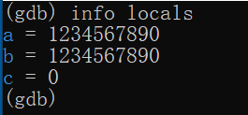

Debugging with gdb
Using “info locals” to show all the variables in the current stack:
And use “bt” to print the function stack:

Slide 31
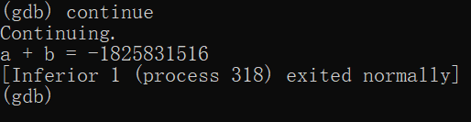
Debugging with gdb
Now that our program is waiting here.
We can use “continue” command to make the program continue to run.

Slide 32
Debugging with gdb
You may need to refer to the GNU document for more detail:
https://www.gnu.org/software/gdb/documentation/
Or if you could search for a beginner tutorial.

Slide 33
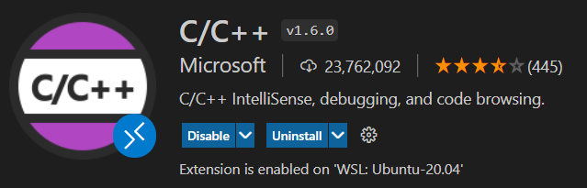
Debugging with vscode
After you know how to use gdb in a command line, you may want to use vscode to do the debugging.
From the directory of your C/C++ codes, run “code .” to start vscode.
You probably have already installed the C/C++ extension, if not, install it:

Slide 34
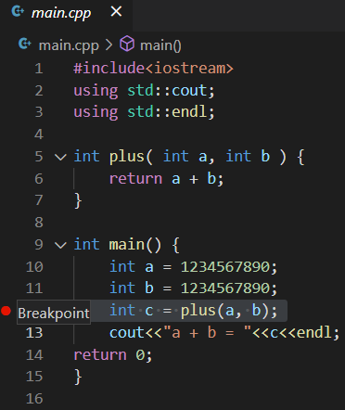
Debugging with vscode
Not when you click on the left, you can easily set break points.
You can remove a break point by
clicking again.

Slide 35
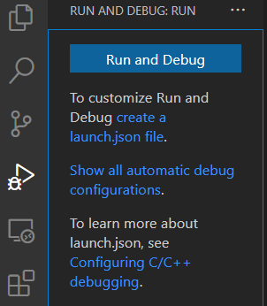
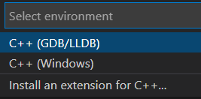
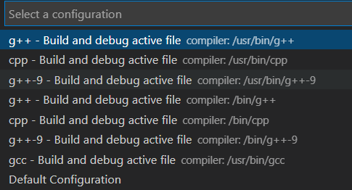
Debugging with vscode
Now click the “run and debug” to debug the program.
Everything will run automatically.

Slide 36
Debugging with vscode

Slide 37
Exercise 1
Write a program that use new to allocate the array dynamically of five integers.
The five values will be stored in an array using a pointer.
Print the elements of the array in reverse order using a pointer.

Slide 38
Exercise 2
Allocate memory for an array of characters, modify elements by integer values one by one, then print out the result as a string. Please try to modify the element out of range and see what will happen.

Slide 39
Exercise 3
Using gdb to debug the following program:
#include<iostream>
using std::cout;
using std::endl;
// naive approach to see if num is a prime number
bool isPrime( int num ) {
for( int i = 1; i <= num; ++ i )
if( num % i == 0 )
return false;
return false;
}
int main() {
int a = 23;
cout<<isPrime(a)<<endl;
return 0;
}

