Slide 1
C/C++ Program Design
Lab 3, Loops and Branching Statements
王大兴，廖琪梅

Slide 2
Loops and Branching Statements
....
….
Makefile

Slide 3
Makefile
What is a Makefile?
Makefile is a tool to simplify or to organize for compilation. Makefile is a
set of commands with variable names and targets . You can compile your
project(program) or only compile the update files in the project by using
Makefile.

Slide 4
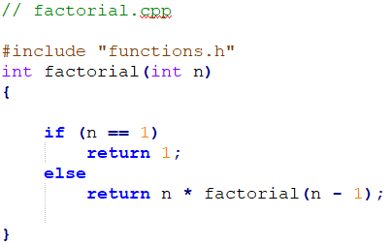
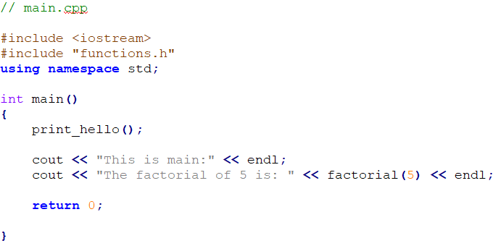
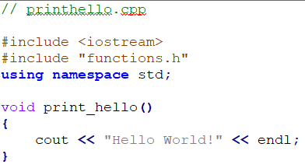

Suppose we have four source files as follows:
Normally, you can compile these files by the following
command:

Slide 5
How about if there are hundreds of files need to compile? Do you think it is
comfortable to write g++ or gcc compilation command by mentioning all
these hundreds file names? Now you can choose makefile.
The name of makefile must be either makefile or Makefile without extension.
You can write makefile in any text editor. A rule of makefile including three
elements: targets, prerequisites and commands. There are many rules in the
makefile.

Slide 6
A makefile consists of a set of rules. A rule including three elements: target,
prerequisites and commands.
targets : prerequisites
<TAB> command
The target is an object file, which is generated by a program.
Typically, there is only one per rule.
The prerequisites are file names, separated by spaces, as input to create the target.
The commands are a series of steps that make carries out.
These need to start with a tab character, not spaces.

Slide 7
comments begins with #
prerequisites
target
Put the
makefile
together
with your
programs.
commands
g++ is compiler name, -o is linker flag and hello is binary file name.

Slide 8
Type the command make in VScode
If you don’t install make in VScode, install it first according to the instruction.
Run the commands in the makefile automatically.
Run your program
output

Slide 9
Defining Macros/Variables in the makefile
To improve the efficiency of the makefile, we use variables.
variables
Write target, prerequisite and commands by variables using ‘$()’

Slide 10
If only one source file is modified, we need not compile all the files. So, let’s
modify the makefile.
If main.cpp is modified, it is compiled
by make.
targets

Slide 11
All the .cpp files are compiled to the .o files, so we can modify the makefile like this:
$@: Object Files
$^: all the prerequisites files
$<: the first prerequisite file
This is a model rule, which indicates that all the .o objects depend on the .cpp files

Slide 12
Using phony target to clean up compiled results automatically
Because clean is a label not a target, the command make clean can execute the clean part. Only make command can not execute clean part.
Adding .PHONY to a target will prevent making from confusing the phony target with a file name.

Slide 13
Functions in makefile
Search all the .cpp files in the current directory, and return to SRC
wildcard: search file
for example:
SRC = $(wildcard ./*.cpp)
All .cpp files in the current directory

Slide 14
patsubst(pattern substitution): replace file
$(patsubst original pattern, target pattern, file list)
Replace all .cpp files with .o files
for example:
OBJ = $(patsubst %.cpp, %.o, $(SRC))
Replace all .cpp files with .o files

Slide 15
All .h files are in inc
All .cpp files are in src
-I means search file(s) in the specified folder i.e. inc folder
GNU Make Manual
http://www.gnu.org/software/make/manual/make.html

Slide 16
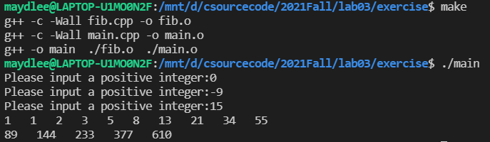
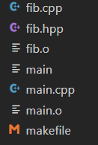
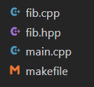
1. The Fibonacci numbers are : 1,1,2,3,5,8……. Please define a function named fib.cpp to compute the nth Fibonacci number. In main.cpp, prompts the user to input an integer n, print Fibonacci numbers from 1 to n, 10 numbers per line. Write a makefile to complete the compilation.
Exercises
Before clean:
After clean:

Slide 17

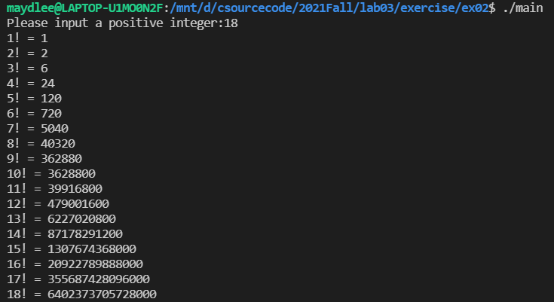
2. Define a function named fac.cpp to compute the factorial of an integer. In main.cpp, prompts the user to input an integer n, print factorials from 1 to n, one factorial per line. Write a makefile to complete the compilation.
Exercises
If you input an integer that is greater
than 20, how about the result? Is that
correct? How to fix the error?

