Slide 1
C/C++ Program Design
CS205
Prof. Shiqi Yu (于仕琪)
yusq@sustech.edu.cn
http://faculty.sustech.edu.cn/yusq/

Slide 2
Standard Output Stream and Standard Error Stream

Slide 3
stdin, stdout, stderr
In C, three text streams are predefined, and their type is (FILE *).
stdin: standard input stream
stdout: standard output stream, for conventional output
stderr: standard error stream, for diagnostic output.
Why do we need the "ugly" black command windows?

Slide 4
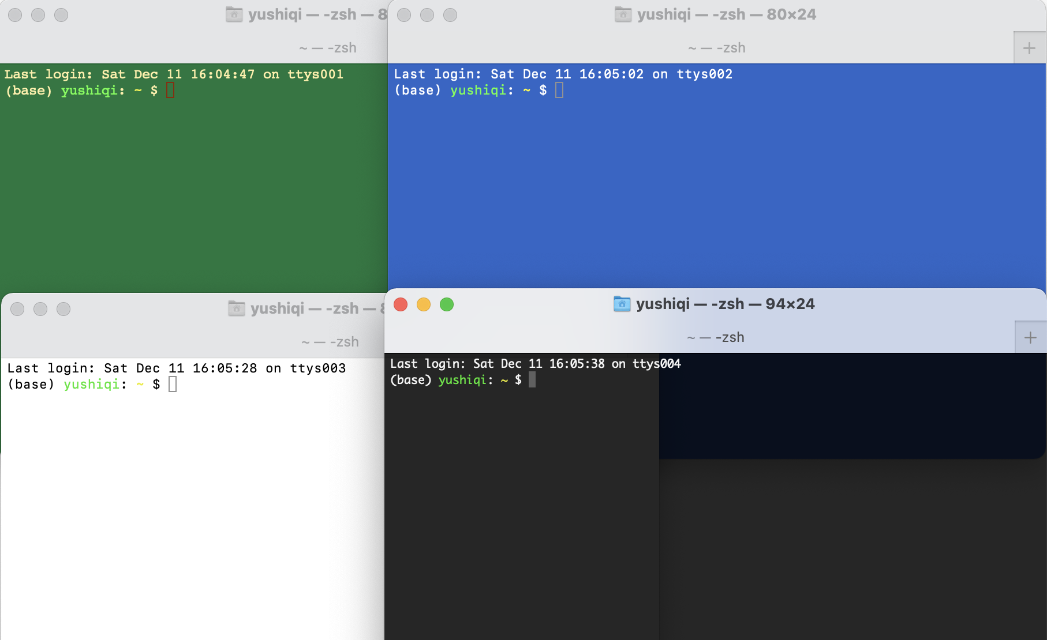
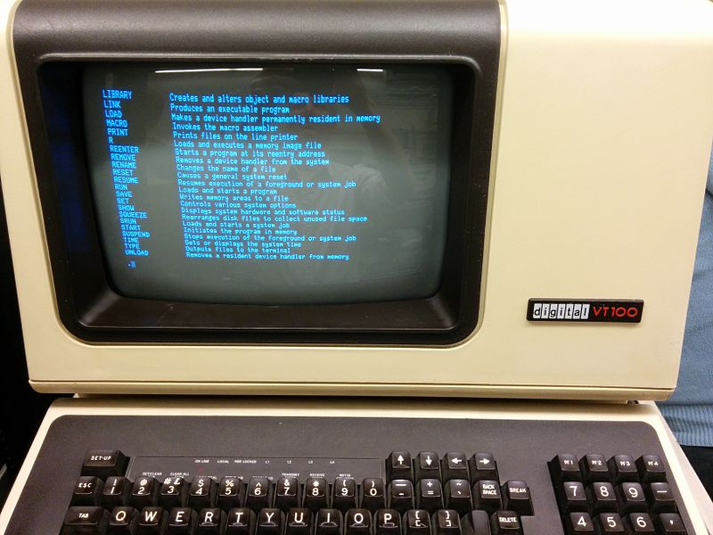
Command-line Interface
The ONLY interface in the past.
The end of the HELP command output from RT-11SJ displayed on a VT100.
https://en.wikipedia.org/wiki/Command-line_interface

Slide 5
But We are in the 21st Centaury
We still need them!
Many computers still have no GUI: severs, intelligent devices
Many programs do not provide GUI: HTTP servers, DB servers, ...

Slide 6
Output Stream and Error Stream
Send contents into streams in C and C++
fprintf(stdout, "Info: ...\n", ...);
printf("Info: ... \n", ...);
fprintf(stderr, "Error: ...\n", ...);
std::cout << "Info: ..." << std::endl;
std::cerr << "Error: ..." << std::endl;
stderr.c stderr.cpp

Slide 7
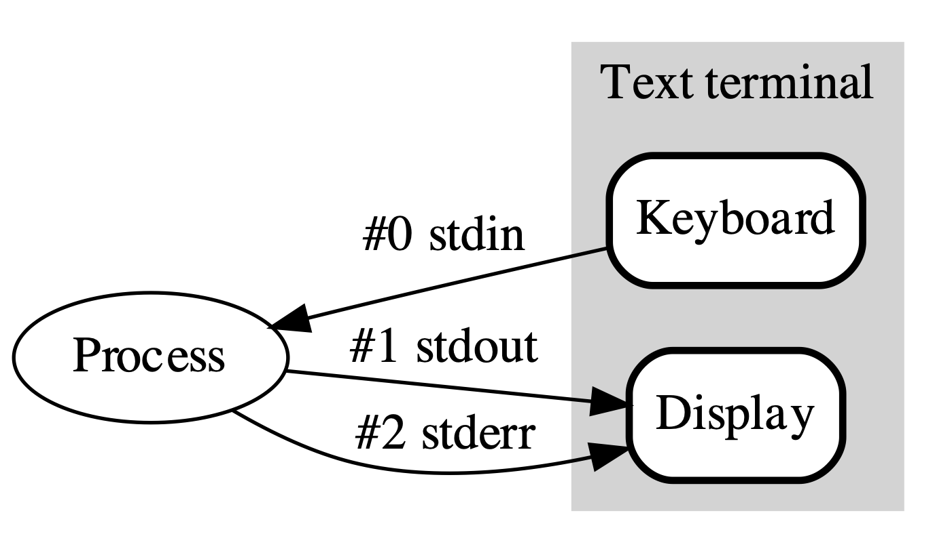
Redirection
The output of a program is in a pipeline.
The output can be redirected. You can redirect the output into a file for debugging especially when the program run a very long time.
./program | less
./program > output.log
./program 1> output.log
./program >> output.log
./program > /dev/null
./program 2> error.log
./program > output.log 2> error.log
./program &> all.log
./program > all.log 2>&1
https://en.wikipedia.org/wiki/Standard_streams

Slide 8
assert

Slide 9
assert
assert is a function-like macro in <assert.h> and <cassert>.
#ifdef NDEBUG
# define assert(condition) ((void)0)
#else
# define assert(condition) /*implementation defined*/
#endif
Do nothing if the condition is true
Output diagnostic information and call abort() if the condition is false.
If NDEBUG is defined, do nothing whatever the condition is.
assert can be used only for debugging, be removed before releasing by a macro NDEBUG.
assert.cpp

Slide 10
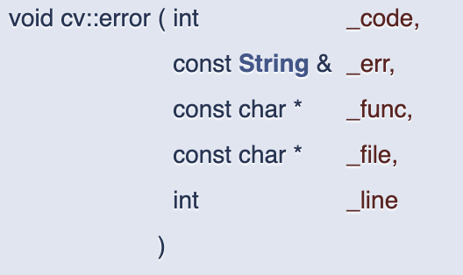
assert
CV_Assert in OpenCV checks a condition at runtime and throws exception if it fails.
cv::error() may behavior differently with different settings.
#define CV_Assert( expr ) do { if(!!(expr)) ; else cv::error( cv::Error::StsAssert, #expr, CV_Func, __FILE__, __LINE__ ); } while(0)

Slide 11
Exceptions

Slide 12
Error Handling
Solution 1: Kill the program when error occurs
float ratio(float a, float b)
{
if (fabs(a - b) < FLT_EPSILON)
{
std::cerr << "The two arguments are too close." << std::endl;
std::abort();
}
return (a - b) / (a + b);
}
A good solution?
If not, how to tell the caller?
error1.cpp

Slide 13
Error Handling
Solution 2: Tell the caller by the return value when error occurs
We have to use the 3rd parameter to send the result.
bool ratio(float a, float b, float & c)
{
if (fabs(a - b) < FLT_EPSILON)
{
std::cerr << "The two arguments are too close." << std::endl;
return false;
}
c = (a - b) / (a + b);
return true;
}
error2.cpp

Slide 14
Error Handling
Solution 3: Throw exceptions (C++ feature)
float ratio(float a, float b)
{
if (fabs(a - b) < FLT_EPSILON)
throw "The two arguments are too close.";
return (a - b) / (a + b);
}
try{
z = ratio(x,y);
std::cout << z << std::endl;
}
catch(const char * msg)
{
std::cerr << msg << std::endl;
}
error3.cpp

Slide 15
More About Exceptions

Slide 16
Handling Exceptions
A try block can be followed by multiple catch blocks.
try{
z = ratio(x,y);
}
catch(const char * msg)
{...}
catch(int eid)
{...}
float ratio(float a, float b)
{
if (a < 0)
throw 1;
if (b < 0)
throw 2;
if (fabs(a - b) < FLT_EPSILON)
throw "The two arguments are too close.";
return (a - b) / (a + b);
}
error4.cpp

Slide 17
Stack Unwinding
If an exception is not handled in the function, throw it to the caller.
If the caller does not handle, throw it to the caller of the caller, or until main()
float ratio(float a, float b)
{
if (a < 0)
throw 1;
if (b < 0)
throw 2;
if (fabs(a - b) < FLT_EPSILON)
throw "The two arguments are too close.";
return (a - b) / (a + b);
}
float ratio_wrapper(float a, float b)
{
try{
return ratio(a, b);
}
catch(int eid){...}
return 0;
}
try{
z = ratio_wrapper(x,y);
}
catch(const char * msg)
{...}
error5.cpp

Slide 18
Catch-all Handler
If an exception is not caught, it will reach to the top caller, and terminate the program😱
A catch-all handler can catch all kinds of exceptions.
int main()
{
runSomething1();
try
{
runSomething2();
}
runSomeOthers();
catch(...)
{
std::cerr << "Unrecognized Exception" << std::endl;
}
return 0;
}

Slide 19
Exceptions and Inheritance
If an object is thrown, and its class is derived from another class.
An exception handler with the base class type can catch the exception.
try
{
throw Derived();
}
catch (const Base& base)
{
std::cerr << "I caught Base." << std::endl;
}
catch (const Derived& derived)
{ // never reach here
std::cerr << "I caught Derived." << std::endl;
}
derived.cpp

Slide 20
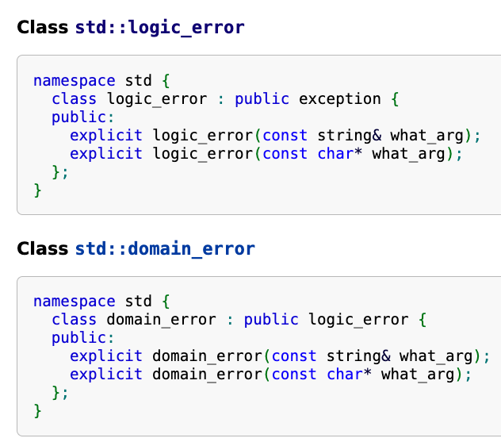
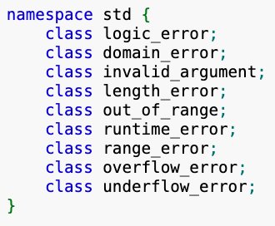
std::exception
std::exception is a class which can be a base class to any exception.
Function std:exception::what() can be overided to return a C-style string message.

Slide 21
Exception Specifications and Noexcept
The noexcept specifier defines a function which will not throw anything.
void foo() noexcept; // this function is non-throwing

Slide 22
nothrow new
Std::nothrow is a constant to select an non-throwing allocation function
int * p = NULL;
try {// may throw an exception
p = new int[length];
}
catch (std::bad_alloc & ba)
{
cerr << ba.what() << endl;
}
// not throw an exception
p = new(nothrow) int[length];
if(p==NULL)
{ ... }
nothrow.cpp

