Slide 1

Summary of Paper
20180075 Myeong Cheol Kim
KAIST Mathematical Science & Computer Science

Slide 2
Motivations

Slide 3


Why Simplification?
Time save
Too many nodes & Edges

Slide 4


Limit of previous work
Unexpected disconnection
Biased to some road-type

Slide 5
Method

Slide 6

Road network data
Non-planar
Has attributes
Primal
Open Street Map

Slide 7



Framework
Utilize patterns
Self loop
lollipop
Gridiron

Slide 8
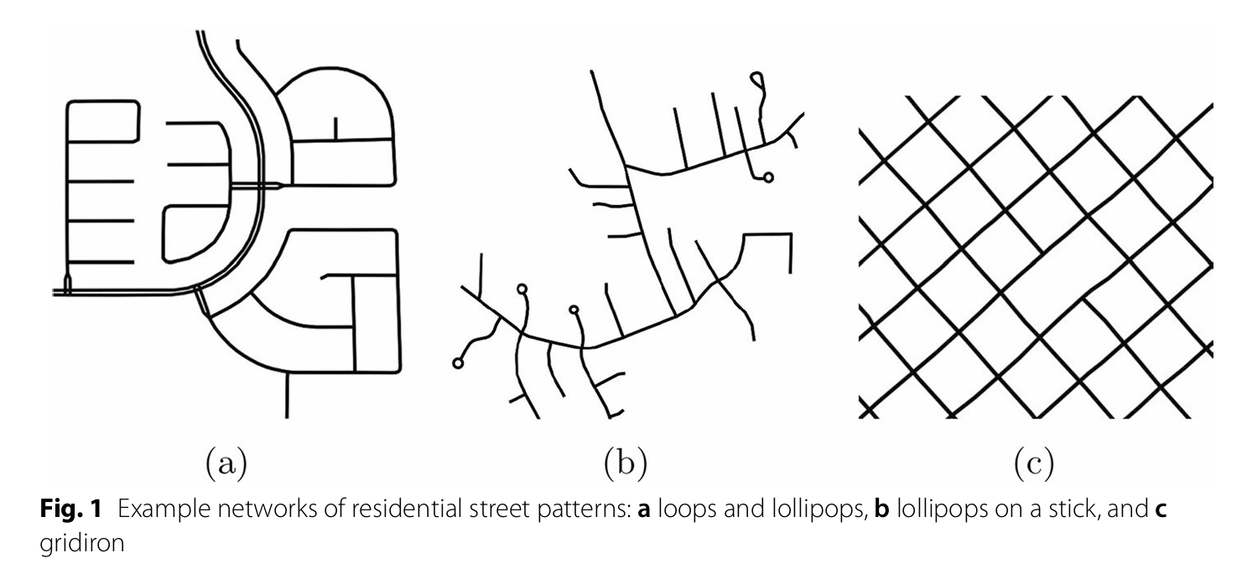
Framework
Utilize patterns
Self loop
lollipop
gridiron

Slide 9
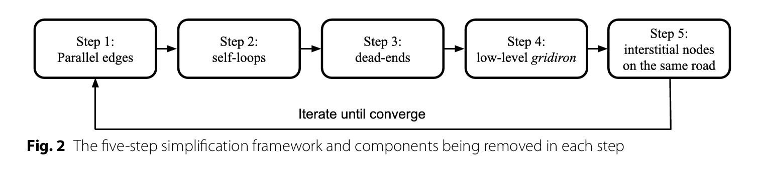
Framework

Slide 10
Framework
Parallel Edges
Multiple Edges

Slide 11
Framework
Self loop
Edge(u,u)

Slide 12
Framework
Dead end
Degree(u)=1

Slide 13
Framework
Gridiron
Conditions
４ Neighbors
Max_edge_len<300m
Road_type=residental
At least two such nodes are adjacent

Slide 14
Framework
Interstitial nodes on the same road
True end node
True end node
Not true end node with degree=2

Slide 15
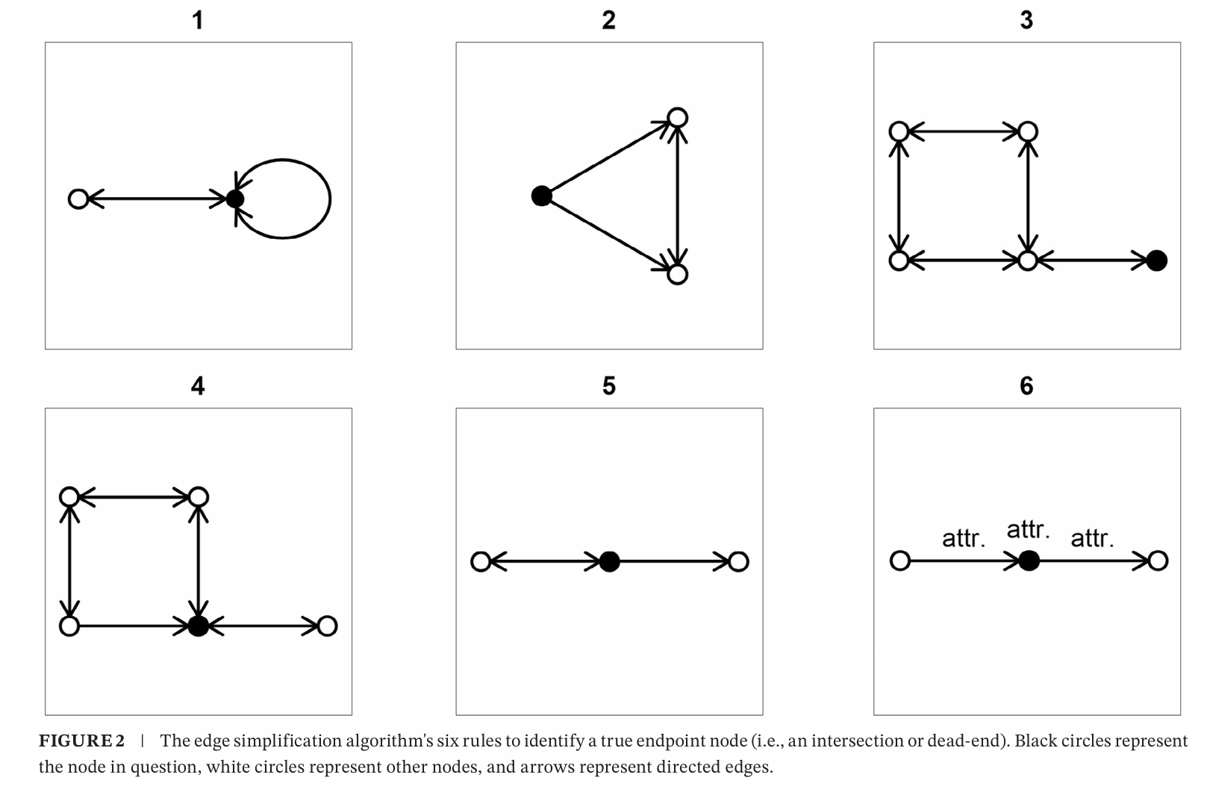
Framework
True end node

Slide 16
Result

Slide 17
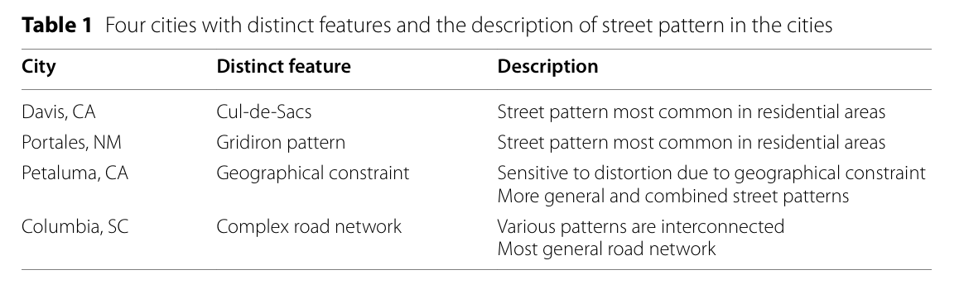
Result
Target cities

Slide 18
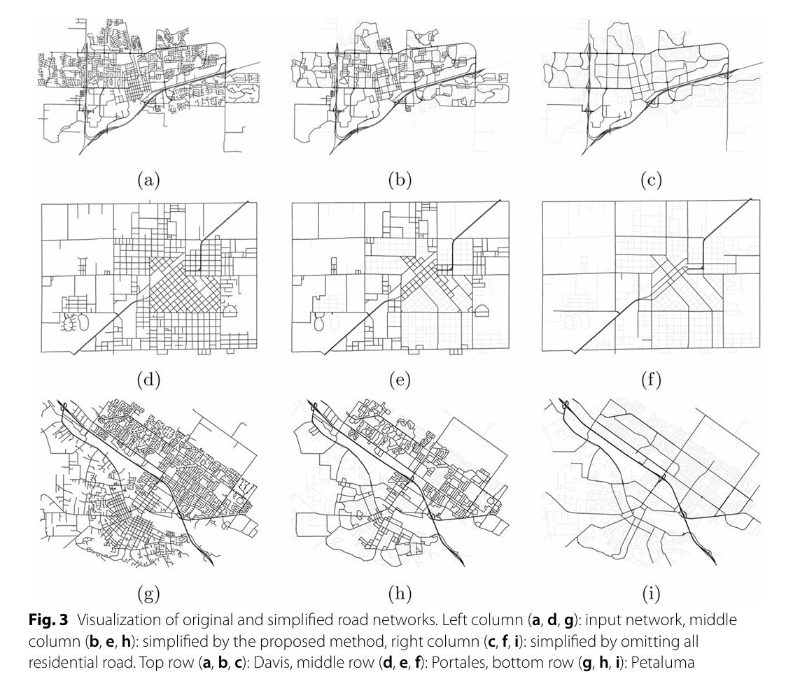
Result
Steps

Slide 19
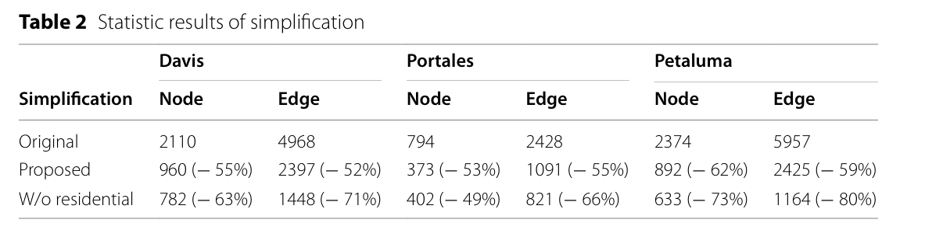
Result
Statistics

Slide 20
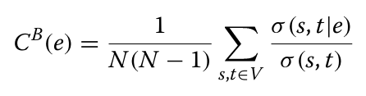
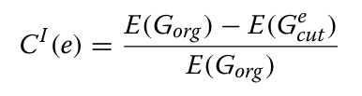
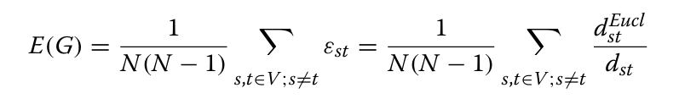
Result
Similarity criterion
Edge betweenness centrality
G without edge e
Normalized Network efficiency
Edge information centrality

Slide 21
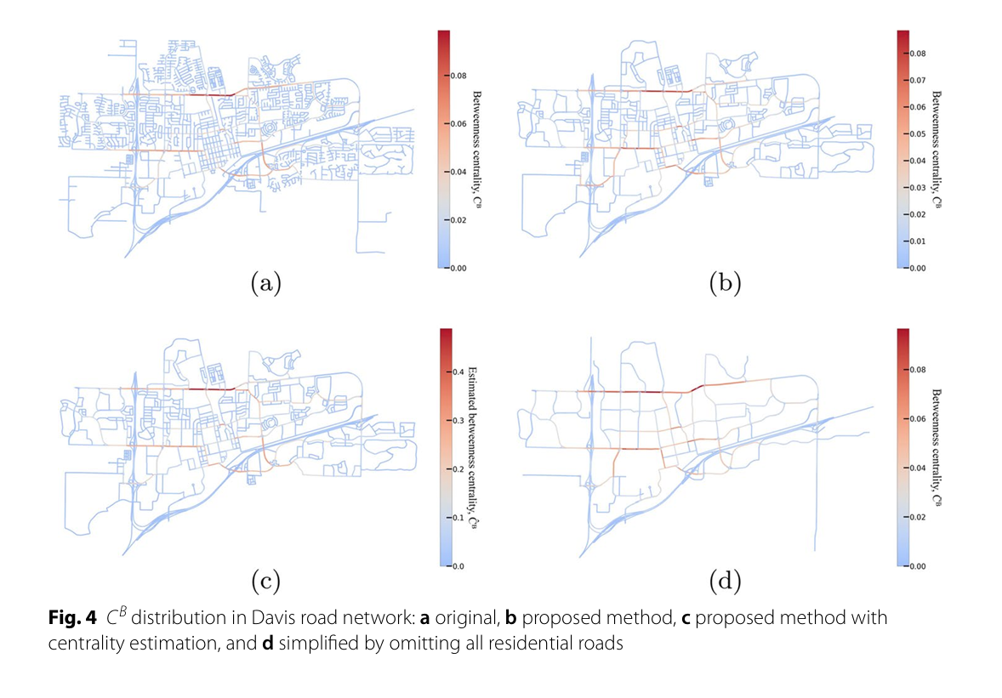
Result
Similarity distribution

Slide 22
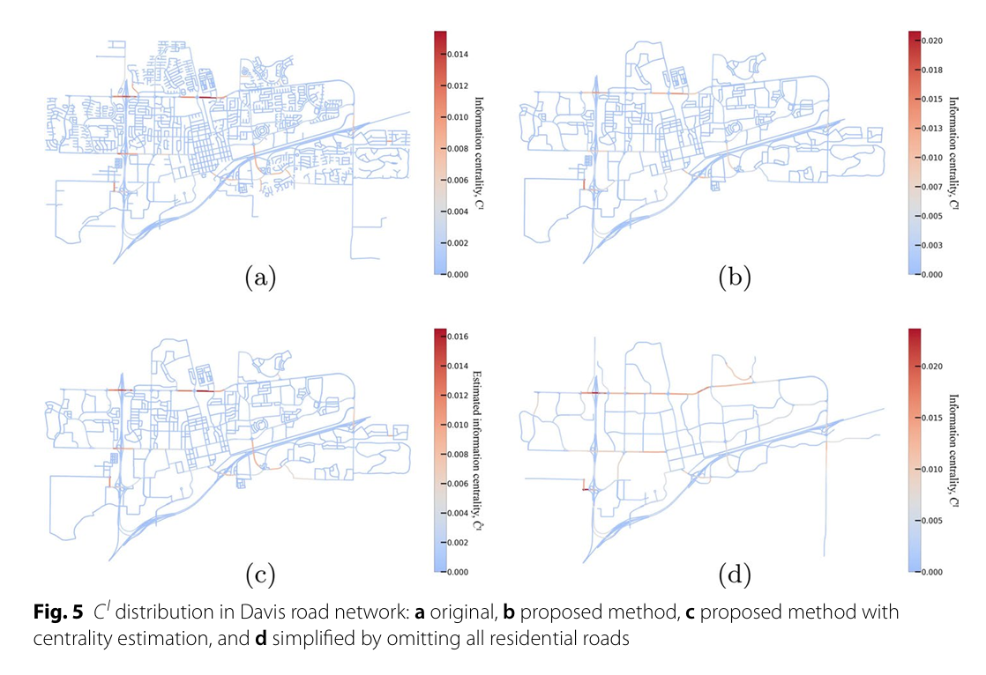
Result
Similarity distribution

Slide 23
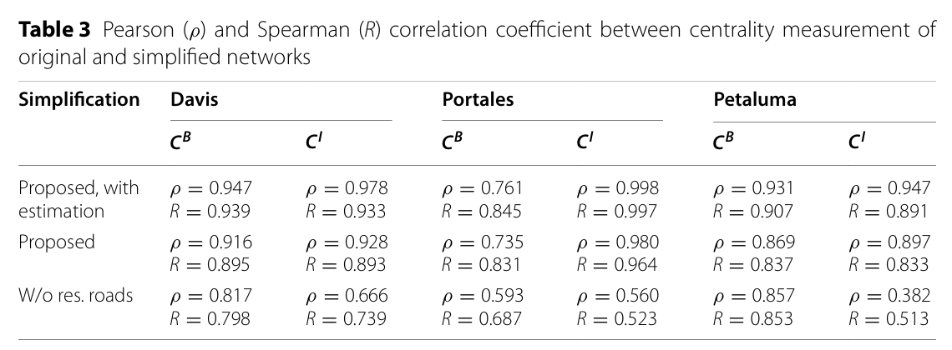
Result
Similarity comparison

