Slide 1

Improvement of paper
20180075 Myeong Cheol Kim
KAIST Mathematical Science & Computer Science

Slide 2


Simplification steps
Difficult to trace deleted component
Make view to identify what to remove for each step

Slide 3
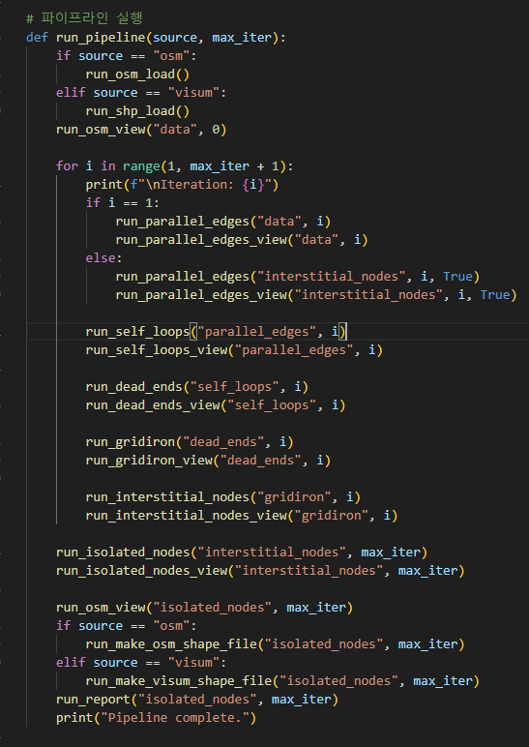
Simplification steps
View makes .png file for each step

Slide 4
Connected Component
Disconnected component interrupt assignment
Remain largest connected component and remove others

Slide 5
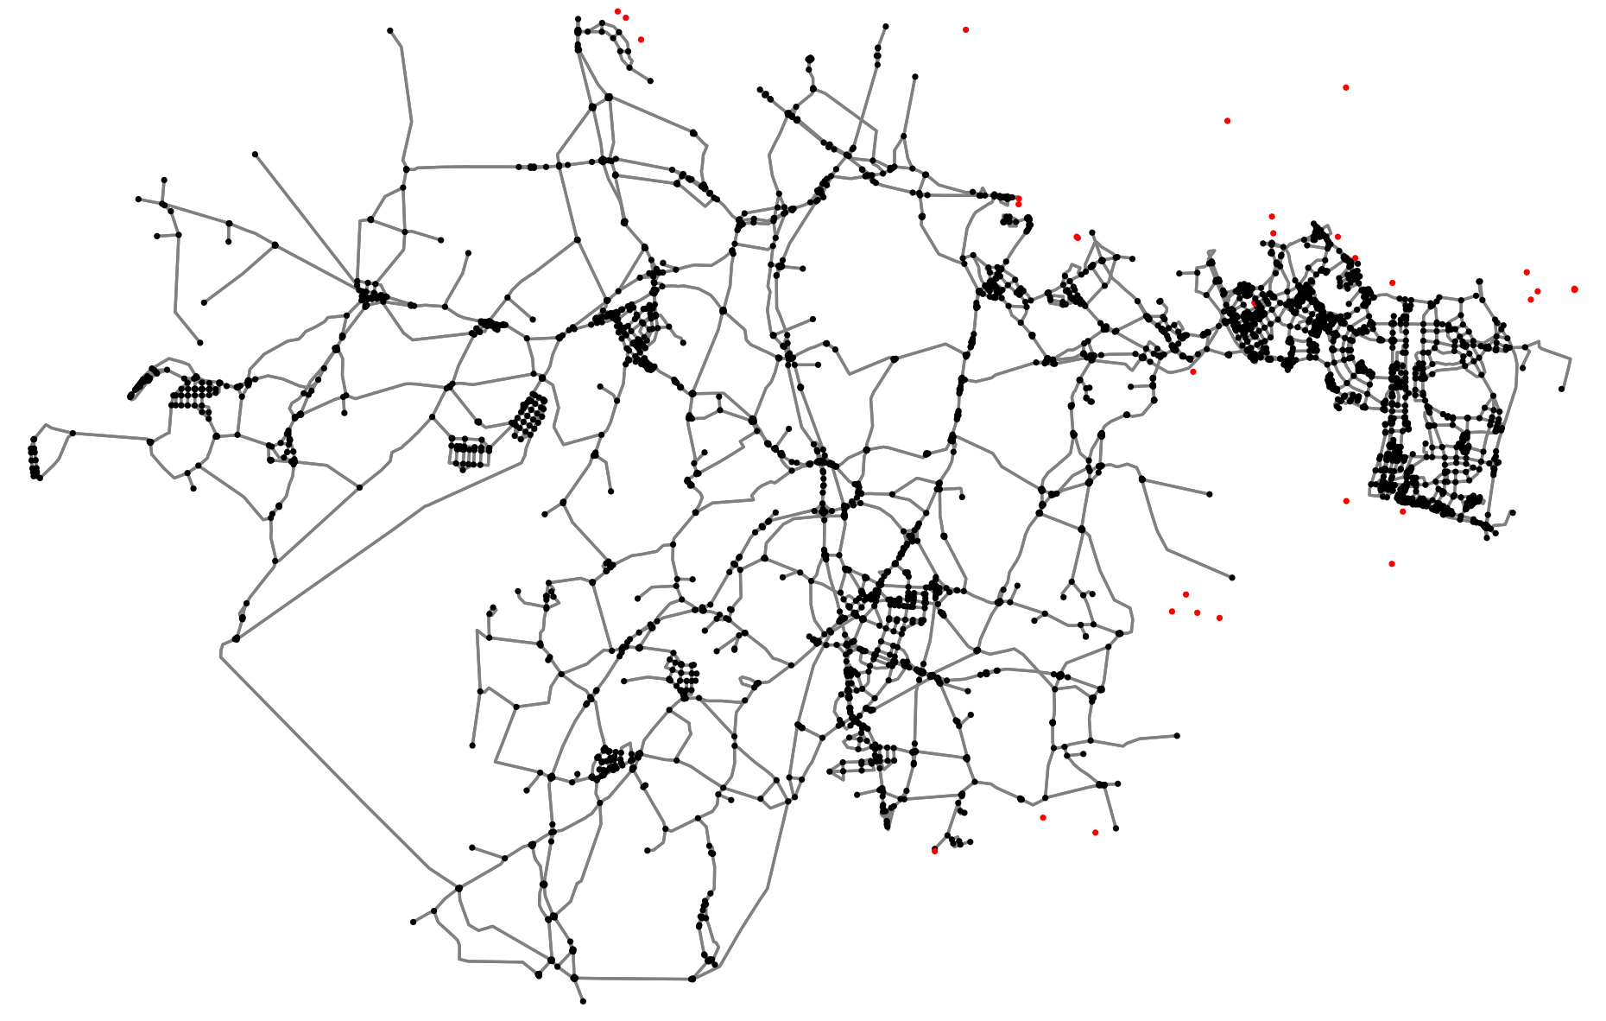
Isolated nodes

Slide 6
Dead-ends
Fake Dead-ends due to map cut
Use bigger map to see whether it is true end node

Slide 7
Dead-ends
Delete important nodes
Check whether length of edge<500m

Slide 8
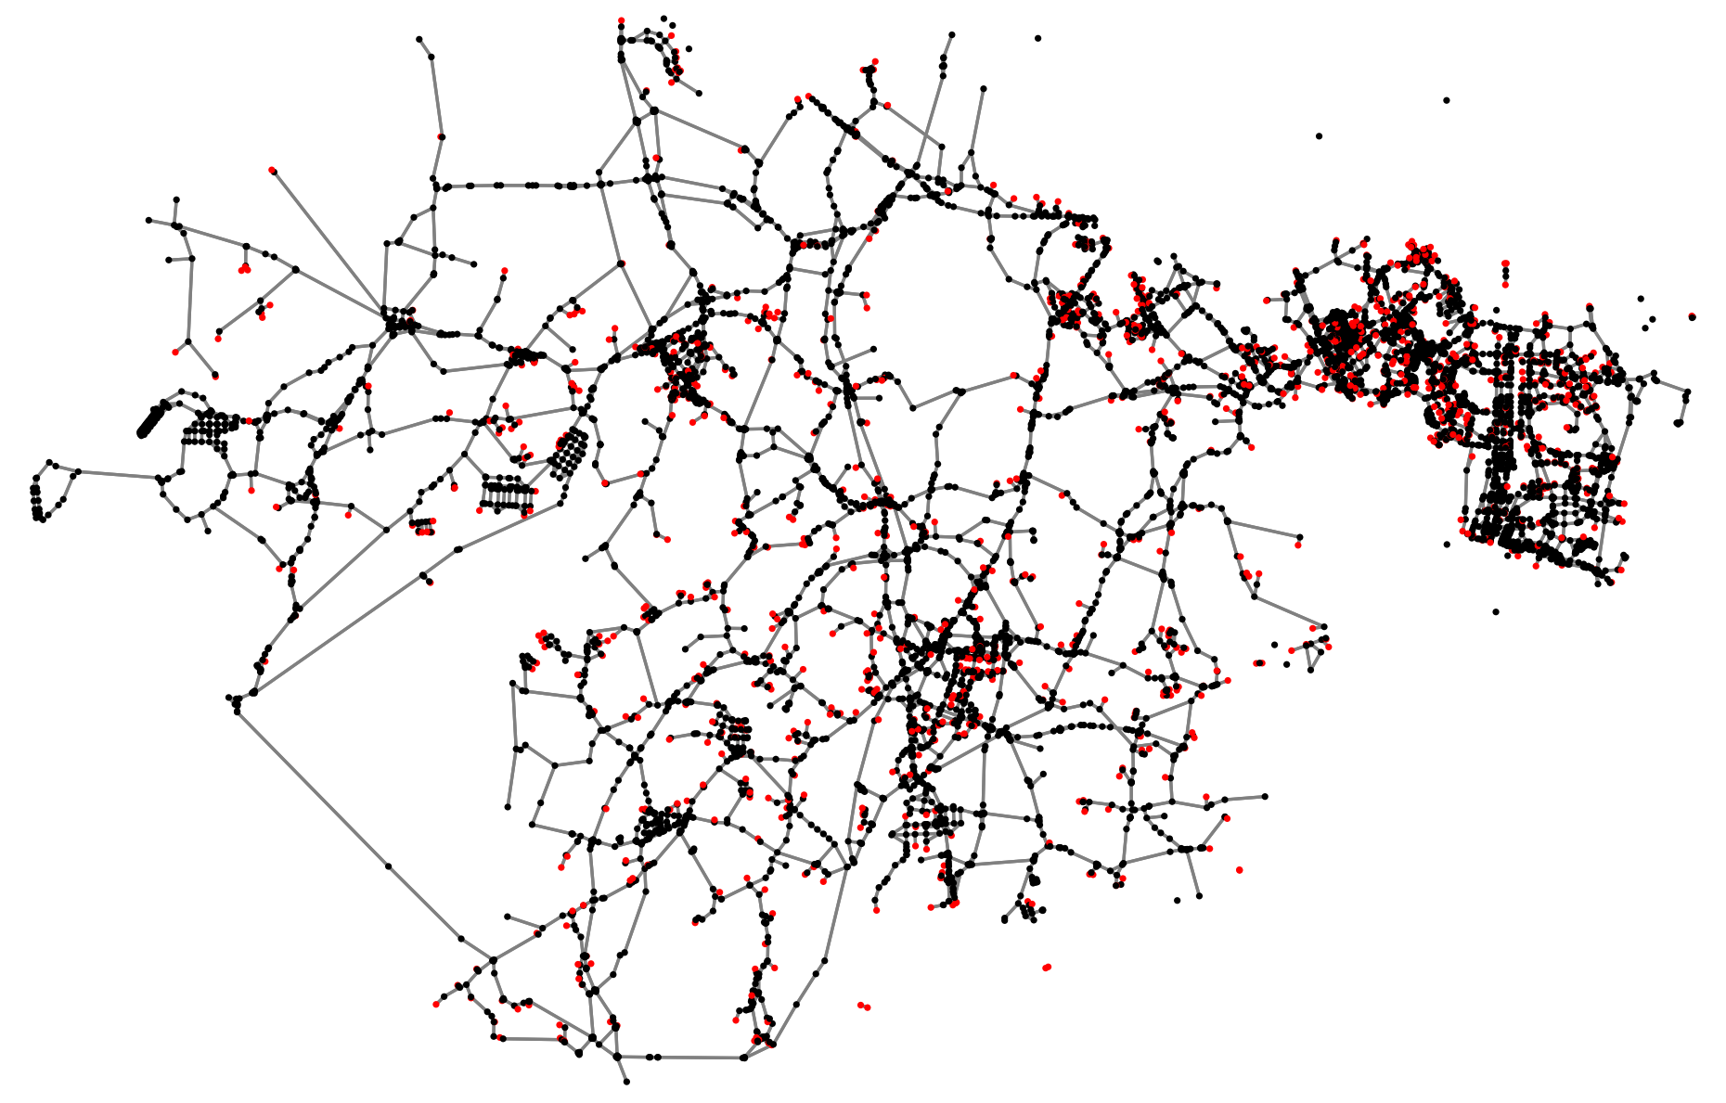
Preserved nodes

Slide 9
Similarity comparison
Centrality does not come from transportation field
Use traffic assignment for similarity comparison

Slide 10





Similarity comparison
O/D matrix
Simplified
Comparison
Visum
original
O/D matrix

