Slide 1






ClickHouse:
Architecture, Features, Performance and Applications
Open-source Columnar OLAP Database
2009
2016
2021
Developed at Yandex for Yandex.Metrica
Open-sourced under Apache 2.0 license
ClickHouse Inc. established as independent company
A high-performance OLAP database designed to analyze billions of rows efficiently.

Slide 2






OLAP and Data Model
ROW-BASED STORAGE
stores full rows
COLUMN-BASED STORAGE
stores each column separately
OLAP systems are built for analytical processing over large datasets.
time
user_id
product
price
time
user_id
product
price
Relational-style tables with rows and columns
Columnar storage reads only the data you need for faster aggregations
Ideal for dashboards, logs, event data,
time-series analysis, and large aggregations
Example: SELECT avg(price) FROM products;
reads only the ‘price’ column in columnar storage.
Less suited for frequent single-row updates
and heavy transactional workloads

Slide 3
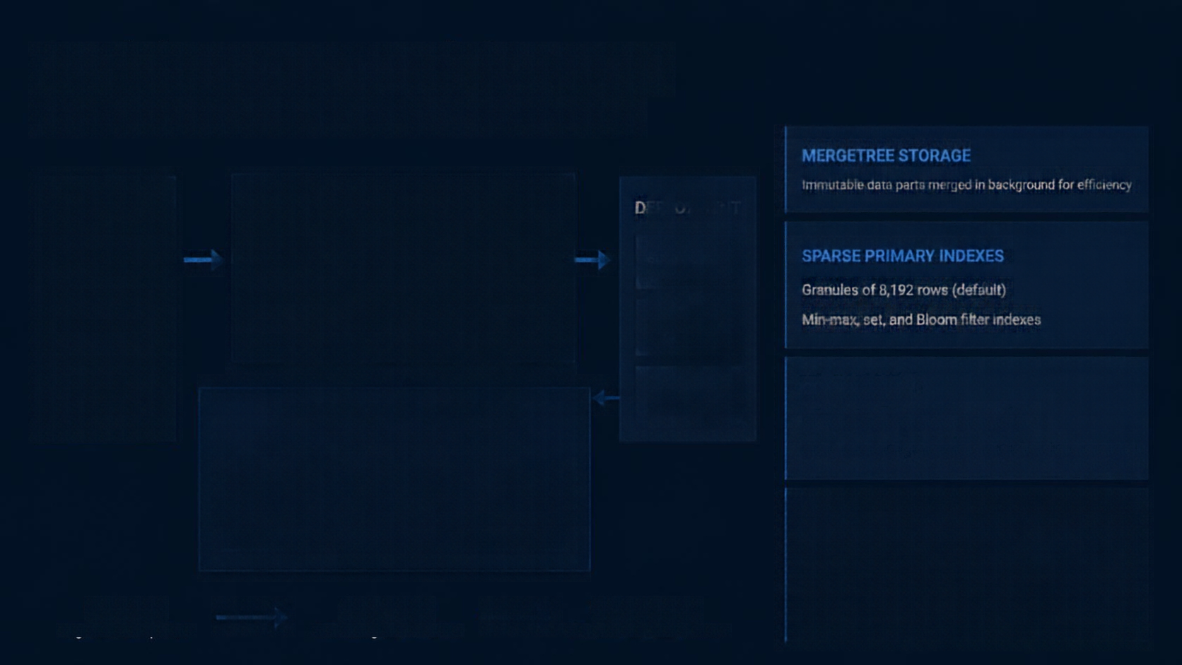





























Architecture and Storage
High-performance columnar engine for real-time analytics
MERGETREE STORAGE
Immutable data parts merged in background for efficiency
CLIENTS
CLICKHOUSE SERVER
DEPLOYMENT
Applications
SQL
Interface
Query
Processor
Execution
Engine
Single Server
SPARSE PRIMARY INDEXES
Granules of 8,192 rows (default)
BI Tools
Vectorized Query Execution
Distributed
Clusters
Min-max, set, and Bloom filter indexes
Data
Ingestion
ClickHouse
Cloud
COMPRESSION
MERGETREE STORAGE ENGINE
LZ4 and ZSTD for storage reduction
Immutable data parts merged in background
Special codes like Delta for improved compression
EXECUTION ENGINE
Background Merges
Vectorized query execution
Multi-core parallelism
DATA FLOW
QUERY FLOW
RESULTS FLOW
Reads only required columns for queries
Ingestion and queries
Processing and execution
Results returned to clients

Slide 4


Scaling and Core Features
SCALE OUT WITH CONFIDENCE
Distributed tables, ReplicatedMergeTree, and ClickHouse Keeper for resilience
BUILT FOR ANALYTICS
Powerful SQL with arrays, quantiles,
time functions, and window functions
SECURE BY DESIGN
RBAC, row-level security, TLS encryption, and LDAP integration
ECOSYSTEM READY
Connects with Kafka, Amazon S3, MySQL, PostgreSQL, Grafana, Superset, Python, and Java

Slide 5





Future Trends
Verified developments shaping ClickHouse
RELEASED
ClickHouse Cloud
managed cloud-native analytics platform
UNDER DEVELOPMENT
Stronger core capabilities
better support for updates, deletes, and joins
Vector search and AI integration prospects
FUTURE POSSIBILITIES
Enhanced JSON and semi-structured data support
exploring next-generation analytics experiences
Source: official ClickHouse documentation, changelogs, and release notes

Slide 6
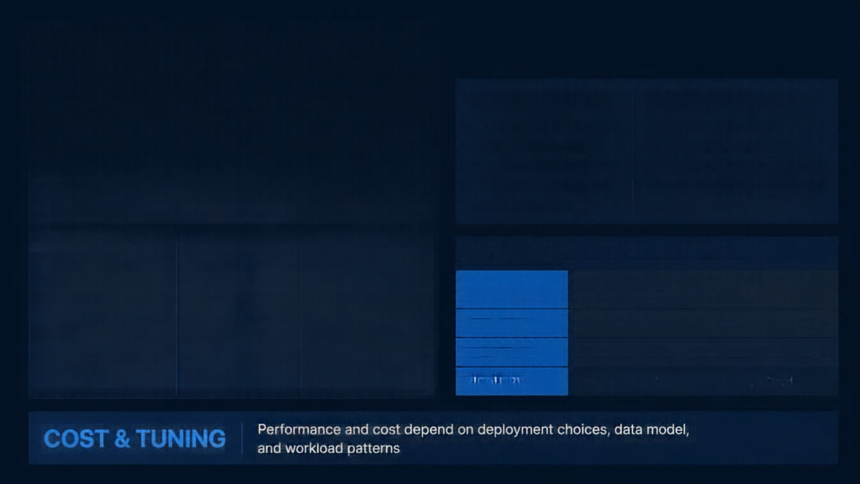







Strengths, Limitations, and Comparison
CLICKHOUSE STRENGTHS
CLICKHOUSE LIMITATIONS
Fast scans and aggregations
High compression efficiency
Scales to massive data volumes
Open source and cost-effective
Supports standard SQL
Less suitable for OLTP workloads
Mutations can be costly
Join optimization can be challenging
Sorting-key design requires trade-offs
AREA
CLICKHOUSE
MYSQL
Primary workload
OLAP
OLTP
Data storage
Column-oriented
Row-oriented
Large aggregations
and analytical scans
Extremely fast
Slower
COMPARISON WITH OTHER ANALYTICAL SYSTEMS
Single-row updates / deletes
Less efficient
Highly efficient
APACHE DRUID
Real-time ingestion and low-latency dashboards; less ad hoc SQL flexibility
Transactions and ACID
Limited
Full ACID compliance
Improving, some
challenges
APACHE PINOT
Real-time analytics at scale; insert-heavy use cases
Joins and optimization
Mature, robust
SNOWFLAKE
Fully managed cloud; separate compute and storage
Scaling and architecture
Sharding and replication; distributed
Replication; scalable
with effort
BIGQUERY
Serverless, tightly integrated in Google Cloud

Slide 7










Use Cases and
Real-World Adoption
ClickHouse powers analytics for the world's most data-intensive organizations.
BUILT FOR REAL-WORLD DATA
VERIFIED ADOPTERS INCLUDE
Web and product analytics | Yandex.Metrica
CLOUDFLARE
Logs and observability |
Uber
Large-scale analytics | Cloudflare, eBay, GitLab
REAL-WORLD IMPACT
IoT and sensor data, ad-tech, finance, monitoring, and HTTP/DNS analytics
GitLab
Cloudflare and Uber rely on ClickHouse to deliver fast, reliable analytics
at massive scale.
Source: ClickHouse adopters page and engineering articles from
Cloudflare, Uber, eBay, GitLab

Slide 8




Performance and Optimization
Performance is driven by columnar reads, compression, vectorized execution, and parallelism
Order by key ensures data locality and faster queries
Partitioning and data-skipping indexes
speed up filtering
Use batched inserts and avoid many tiny inserts to reduce data parts
Real-world speed depends on workload, hardware, schema design, and query patterns
INGEST
ORGANIZE
INDEX
EXECUTE
RESULTS
batch inserts reduce parts and overhead
partitioning improves manageability
data-skipping indexes speed up filtering
vectorized execution and parallelism
faster queries and lower latency
Benchmark fairly against MySQL with equivalent queries, identical data, same hardware, and measured timings

Slide 9








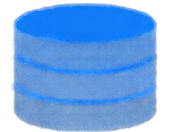
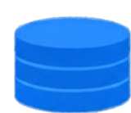

Practical Applications and Database Strategy
APPLICATIONS
MYSQL
CLICKHOUSE
CONSUMERS
Web and Mobile Apps
Services
IoT Devices
Monitoring Agents
OLAP
Dashboards
Reports
Alerts
Analytics Tools
OLTP
Dashboards
Logs & Events
Monitoring
Real-Time Analytics
Transactional Workloads
Strong ACID Guarantees
WHY THIS COMBINATION WORKS
Real-time reporting without impacting transactional system
Best tool for each workload type
ClickHouse: analytics, events, logs, dashboards, real-time insights
MySQL: transactions, user data, operations, strong consistency
Both: modern applications needing speed and reliability

Slide 10


Conclusion and References
KEY TAKEAWAYS
ClickHouse provides columnar storage,
fast analytic queries, compression, scalability
Designed for large-scale analytics
MySQL common for transactional applications
REFERENCES
Official ClickHouse documentation
ClickHouse GitHub repository
ClickHouse adopters
Cloudflare engineering article
Uber engineering article
MySQL reference manual
Database textbook (OLTP & OLAP)
https://clickhouse.com/docs
https://github.com/ClickHouse/ClickHouse
https://clickhouse.com/customers
https://blog.cloudflare.com/tag/clickhouse/
https://eng.uber.com/tag/clickhouse/
https://dev.mysql.com/doc/
https://www.db-book.com/
THANK YOU

