Slide 1
VWT Characterization 2017a
Analysis of Q Ratio
September 2017

Slide 2
Q Ratio is a sensitive non-dimensional parameter that gives the fraction (or percent) of probe Q values in comparison to the tunnel Q value.
Q Ratio = Qprobe / Qtunnel
Q Ratio uncertainty depends on tunnel speed. It is approximately:
2% at Q=3 (50 fps)
0.7% at Q=10 (95 fps)
0.3% at Q=20 (140 fps)

Slide 3
The database was collected a 3 nominal speeds – 50, 95, and 140 fps. These correspond to nominal Q values of 3, 10, and 20 psf.
Orientations of 0, 90, and 270 degrees and heights of 0, 2, 2.5, 3, 4, and 10 ft were collected at the above speeds.
3 ft height is the most extensive database produced. Analysis concentrates on this height. Other heights have been reviewed and are consistent with findings at 3 ft.

Slide 4
Bottom Line Up Front
Initial review indicates
Large data scatter, non repeatable
Non convergence with acquisition Duration and Delay
Erratic profile across tunnel – probes suspect
Detailed review reveals criticality of tunnel setting Q
Less than 1% tolerance is necessary
Leads to excellent repeatability
Duration and delay show convergence
Regions of smooth profile (probe confidence)
Identification of “sweet spots”

Slide 5
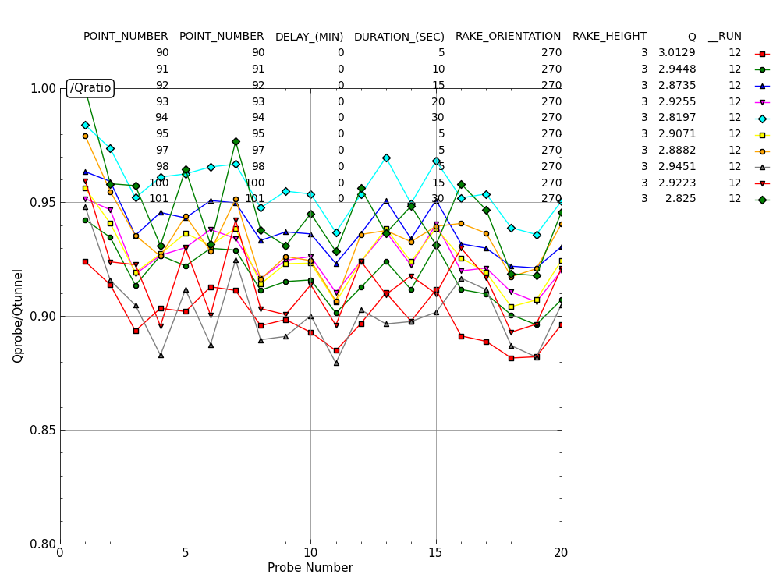
Example Qratio Scatter

Slide 6
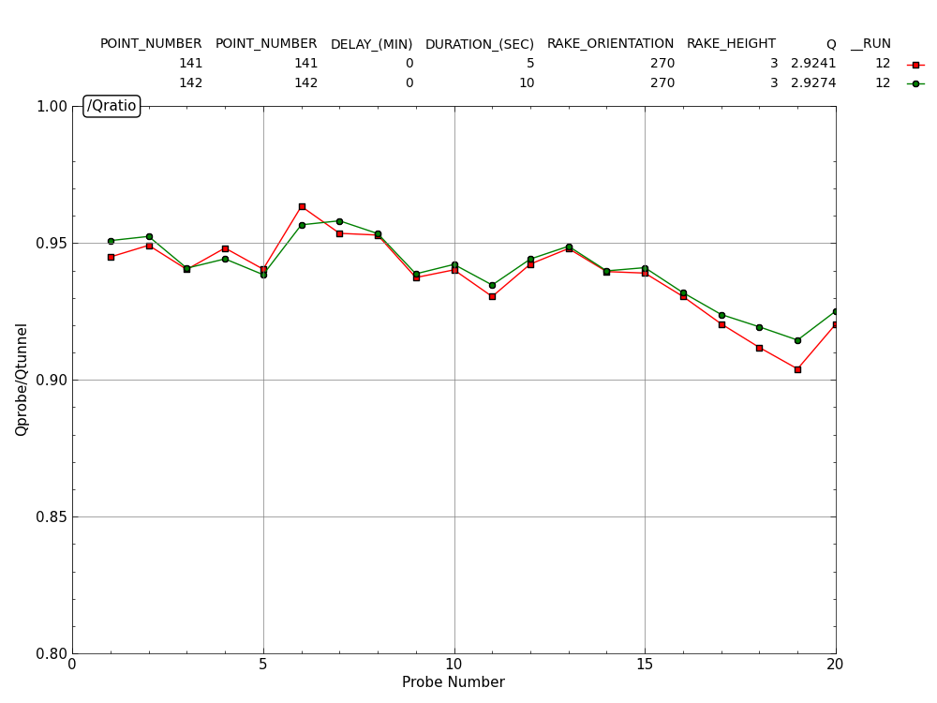
Example Qratio for Matched Q 2.92 psf
Uncertainty at this setting is about 2%

Slide 7
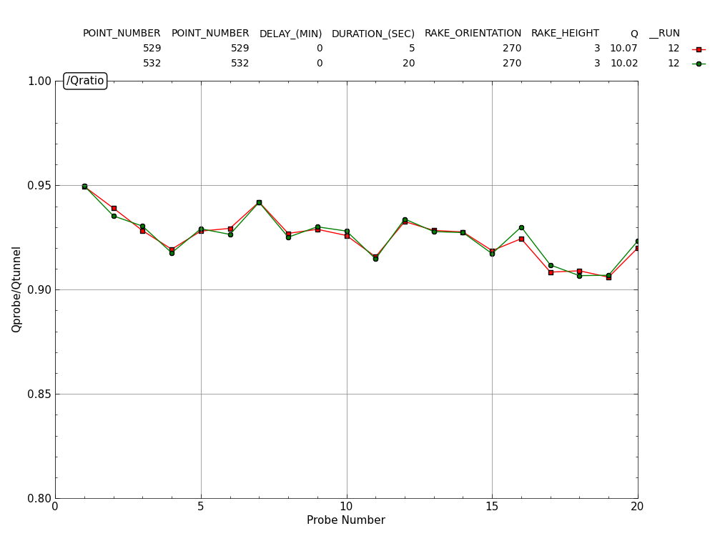
Example Qratio for Matched Q 10.0 psf
Uncertainty at this setting is about 0.7%

Slide 8
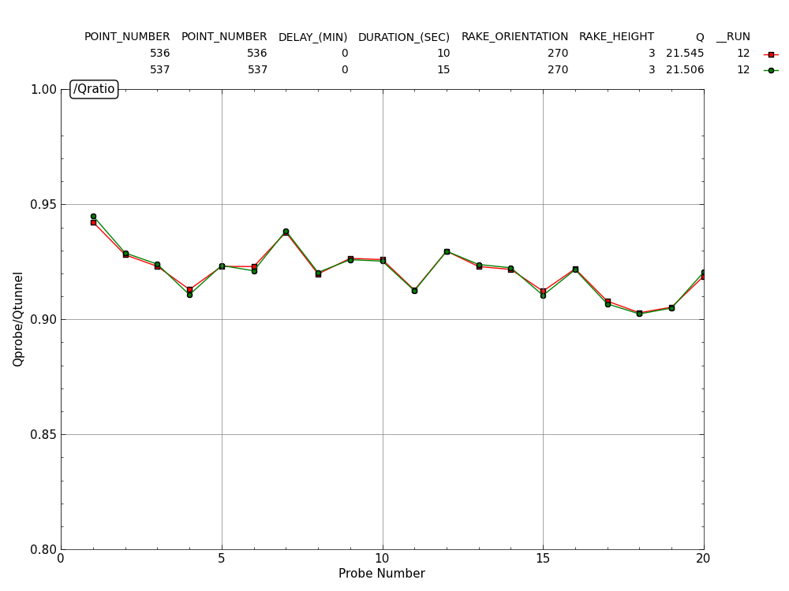
Example Qratio for Matched Q 21.5 psf
Uncertainty at this setting is about 0.3%

Slide 9
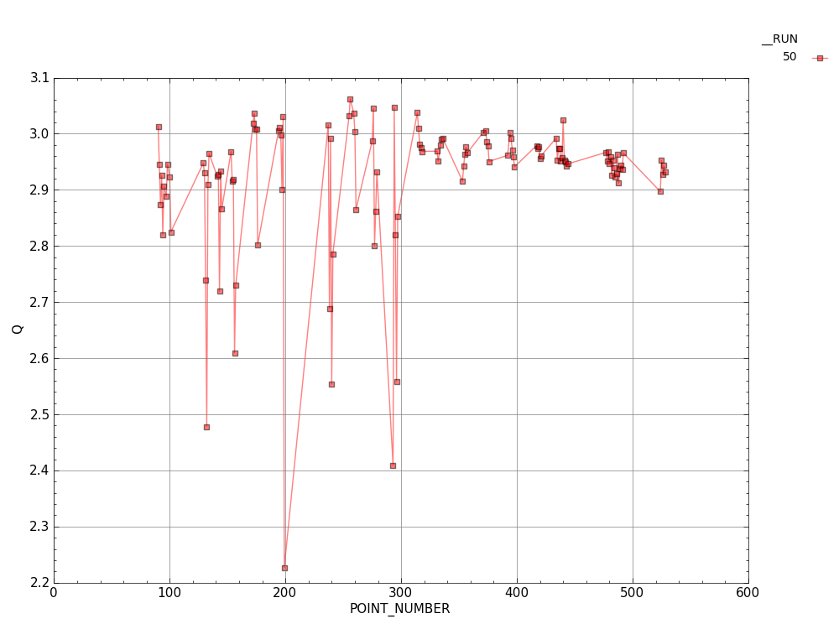
Variation of Q for 50 fps Database
For the most part, Q varied by 7% during our runs. As it turns out, repeatability and duration/delay cannot be assessed unless Q is held to ~ 0.5%

Slide 10
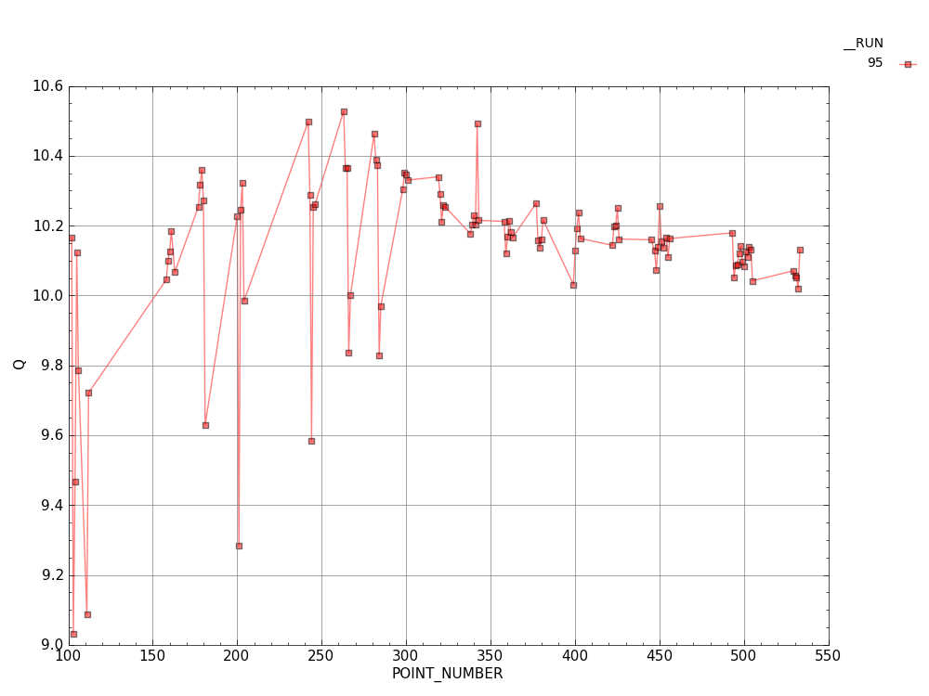
Variation of Q for 95 fps Database
For the most part, Q varied by 5% over the 95 fps database.
Constraint for repeatability at the higher speeds is not as severe as at the low speeds.

Slide 11
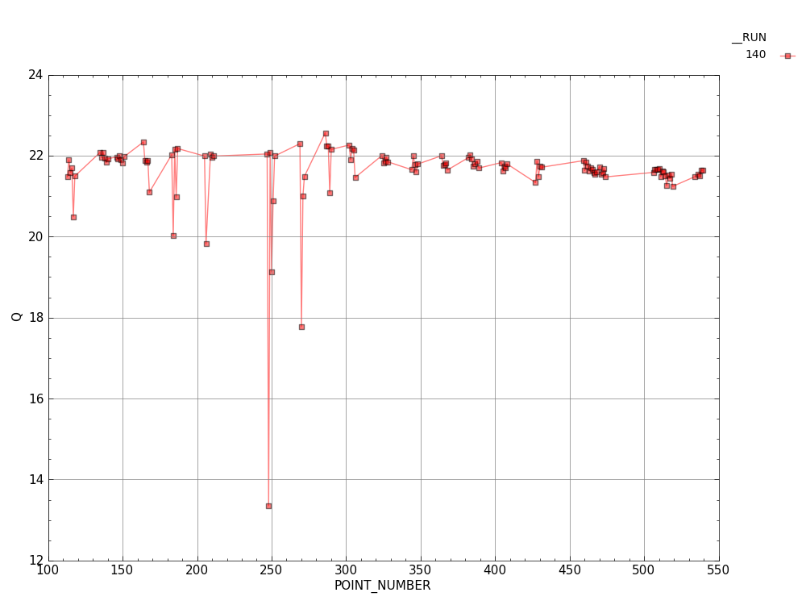
Variation of Q for 140 fps Database
For the most part, Q varied by 9% over the 140 fps database.

Slide 12
“Sweet spots”
Q ratio is critically dependent on the Q value.
In the past we have held to the notion that Q test section is 95% of the Q tunnel.
This data suggests otherwise. It shows that very small changes in Qtunnel can make this factor vary between 90% and 110%.
“Sweet spots” are defined here as settings where the factor is close to 100%

Slide 13
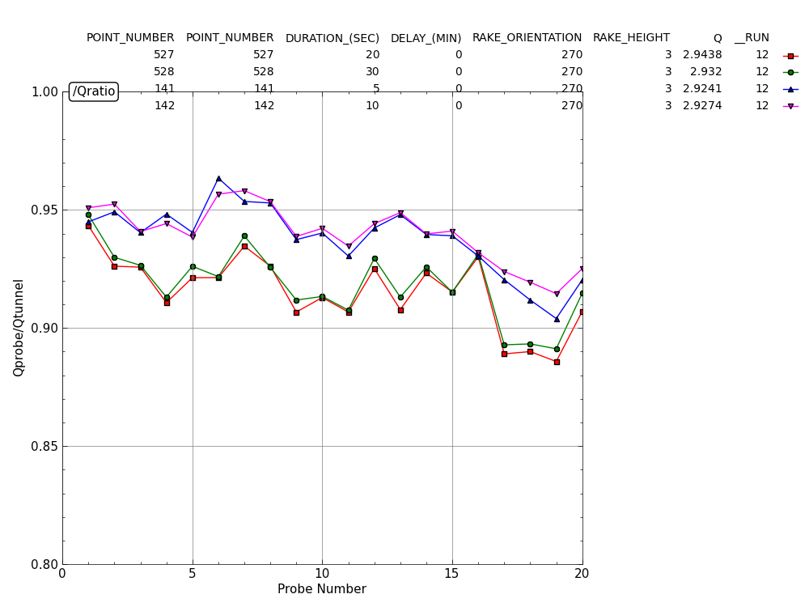
Example “sweet spot” at 50 fps

Slide 14
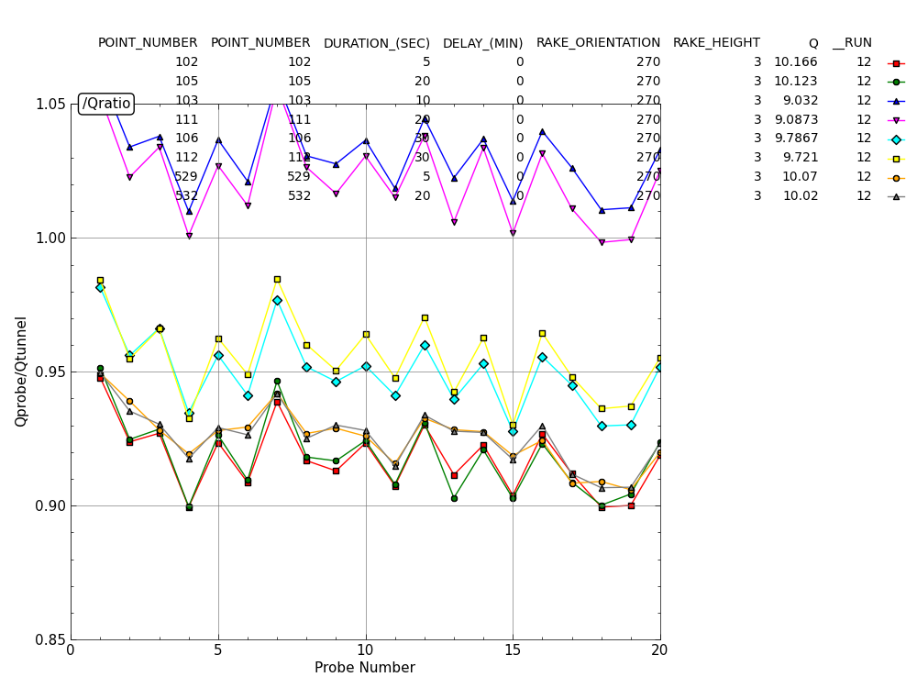
Example “sweet spot” at 95 fps
Increasing Q from 9.0 to 10.1. An overall change of 10%. “Sweet spot” at Q=9.0

Slide 15
After reviewing the entire database from a repeatability perspective, duration produces consistent results above 10 seconds and even 5 seconds is adequate in some cases. Delays of at least several minutes are a good idea and did payoff.
The transient in Qtunnel can confound either of these since the tube lag time can be longer than the tunnel flow/motor control transient cycle.

Slide 16
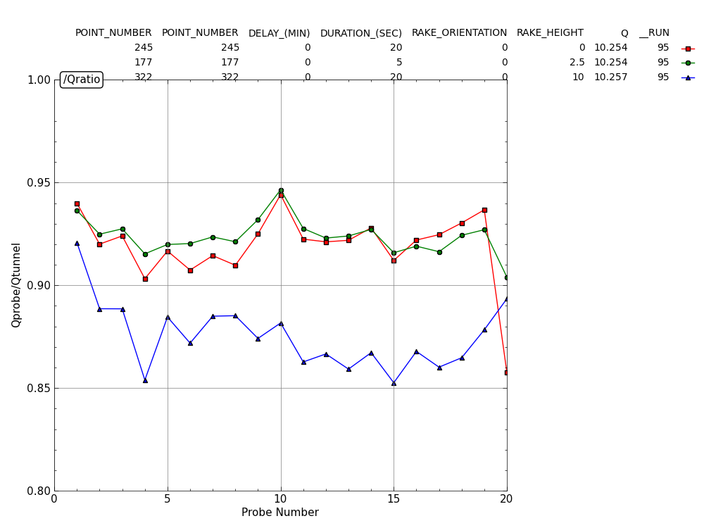
Height Trend for 0 degrees and 95fps
For speed, height and orientation analysis, Q’s must be very well matched. (2,3 and 4 ft are not well matched)

Slide 17
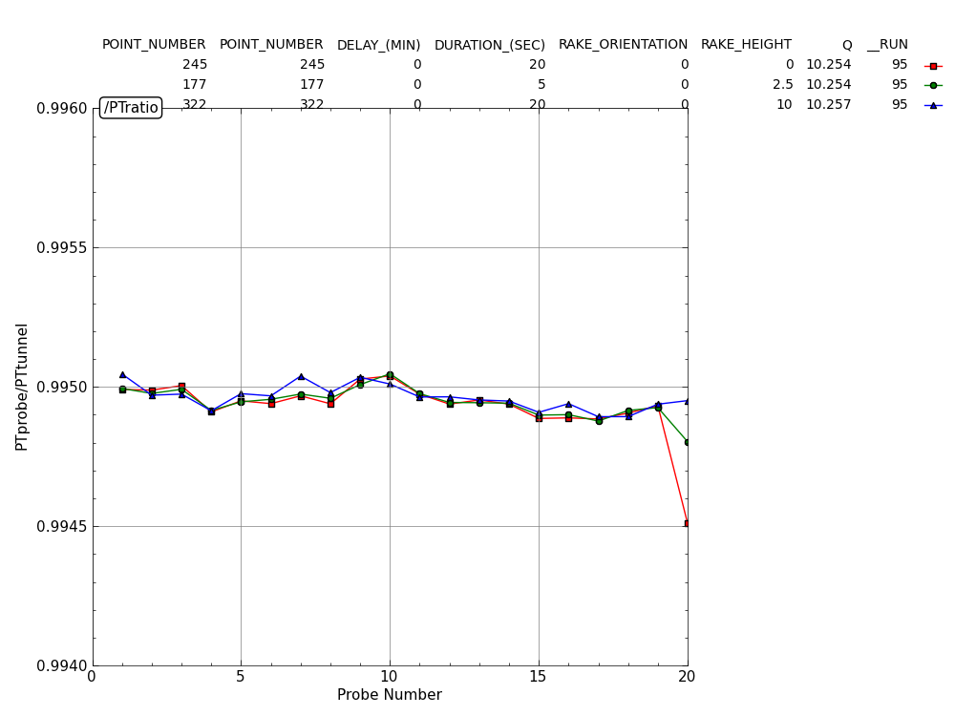
Height Trend for 0 degrees and 95fps
Height variation effects rake Total pressures less than 0.001%. Uncertainty is 0.02%

Slide 18
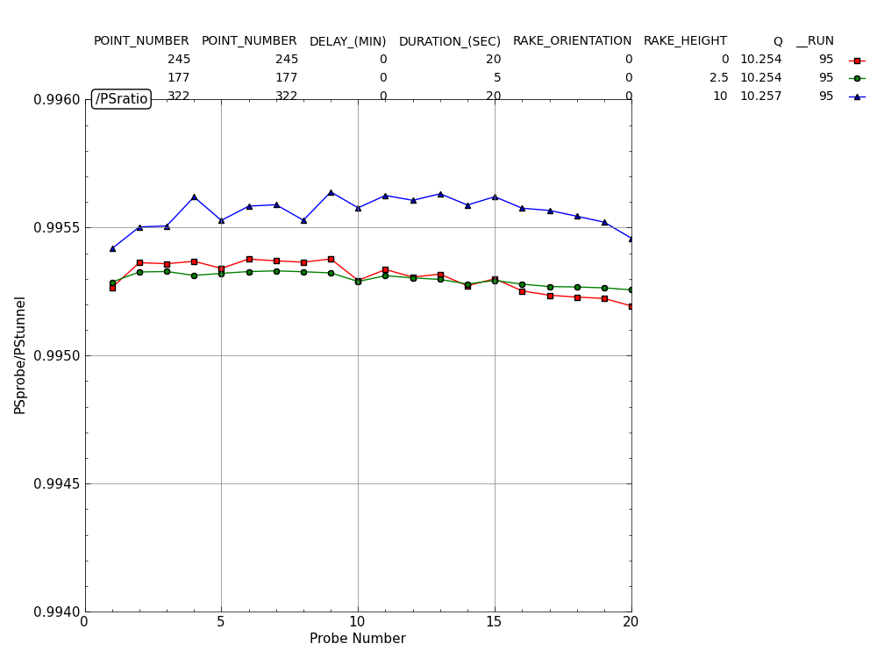
Height Trend for 0 degrees and 95fps
Height variation effects rake Static pressures by about 0.01%. Uncertainty is 0.02%

Slide 19
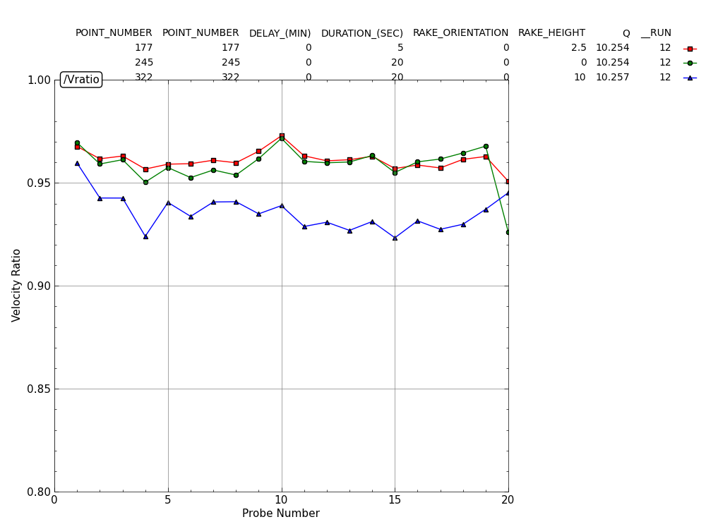
Height Trend for 0 degrees and 95fps
Height variation effects velocity by about 4%.

Slide 20
A database needs to be generated with Q’s matched to 0.5% across the height and orientation scans. Subsequent entries might need to focus on a single speed, (mid-range) as a means to validate this conclusion.
The stability of condition for a given Q setting should be analyzed by experiment to see if there are warm-up affects or certain settings where the flow instability contributes to the drifting Q. We should look for settings that are in our favor for maintain constant Q.
The tunnel pitot-static probe should be analyzed by CFD to see if it represents speed accurately at its location. Else, the assessments wrt height may not be intuitive.

Slide 21
Repeat:
The measurements being made are delicate changes in pressure. Tubing lag time, tunnel unsteadiness, and drifting tunnel conditions are all in play simultaneously. This is more than the likely source of complex results.
With these factors combined, duration and delay will be difficult to isolate. There values should be chosen on the high side for all future data for this set-up.

