Slide 1
A Case Study in Formal Specification and Runtime Verification of a CubeSat Communications System
Zachary Luppen, PhD Student
Dae Young Lee, PhD; Kristin Yvonne Rozier, PhD
AIAA SciTech: IS-30, Formal Methods for Intelligent
Aerospace Systems

Slide 2
Contributions
1) We develop a reference set of formal specifications in mission-time linear temporal logic (MLTL) describing a modeled CubeSat communications system
2) We detail our validation strategy over these specifications using experimental evaluation with the R2U2 tool
3) We highlight and discuss specification patterns that emerge while developing and revising the specifications
4) We discuss lessons learned from validating these specifications that may inform future CubeSat runtime verification efforts

Slide 3
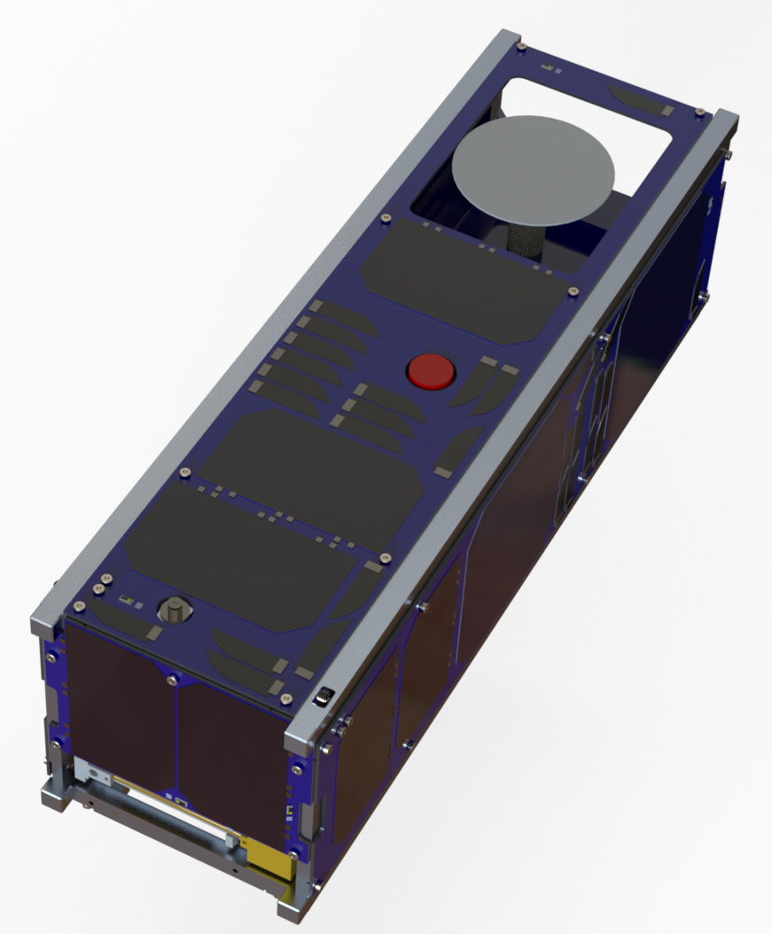
CubeSats
CubeSats becoming widely used owing to their relatively low cost and fast turnaround times.
CubeSat communications systems are extremely important to any mission.
Communications system failures are one of the most common types of failures with CubeSat missions .
Formal methods are used to specify, develop and verify software and hardware systems, but despite failures being common, nobody has used the techniques with CubeSats.

Slide 4
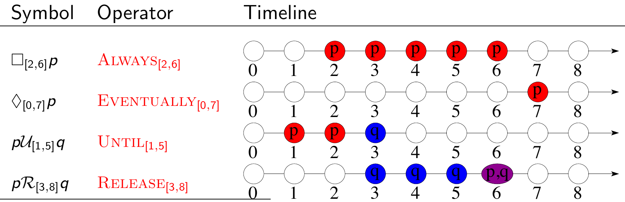
Mission-Bounded Linear Temporal Logic¹
Mission-Time Temporal Logic (MLTL) reasons about integer-bounded timelines:
finite set of atomic propositions { p q }
Boolean connectives:
Temporal connectives with time bounds
1. T. Reinbacher, K.Y. Rozier, J. Schumann. “Temporal-Logic Based Runtime Observer Pairs for System Health Management of Real-Time Systems.” TACAS 2014.

Slide 5
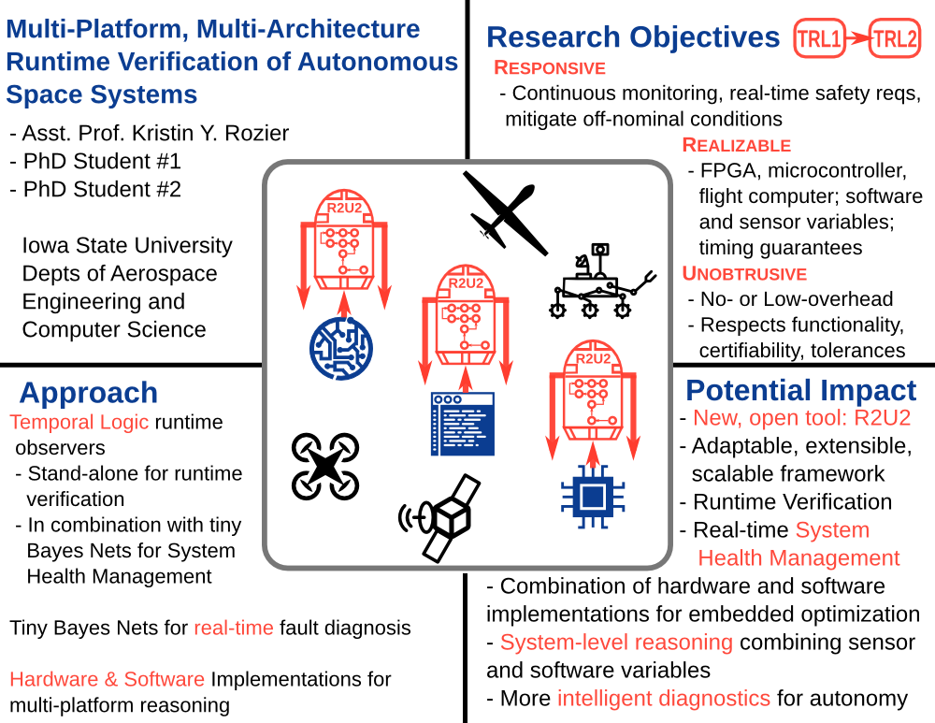
Realizable, Responsive, Unobtrusive Unit (R2U2)

Slide 6
Realizable, Responsive, Unobtrusive Unit (R2U2)
Realizability
easy, expressive specification language
generic interface to connect to a wide variety of systems
adaptable to missions, mission stages, platforms
Responsiveness
continuously monitor the system
detect deviations in real time
enable mitigation or rescue measures
Unobtrusiveness
functionality: not change behavior
certifiability: avoid re-certification of flight software/hardware
timing: not interfere with timing guarantees
tolerances: obey size, weight, power, telemetry bandwidth constraints
cost: use of commercial-off-the-shelf (COTS) components

Slide 7
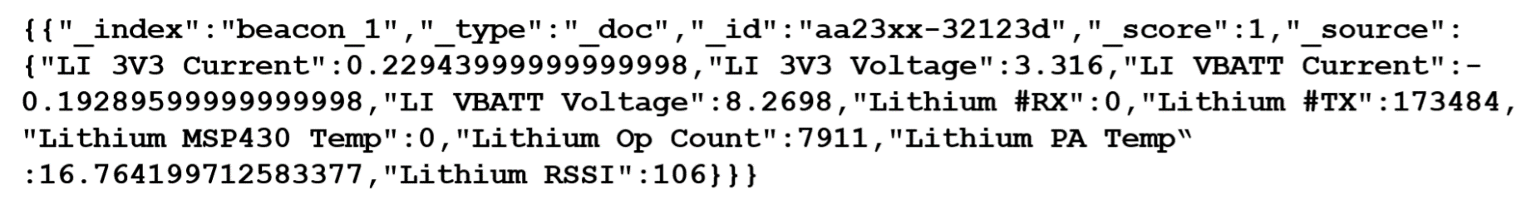
Sample Telemetry Message
Highly simplified message
Parameters are either essential ID info, or relate to communications system

Slide 8
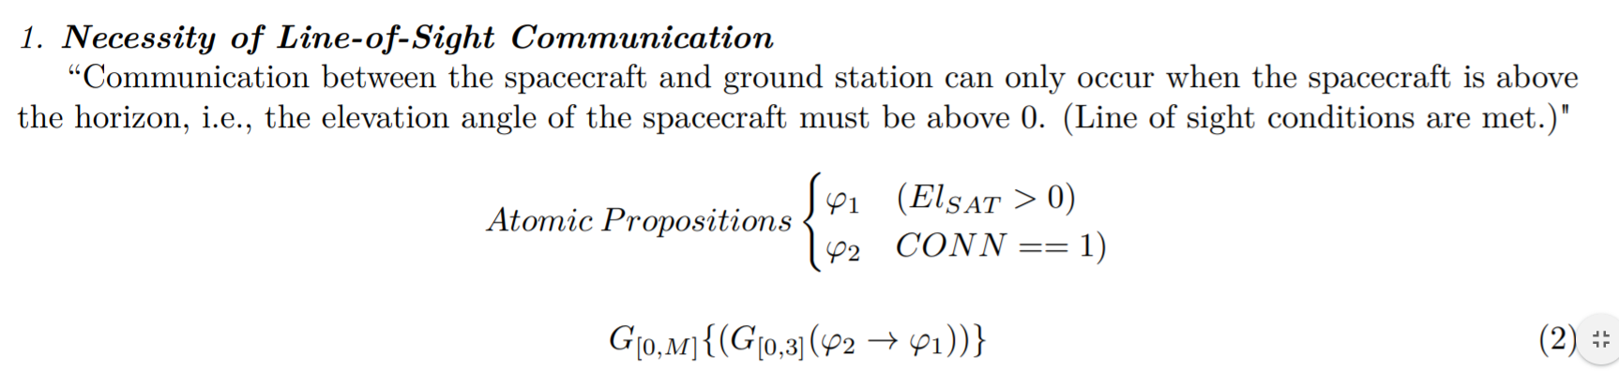
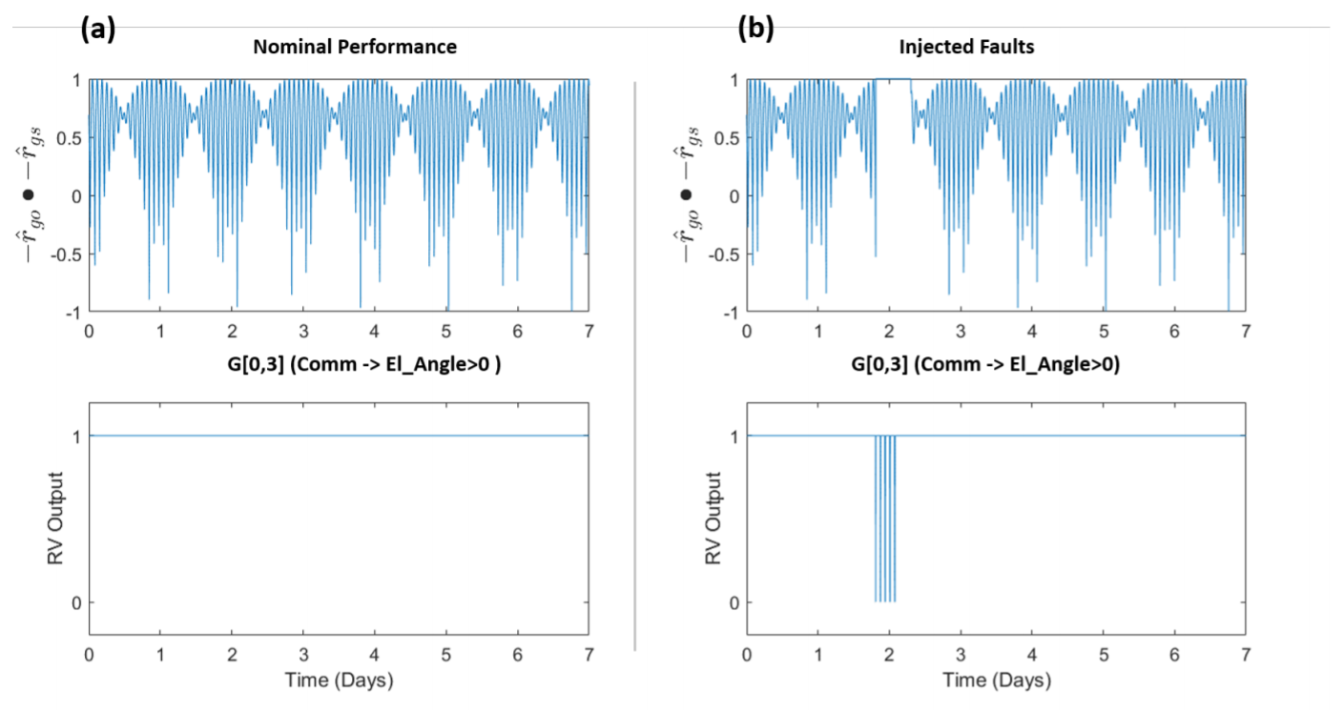
Results (Slide 1)

Slide 9
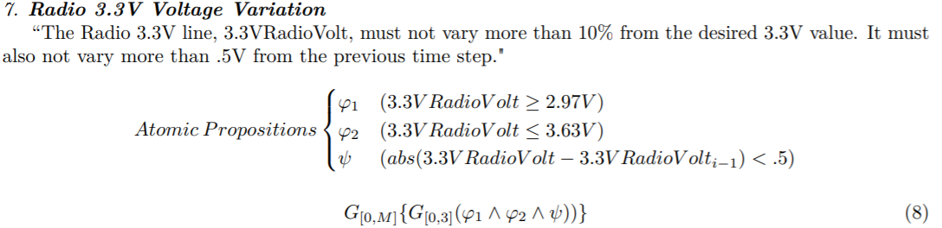
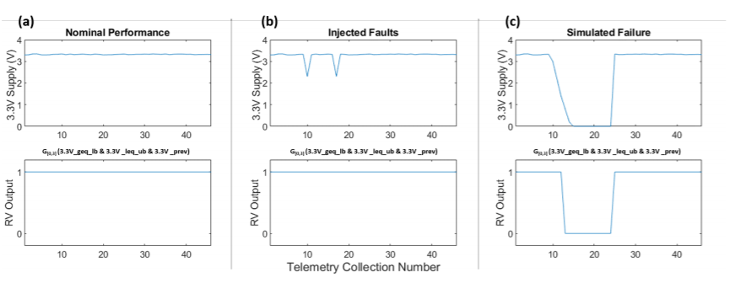
Results (Slide 2)

Slide 10
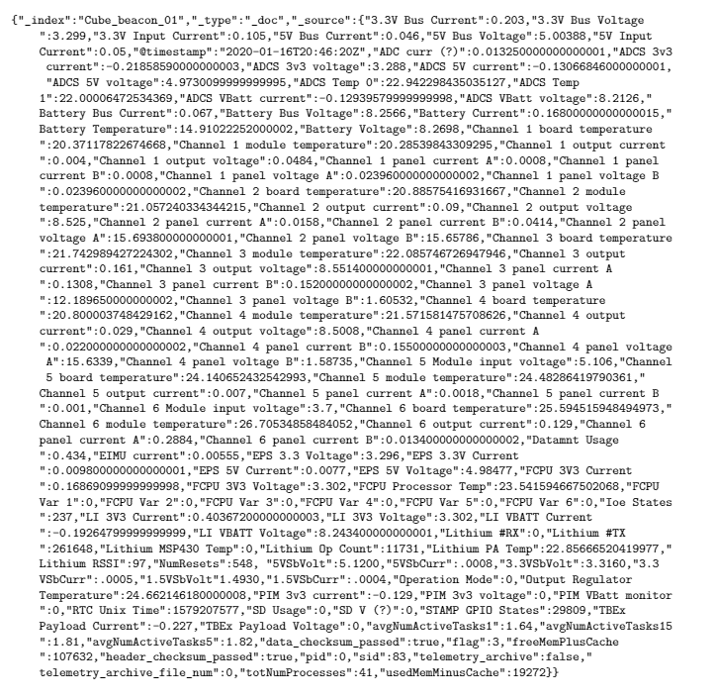
Future Work (1)
Analysis of full telemetry set

Slide 11
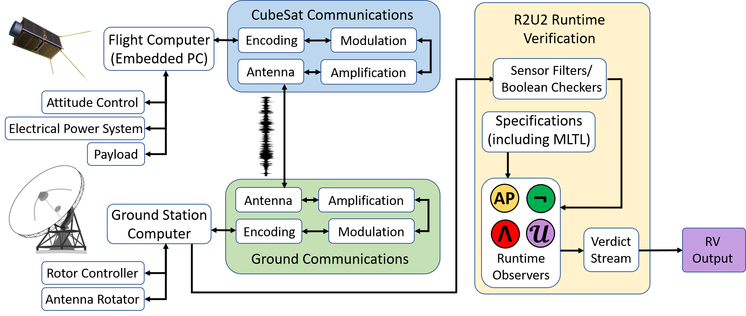
Future Work (2)
Application to real CubeSat project
Explore benefits of embedding RV on the CubeSat

