Slide 1
A Case Study in Formal Specification and Runtime Verification of a CubeSat Communications System
Zachary Luppen, PhD Student
Dae Young Lee, PhD; Kristin Yvonne Rozier, PhD
AIAA SciTech: IS-30, Formal Methods for Intelligent
Aerospace Systems

Slide 2
CubeSats

Slide 3
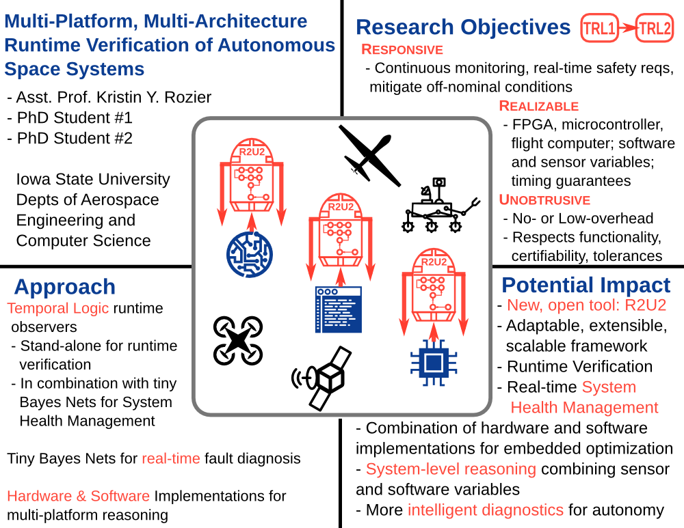
Realizable, Responsive, Unobtrusive Unit (R2U2)

Slide 4
Realizable, Responsive, Unobtrusive Unit (R2U2)
Realizability
easy, expressive specification language
generic interface to connect to a wide variety of systems
adaptable to missions, mission stages, platforms
Responsiveness
continuously monitor the system
detect deviations in real time
enable mitigation or rescue measures
Unobtrusiveness
functionality: not change behavior
certifiability: avoid re-certification of flight software/hardware
timing: not interfere with timing guarantees
tolerances: obey size, weight, power, telemetry bandwidth constraints
cost: use of commercial-off-the-shelf (COTS) components

Slide 5
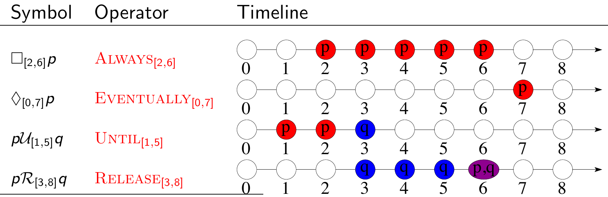
Mission-Bounded Linear Temporal Logic¹
Mission-Time Temporal Logic (MLTL) reasons about integer-bounded timelines:
finite set of atomic propositions { p q }
Boolean connectives:
Temporal connectives with time bounds

Slide 6
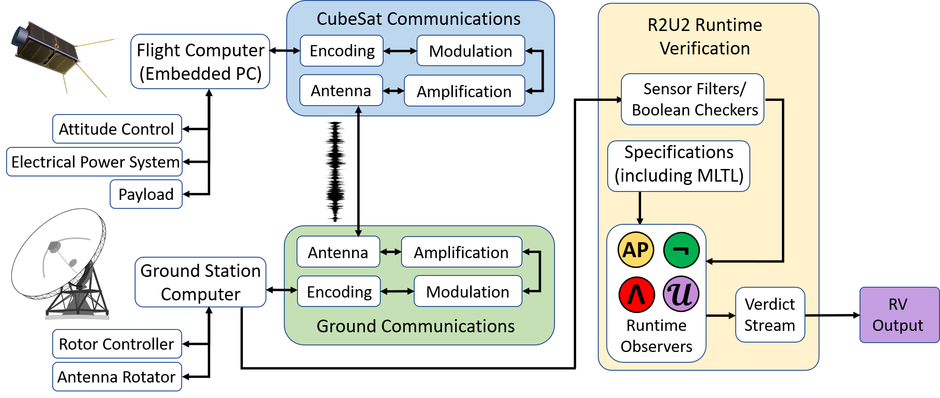
RV for a Real CubeSat Configuration

Slide 7
Contributions

