Slide 1
A Case Study in Formal Specification and Runtime Verification of a CubeSat Communications System
Zachary A. Luppen, Dae-Young Lee, Kristin Y. Rozier
Iowa State University
AIAA SciTech Conference, 11-15, 19-21 January 2021
Copyright © 2020 by The American Institute of Aeronautics and Astronautics. Published by the American Institute of Aeronautics and Astronautics, Inc., with permission.

Slide 2


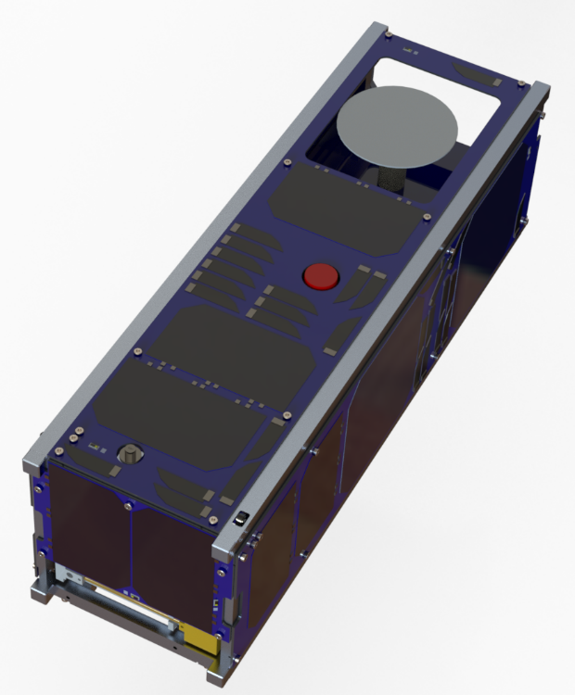
CubeSats
Small, compact satellites
Low cost
Fast turnaround
Popular with academic, commercial, amateur and government groups
Different kinds of small satellites
Nanosatellites
Picosatellites
Femtosatellites
Collectively refer to these as CubeSats

Slide 3
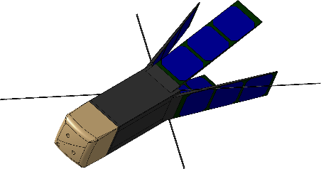
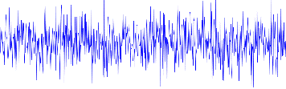
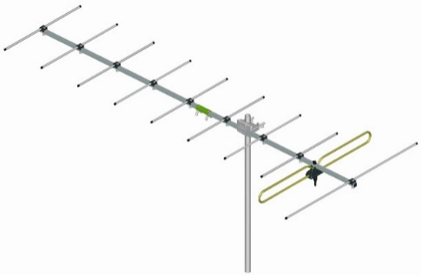
Motivation for Case Study
Communications systems are extremely important to any mission.
These failures can halt a mission or end it prematurely.
One of the most common types of failures with CubeSat missions^{1,2}
Validate, verify these systems during runtime.
1. Mike Tolmasoff, Renelito Delos Santos, and Catherine Venturini, “Improving Mission Success of CubeSats,” ,May 2007.
2. Langer, M., and Bouwmeester, J., “Reliability of CubeSats – Statistical Data, Developers’ Beliefs and the WayForward,” , 08 2016.

Slide 4
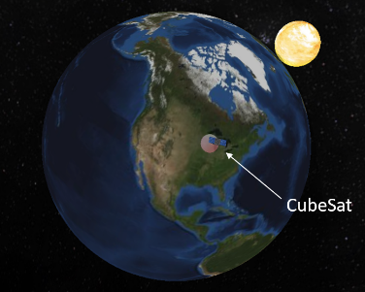
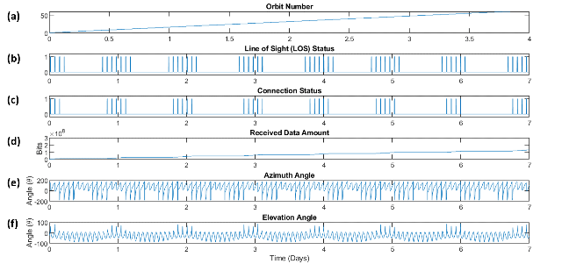
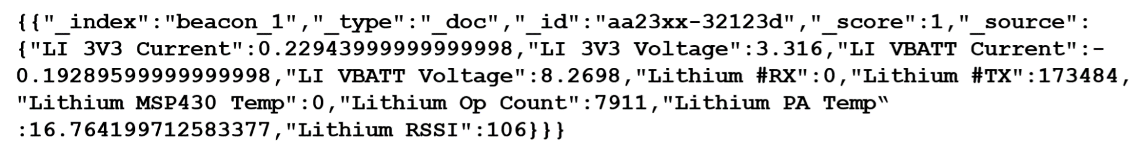
CubeSat Communications System
Developed using Matlab/Simulink toolboxes
Orbital Simulation
Aerospace Blockset CubeSat Simulation Library
Outputs orbital information
Communications Simulation
Operates USRP B210 SDR to communicate sample telemetry

Slide 5
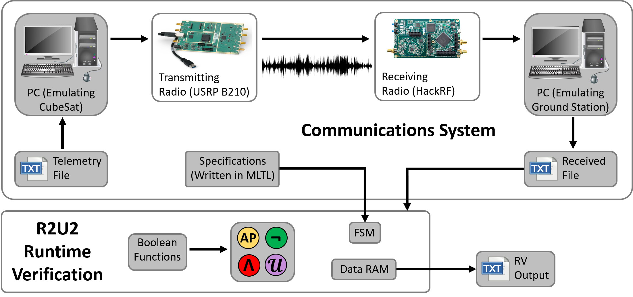
Partial Setup
Receiving
Radio (USRP B210)

Slide 6
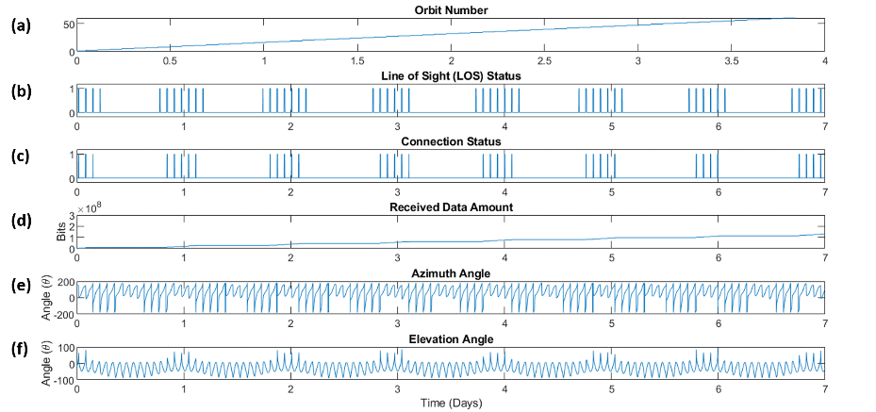
Verification of Datasets
Develop specifications detailing expectations for each dataset
Demonstrate that data traces from the orbital simulation and telemetry are verifiable with runtime verification (RV)

Slide 7
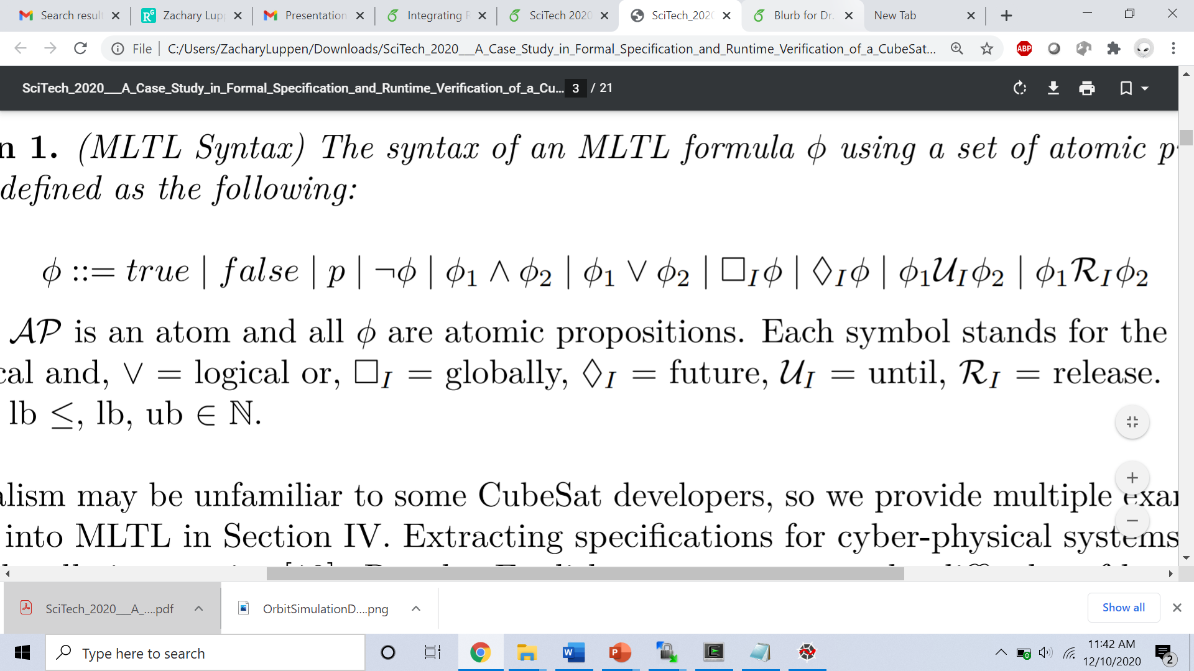
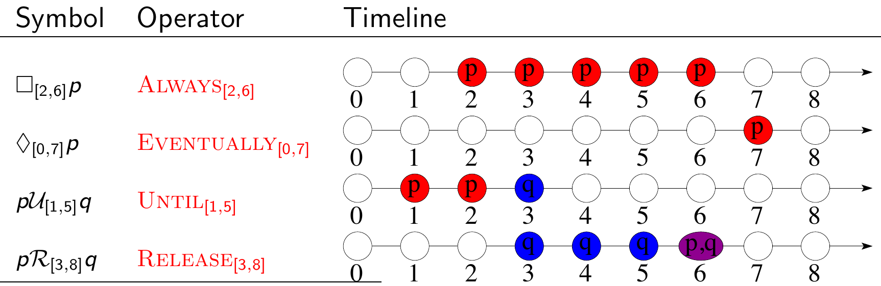
Mission-Bounded Linear Temporal Logic³
Mission-Time Temporal Logic (MLTL) reasons about integer-bounded timelines:
finite set of atomic propositions { p q }
Boolean connectives: , , ,
Temporal connectives with time bounds
3. T. Reinbacher, K.Y. Rozier, J. Schumann. “Temporal-Logic Based Runtime Observer Pairs for System Health Management of Real-Time Systems.” TACAS 2014.

Slide 8
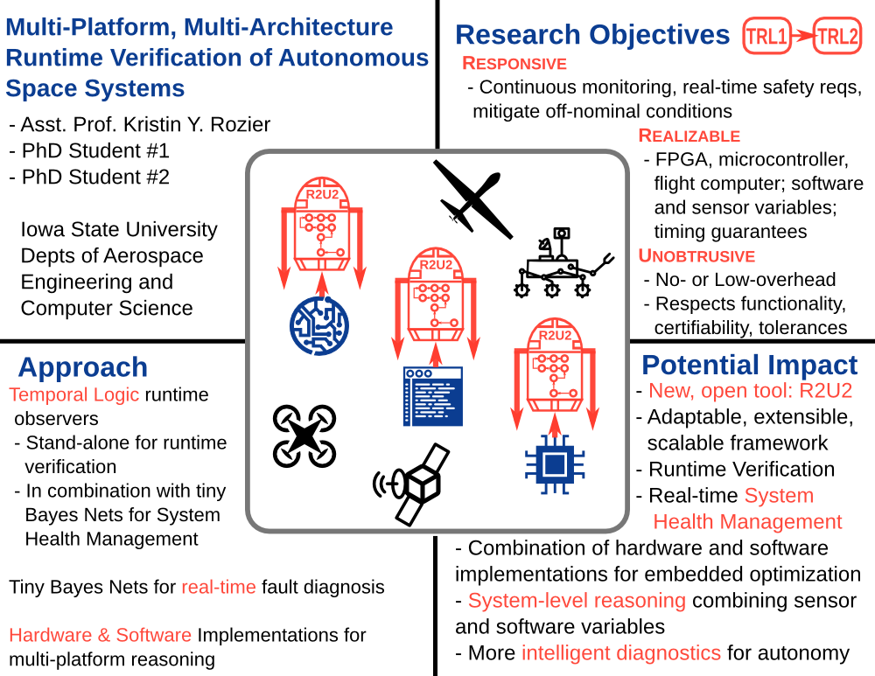
Realizable, Responsive, Unobtrusive Unit (R2U2)

Slide 9
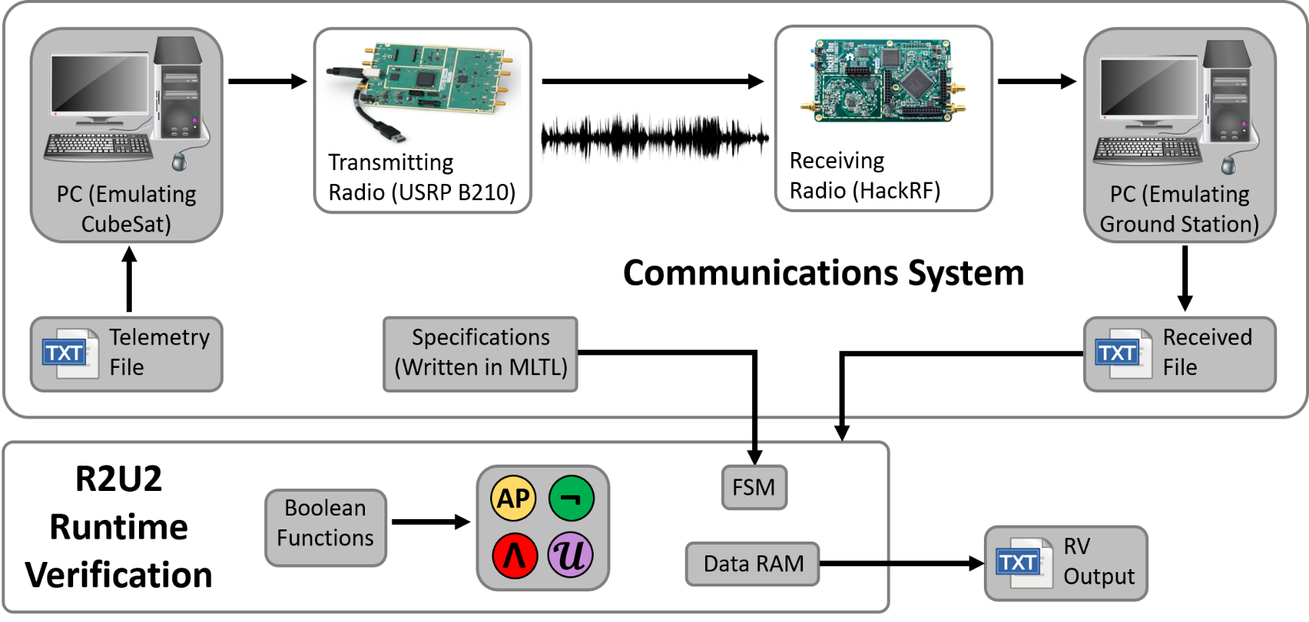
Complete Setup
Receiving
Radio (USRP B210)

Slide 10
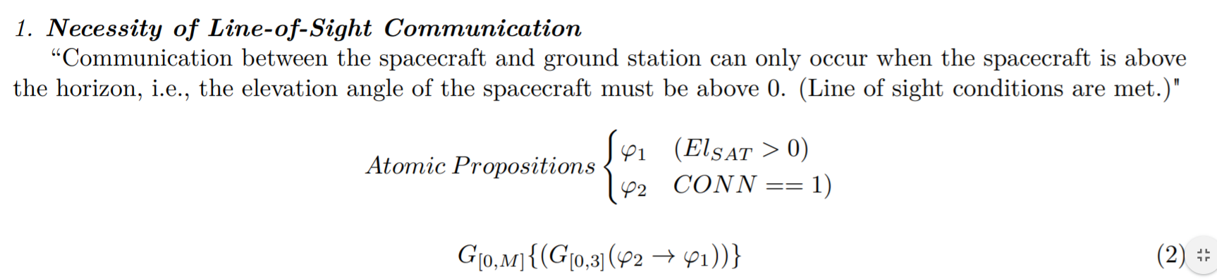
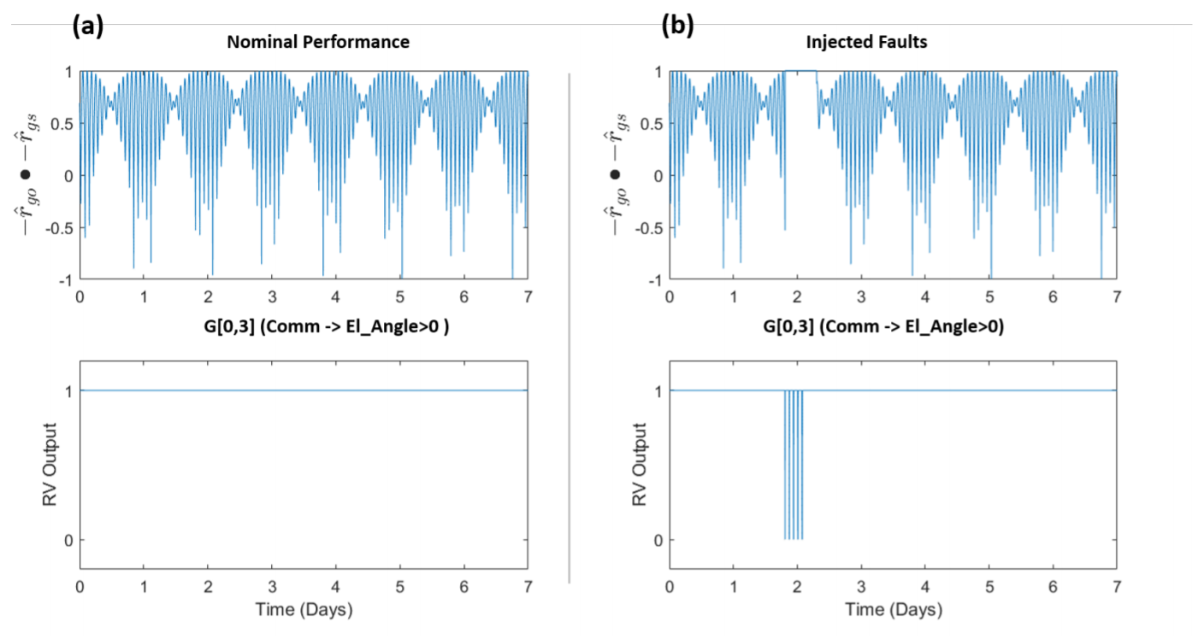
Results (Slide 1)

Slide 11
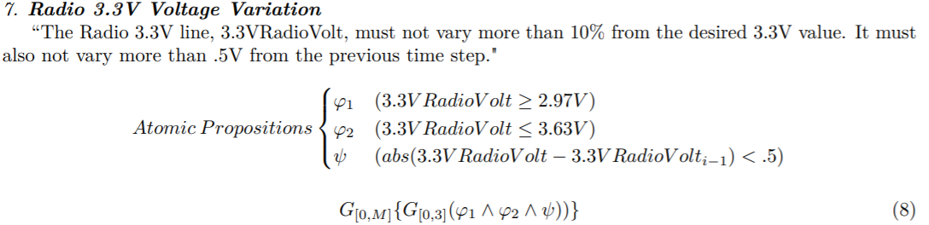
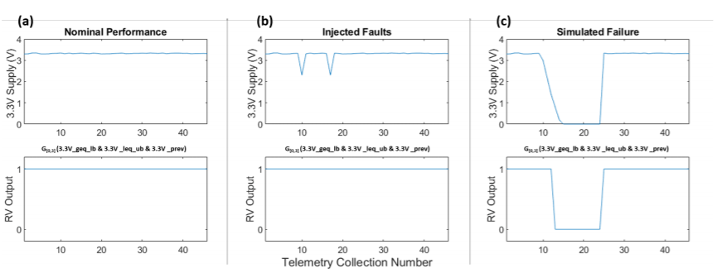
Results (Slide 2)

Slide 12
Contributions
1) Develop reference set of formal specifications in mission-time linear temporal logic (MLTL) describing a modeled CubeSat communications system
2) Detail validation strategy over these specifications using experimental evaluation with the R2U2 tool
3) Highlight and discuss specification patterns that emerge while developing and revising the specifications
4) Discuss lessons learned from validating these specifications that will inform future CubeSat runtime verification (RV) efforts

Slide 13
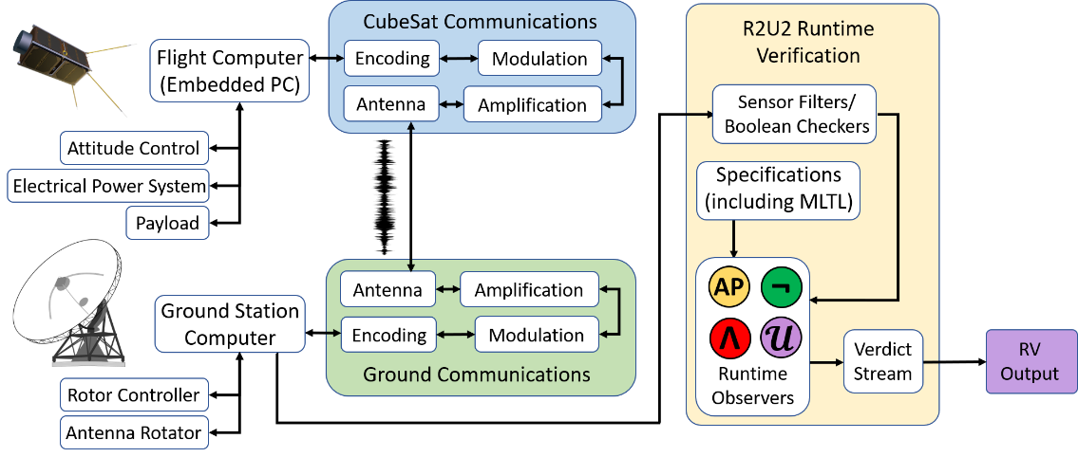
Future Work
Apply formal specification and RV in the design of other CubeSat subsystems, such as an electrical power system (EPS) and an attitude determination and control system (ADCS).
Useful in evaluating CubeSat telemetry from ground station and autonomously verifying whether the CubeSat’s performance at that time is nominal.
Applying our methods to a real CubeSat system is the ultimate demonstration.

Slide 14
Backup

Slide 15
Conclusion
Explored benefits of formal specification and runtime verification on a simulated CubeSat communications system.
Demonstrated how R2U2 can be used to detect serious faults in a communications system.

Slide 16
Realizable, Responsive, Unobtrusive Unit (R2U2)
Realizability
easy, expressive specification language
generic interface to connect to a wide variety of systems
adaptable to missions, mission stages, platforms
Responsiveness
continuously monitor the system
detect deviations in real time
enable mitigation or rescue measures
Unobtrusiveness
functionality: not change behavior
certifiability: avoid re-certification of flight software/hardware
timing: not interfere with timing guarantees
tolerances: obey size, weight, power, telemetry bandwidth constraints
cost: use of commercial-off-the-shelf (COTS) components

Slide 17
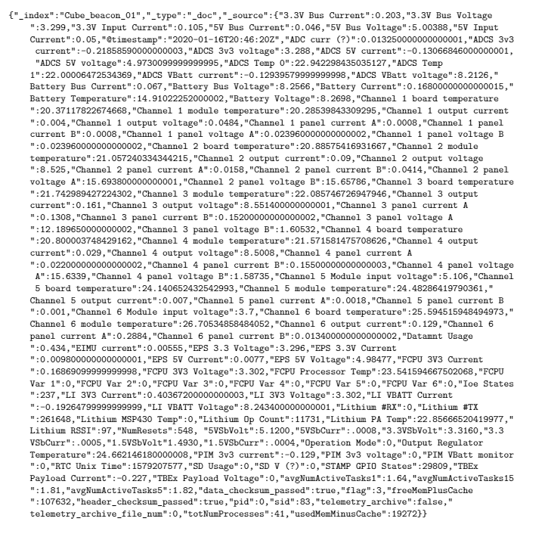
Future Work (2)
Analysis of full telemetry set
Explore patterns, similarities (i.e., how many voltages and currents, how many specs are similar)

Slide 18
Sample Telemetry Message
Simplified message (tens to hundred of variables describing other systems left out)
Parameters are either essential ID info, or relate to communications system

Slide 19
Presentation Title
Please note formatting guidelines below.
Landscape orientation
16:9 ratio
Font
Sans serif (e.g. Helvetica, Arial, Tahoma)
Sized 24-40 points
Minimal information—highlight main points
No commercialism/advertising
Can your slides be easily read from 15 meters away?

