Slide 1

Enhancing Users Visual Comprehension In UX/UI Web Application
Daylen Mejlak & Mario Mallia-Milanes
Institute of Information & Communication Technology
MCAST, Paola, Malta

Slide 2
Problem Definition
The problem that is being addressed here is how does users act and behave when navigating with such User Interfaces being either good or bad. For a UX Designer is a bit of a challenge to know and indicate which UI/UX if found difficult by the users to interact with.
Head tracking and time efficiency are taken into consideration to analyse user behaviour with such UI’s.
In order to achieve good results, the head of the user needs to be well detected and difference in movement changes will then be compared depending on the navigation of the UI itself.

Slide 3
Hypothesis & Questions
Aim of Study:
The aim of this research is to use computer vision to analyze the user’s head behavior while navigating through a user interface using a head tracking program. This study focuses specifically on the user’s behavior when navigating through a bad and good UX/UI design.
Hypothesis:
The hypothesis of this study is that by using computer vision especially head tracking, it is possible to identify the user’s head posture and head tracking while the user is navigating with a specific user interface.
Research Questions:
Was the head tracker able to distinguish difference in user behavior with both UX/UI’s ?
What were the differences between both UX/UI’s if there were any ?
Was the intended result obtained from the head tracking prototype ?
Notes:
Therefore, this research intends to focus on the recognition and catering of accents within the English spoken language and we hypothesise that…
To address the hypothesis, we ask these 3 research questions to identify the determining factors of accents and how ASR can be enhanced with our research

Slide 4
Literature – UX/UI
User Experience (UX) design is the process to design and create products which provides a meaningful experience to users (interaction design foundation, 2022).
UX design aims to provide an experience to the user when interacting with the product as positive as possible so that it keeps the users loyal to the product itself (Gangadharan,2019).
Designing for user experience entails taking into account the complete user journey, from the first time a product or service is researched through use and engagement. In other words, the goal is to create a seamless and pleasant experience from beginning to end (Ijaz, 2022).
User Experience design is also important because it covers the overall look and feel of the product/website, the ease of use, the accuracy and also reliability of data and also the speed and responsiveness of the interface (Ijaz,2022).

Slide 5
Literature – Computer Vision
Computer vision focuses on gathering details about a situation from photographs of that scene. It has numerous uses, including in the processing of documents, robotic guiding, radiography, microscopy, industrial inspection, and remote sensing (IBM, 2022).
Computer vision is a branch of artificial intelligence (AI) that enables computers and systems to extract useful information from digital photos, videos, and other visual inputs and to execute actions or make recommendations based on that information (IBM,2022).

Slide 6
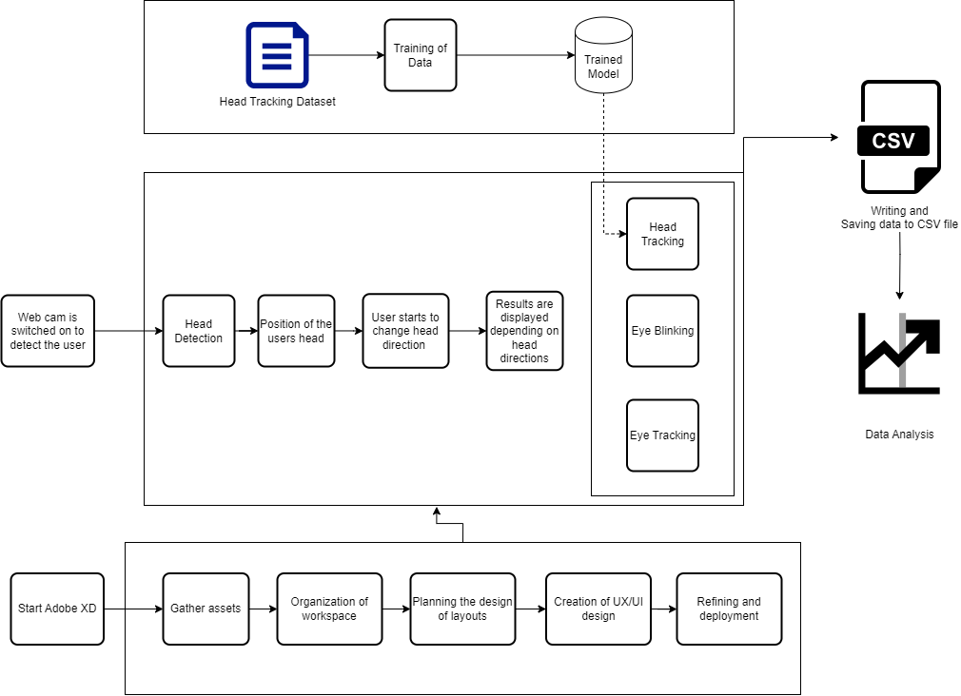
Methodology Research Pipeline
Pipeline:

Slide 7
Methodology
The research pipeline begins by explaining the process required to carry out the study. The head tracking dataset is first used, and then the model is trained particularly for head tracking. However, once the data has been successfully trained and the prototype is ready to begin working, the webcam is activated to detect the user's head, and then able to determine the position of the head. Furthermore, the user starts to change head direction due to navigation with the UX/UI and then the results are displayed depending on the head directions done be the user. The results found are written and saved to the CSV file and then the data analysis is carried out in tables. The UX/UI development on the other hand, is produced using Adobe XD, which first the assets are gathered such as color scheme, font style, images and information, then the workplace had to be organized by placing the assets found neatly so that work is produced better. Furthermore, planning had to be done on the design of the UI and then the creation of the UI/UX designs needed to be implemented. Finally, some refining so that the UX/UI designs, both the good and the bad is done as good as possible for the user's to navigate with.
The mixed-methodology approach is utilized, since the study utilized both quantitative and qualitative data approaches.

Slide 8
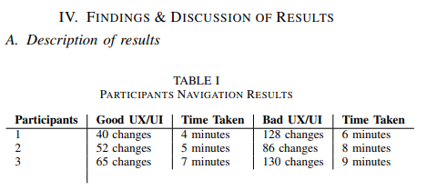
Participant Navigation Results

Slide 9
Participant Navigation Results
The data found in table 1 represents the participants engagement with both UX/UI’s and the time taken for the completion of the navigation.
Participant 1 recorded 40 changes in head direction in the good UX/UI and the time taken to navigate the good UX/UI was 4 minutes. On the other hand, 128 changes were detected in the bad UX/UI with a total of 6 minutes of navigation. Participant’s 3 data shows that it has more changes in direction in general, with a total of 65 changes in the good UX/UI in 7 minutes of navigation and 130 changes on the bad UX/UI in 9 minutes of navigation. Lastly, participant 2 recorded 52 changes in the good UX/UI with a total of 5 minutes of navigation. In the bad UX/UI, a total of 86 changes were recorded in a total of 8 minutes.
As the table indicates, all participants had fewer changes in head direction in the good UX/UI, meaning that the participants found the interface quite user friendly. On the other hand, the bad UX had the most changes in direction, this means that the users could have found the interface more challenging and confused.

Slide 10
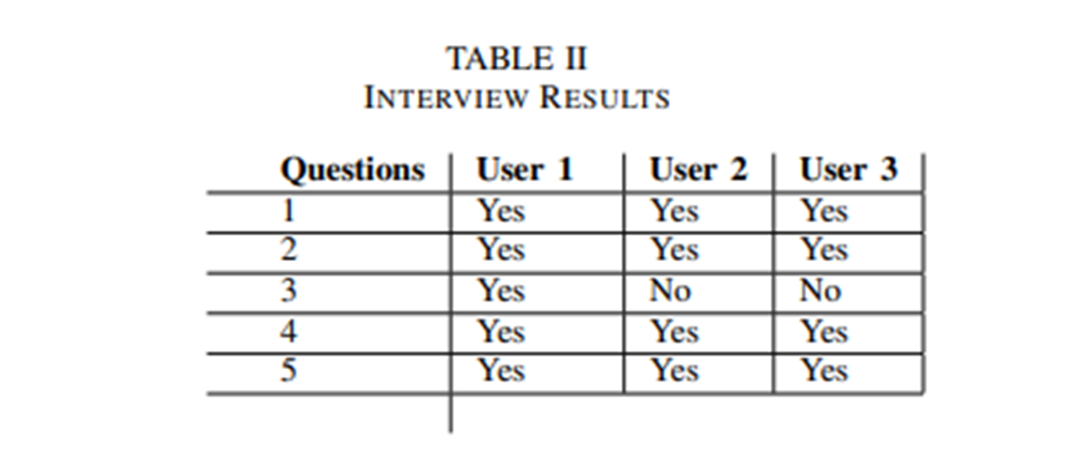
Participant Interview Results
Interview Questions:
Was there a difference between the first and second UI?.
Was there a difference in typography between the UI’s?
Was the color scheme well-matched to the theme?
Was there a difference in consistency between UI’s?
Was there a UI in which you felt less guided?

Slide 11
Participant Interview Results
Throughout the interview, every participant noticed a distinction between the first and second UI. Mainly, all the participants noticed the same differences being that, they found the first UI (good UI) much better than the second UI (bad UI).
When navigating with the first UI, all participants reported feeling more led and less lost than when using the second UI. In the second UI, participants felt lost because in the menu, there was not highlighted were the user currently is and also stated that it was not that user friendly because there were no back to top buttons and also no back buttons when the participants were viewing the information about the pets.

Slide 12
Participant Interview Results
All participants claimed that in the second UI, the typography layout was lengthy in width and also the wording was difficult to read and understand, which that is why participants took longer navigating the second UI than the first. In regards to, the color implementation, the first participant liked how the color was implemented unlike the other two participants. What the other users not like was how the color was implemented on the learn more buttons found in the our pets section. Users mentioned that there was no contrast and was difficult to read what was written in the button.
All participants claimed that there was a change in consistency in the second UI which lead to a negative impact. Due to the change in consistency participants felt a bit confused.

Slide 13
Conclusions
This study sought to develop and test the user’s navigation with a good and bad UX design. Furthermore, the focus of this study was to use computer vision to assess the user’s head movement while navigating through a user interface with a head tracking program.
The hypothesis of this study was to use computer vision and identify the user’s head posture and head tracking while the user navigates with a specific user interface, after thorough testing the results indicate that the hypothesis holds true.
The overall results of this study indicated that the participant’s user experience navigation was better in the first UX/UI (good) design than the second UX/UI (bad) design. This result addresses mainly all three research questions. Research question one, which sought to distinguish a difference in user behavior with both UX designs through the head tracker. Research question two, was mainly for identification in differences between both UX/UI’s. Research question three, was to confirm that the intended result was obtained from the head tracking prototype. Therefore, since the results of this study determined a change in user behavior between one UX and another due to the head tracking program, all three research questions were determined and answered.

Slide 14
Future Recommendations
A recommendation would be to host the head tracking prototype online so other users can test their behavior with other UX/UI designs.
In the near future , the eye gaze tracking can be implemented in order to track users and gather data depending on the eye activity while navigating with such UX/UI.

Slide 15
References
[1] M. Orlova, “User experience design (ux design) in a website development: website redesign,” 2016.
[2] I. Solutions, “What is computer vision?” [Online]. Available: https://www.ibm.com/ topics/computer-vision?fbclid=IwAR1N4w-l-BVNsnBg aiApkSUhkqUQvmfCHV0k-ZQuHKd0rPyCytYz9R KyE
[3] D. Mihai, “Unlocking the power of artificial intelligence in ui/ux design,” Mar 2023. [Online]. Available: https://bootcamp.uxdesign.cc/ unlocking-the-power-of-artificial-intelligence-in-ui-ux-design-ce22f1d2ddd4
[4] I. D. Foundation, “What is user experience (ux) design?” Aug 2022. [Online]. Available: https://www.interaction-design.org/literature/topics/ ux-design
[5] J. Gube, “What is user experience design? overview, tools and resources,” Oct 2010. [Online]. Available: https://www.smashingmagazine.com/2010/10/ what-is-user-experience-design-overview-tools-and-resources/

Slide 16
References
[6] A. Ijaz, “The difference between a good amp; bad ux design,” Aug 2022. [Online]. Available: https://medium.com/geekculture/ the-difference-between-a-good-bad-ux-design-91ac979323c7
[7] P. Gangadharan, “The importance of user experience design,” May 2019. [Online]. Available: https://uxplanet.org/ the-importance-of-user-experience-design-988faf6ddca2
[8] J. Nielson, “10 usability heuristics for user interface design,” Nov 2020. [Online]. Available: https://www.nngroup.com/articles/ten-usability-heuristics/?fbclid= IwAR3eSnX5B0CurVFUihLv-KBcOI6Ulo6vNWQU69Jz5jFbUPG3PX Isf6jb6M
[9] R. Krause, “Maintain consistency and adhere to standards (usability heuristic 4),” Jan 2021. [Online]. Available: https://www.nngroup.com/articles/consistency-and-standards/?fbclid= IwAR3DNAQU5ctdOz2xCKD8sqmcxR5vEvIwbMGbVbjgeAXnDDLFsx7Bd-t5M-c
[10] A. Rosenfeld, “Computer vision: basic principles,” Proceedings of the IEEE, vol. 76, no. 8, pp. 863–868, 1988.

Slide 17
References
[11] IBM, “What is computer vision?” [Online]. Available: https://www. ibm.com/topics/computer-vision?fbclid=IwAR1N4w-l-BVNsnBg aiApkSUhkqUQvmfCHV0k-ZQuHKd0rPyCytYz9R KyE
[12] L. Quinn, “The impact of ai on ux design: Opportunities and challenges,” Feb 2023. [Online]. Available: https://uxplanet.org/ the-impact-of-ai-on-ux-design-opportunities-and-challenges-a9e466d319ad
[13] T. Contributor, “What is head tracking?: Definition from techtarget,” May 2017. [Online]. Available: https://www.techtarget.com/whatis/definition/head-tracking?fbclid= IwAR1B-nBHwhsGcPrlsNGTG1GTSRBd6faxoKoejbrZUukYd IyAJs0RSaGtjs
[14] B. T. Carter and S. G. Luke, “Best practices in eye tracking research,” International Journal of Psychophysiology, vol. 155, pp. 49–62, 202.

Slide 18
References
[15] M. Macedo, “Eye-tracking in mobile ux research,” Oct 2021. [Online]. Available: https://www.smashingmagazine. com/2021/10/eye-tracking-mobile-ux-research/?fbclid= IwAR180deky7b0XNUad1-iK2ZcsHIt9z3MIuueIO8j-6Hl7PaIyBWO n9rdq0
[16] P. Ramakrisnan, A. Jaafar, F. H. A. Razak, and D. A. Ramba, “Evaluation of user interface design for leaning management system (lms): Investigating student’s eye tracking pattern and experiences,” ProcediaSocial and Behavioral Sciences, vol. 67, pp. 527–537, 2012.

Slide 19
Thank you Daylen Mejlak, Mario Mallia-Milanes

