Slide 1
음성인식을 위한 언어처리

Slide 2
Spoken Language Understanding
음성언어 이해
← 음성인식(신호처리기반) + 자연어처리
고립단어인식
핵심어 검출
연결단어 인식
낭독체 연속음성인식
대화체 연속음성인식
Speech Understanding
recognition
parsing
Speech
Text
Interpretation
synthesis
generation
TTS
Speech Generation
TTS: Text-to-Speech
CTS
CTS: Concept-to-Speech
음성언어처리 소개

Slide 3
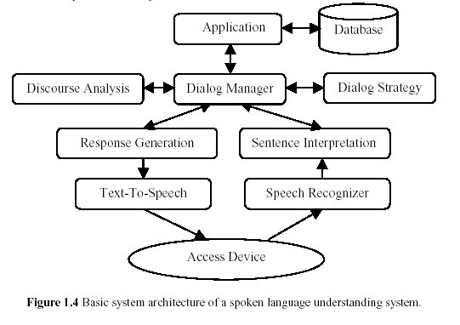
Spoken Language Understanding System
음성언어처리 소개

Slide 4

W3C Speech Interface Framework for Voice Web Applications
N-gram Grammar ML
Speech Recognition
Grammar ML
VoiceXML 2.0
Natural Language
Semantics ML
Language
Understanding
ASR
Context
Interpretation
World
Wide
Web
Lexicon
DTMF Tone Recognizer
Dialog
Manager
Prerecorded Audio Player
Media
Planning
Telephone
System
User
Language
Generation
TTS
Reusable Components
Speech Synthesis ML
음성언어처리 소개

Slide 5



Continuous Speech Recognition
연속 음성 인식 시스템 구성도
Search
Speech input
Signal processing
front-end
Word-level
matching
Sentence-level
matching
Recognized sentence
Front-end converts the raw acoustic waveform into A.
Acoustic model gives an estimate of P(A|W).
Language model gives an estimate of P(W).
Decoder finds Ŵ among all W.
Search network
generation
Acoustic
Model
Lexicon
Language
Model
Acoustic
Model
Language
Model
(Phone-level)
Acoustic Model
Language
Model
Word Model
(Lexicon)
음성언어처리 소개

Slide 6
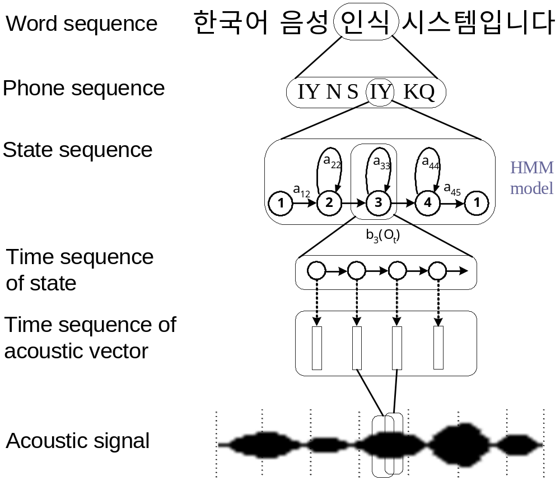


Standard Model for Continuous Speech Recognition
W
L
Training
Recognition
10ms
A
음성언어처리 소개

Slide 7
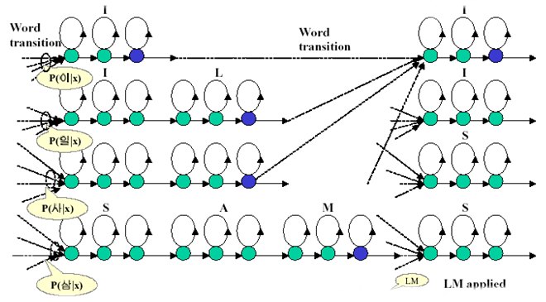
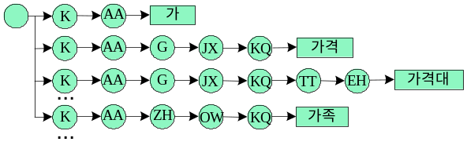
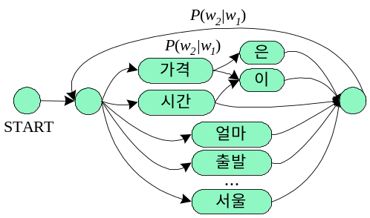
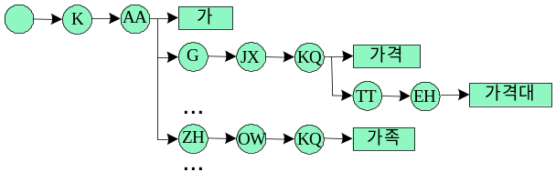
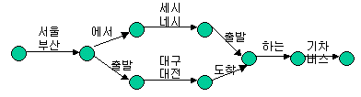
Decoder
(Search Network)
Feature
Extractor
가격은 얼마 …
N-gram
K
AA
G
FSN
...
(Phone-level)
Acoustic Model
Word Model
(Pronunciation Lexicon)
Language Model (Grammar)
음성언어처리 소개

Slide 8
Language Model Theory
Perplexity
Role of Language Models
Linguistics-based Grammars
Finite-State Grammars
Statistical Language Models
  N-grams
  Class-based N-grams
  Probabilistic Context-Free Grammars
  Smoothing
    Data Sparseness Problem
    Linear Interpolation
    Discounting
    Backing-off
언어모델 소개

Slide 9

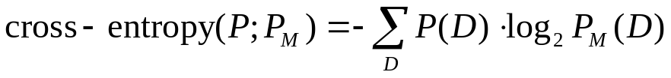
Perplexity
Branching factor
  the number of items in the active vocabulary at a single point in the application
Perplexity: average branching factor
  the amount of branching found in an entire application
    an application consisting entirely of “yes” and “no”: perplexity = 2
  measure of language model quality based on the concepts of entropy
        D: new data sample
        M: given language model
언어모델 소개

Slide 10
Role of Language Models
Speech recognition applications do not consist of an unorganized conglomeration of words. They possess the same structure and sequence as the tasks to which they are linked. That structure can be as rigid as a command sequence for controlling a piece of equipment or as flexible as dictation. The methods used to organize application vocabularies are called language models.
Language model reduces perplexity.
  Recognition step involves searching through the application vocabulary (active vocabulary) to locate the best match for spoken input.
  Reduce perplexity by limiting the words in the active vocabulary or assigning a probability ranking to those items.
Language model increases speed and accuracy.
  Fewer candidates for a recognizer to evaluate
Language model enhances vocabulary flexibility.
  Place confusable words in different active vocabulary set, i.e., words within each active vocabulary are acoustically distinct.
언어모델 소개

Slide 11
Linguistics-based Grammars
Focus is on designing a system that understands the sense of what user has said as well as identifying the spoken word.
Why linguistics-based models?
  Use of additional knowledge will refine the active vocabulary by eliminating illogical or impossible choices.
  Cognitive, behavioral and linguistic knowledge are natural components of human interaction.
Natural, flexible, user-friendly, human-like speech recognition is a by-product of including non-acoustic knowledge about human communication.
언어모델 소개

Slide 12
Linguistics-based Grammars
Context-free grammar
  Define allowable structures (deterministic) with context-free rules.
  Chart parsing applies the context-free rules to the spoken input and keeps track of the rules that were successful by placing them on a chart.
S → NP VP VP → AUX VP
NP → DET NP VP → V PP
NP → ADJ N PP → PREP NP
KEY : S = sentence ADJ = adjective
NP = noun phrase N = noun
VP = verb phrase AUX = auxiliary verb
PP = prepositional phrase DET = determiner
V = verb PREP = preposition
언어모델 소개

Slide 13
Linguistics-based Grammars
Grammars with multiple knowledge sources
  morphology, syntax, semantics, pragmatics, discourse, common-sense knowledge
  Combine syntactic analysis with semantics, statistics and other sources of knowledge.
  Include analysis of the conversational interaction with the user (discourse processing).
  Pragmatic constraints are knowledge sources used to predict the content of the user’s next utterance.
언어모델 소개

Slide 14
Finite State Grammars
Reduce perplexity by describing the words that are allowable at any point in the input.
Simplify application development by replacing listings of allowable utterances with generic descriptions.
  SENTENCE1 = Part-number NUMBER
  Input utterance: Part-number 1 2 3
  Part-number 9 8 4 5
$digit = 0|1|2|…|9;
$number = $digit {$digit};
언어모델 소개

Slide 15
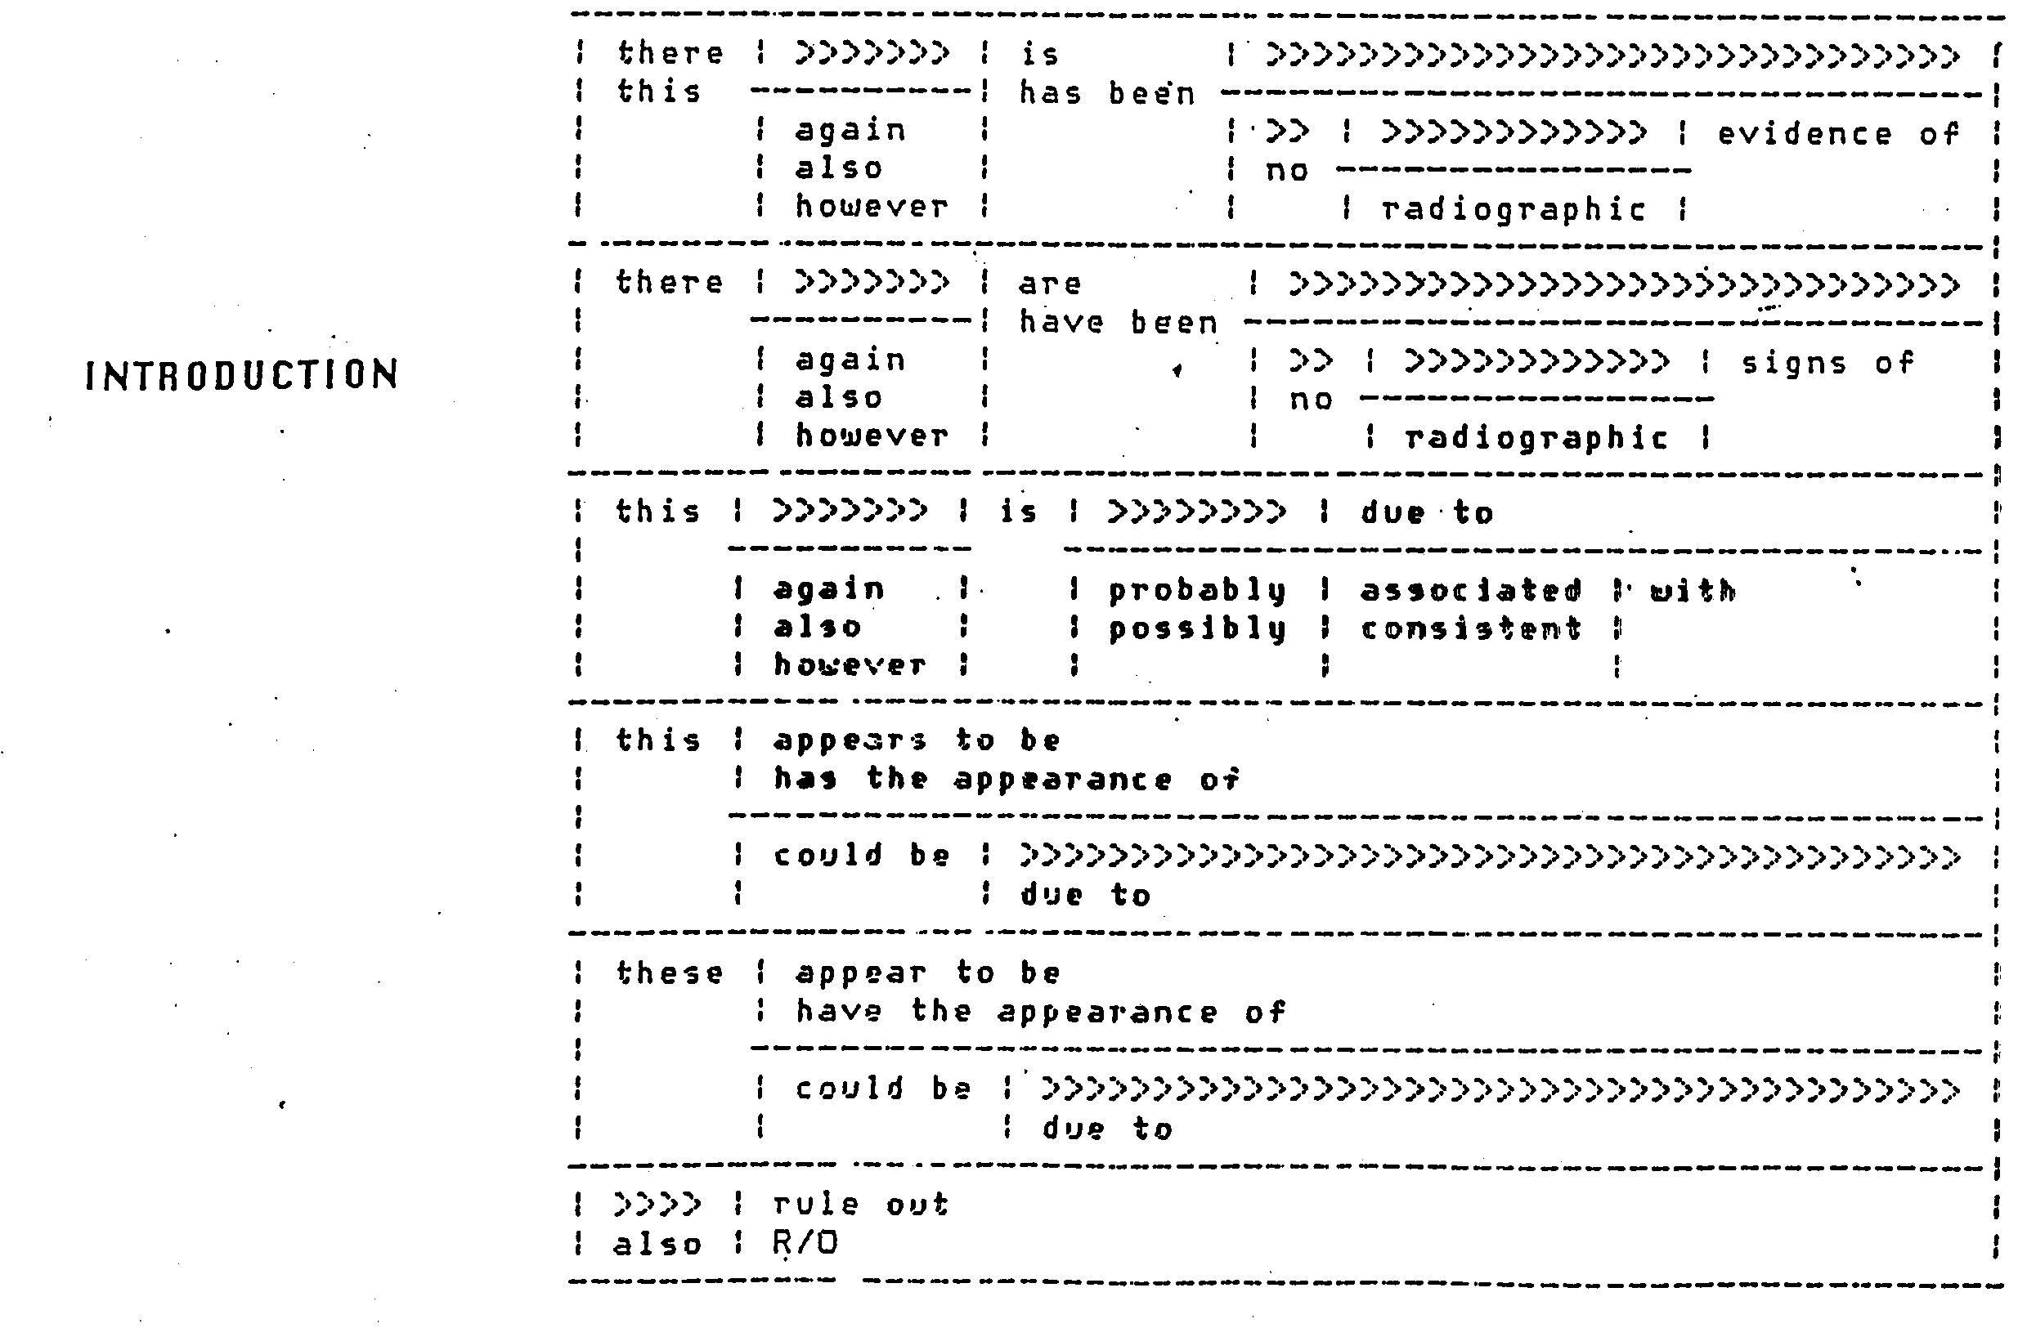
Finite State Grammars
Syntax of SSI’s Phonetic Engine
언어모델 소개

Slide 16
Finite State Grammars
Problems
  Only the word and sentence sequences that have been programmed into grammar can be recognized (not flexible).
  cannot rank active vocabulary in terms of their likelihood of occurrence (i.e. all members of the active vocabulary have the same likelihood of occurrence).
  represented using finite-state networks like HMM but neither the states nor the transitions are characterized by probability.
Finite-state grammars in commercial recognition systems
  Most effective in structured applications such as data entry and voice-and-control of equipment.
  Difficult things are identifying and defining the linguistic and structural requirements of the task.
  Need to insure that the people using the system speak only the allowable words and word sequences.
  These techniques are less useful for applications that expect large populations of one-time users.
언어모델 소개

Slide 17
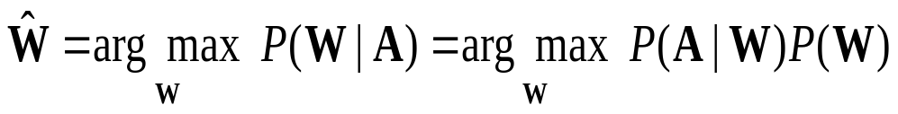
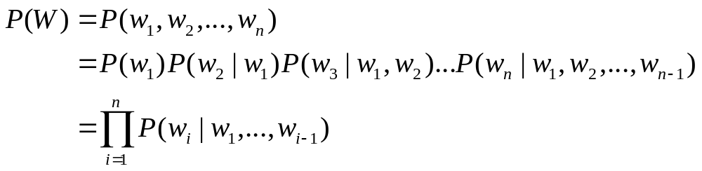
Statistical Language Models
Acoustic
Model
Language
Model
N-grams
Class-based N-grams
Probabilistic context-free grammars
Word history
음성언어처리 소개
언어모델 소개

Slide 18

N-grams
Word histories according to the last N-1 words
  The choice of N is based on a trade-off between detail and reliability, and will be dependent on the quantity of training data available.
  Bigram (N = 2)
    fewer parameters → more reliably estimated
  Trigram (N = 3)
    more precise → more accurate language model
    need sufficient training data
      For the quantities of language model training data typically available at present, trigram models strike the best balance between precision and robustness, although interest is growing in moving to 40gram models and beyond.
언어모델 소개

Slide 19
N-grams
Advantages
  simplicity
    easy and efficient to train, even when corpora of millions of words are used
    can be based on a large amount of real data
  simultaneously encode syntax and semantics
  can be easily included in the decoder of a speech recognizer
Disadvantages
  cannot handle long-range dependencies
    The current word is clearly dependent on much more than the previous one or two words.
  recognition error due to nonsensical or ungrammatical word combinations
    a brilliant financial analysts
  N-gram approach can fragment the data unnecessarily.
언어모델 소개

Slide 20
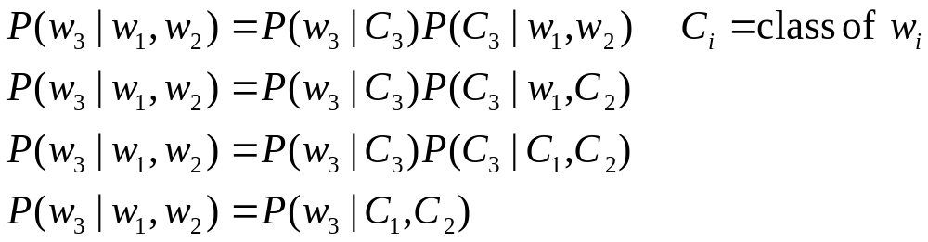
Class-based N-grams
Define a mapping of the vocabulary words into a smaller number of classes. The N-grams are then based on these classes.
Classes
  linguistically motivated: part-of-speech or linguistic function
  groups of similar fashion: days of the week, numbers, airline names
  automatically derived from the training data
the most commonly used form
언어모델 소개

Slide 21
Class-based N-grams
Advantages
  much more compact than word-based models
  use more context
  reduce the problem of data sparsity
  make much more reliable probability estimates for event unseen in the training data
  Class-based models have been particularly successful in situations where limited quantities of training data were available.
Disadvantages
  lose some of the semantic information
    This problem can be partially overcome by constructing language models which combine information from word-based and class-based models
  still fails to overcome the problems of long-term dependencies
언어모델 소개

Slide 22
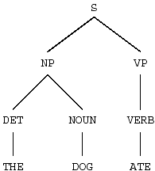
Probabilistic Context-Free Grammars
CFG consists of
  terminal symbols : words
  non-terminal symbols : grammatical objects
  rewrite rules : specify how symbols can be related
A PCFG assigns probabilities to each of the rewrite rules.
  Each parse of a sentence has a probability associated with it.
  The sum of these can be considered to be the probability of the sentence.
Train PCFGs by estimating appropriate rewrite rule probabilities.
  Select probabilities which maximize the likelihood of training corpus.
언어모델 소개

Slide 23
Probabilistic Context-Free Grammars
Advantages
  linguistically motivated
  capture the long-range dependencies that are ignored by N-gram models
  PCFGs have been used successively in some smaller vocabulary tasks.
Disadvantages
  syntactic approach
  → lose much of the useful semantic information that word-based N-gram models encode
  The training algorithms are very computationally demanding, and have not seen much use except on very small training corpora.
언어모델 소개

Slide 24
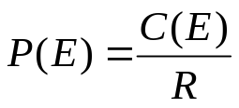
Data Sparseness Problem and Smoothing
Data sparseness problem
  The maximum likelihood estimate for the probability is biased high for observed events and biased low for unobserved ones.
  In an N-gram language model it is impossible to avoid the problem of unseen events.
    64,000 word vocabulary → 2.62 × 10¹⁴ possible trigrams
    → Even a 100 million word training corpus can contain at most 0.000038% of these trigrams.
    If a trigram never occurs in the training text, then the method of maximum likelihood estimation will assign any string which contains the trigram a probability of zero, and it will not be correctly transcribed by the speech recognition system.
    The perplexity of the model with respect to any text which contains this string will be infinite.
Need techniques
  to smooth the data to correct the bias of the maximum likelihood estimates.
  to ensure that no word strings are assigned zero probabilities.
언어모델 소개

Slide 25
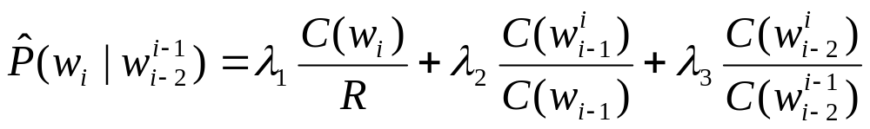
Linear Interpolation
  In order to avoid zero probabilities, define the N-gram probabilities to be a linear combination of the 1-gram, 2-gram, …, N-gram maximum likelihood probability estimates.
Trigram probability:
R = # of words in the training text
λ₁+ λ₂+ λ₃ = 1
언어모델 소개

Slide 26
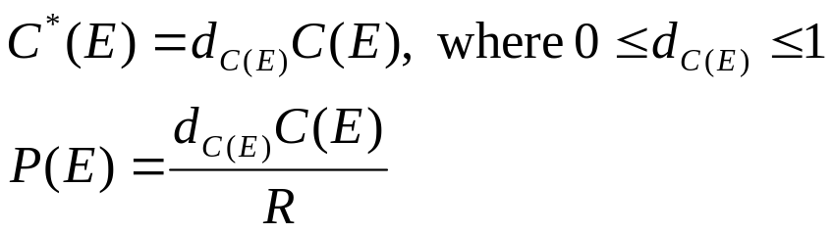
Discounting
Discounting is a more principled method of correcting the bias towards observed events of maximum likelihood probability estimates.
An event’s count is discounted by multiplying it by a discount coefficient.
The remaining probability mass is distributed among unseen events.
언어모델 소개

Slide 27
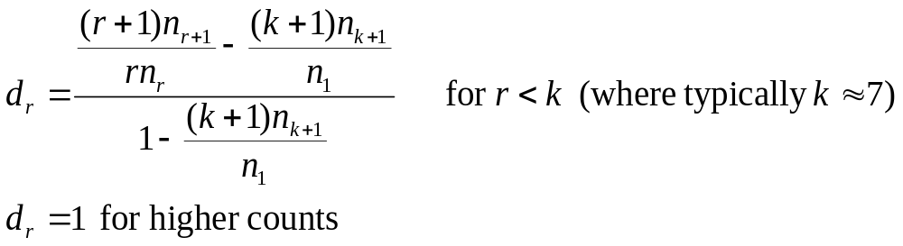
Good-Turing Discounting
the most commonly used discounting scheme
first applied by Katz who used it in conjunction with backing-off
Diadvantages
  It is necessary that d_{r}>0 for all r, and this puts some constraints on the relative values of n₁, n₂, …, n_{k+1}.
  These constraints will be satisfied by naturally occurring data but may not be if one has doctored the data in some way (for example by boosting the counts of some subset of the N-grams).
언어모델 소개

Slide 28
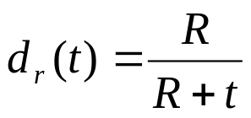
Witten-Bell Discounting
The discounting coefficient is dependent not on the event’s count, but on t.
  t: the number of distinct events which followed the particular context
  For the bigram “A B”, t is the number of distinct bigrams of the form “A *”, which occurred in the training data.
Motivation
  Assign probability estimates to unseen events which reflect how many times novel events have been seen in the past.
  T is viewed as being the number of times that a novel event has previously been observed following a particular context.
언어모델 소개

Slide 29
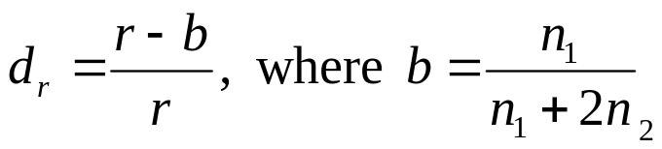
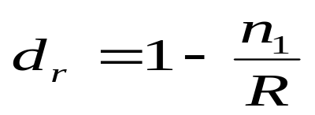
Absolute Discounting
Subtract a constant b from each of the counts.
Linear Discounting
Subtract a quantity proportional to each count from the count itself.
언어모델 소개

Slide 30
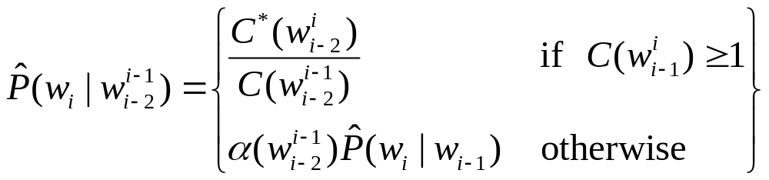
Backing-off
If data in a language model is insufficient to accurately estimate a word probability, back-off to a less specific language model.
  N-gram → (N-1)-gram
  word-based trigram → class-based trigram
back-off weight
언어모델 소개

Slide 31
한국어 연속음성인식 시스템
Search
Speech input
Signal processing
front-end
Word-level
matching
Sentence-level
matching
Recognized sentence
Acoustic
Model
Lexicon
Language
Model
Recognizer
Training
Speech
database
HMM 기반
Subword
Model
Grapheme-to-
Phoneme
Vocabulary
N-gram
grammar
대용량
연속음성 DB
학습용 발음열
Phonetic Transcription
형태소기반 발음사전
Pronunciation Dictionary
사전의 표제어 및
디코딩 단위
한국어 발음열 자동 생성 시스템
Automatic Transcription generation
of pronunciation variants
Text
Corpus
형태소 분석
(음가 기준) 형태소
한국어 연속음성인식을 위한 언어모델

Slide 32
한국어 연속음성인식
한국어 연속음성의 특징
  교착어: 실질형태소 + 형식형태소
  첨용과 활용이 자유롭다.
  용언의 불규칙, 축약, 생략 현상 발달
  음운변화 현상이 발달
한국어 대어휘 연속음성인식 시스템
  음운변화를 반영한 음향모델 학습과 발음사전 생성 필요
  사전 크기, 미등록어(Out-of-Vocabulary) 등을 고려한 합리적인 언어처리 단위 필요
 형태소 해석 필요
한국어 연속음성인식을 위한 언어모델

Slide 33
형태소 해석
문자기반 형태소 해석
  여러 음운변화현상에 대해 형태소의 원형을 복원하므로 소리값을 유지하지 못한다.
음성기반 형태소 해석
  발음사전과 언어모델 생성을 위해서 텍스트 처리
    음운변화현상 반영 필요
  소리값을 유지하기 위하여 불규칙, 축약, 생략 현상에 대해 형태소의 원형을 복원하지 않는다.
    불규칙: 아름다운(아름답+ㄴ) →아름다우+ㄴ
    축약: 했지(하+었+지) → 해+ㅆ+지
    생략: 꺼(끄+어) → 꺼
한국어 연속음성인식을 위한 언어모델

Slide 34
언어처리 기본단위
Word
  영어의 인식 단위, 띄어쓰기 단위
  인식 단위 선정이 용이하다.
어절
  한글의 띄어쓰기 단위
  발성의 지속 시간이 길다.
  조사와 어미, 본용언과 보조용언을 분리하기도 한다.
  활용이 제한적 → 사전크기 증가
형태소
  활용이 자유롭다.
  단음소, 단음절 형태소가 많아서 인식오류 증가
  인식성능 개선을 위해 적절한 길이의 발성 시간과 적절한 수의 사전 표제어를 가질 수 있게 하는 형태소 결합이 필요함.
한국어 연속음성인식을 위한 언어모델

Slide 35
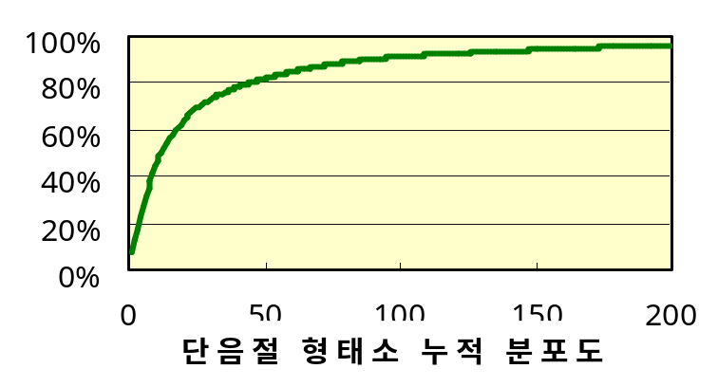
언어처리 기본단위
신문, 방송뉴스 텍스트 코퍼스 예
단음절 (단음소 포함) 형태소 분포
  전체 형태소의 54%
  1,175개 단음절 형태소
  상위 12개 : 50%
  상위 100개 : 90%
 | 문 장 | 어 절 | 형태소
Total | 275,695 | 3,315,950 | 7,013,216
Unique |  | 516,410 | 65,110
한국어 연속음성인식을 위한 언어모델

Slide 36
언어처리 기본단위
결합형태소
  박영희(2002)
  학습데이터의 통계정보를 이용하여 형태소 결합
    형태소 쌍의 출현빈도, mutual information, unigram log-likelihood 등
  예 (출현빈도 기준 상위 5개)
    하_ㄴ, 하_는, 이_ㅂ니다, 해_ㅆ_다, 이_ㄴ
  결합형태소 생성이 쉽다.
  추가 결합형태소 수가 적다.
  단음절 형태소 감소
추가 결합형태소 수 | 0 | 200 | 1000 | 2000
단음절 형태소 비율 | 54% | 38% | 30% | 26%
한국어 연속음성인식을 위한 언어모델

Slide 37
발음열 자동생성의 필요성
한국어 발음 변화 예제
학생 [학쌩], 학문 [항문], 법학 [버팍]
신라 [실라], 음운론 [음운논]
감기 (명사) [감기], 감기 (어간 + 어미) [감끼]
겨울나그네 [겨울라그네]
너는 산을, 나는 바다를 [너는 사늘, 나는 바다를]
사적 (史蹟) [사적], 사적 (史的) [사쩍]
문자열-발음열 자동 변환의 필요성
실제 음성을 받아 적는 수작업의 문제점
  구축된 많은 양의 대화 내용을 전사하기가 어려움
  한국어 음운변화에 대한 전문적인 지식이 요구됨
  많은 시간과 노력이 요구됨
  발음열에 대한 일관성 유지가 어려움
한국어 연속음성인식을 위한 언어모델

Slide 38
한국어의 형태음운론적 특성
한국어는 표음문자이지만 조음 현상으로 인해 음소 문맥(phonetic context)에 따라
음운변화 현상이 발생하며 형태소 결합 종류에 따라 서로 다른 발성
발음열이 음운 변화 과정을 통해 실제와 다른 음소의 배열을 가지는 경우
1) 음소 연결 제약 조건
: 일부 음소가 음절의 특정 위치에 나타나지 못하거나 특정한 음소의 배열이
허용되지 않는 경우, 즉 음소 연결 제약에 위배되는 음소의 배열이 생겨나면
이를 시정하기 위한 음운 현상이 일어남.
2) 언절을 구성하는 형태소의 종류와 연결 형태
: 음소 배열이 같더라도 구성 형태소의 종류가 다르면 다른 방향으로 음운 변화
문자열
감기
솜이불
솜이
(음소문맥:ㅁ+ㄱ)
(음소문맥:ㅁ+ㅇ)
발음열
감기
감끼
솜니불
소미
형태소 결합
명사
어간+어미
복합명사
명사+조사
한국어 연속음성인식을 위한 언어모델

Slide 39
한국어의 음운변화과정
한국어 단어 철자
Korean Orthography
음운변화 과정
발음열
Phonetic Transcription
음소 변동 규칙, 변이음 규칙
1. 음소 변동 규칙 (Phonetic Change Rule) → phonemic transcription
음소 변동 규칙을 적용해 음절경계에서 규칙이 적용될 앞 음절 초성과
뒷 음절 종성의 음소 쌍을 음소 문맥으로 정의
  필수 음소 변동 규칙
  수의적 음소 변동 규칙
2. 변이음 규칙 (Allophonic Rule) → phonetic transcription
하나의 음소가 여러 변이음으로 변화되는 현상을 규칙화
○ 하나의 음소는 음성 환경, 말의 속도와 스타일에 따라서 다양한 음가를 가짐
○ ‘밥’에서 초성의 ‘ㅂ’과 종성의 ‘ㅂ’은 서로 다른 소리값
한국어 연속음성인식을 위한 언어모델

Slide 40
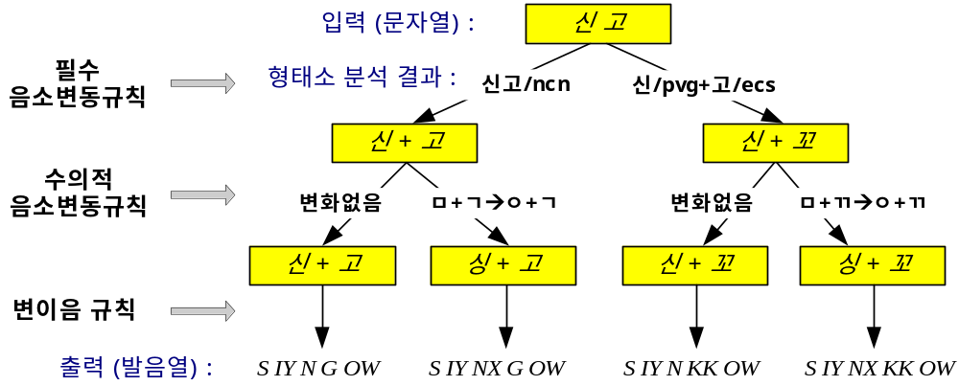
음소변동규칙 적용 과정
입력 :
신발/ncn
+
을/jco
신/pvg
+
고/ecc
#
+
+
+
걸(걷)/pvg
어/ecs
가/pvg
ㄴ다/ef
S IY N B AA R
[신바ㄹ]
S IY N
[신]
WW L
[을]
KK OW
[꼬]
K AX R
[거ㄹ]
AX
[어]
G AA
[가]
N D AA
[ㄴ다]
S IY M B AA R
[심바ㄹ]
S IY NX
[싱]
변자음화
연음규칙
변자음화
경음화
ㄷ-불규칙
처리
연음규칙
탄설음화
설측음화
유성음화
한국어 연속음성인식을 위한 언어모델

